Slide 1
Miss Angiolini &
Ms. DiStasi
5th Grade
2023-2024

Slide 2
9:15-10:15- MATH 2:10-2:50- Social Studies/Science
10:20-12:00- LITERACY 2:50-3:10- SEL
12:00-12:30- LUNCH 3:10-3:20- DISMISSAL
12:40-1:10- W.I.N. (Chorus Thursdays)
1:10- 1:30-RECESS
1:30-2:10- SPECIALS

Slide 3
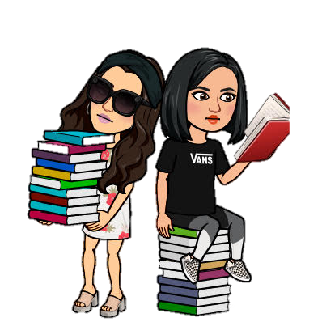
LITERACY
Independent Reading Strategies
Taught in small group & whole group
Mentor Texts
Reading Response Journals (RRJ)
Conferencing
Genres
IXL Diagnostic/Weekly Skills
Reading Logs (Collected monthly)

Slide 4
DAILY
Reading Logs
30 minutes every night except for Fridays
Initialed by a parent/guardian
Students will log the title of the book, how many pages read, the amount of time they read for, and the date.

Slide 5
Writer’s
Workshop
Mini-Lessons
Narrative, Informational, Literary Essay, and Opinion
Conferencing
Timed Writings
Grammar (IXL & other websites)

Slide 6
What I Need
Extra Help, Enrichment, Make up / Catch up,
Project Based activities
WIN
Skills change and groups change based on student needs.
Students will rotate through different groups that will focus in on different skills
Fraction Sense program
Literacy/Word Problems

Slide 7
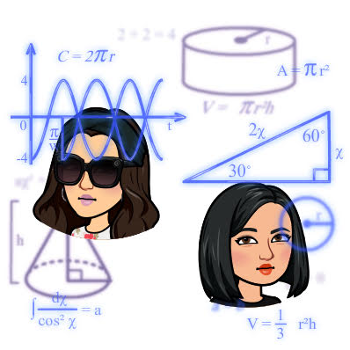
MATH
Envision Mathematics 2020 Grade 5
Taught in small group rotations
You can log on to the website from home to access games, videos, and practice pages
Supplemental websites to reinforce
Skills (Splash Learn, IXL, Freckle, Prodigy, Reflex)

Slide 8
Science/Social Studies
Science:
Properties of Matter
Space Systems
Earth’s Processes
Organisms & Ecosystems
Social Studies
Westward Expansion
Constitution & Government
Early American Landscape
**Hands on & Project Based Learning Activities**

Slide 9
Daily homework is given in math and reading (except Fridays)
Math homework will be in the math additional practice workbook (please do not rip out pages!)
All homework will be written down on weekly homework sheets
Tests announced about 1 week in advance
Homework will also be posted on the class page (most days)

Slide 10
Allergies
We are a PEANUT, TREE NUT, COCONUT and ALL NUT FREE classroom!
Class Celebrations
Parents will be allowed to attend class celebrations (limited number 4 per party)
Donations will be taken, if you are interested in helping out with class celebrations, through a Signup Genius
A class parent will be chosen to help facilitate each of the class parties
Classroom Management
Class Dojo
Points awarded individually
Various Class Coupon Prizes
BINGO Board
Whole Class Reward System
Class Rules
We created rules together

Slide 11
Please send in a note for any dismissal changes. If sending an email, please send it to both Miss Angiolini & Ms. DiStasi at
bangiolini@jacksonsd.org
mdistasi@jacksonsd.org
Breakfast is an option for all students! It costs $1.00 and starts at 9:00 am.

Slide 12
CONFERENCES
Parent Teacher Conferences will be held on November 6th-8th
Evening Conferences will be Tuesday, November 7th
Dismissal is 1:40pm on those days
**Parents/Guardians sign up online using Genesis- Parent Portal website**

Slide 13
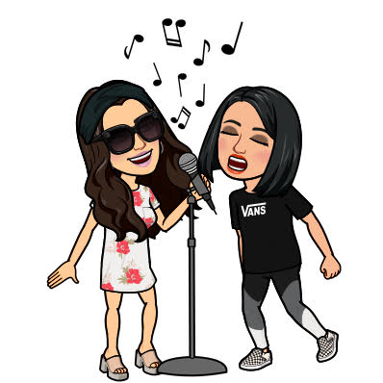
CHORUS
5th Grade Activity
All 5th grade students will participate in chorus this year!
Chorus happens once a week in addition to our regularly scheduled music class. Our class has chorus on Thursdays!
The chorus concert will take place in January! Date is TBD!!

Slide 15
THANK YOU!!
Please make sure you signed in and filled out the birthday sheet!
Thank you so much for coming tonight!
We are looking forward to a fantastic year together!
Please feel free to reach out to us at any time with any questions!
Emails: bangiolini@jacksonsd.org
mdistasi@jacksonsd.org

