Slide 1
How to Write a Refutation Paragraph
Strengthening Your Argument Through Concession

Slide 2
The Refutation Paragraph
Found only in argument essays and argument research papers
Also known as the concession paragraph, because it concedes points
Acknowledges the valid points of the opposing argument
Prevents the writer from sounding narrow-minded, prejudiced, or uninformed
Establishes the ETHOS of the writer~
  Shows you are ethical, that you see all sides, understand and appreciate your opponent’s point of view
This will not weaken your argument. A good concession paragraph will actually strengthen the paper by showing that the writer has thoughtfully understood and considered both sides before arriving at the final argument position.

Slide 3
The Refutation Paragraph
Be careful! Be sure the other argument does not end up sounding better than your own.
You will need to counter the argument—or, sometimes, explain where you agree with your opposition
And where the differences lie.
https://www.youtube.com/watch?v=RmqETlEJLyk

Slide 4
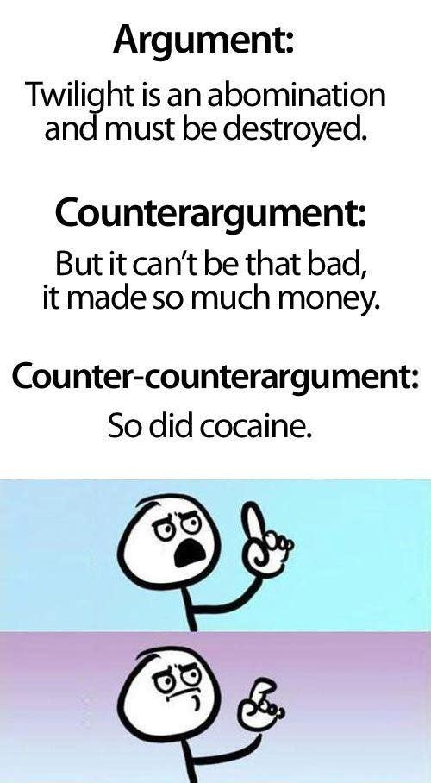
The Basic Format

Slide 5
Components of the Refutation Paragraph
A Refutation Paragraph Typically Does the Following:
  Counter-point: Introduces the opposing argument using a sentence starter
  Rebuttal: Transitions and “counters” the argument and connects back to your thesis/argument

Slide 6
The Refutation Paragraph
Introduce the Opposing Argument/Counter-point
The writer summarizes the opposition's viewpoint openly and honestly. Ignoring the opposition is futile because the audience is aware of the opposing arguments and will doubt the credibility of a presentation that chooses to ignore the opposition rather than deal with it.
  Ways writers can begin:
  Some opponents may argue….
  It is often argued that...
  It may be true that...
  Opposing views claim...
  Of course, opponents have a valid point when they say that killing blue-nosed purple poppy plant eaters which automated machetes that spew acid at their victims is cruel and unusual.

Slide 7
The Refutation Paragraph
Acknowledge parts of the opposition that are valid
The writer acknowledges that some of the opposition's claims may be valid, but the writer still shows that his own claims are stronger. The strength of the writer's claims are more convincing than the opposing viewpoints. A writer might explain the opposition's weakest points, contrasting them with his argument's strongest points.
  Ways writers can begin:
  Admittedly,
  Certainly,
  Of course,
  One cannot deny that...
  One cannot deny that the unnecessary spilling of radio-active, glow-in-the-dark blue-nosed blood is barbaric, especially when the exterminators accompany their rampages with high-pitched squeals of “Kill ‘em buggars!” and “Yippeeeee!”
  At the same time...

Slide 8
The Refutation Paragraph
Rebuttal/Counter the Argument
Introduce the rebuttal of the concession argument. The writer refutes the opposition's claims showing they are incorrect or inconsequential--not a real problem.
  Ways writers can begin:
  Nevertheless,
  However,
  On the other hand,
  But...
  Nevertheless, it is undeniable that the blue-nosed purple poppy eater is a dangerous menace to society, whose ravenous appetite for poppies is creating a frightening shortage of poppy seeds in the nation, and therefore, putting millions of poppy seed muffin makers out of work, leaving their children barefoot, unclothed, hungry, and whiney.

Slide 9
The Refutation Paragraph
The refutations should summarize why the counter argument is not a sufficient solution.
  Ways writers can begin
  Thus,
  Therefore,
  As a result,
  Thus, it is reasonable and humanely ethical to assume that, while the extreme violence and sport-like nature of the killings must stop, the blue-nosed purple poppy eater population must be eradicated from America.

Slide 10
Refutation Example
Thesis: Students should be allowed to participate in an open campus.
Many school administrators think an open campus would be a temptation for students to cut classes and act irresponsibly. However, students who earn the privilege of open campus would be unlikely to jeopardize that privilege; besides, rules could be created to rescind the privilege after one class cut. According to Principal Joseph Atkins, “97% of students at Scotch Plains High School in New Jersey maintained their honor roll status after three years of open campus” (Smith). Students would never risk lowering their grade point by cutting a class.

Slide 11
Many school administrators (Transition to side AGAINST YOUR THESIS) think an open campus would be a temptation for students to cut classes and act irresponsibly (counterpoint). However (Transition BACK to supporting your thesis), students who earn the privilege of open campus would be unlikely to jeopardize that privilege; besides, rules could be created to rescind the privilege after one class cut (Refutation). According to Principal Joseph Atkins, “97% of students at Scotch Plains High School in New Jersey maintained their honor roll status after three years of open campus” (Smith). (Textual evidence to support your thesis) Students would never risk lowering their grade point by cutting a class (Back to your thesis).

Slide 12
Classwork
Using the handout provided, annotate by boxing, underlining and highlighting the three components of a refutation.
Please raise your hand when you are done.

Slide 13
Classwork/Homework
Go back to your RST on changing school start times and create an original refutation paragraph with the three components.
Whatever you don’t finish becomes homework.

Slide 14
Peer Review Homework
Turn-Pair-Share: Work with a partner to complete the following.
Read your peer’s five examples of refutations. Underline the counter-point (if they copied it from the homework sheet), box the transitional phrase, and then highlight the rebuttal that connects back to the thesis. Last, star the best example of a refutation.
Highlighters are located in the front of the room.

Slide 15
The Refutation Paragraph
Thesis: School choice turns out to not only be a bad idea; it’s also a violation of our constitution.
Refutation: ...[Introduce Opposing Arguments] Considering the many challenges facing public schools, it’s understandable that many people would be eager to pursue new options. Supporters of school choice point out that under the current public school system, parents with economic means already exercise school choice by moving from areas with failing or dangerous schools to neighborhoods with better, safer schools. Their argument is that school choice would allow all parents the freedom, regardless of income level, to select the school that provides the best education (Chub and Moe). Schools would then have to compete for students by offering higher academic results and greater safety. Schools unable to measure up to the standards of successful schools would fail and possibly close.
[Acknowledge Valid Parts] Activists within the school choice movement can be applauded for seeking to improve public education, but the changes they propose would in fact seriously damage public education as a whole.

Slide 16
The Refutation Paragraph
[Counter Arguments] One of the biggest dangers of school choice is the power behind large corporations specializing in opening and operating charter schools. Two notable companies are Green Dot, which is the leading public school operator in Los Angeles (Green Dot), and KIPP, which operates 65 schools in 19 different states [KIPP]. These companies represent a growing trend of privatization of public schools by large corporations. It is feared that these corporations could grow to a point that public control of education would be lost. Education policy would be left in the hands of entrepreneurial think tanks, corporate boards of directors, and lobbyists who are more interested in profit than educating students [Miller and Gerson].
[Begin Concluding] Education should be left in the hands of professional educators and not business people with MBAs. To do otherwise is not only dangerous, it defies common sense.ens

Slide 17
The Refutation Paragraph
Thesis: In this time of threats and terrorism attacks on our national security, citizens should support the United States Government in issuing safe traveler cards to all citizens and legal residents of the country.
........[Introduce Opposing Arguments] As attractive as Safe Traveler Cards or national ID cards are, they are not without drawbacks. For one thing, as Easterbrook notes, these cards would expedite security procedures only for travelers who do not mind volunteering such information to obtain a card. Moreover they would not prevent passengers with "clean" backgrounds from bringing weapons or explosives on board, as was the case in the September 11 attacks. Perhaps the biggest drawback is that some people believe that these cards would deprive people of their privacy and that for this reason, their disadvantages outweigh their advantages (168). Dershowitz 591).

Slide 18
The Refutation Paragraph
........However, there are many who disagree with these contentions. [Acknowledge Valid Parts] While national ID cards could lessen a person's anonymity and privacy, [Counter Argument] this is a small loss that would be offset by a great increase in personal security. To Dershowitz--a self proclaimed civil libertarian--this tradeoff would be well worth it. According to Dershowitz, the national ID card would be only a little more intrusive than a photo ID card or social security card. Best of all, it would reduce or eliminate the need for racial profiling: "Anyone who had the [national ID] card could be allowed to pass through airports or building security more expeditiously, and anyone who opted out could be examined much more closely" (590). Such cards would enable airport security officials to do instant background checks on everyone. [Begin Concluding] The personal information in the system would stay in the system and never be made public. The only information on the card would be a person's "name, address, photo, and [finger]print" (Dershowitz 591).

Slide 19
Practice
Find with a partner. EVERYONE SHOULD HAVE A PARTNER!!! You will receive an envelope with a basic format of an essay with refutations.
You need to order the counterpoints and points based on the transitions. Once you think you have it, call me over. NO GLUING – just organize it on your desk.

Slide 20
When you are done with rebuttals,
Please get a chrome book, go to my class page under Synthesis/RST. Next open the document entitled “Synthesis Writing Template”, this is the format for you to revise your original RST on changing school start times. You need to revise your original essay to include effective introductions and conclusions, methods of integrating texts (the four methods), and a refutation. It is still a six paragraph essay, just revised based on the skills we have been working on for the past two weeks.
The packet of readings is on the class page ABOVE the directions.
This is due to Turnitin on Wednesday, October 2nd at 7:30 am.

Slide 21
Review of Counterpoint and Refutation
Rows 1 and 2 – Review each other’s homework and, as a group, decide on who has the best rebuttal for #1. Write it on the board.
Rows 3 and 4 – Review each other’s homework and, as a group, decide on who has the best rebuttal for #2. Write it on the board.
Rows 5 and 6 – Review each other’s homework and, as a group, decide on who has the best rebuttal for #3. Write it on the board.
Rows 7, 8 and 9 – Review each other’s homework and, as a group, decide on who has the best rebuttal for #4. Write it on the board.

