Slide 1
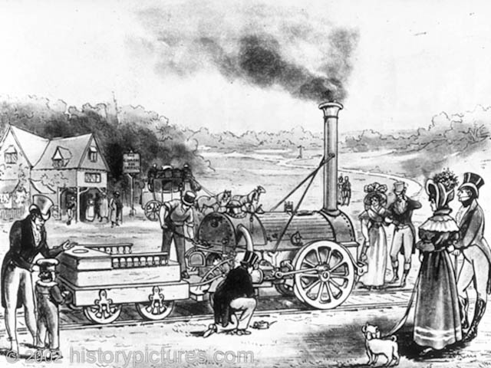
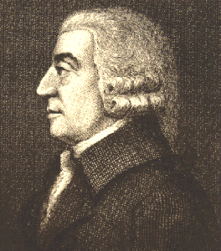
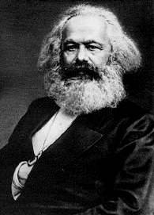
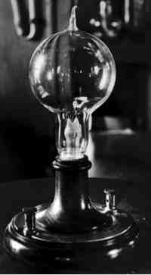
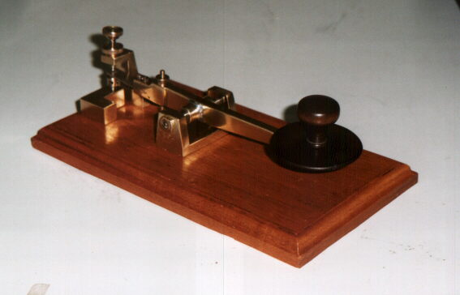
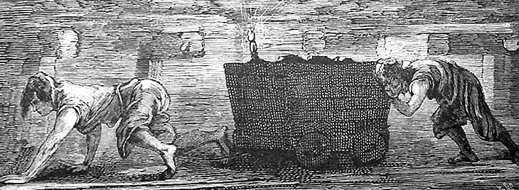
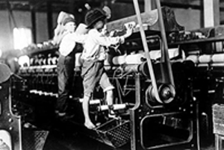
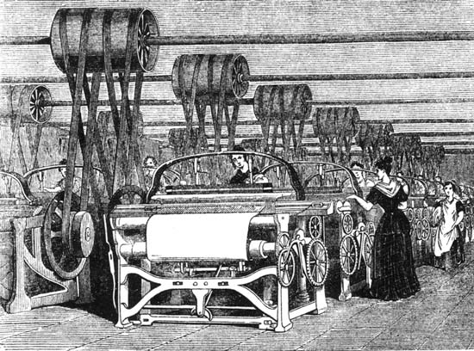
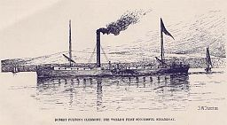
The Industrial Revolution

Slide 2
How has technology had an influence / impact on our lives over the past 20-30 years??

Slide 3
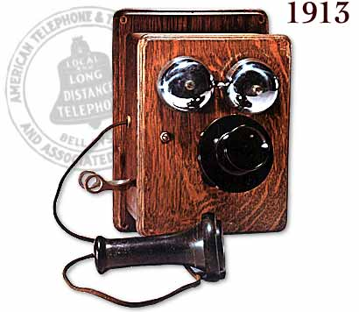
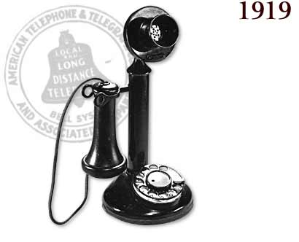

Slide 4
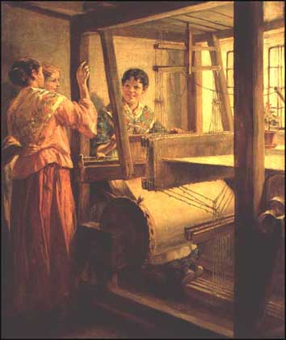
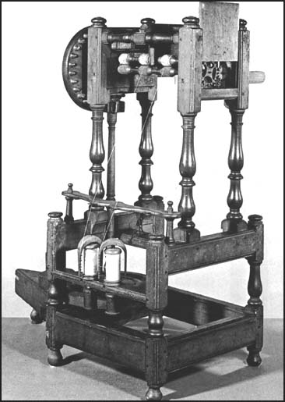
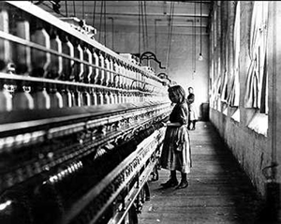
Industrial Revolution
Once science used for practical purposes we see, rapid innovation & change.
*scientific revolution
By mid 18th century, machines began to replace human & animal labor on a large scale
Industrial Revolution

Slide 5
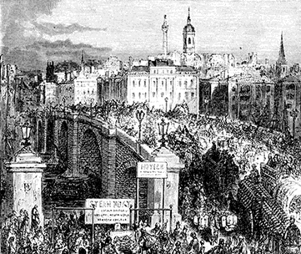
Agricultural Revolution
Before a society can industrialize, it must be able to feed its people more efficiently.
WHY?
Lowers cost of food = healthier people
Population increases
Fewer people needed to farm = more workers who can move to the cities
& work in factories.

Slide 6
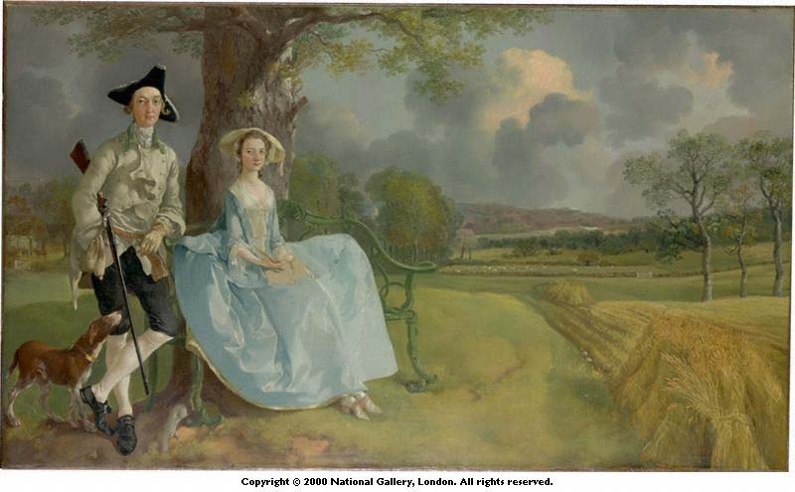
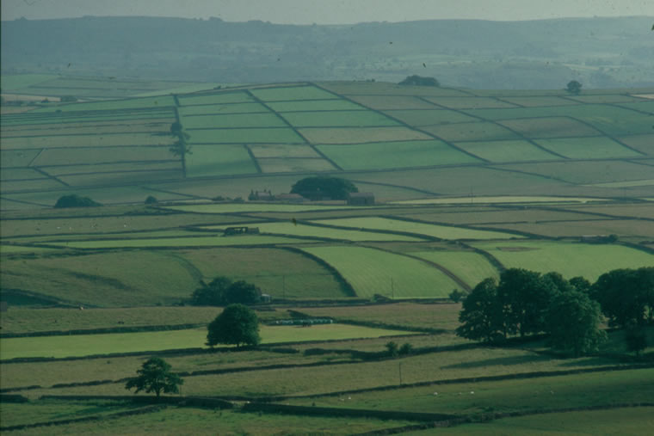
Agricultural Revolution in England
Enclosure Movement
Parliament controlled by landowners (gentry)
Ends “common lands” w/ Enclosure Acts
Allows for a more productive use of land
(also profits & many small farmers move to cities)

Slide 7
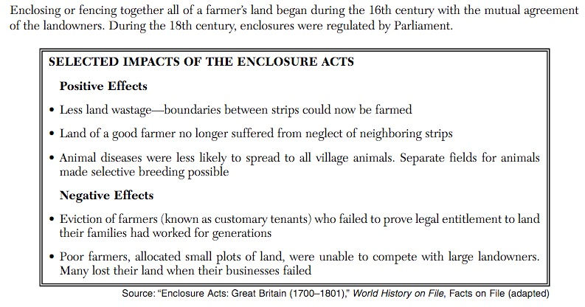

Slide 8
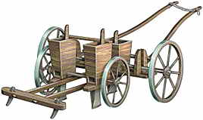
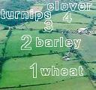
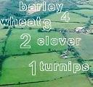
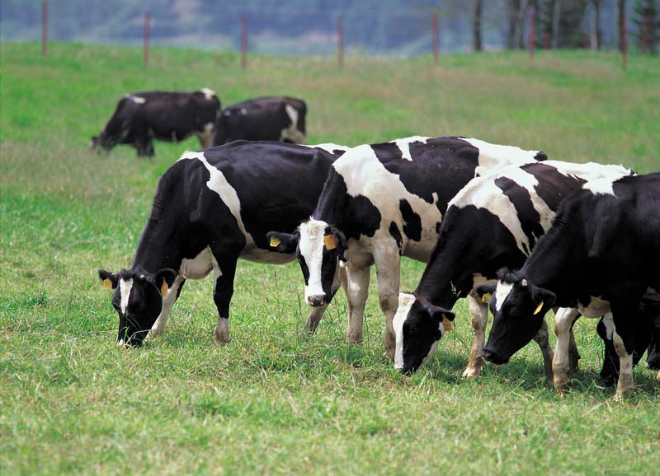
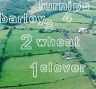
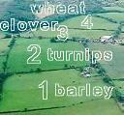
Agricultural Revolution in England
New farming & breeding techniques (Dutch)
Seed drill (Jethro Tull)
Charles Townsend: root plants / crop rotation
manure as fertilizer
Selective breeding

Slide 9
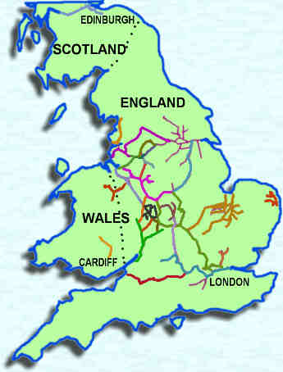
Industrial Revolution Begins in England First (1750’s)
WHY???
Land & geography
Natural resources (coal & iron)
Navigable rivers & water power
Canals & roads (transportation)
An island!

Slide 10
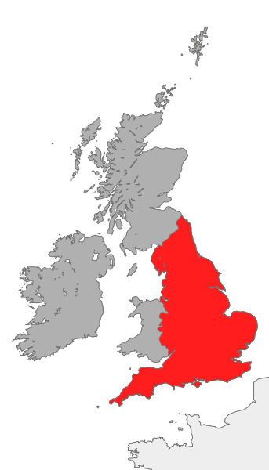
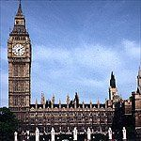
Why England First ?
Labor supply (large & growing population)
Capital ($) for investment thanks to the Commercial Revolution – mercantilism
Stable gov’t that
promoted banking & economy

Slide 11
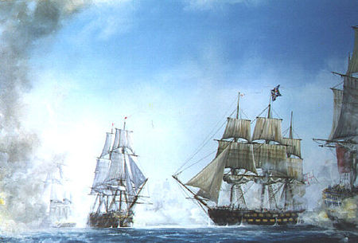
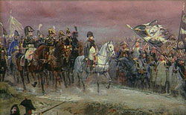
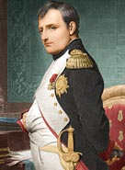
Why England First ?
Overseas empire
(markets & raw materials)
& strongest navy in the world
to protect it.
6. Was able to avoid much of the destruction of the Napoleonic Wars.

Slide 12
Cause & Effect
Enclosure movement
Better farming techniques & rise in city population (jobs)
2. Crop rotation
Higher crop yields, healthier people (increase population)
Flying shuttle, spinning jenny, power loom
Increase textile production, less need for apprentice system & skilled craftsmen.
4. Steam engine & McAdam roads
Improved transportation of people, raw materials & finished goods.
Expansion of the railroad
Industrial growth = cheap transportation of materials / goods
New Jobs (railroads & mine workers)
Encouraged taking distant city jobs; lured city people to countryside

Slide 13
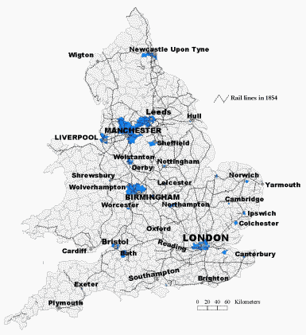
Railroads
George Stephenson’s “Rocket” was the
1st steam locomotive for pulling cars.
By the 19th century, Britain had more
rail lines & major urban centers than
any other country.
(1830) Liverpool to Manchester RR
was the 1st widely used railroad.

Slide 14
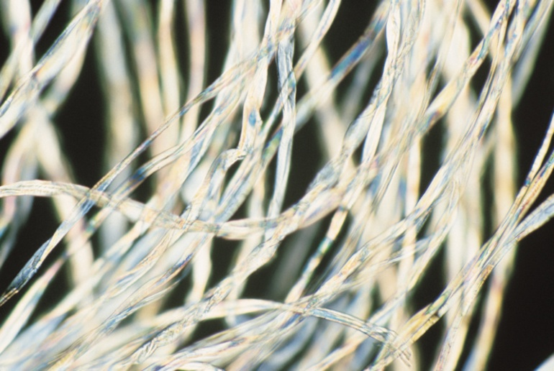
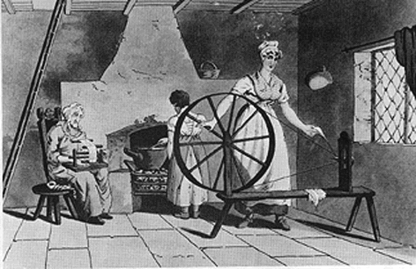
Cotton Textiles
1st industry to be mechanized
cheap; from Egypt & India (part of empire)
Domestic system (“putting out”)
Bring work to laborers in homes
Each do a different task
with hand operated machines
…spinners, weavers, etc.

Slide 15
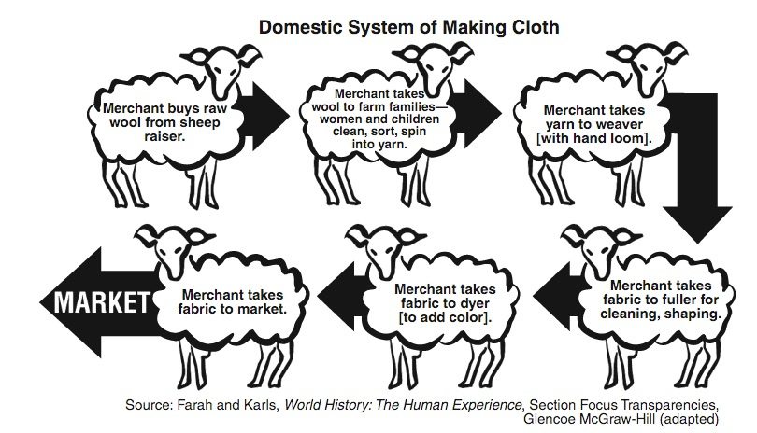

Slide 16
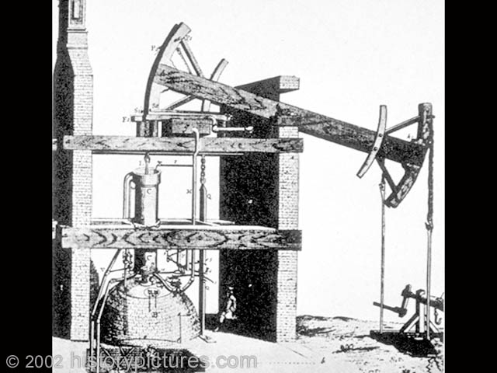
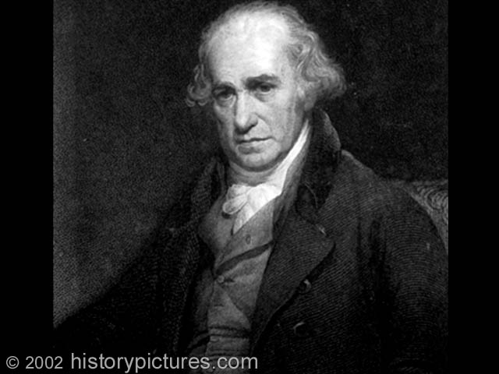
Cotton Textiles
New inventions & power sources
Water power then steam
James Watt perfects steam engine to be used in mills by 1782; powered by coal
Newcomen’s
Steam engine
James Watt

Slide 17
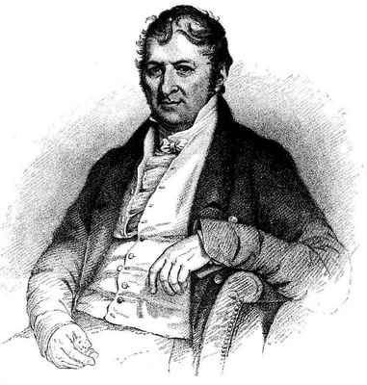
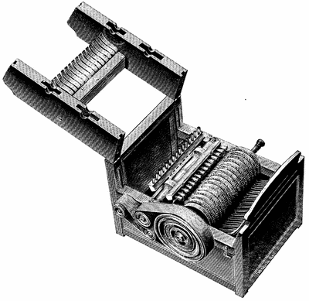
Eli Whitney’s Cotton Gin (1793)
The invention of the cotton gin made it easier to separate the seeds from the raw cotton fiber.
This helped meet the growing demand for raw cotton that the expanding textile industry required.

Slide 18
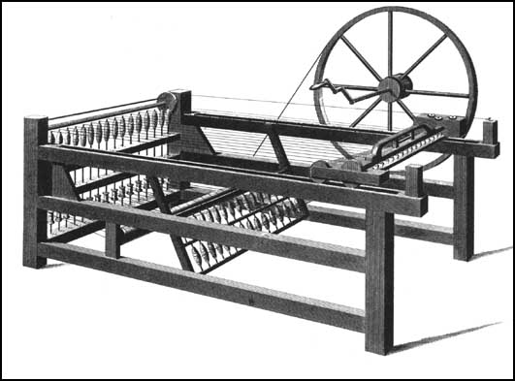
Cotton Textiles
Factory system
Larger, bulkier machines & need for power sources require bringing workers to a large production center = factory
Hargreaves’
Spinning Jenny
Arkwright’s
“water frame”

Slide 19
British Population Moves to the Cities
Of the cities shown on the bar graph, which one had the largest population increase between 1760-1860? Which had the smallest?
What mode of transportation were all English companies required to have in order to transport goods to Europe?
Which 2 cities appear to have “missed out” on the Industrial Revolution?
Where was most of the English population living in 1750? In 1850? What caused this population shift?
What is the approximate total population of the 5 cities on the chart in 1760? How much did the total population increase by 1881?
Why do you think it important for factories to be near their sources of energy?
Explain how an unintended consequence of more efficient farming was to provide one of the three necessary factors of production required for the Industrial Revolution to occur.

Slide 20
Source Analysis
Groups of 3
Analyze TWO assigned documents/sources
(all do docs 1 & 11)
What does each tell us about the Industrial Revolution, its impact & effects?
What is the point of view of the source?
(Positive? Negative? Reliable? Why??)

Slide 21
Do Now
What was the greatest benefit of the Industrial Revolution?
What was the greatest harm brought by the Industrial Revolution?

Slide 22
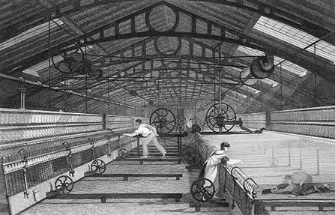
Factory System
“mass production” , division of labor & assembly lines
Do work faster & easier which increases production with cheaper, unskilled labor
(less need for skilled craftsmen & apprentices)

Slide 23
The Factory System

Slide 24
Interchangeable Parts
American, Eli Whitney ran an arms factory and made important contribution to this idea.
Made production & repair of products easier.

Slide 25
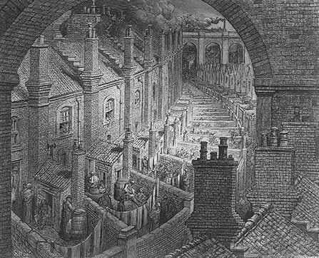
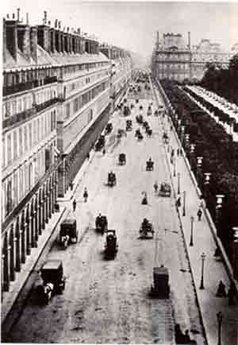
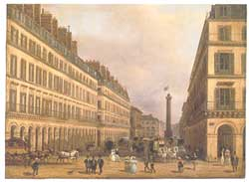
Factory System
2. Leads to a growth of cities (jobs)

Slide 26
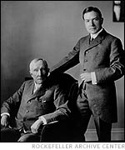
Factory System
3. Middle class factory owners (capitalists who believe in private ownership) make $ & increase power
“entrepreneurs”: invest for anticipated profit
(take a risk!)
Commercial capitalists = trade of goods
Industrial capitalists = production
(both want a favorable balance
of trade!!)

Slide 27
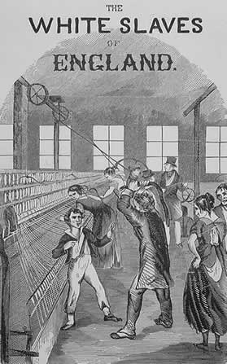
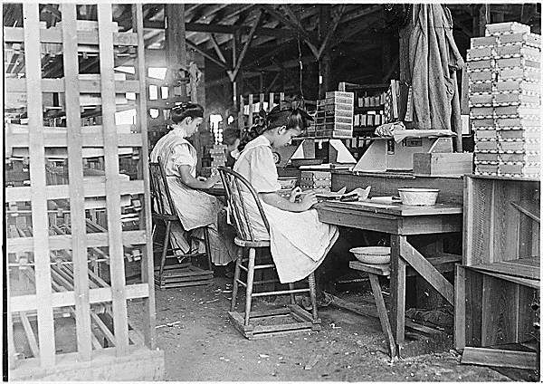
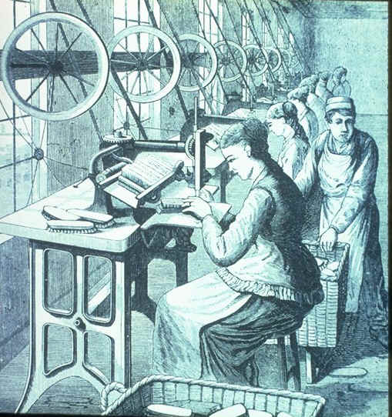
4. Factories & working conditions:
dark, noisy, poorly ventilated & unsafe
12-16 hour days / 6 days per week
low pay (unskilled) / easily replaced

Slide 28
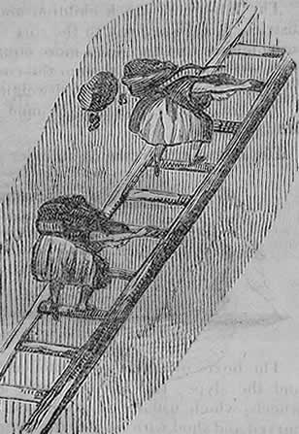
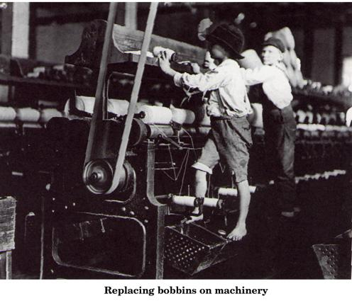
Factories & working conditions:
No workers compensation / job protection
Child labor
Unequal pay for women

Slide 29
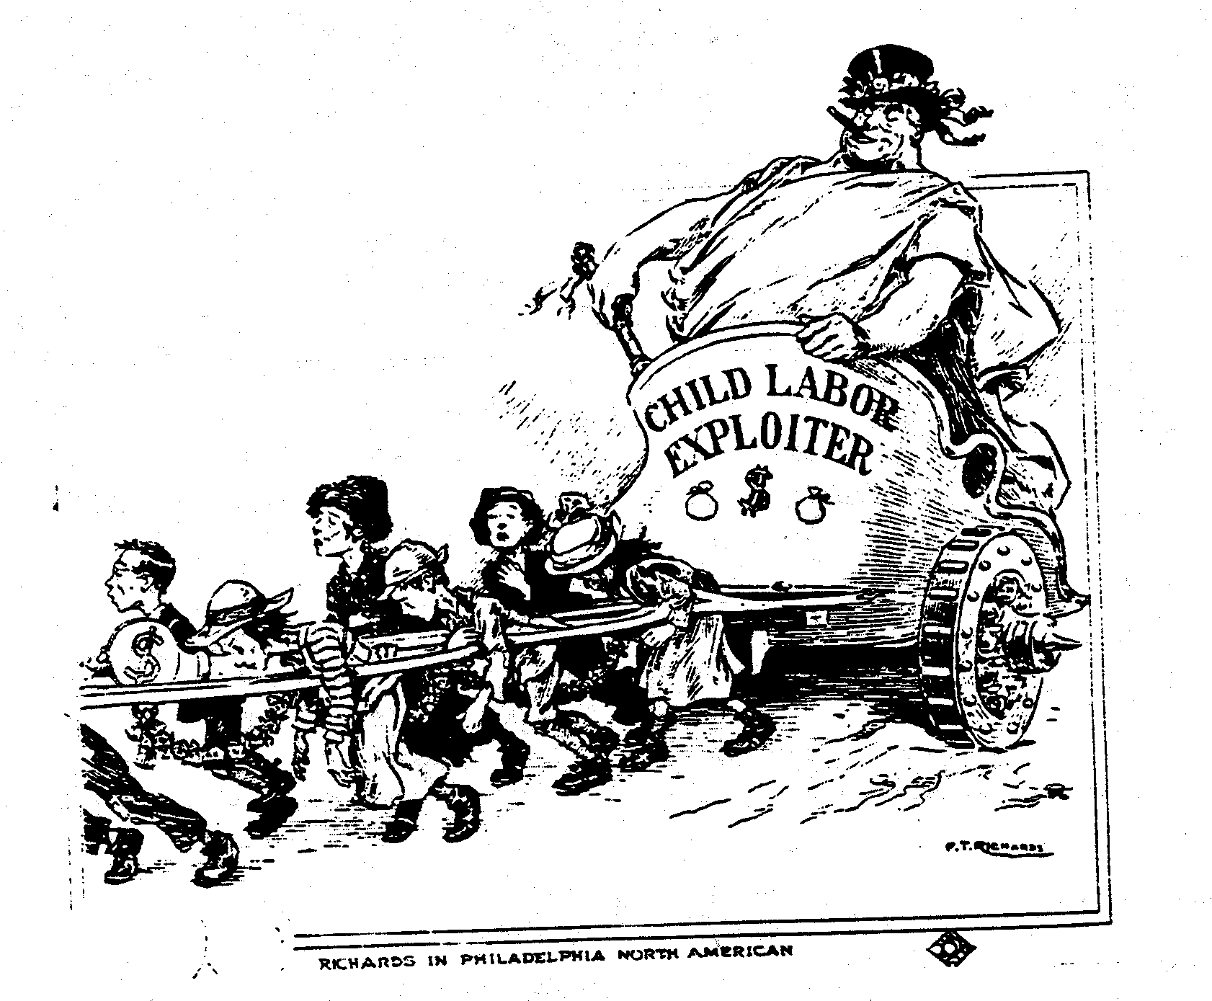
What do you see happening? Who is involved?

Slide 30
5. Effects on Workers & Society
People looking for work move to live near the factories = rapid urban growth & increase in population…PROBLEMS:
Poor / insufficient housing
Poor health conditions (water, sewage, pollution & disease)
Tenement Housing

Slide 32
Effects on Workers & Society
b) Unemployment & crime
(1829) – 1st permanent police force in London (Sir Robert Peel = “Bobbies”)

Slide 33
Effects on Workers & Society
c) Society:
Middle class factory owners
benefit most in the beginning:
($) = better living conditions
and political influence.
Working class struggled economically & did not see an improvement in standard of living until the 2nd half of the 19th century
Eventually the standard
of living improved for all in
Industrialized nations.

Slide 34
Analyze Cause & Effects
Create a chart that shows how industrialization effected the way people lived and worked.
Show its effects on each of the following AND then assess whether it was GOOD or BAD
Poor city dwellers
Factory workers
Merchants, factory owners & middle class
Children
the environment

Slide 35
Chp. 25 – section 2 DO NOW
What were the conditions like for the average worker who operated the machines in these new factories when the Industrial Revolution got under way ? Give examples

Slide 36
Industrialization Spreads
Using pgs. 733 answer the following:
How did the Industrial Revolution effect the relationships between industrialized & non-industrialized nations around the world?

Slide 37
International Impact of Industrialization
Shifted the world balance of power (West)
Led to increased competition among industrialized nations
poverty among less-developed ones
Widened the “wealth gap” between the two, but strengthened their economic ties
Industrialized nations needed a steady supply of raw materials as well as markets to sell their finished products . . . They seized colonies from non-industrialized areas for both (resources & markets) = IMPERIALISM

Slide 38
Do Now:
What actions did workers take to bring about or force change of the miserable conditions?
What remedies/reforms did governments eventually make to improve the working class situation?

Slide 39
Effects of the Industrial Revolution
6. Labor Organizes: To protest conditions & force reform, workers try to organize.
(in unity they had strength)
a) (1811) “Luddites” & machine breakers
Reward poster for information
leading to the arrest of Luddite
activists.

Slide 40
Labor Organizes
b) Strikes & work stoppages
c) Labor unions & collective bargaining
Early gov’t opposition for fear of violence & effects on the economy.

Slide 41
Labor Demonstrations & Violence

Slide 42
Chartism
Chartism was a working class movement, which emerged in 1836. Chartists wanted to gain political rights and influence for the working classes. Name comes from the formal petition, or “People's Charter,” that outlined main aims of the movement.

Slide 43
Effects of the Industrial Revolution
8. Government Reform
Governments eventually forced to act & make reform…England leads the way:
Unions & peaceful actions legalized
Minimum wage & hours established
(10 Hour Act)
Limits/restrictions on child labor (ex: Factory Act)
Regulation of working condition
Regulation on housing & sanitation
Voting privileges extended to working class
Germany led the way with social welfare
(workers compensation & pensions)

Slide 44
Industrial Revolution
1st Revolution (late 18th-early 19th century) resulted in an increase of production
2nd Revolution (late 19th – 20th century) industrialized society with new forms of energy (steam, electricity, gas, etc.) and improved transportation & communication (telephone, radio & motion picture) effecting everyday life
STEEL becomes a key product: Henry Bessemer
(machines, railroads, ships, autos, buildings)

Slide 46
Technological Innovations
Henry Bessemer’s process for refining steel (1858)
The Bessemer Converter

Slide 47
“Skyscrapers”
Using internal steel beams to support weight instead of walls led to these tall buildings
Chrysler Building
(1929) 1046 feet
Tribune Building
(1873) 260 feet
World Building
(1890) 309 feet
Flatiron Building
(1902) 285 feet

Slide 48
Empire State Building - 1931
1250 feet

Slide 49
Alexander Graham Bell
1847-1922 Edinburgh, Scotland
both his mother and wife were deaf, profoundly influencing his life's work
one of the founding members of the National Geographic Society
Developed a hydrofoil which set a world marine speed record of 70.86 in 1919
credited with inventing the first practical telephone

Slide 50
Telephone - 1876
Alexander Graham Bell
Copy of the original Bell telephone

Slide 51
Thomas Edison
Born 1847 in Ohio - Died 1937 in New Jersey
American inventor & businessman
Held over 1,900 U.S. patents
The “Wizard of Menlo Park”
Developed the phonograph, the motion picture camera, and a long-lasting, practical electric light bulb, stock ticker, a mechanical vote recorder, a battery for an electric car

Slide 52
Edison’s Improved Light Bulb (1879)
Thomas Edison next to
his phonograph (1877)
(1882) He also designed plans
for an electric power station to
bring electricity to a wider area.
The “Wizard of Menlo Park” would create many
other inventions like the kinetoscope
(to create motion pictures) & was issued 1,093 patents.
PG. 763

Slide 53
Henry Ford
1863-1947 United States of America
Industrialist and sponsor of the development of the assembly line technique of mass production.
His introduction of the Model T automobile revolutionized transportation and American industry
Transformed American life & society by developing and manufactured the first automobile that many middle class Americans could afford
Credited with mass production of inexpensive goods coupled with high wages for workers

Slide 54
The Automobile
(1885) German, Karl Benz developed 1st practical gasoline fueled automobile.
(1908) American, Henry Ford introduced the assembly line production method to mass produce cars…making them more affordable.

Slide 55
The Wright Brothers
American inventors & aviators
Capitalizing on the national bicycle craze opened a repair and sales shop in December 1892
Credited with inventing and building the world's first successful airplane and making the first controlled, powered and sustained heavier-than-air human flight.
Orville Wright
1871-1948
Wilbur Wright
1867-1912

Slide 56
Aircraft
Ferdinand von Zeppelin & the first
dirigible airship (1900)
Wilbur & Orville Wright ‘s “Flyer 1” was the first powered aircraft
to make flight on December 17, 1903.

Slide 57
Economic Ideas
Capitalism: private ownership & control of production, motivated primarily by profit.
Laissez – faire: “leave alone”
government should not directly interfere with the operation of business…limited regulations
Liberalism & laissez-faire capitalism gave immediate benefits to the middle class, so some working class people looked to other ideas.

Slide 58
Economic Ideas
socialism: political & economic philosophy based upon the belief that means of production & resources should be owned/operated by the government for the good of all.
Against the ideas of laissez-faire

Slide 59
Important People
Adam Smith: wrote Wealth of Nations (1776)
Capitalism: private control of production
against mercantilism
Supply & demand
Law of competition
Laissez-faire capitalism

Slide 60
Adam Smith on “self-interest”
It is a natural characteristic of all people
It is our self-interest that prompts us to
work hard, take risks, and in the end benefit
others through our activities
If people want to serve their own interest,
they have to serve others first.

Slide 61
Adam Smith on “wealth”
Anti-mercantilism . . .
Wealth of a nation not measured by how
much gold or silver it had, but by how many
goods and services its people consumed
If money or gold doubled but prices also doubled, the nation and its people would be no better off

Slide 62
Adam Smith . . .
Wanted people in different countries to be
able to freely trade without government
prohibitions (tariffs or quotas) – free trade!
Competition keeps prices down and quality up

Slide 63
Adam Smith on government . . .
Government has only three duties
1. Provide national defense
2. Provide a system of justice (a court system)
3. Public works such as roads and bridges
Government should not be involved in economy

Slide 64
Utopian Socialism
An idea developed among socialists that government should protect the freedoms of all & control the distribution of wealth
“welfare state”
This led to “Utopian Socialism”…
social & economic planning by the government
“cooperation not competition”

Slide 65
Important People
Karl Marx (1818-1883)
Communist Manifesto (1848)
History is a series of conflicts
between the “haves” vs. “have nots”
Struggle to control production ($)
Forgotten co-author Friedrich Engels

Slide 66
Marx’s stages of economic development
1. Primitive Communism
2. Slavery
3. Feudalism
4. Capitalism
5. Dictatorship of the Workers, or
Socialism
6. Pure Communism

Slide 67
Marx’s “Communism”
Last stage = capitalist stage of industrial era
Poverty of the masses & revolution of the workers - “proletariat”
A classless society where people will work for the benefit of all, not just themselves
True communism as all production shared & all needs met: “From each according to their abilities, to each according to their needs”

Slide 68
Marx’s Communism
No need for government
Nations will disappear
“workers of the world unite, you have nothing to lose but your chains”
Religion is a distraction & distorts reality
“opiate of the people”

Slide 69
Imagine there's no heaven It's easy if you try No hell below us Above us only sky Imagine all the people Living for today…
Imagine there's no countries It isn't hard to do Nothing to kill or die for And no religion too Imagine all the people Living life in peace...
Imagine no possessions I wonder if you can No need for greed or hunger A brotherhood of man Imagine all the people Sharing all the world...
You may say I'm a dreamer But I'm not the only one I hope someday you'll join us And the world will live as one

Slide 70
But does it work?

Slide 71
. . . and then there were 3!

Slide 72
Self Interest???

Slide 73
How would supporters of each use the image & message to win supporters?

Slide 74
Smith or Marx???
Laissez-faire capitalism
Communism
History is a struggle between “have’s & have nots”
The proletariat will rise up & seize power
“supply & demand” is the “invisible hand” that determines price & profit
The Communist Manifesto
The Wealth of Nations
Eventually a “classless” society will emerge where all resources will be shared
The law of competition
Government should limit its interference with the operation of business
Gov’t will eventually be unnecessary & disappear
Private ownership & free enterprise

Slide 75
Capitalism & Communism
Adam Smith (1723-1790)
Karl Marx (1818-1883)
Laissez-faire capitalism
Supply & demand = “invisible hand”
Wealth of Nations
Law of competition
Limited gov’t interference w/ business
Private ownership & free enterprise
Communism
History is a struggle between have’s & have nots
Proletariat will rise up & seize power
Communist Manifesto
Eventually a classless society
Gov’t eventually unnecessary & disappears

Slide 76
Thomas Malthus - 1798
Poverty & famine were natural
outcomes of overpopulation.
(Inevitable)
Obstacle to further progress. (caused misery)
Explained decline of living conditions in England.
Blamed irresponsibility of lower classes.

Slide 77
David Ricardo - 1817
“iron law of wages”
Pointless to artificially raise wages to help working class standard of living because wages are directly related to population.
Controlled by supply & demand
Would always remain around
“subsistence level”
Did these guys subscribe to
laissez faire ideas?

Slide 78
John Stuart Mill (1806-1873)
Government should protect the freedoms of all & control the distribution of wealth
“welfare state”
Unions & expansion of suffrage will protect common interest
Led to ideas of
“Utopian Socialism”…
social & economic planning
“cooperation not competition”

