Slide 1
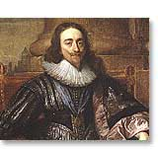
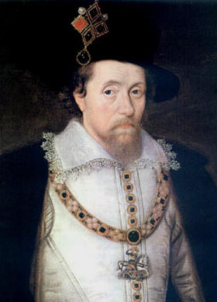
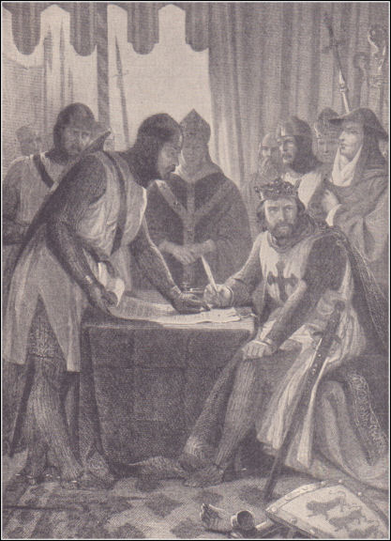
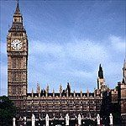
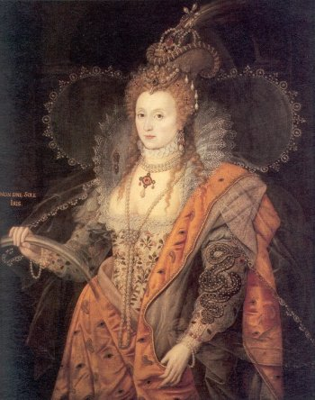
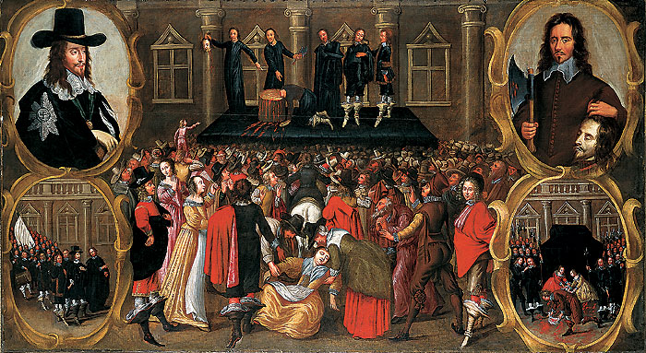
England & Constitutional Monarchy

Slide 2
DO NOW: Can you “C” Elizabeth?
Assess how each of the following terms can be used to describe Elizabeth and her actions as ruler:
captivating, clever, commanding,
compromising, cultural

Slide 3
Explain the quote. . .
With regards to her views on religion…what do you think Queen Elizabeth meant when she said,
“I do not desire windows
into men’s souls.”

Slide 4
Elizabeth source & text pgs. 494 & 614
What family dynasty was she from?
How did she become queen of England?
What problems of religion did she face?
What was Elizabeth’s solution to religious division in England?
What policies led to eventual conflict with Spain?
What actions do you think demonstrated that Elizabeth was both a clever & fair ruler? Explain.
The great cultural achievements in England during Elizabeth’s reign were highlighted by whom?
Why did Elizabeth’s death in 1603 present a problem for England?

Slide 5
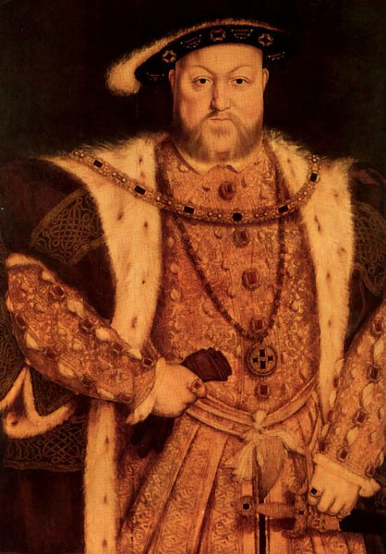
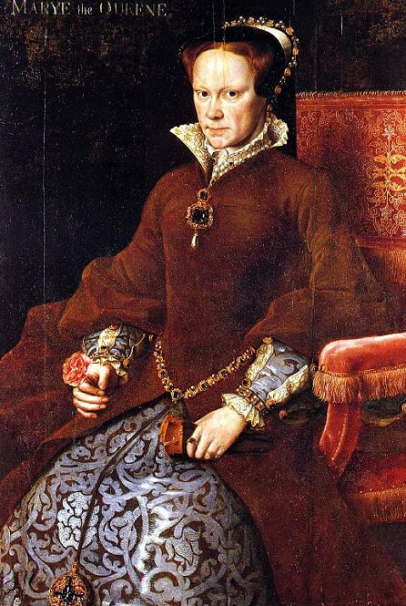
TUDOR DYNASTY
Tudor dynasty takes over
England in 1485 after Wars of the Roses.
Henry VIII & Anglican Church
Daughter Mary (1553-1558):
1st queen to rule England
Henry VII
(1485-1509)
Henry VIII (1509-1547)
“Bloody Mary” who tried restore Catholicism to England

Slide 6
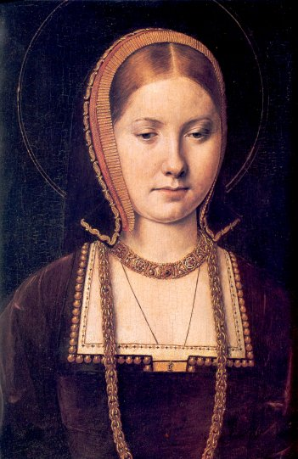
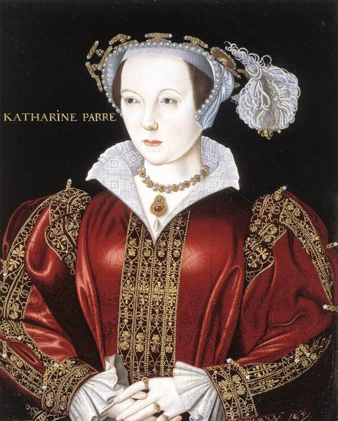
Henry’s Wives
Catherine of Aragon (1509-1533)
Anne Boleyn 1533-36
Jane Seymour (1536-1537)
Anne of Cleves (1540)
Catherine Howard (1540-1542)
Katherine Parr (1543-1547)
Notes:
-Henry spent much of his energy in his social life in the courts, marrying six times in total.

Slide 7
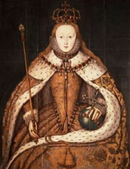
Queen Elizabeth Tudor I
Born: September 7, 1533 to King Henry VIII and
Anne Boleyn, his second wife.
Coronated: January 15, 1559 at Westminster Abbey
Died: March 24, 1603 at age 69
Notes:
-Henry was devastated with Elizabeth’s birth because he had been hoping for a son and an heir to his throne. When Anne Boleyn was declared null and void, Elizabeth was declared illegitimate and she no longer held a place in the line of succession
-Later, Henry reinstated his daughters in the line of succession
-She had a special flare for languages, and by adulthood, she could reputedly speak five languages fluently.
- Her last stepmother, Katherine Parr, made sure that Elizabeth and her brother Edward were well-educated

Slide 8
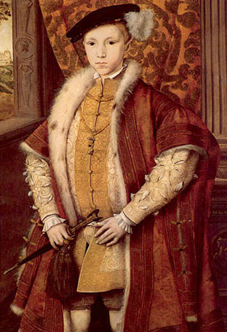
Pre-Ruling Conflicts
Before she became Queen, Elizabeth, a Protestant, clashed with her sister Mary and other Catholics.
While her brother Edward was King, Elizabeth was wrongfully implicated in a plot to overthrow the young King by his uncle Thomas Seymour.
Then, in the Wyatt Rebellion of 1554, Queen Mary accused Elizabeth of being in the plot to overthrow her.
Notes:
- Elizabeth was thought to be part of this plot because Thomas was widely known in his affection or the young princess.
- While Mary was Queen, she was frequently suspicious of Elizabeth and constantly thought that Elizabeth and other Protestants would try to overthrow her.

Slide 9
The Captivity of Elizabeth
After the Wyatt Rebellion, Elizabeth was locked up in the Tower of London even though there was no evidence against her.
She was let go (ironically) at the bequest of Mary’s husband, King Phillip of Spain.
Notes:
-Although many of Mary’s Catholic followers wanted her executed, she was simply locked up in the Tower of London for two months.
- It was widely known that Mary’s husband, King Phillip of Spain, had actually wanted to marry Elizabeth.

Slide 10
State of Affairs in 1558 . . . “NOT GOOD!”
'The Queen poor; the realm exhausted; the nobility poor and decayed; want of good captains and soldiers; the people out of order; justice not executed; justices of peace unmeet for office; division among ourselves; war with France and Scotland; the French King, having one foot in Calais and the other in Scotland; steadfast enmity (opposition), but no steadfast friendship abroad.'
An anonymous contemporary observer in 1558
Notes:
The conflicting beliefs of King Edward and Queen Mary had left England in a sorry state of affairs at the beginning of her reign.

Slide 11
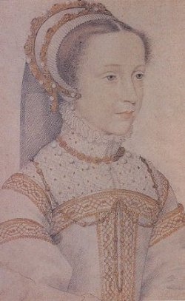
Elizabeth (1558-1603)
“Greatest Tudor Monarch”
Religious tolerance, but
demanded national unity
trouble w/ Catholics & Puritans
Puritans want to “purify”
Anglican Church
Catholics & Mary Stuart of
Scotland

Slide 12
Scotland
Many believed that Mary, Queen of Scots, a catholic, was the rightful Queen of England.
After Mary was forced out of Scotland and fled to England, Elizabeth imprisoned her for 20 years.
Although Elizabeth did not want to have her cousin executed, she was forced to send Mary to execution after the plot of Babington was uncovered.; a plot in 1586 to assassinate Queen Elizabeth and put the rescued Mary, Queen of Scots, on the English throne.
The long-term goal of the plot was an invasion by the Spanish forces of King Philip II and the Catholic League, leading to the restoration of Catholicism in England.
Notes:
-Since Elizabeth knew Catholics would be outraged if she executed Mary, the Queen kept Mary safe in the tower until she was forced to have her executed.

Slide 14
Explain the quote. . .
With regards to her views on religion…what do you think Queen Elizabeth meant when she said,
“I do not desire windows
into men’s souls.”

Slide 15
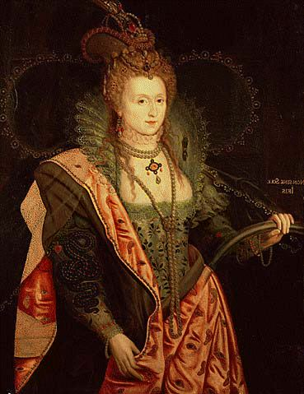
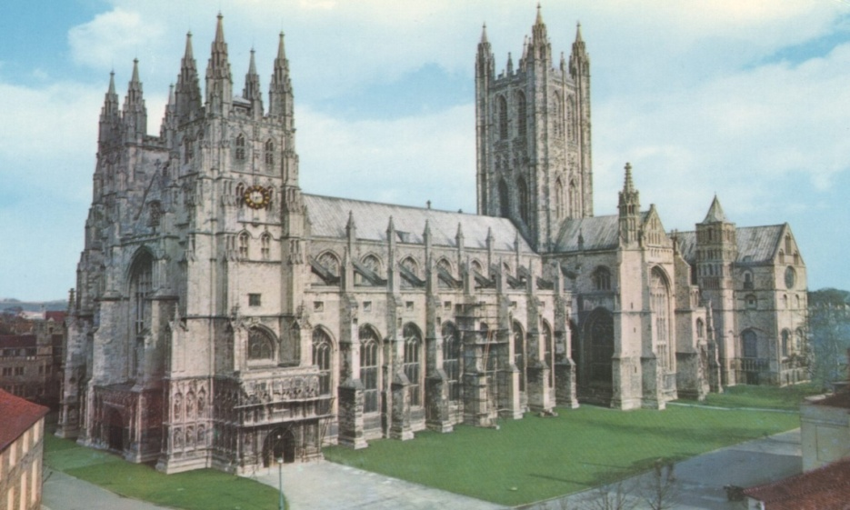
Elizabeth Restores Protestantism in England
Made head of the Anglican Church by Parliament
Very moderate reforms
She herself believed in toleration of all religions.
‘There is only one Christ, Jesus, one faith… all else is a dispute over trifles.’
“We are all English first . . .
loyal to monarch & country.”

Slide 16
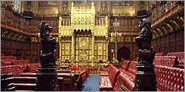
Elizabeth (1558-1603)
Skillfully dealt with Parliament
Period of flourishing culture…
time of Shakespeare

Slide 17
Elizabeth’s Refusal to Marry
Most thought that Elizabeth would marry within her first year or so as Queen.
Elizabeth valued the independence she had and did not feel she needed a man to guide her.
Feared foreign threat
It would have also been politically difficult for her to choose a suitable husband.
The Privy Council, whose job it was to choose a husband for the Queen, was too divided to ever agree on a suitable mate.
This made it much easier for Elizabeth to refuse any marriage suggestions or proposals.
Notes:
'Everything depends upon the husband this woman takes.' -the Spanish ambassador De Feria, 1560
Elizabeth’s unwillingness to marry could have come from the sight of the unsuccessful marriages of her father or a fear of dying in childbirth.
Another reason for not marrying could have just been that she was simply not a romantic person, she was pragmatic and harsh.

Slide 18
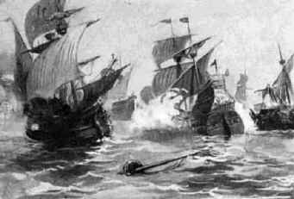
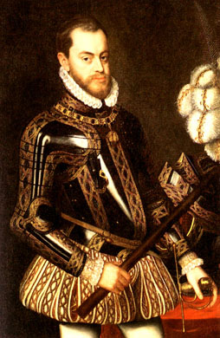
Elizabeth (1558-1603)
Foreign policy: rival Spain, sea dogs &
defeat of the Spanish Armada (1588)
…turning point in history!
Always ENGLAND 1st!!!
Never married…no children (problem)
Philip II:
Catholic
Monarch of
Spain

Slide 19
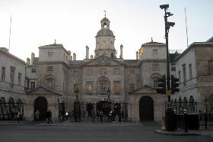
Whitehall Palace, London

Slide 20
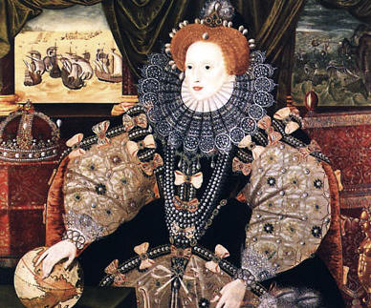
Political Skill
Elizabeth’s approach to the monarchy was drastically different from any of her predecessors because of her willingness to listen to those around her.
She would change a policy if it was unpopular.
Her approach to politics was serious, conservative, and cautious.
Notes:
Elizabeth was dedicated to her country in a way few monarchs had been or have been since. Elizabeth had the mind of a political genius and nurtured her country through careful leadership and by choosing capable men to assist her, such as Sir William Cecil and Sir Francis Walsingham.

Slide 21
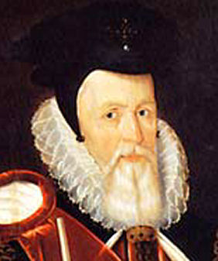
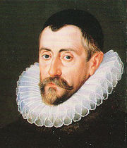
Advisors
Elizabeth was especially gifted at choosing smart people to help her lead.
Sir William Cecil Secretary of State
Sir Francis Walsingham, The Queen’s Spymaster
Notes:
-The role of the secretary was mainly advising the Queen, overseeing the preservation of law and order, defending the realm against plots, and genera security
- William Cecil joined Elizabeth as her chief advisor in 1558 and then served her until he died in 1598.
- He was her major confidante and considered one of the greatest statesman in English history.
-

Slide 22
Privy Council
The main job of the Council was to give advice to Queen Elizabeth. The Councilors did not always agree on matters, but Elizabeth listened to all sides of the argument, and then made up her own mind about what to do. This increased her power as she could always make the final decision
The Privy Council was part of a more localized method of government which was very important in Tudor England.
Royal representatives were situated in every county in the country to make sure that the Queen’s wishes were carried out.
Notes:
By the end of her term, there were only thirteen council members and they met every day.

Slide 23
Summation – Written response
Think back to our discussion on day one of this chapter regarding the pros & cons of monarchy.
Choose any two monarchs we have discussed & analyzed this week . . .
One you believe was a GOOD ruler
One you believe was a BAD ruler
For each:
Identify the dynasty he/she was a part of and what country/region he/she ruled
Provide multiple examples of evidence to support your position on each.

Slide 24
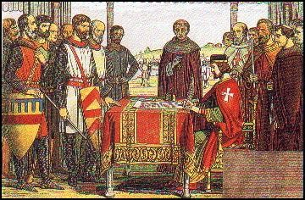
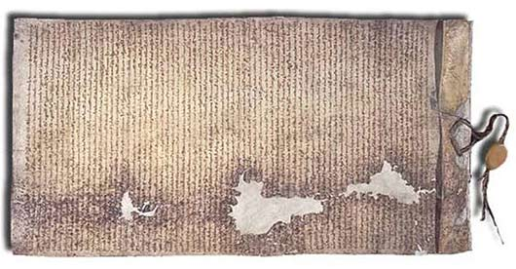
Development of Limited Monarchy in England
Magna Carta (1215)
“Great Charter”
Forced on John I by nobles
Limited the power of the king
“the king is not above the law”
No new taxes w/out consent of the
Great Council
Protected rights of
nobles; later extended
to all citizens
John I signs the
Magna Carta at
Runnymede
Copy of the Magna Carta

Slide 25
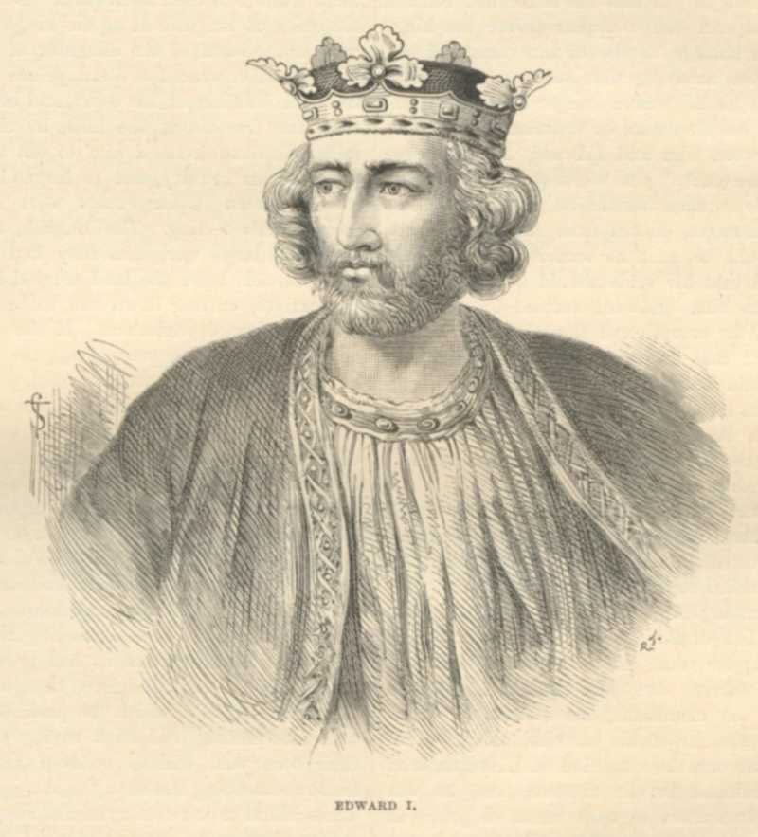
Development of Limited Monarchy in England
Edward I (1272-1307)
Expansion of “Common law”
Decisions of royal courts were
recorded & became basis for
future court decisions
(which along with juries was
started by Henry II: 1154-89)
Jury system & common law are the basis for present day legal systems in both England & the United States.

Slide 26
Development of Limited Monarchy in England
Power struggles between king & nobles continued into the 1260’s-70’s, included the demand for more representation in the
Great Council
(1295) Edward legally extends membership to “middle classes” (knights & burgesses) creating “Model Parliament”

Slide 27
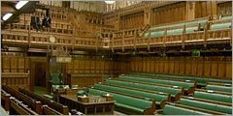
Development of Limited Monarchy in England
“what touches all, must be approved by all”
Houses of Lords & Commons
1st step towards representative government in England

Slide 28
1. Who were the Stuarts & how did they attain the throne of England?
2. Why did James I & Charles I have such difficulty with Parliament?
3. How did religion play a role in the friction between the Stuarts & Parliament?
4. Describe the Petition of Right (1628).
5. Why did civil war start? Describe opposing sides & outcome
Who was Cromwell? What role did he play?
Did the “commonwealth” of England have any better success at dealing with Parliament? Do you think Cromwell was popular with the people?
8. What was the Restoration & why did it occur?
9. What was the Glorious Revolution & why did it occur?
How was it a victory for the people of England?

Slide 29
Timeline Directions
Your group will be assigned an item/topic to research. Create an outline of information identifying/describing who or what it was, actions or events / causes & effects surrounding it.
You will place your item/topic on the event timeline on the front board.
Your group will present & explain the topic to the class and answer any of my questions.
Grade based upon correct placement on timeline, accuracy of information and group presentation.
(25 points)

Slide 30
TIMELINE ITEMS
James I James II Charles I Charles II
Act of Union Cabinet Petition of Right
Habeas Corpus Restoration Glorious Revolution
Great Fire Constitutional Monarchy Civil War
Elizabeth dies Commonwealth of England

Slide 31
Stuarts & Civil War
1603: Queen Elizabeth dies
with no heirs…
Parliament invites cousin
James of Scotland
(son of Mary Stuart former
Queen of Scots) to become king
James I who was king of England (1603-1625)
started the Stuart dynasty
Wrote “The True Law of Free Monarchies”,
which defended the divine right of kings.

Slide 32
Stuarts & Civil War
James I & son Charles I attempt to rule as “absolute monarchs”…not English way
Believed in the “divine right” theory
levy taxes w/o Parliament approval
Create royal courts that resort
to unfair trials
Illegal imprisonment & torture
King Charles I (1625-1649)

Slide 33
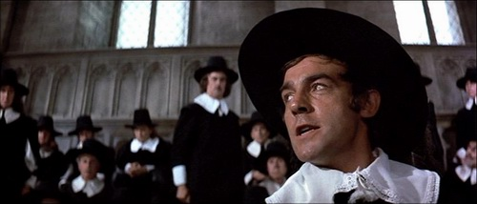
Stuarts & Civil War
Oppose & persecute Puritans
(who made up large % of Parliament)

Slide 35
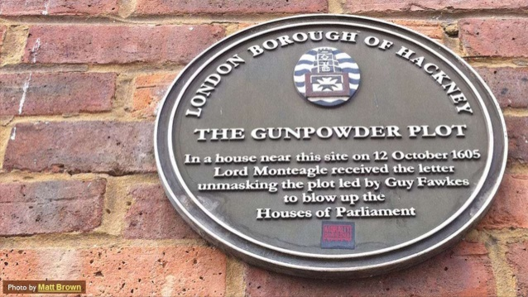

Slide 39
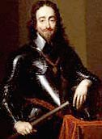
Stuarts & Civil War
Petition of Right (1628)
Issued by Parliament when Charles requested new taxes (needed $)
Limits power of the monarch:
No illegal imprisonment
No new taxes w/o Parliament’s ok
No forced quartering of troops
…Charles agrees, takes $, then ignores it!
Parliament objects, Charles dismisses them and rules for 11 years alone = absolute rule (1629-40)

Slide 40
Stuarts & Civil War
(1637) – Charles tries to impose a standard prayer book upon his Presbyterian subjects in Scotland
Scotland revolts (1639) & invades England…
Charles needs $; recalls Parliament by 1640

Slide 41
What flag is this? What 3 countries flags were combined to create it?

Slide 42
1707 – Act of Union
In 1707, England & Scotland will be officially unified into the “United Kingdom of Great Britain”
Cross of St. Andrew Scotland
Cross of St. George
England
The “Union Jack”
– U.K.
St. Patrick’s Cross - Ireland

Slide 43
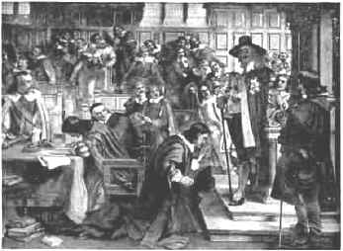
Stuarts & Civil War
Money granted, but place limits on royal power…sat for 20 years = “Long Parliament”
(dominated by Puritans)
(1642) they push too far & Charles sends troops to arrest opponents = spark of civil war
Charles enters Parliament with troops
calling for the arrest of the leaders
who oppose him.

Slide 45
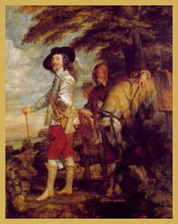
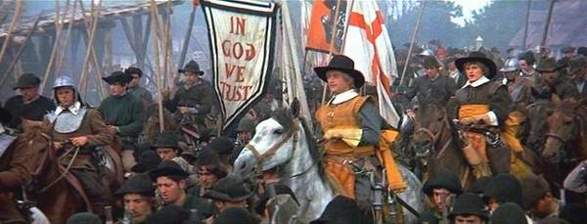
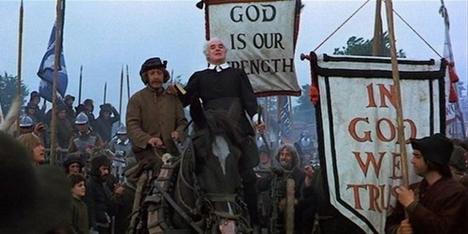
Civil War (1642 -1648)
Cavaliers = king’s supporters
(Anglicans, nobles, Catholics)
Roundheads = supporters of Parliament
(Puritans, middle class, all vs. absolute rule)

Slide 46
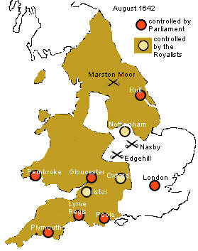
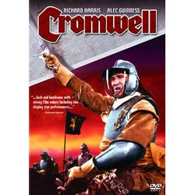
Civil War (1642 -1648)
Early Cavalier success until Oliver Cromwell organizes & leads Parliament’s New Model Army to victory (Marston Moor & Naseby)
One of the
“Ironsides”
cavalry
of Cromwell’s
New Model
Army

Slide 47
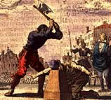
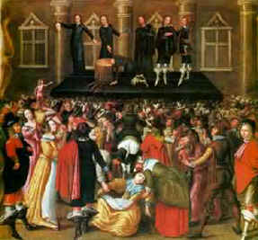
Commonwealth & Dictatorship
Charles I found guilty of treason & executed (1649)

Slide 48
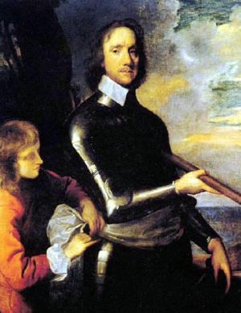
Commonwealth & Dictatorship
1648: Cromwell “purged” Parliament
1649: Monarchy dissolved = Commonwealth of England established (a republic)
1653: Parliament dissolved & Cromwell becomes a dictator: “Lord Protector”
Was Cromwell much different
than the absolutist Stuarts?
Purged & abolished Parliament
Censored the press
Imposed strict code on the people
Son Richard succeeded him to power

Slide 49
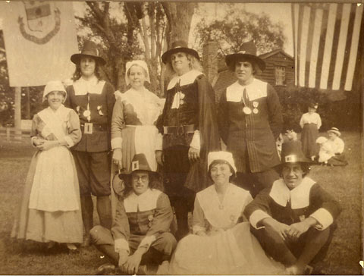
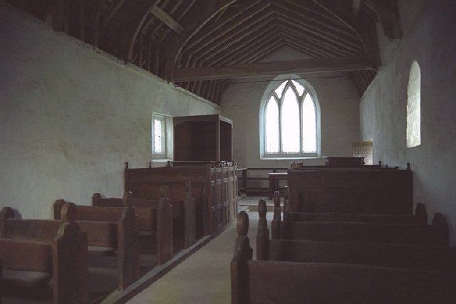
Puritan Commonwealth (1649-60)
Cromwell, a Puritan, issued a strict moral code which became very unpopular
(Closed theatres, no public amusement / sporting events, no drinking, gambling, no make-up or colorful dress, censorship of the press, brutalized the rebellious Irish, persecuted Catholics)
Very simple interior of a
Puritan Church; no “popery”

Slide 51
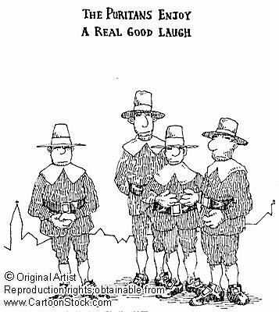
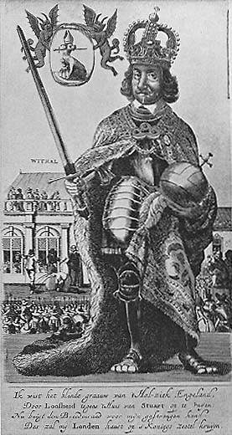
He did expand England’s trade!
BUT . . .
Was he much better than an
absolute monarch???
Cartoon satire of
Cromwell as an
“absolute monarch.”

Slide 52
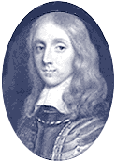
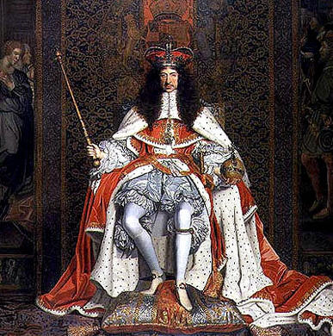
Restoration (1660)
2 years after Cromwell dies, new Parliament invites back Charles II (1660=1685) and “restores” monarchy
Cooperative & non-confrontational
But, secretly Catholic & had ties
to Louis XIV (suspicion)
Richard Cromwell, forced out after 2 years
The “Merry Monarch”
Charles II

Slide 54
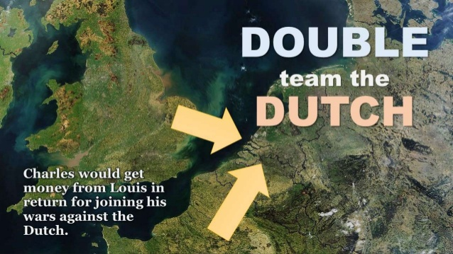

Slide 55
Balance of Power:
Maintaining an even distribution of international power & politics to preserve national security.
(No one gets too strong & threatens the others!)
DIPLOMACY & ALLIANCES

Slide 56
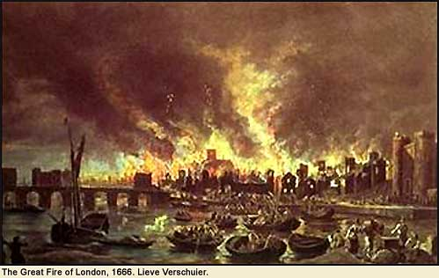
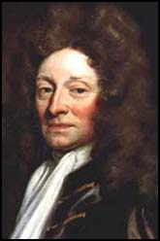
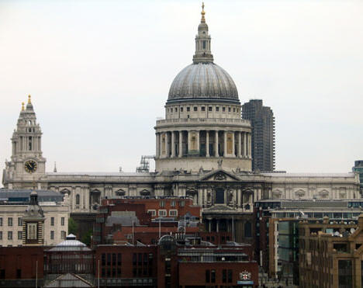
Restoration (1660)
Charles promoted arts & culture
Popular with the people
Great Fire of London (1666)
Architect
Christopher Wren
St. Paul’s Cathedral

Slide 57
Constitutional Monarchy
Habeas Corpus Act (1679):
The accused has the right to be informed of charge against him
The accused has the right to be brought before a judge
The accused has the right to a fair & “speedy” trial
“to produce the body”
Protection from illegal imprisonment

Slide 58
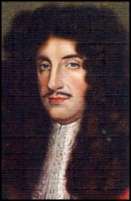
Parliament’s Suspicions
1st political parties form in Parliament:
Tories want strong monarch
Whigs = limited monarch & strong Parliament
Charles II

Slide 59
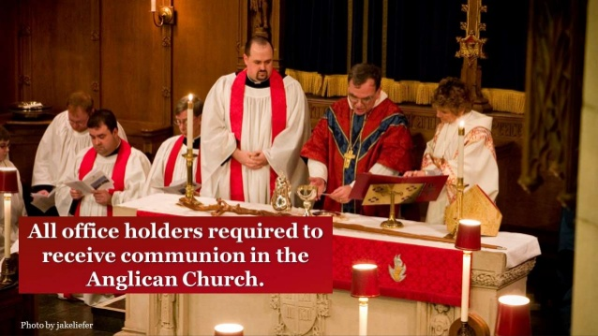
(1673) Test Acts: Fear of Catholicism, so outlawed Catholics from government

Slide 63
James II (1685-1688)

Slide 64
James II (1685-1688)

Slide 65
James II (1685-1688)
Charles’ brother becomes king; a Catholic & absolute ruler
Disagreements w/ Parliament
Succession problem

Slide 66
JAMES II

Slide 67
“Glorious Revolution”
Parliament invites James’
daughter Mary & husband William
(of Holland)
to rule.
William & Mary

Slide 68
“Glorious Revolution”
James flees (little support)
this Bloodless revolution is called the
“Glorious Revolution”
William of Orange & his army
landing at Torbay, England (1688)

Slide 69
Constitutional Monarchy
Limited monarch as Parliament is now supreme
all monarchs must be approved by Parliament
All monarchs must accept the Bill of Rights
limits power of monarch
protects people’s rights
The king is not above the law!

Slide 70
English Bill of Rights (1689)
King cannot suspending or create laws w/o Parliament.
King cannot raise taxes without Parliament's consent.
Subjects can petition their king without fear of imprisonment.
King cannot raise a peace-time army w/o Parliament's consent.
Free election of Parliament must be permitted.
Parliament must be allowed to meet frequently.
Freedom of speech.
There should be no excessive, cruel or unusual punishments.
Right of trial by jury for the accused.
Nobody can be punished before conviction and trial.

Slide 71
Limited / Constitutional Gov’t
Throughout England’s history, several documents or actions worked to create limits on the monarch’s power & safeguard certain rights/liberties of the people from the abuses of absolute rule.
Identify each of the documents below & explain how it limited the power of the monarch and/or protected certain rights of the people:
Magna Carta (1215)
Creation of Model Parliament (1295)
Petition of Right (1628)
Habeas Corpus Act (1679)
Bill of Rights (1689)
Identify & describe examples of how the English government and/or legal system are similar to the United States today.

Slide 72
Constitutional Monarchy
With Parliament’s victory over the Stuarts, the monarchs of England now see their power “limited” by documents of law:
“Constitutional monarchy”
(no single document)
Magna Carta:
No new taxes w/o consent of Great Council
Protected noble rights (like jury trial)
“king is not above the law”
rights of the nobility later extended to all

Slide 73
Constitutional Monarchy
2. Model Parliament:
Extended membership in Parliament to more people (middle classes)
“what touches all must be approved by all”
1st step towards a representative government

Slide 74
Constitutional Monarchy
3. Petition of Right:
No new taxes w/o Parliament approval
No illegal imprisonment
Accused must be informed of charge & receive a trial by jury
Limits power of monarch
Protects people against abuses of a monarch

Slide 75
Constitutional Monarchy
Habeas Corpus Act:
The accused has the right to be informed of charge against him
The accused has the right to be brought before a judge
The accused has the right to a fair & “speedy” trial
“to produce the body”
Protection from illegal imprisonment

Slide 76
Constitutional Monarchy
Bill of Rights:
Monarch is an official approved by Parliament
Monarch is subject to laws
Protects basic civil liberties & rights
Safeguards against absolute rule
Parliament is supreme
(represents the people)

Slide 77
1707 – Act of Union
In 1707, England & Scotland will be officially unified into the “United Kingdom of Great Britain”
Cross of St. Andrew Scotland
Cross of St. George
England
The “Union Jack”
– U.K.
St. Patrick’s Cross - Ireland

Slide 78
Constitutional Monarchy
(1689) Still property requirements to vote & serve in government.
Religion: (1673) No Catholics in gov’t
(1689) Freedom of worship for all Protestants
(but not Catholics/Jews)
(1701) Only Protestants can hold the throne
(Hanover Dynasty from Germany & Cabinet)
1st Prime Minister – Robert Walpole

Slide 79
Rulers of England (1558-1820)
(1588-1603) – Elizabeth I (Tudor)
(1603-25) – James I (Stuart)
(1625-49) – Charles I
(1649-60) – Cromwell’s Dictatorship
(1660-85) – Charles II (Stuart)
(1685-89) – James II
(1689-1702) – William & Mary
(1702-14) – Anne
(1714-27) – George I (Hanoverian)
(1727-60) – George II
(1760-1820) – George III
King George I
King George III

Slide 80
ENGLAND & THE UNITED STATES
How many similarities can you identify between the English government that formed by the end of the 1600’s and our government today, which first formed in the 1780’s?

Slide 81
Similarities to the U.S.
Limited power of the chief executive
a representative body of the people
Representatives of the people make laws & levy taxes
A Bill of Rights protecting the people
Use of “common law”
Jury systems
Right to be informed of charge
Right to a “speedy” trial
No cruel/unusual punishment

Slide 82
Similarities to the U.S.
Is this a coincidence???
NO, our “Founding Fathers” who wrote the U.S. Constitution were originally British subjects raised in the British political & legal tradition during the 1700’s . . .
The generation after Parliament’s actions.

Slide 83
TEST STUDY GUIDE
Kings, queens, Cromwell
Elizabeth’s Reign
Events in struggle between Stuarts & Parliament
English Civil War
Cromwell
Restoration & Glorious Revolution
England’s Constitutional Monarchy
Documents & actions that limit/form government (Magna Carta, Parliament, Bill of Rights, etc.)
Similarities between England & U.S. gov’t & legal system

Slide 85
Absolute Monarchy – Summary/Evaluation
Determine whether each statement is either a positive / benefit or a negative /weakness to a nation under an absolute monarch.
Provided a strong central government
The welfare of the nation depends upon the ability of only one person
Many good rulers are succeeded by poor ones which creates a weak/unstable government
Many absolute rulers put personal interests & selfish motives above what is in the best interests of the people & nation
United people together under them to form a nation
Many absolute monarchs involved their nations in frequent wars
Absolute rulers tend to disregard the “rights” of the people

Slide 86
Enlightened Despots
Some monarchs acknowledge
criticisms of “abuse of power”
“Enlightened Despots” felt they had a responsibility to their people & used their power to improve the people’s lives.
(examples: reforms, religious toleration, living conditions)
Frederick the Great
Joseph II, Hapsburg ruler of Austria (1780-90)

Slide 87
Middle East Map Choices
Tunisia West Sahara Morocco Turkey
Qatar Bahrain Iran Iraq Israel
Algeria Libya Egypt Cyprus Oman
Kuwait Lebanon Jordan Yemen
Saudi Arabia United Arab Emirates Syria

Slide 89
1
2
21
3
5
18
19
9
8
13
10
12
11
14
15
16
17
6
23
7
20
4
24
22

