Slide 1
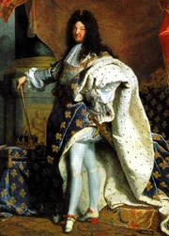
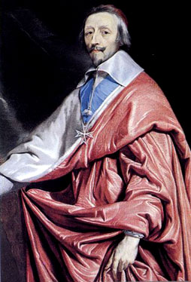
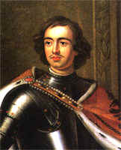
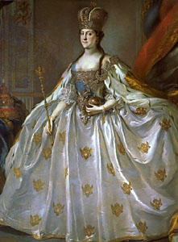
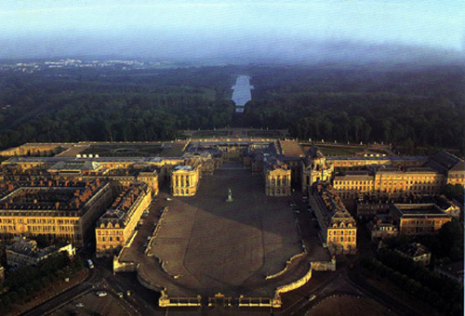
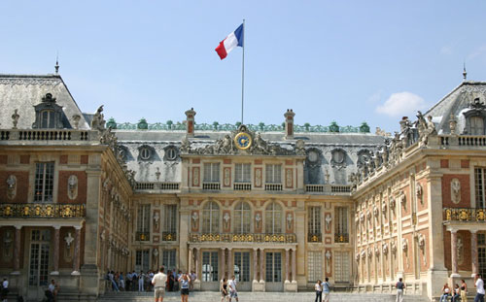
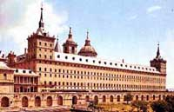
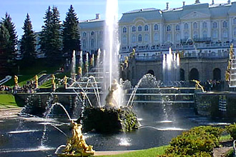
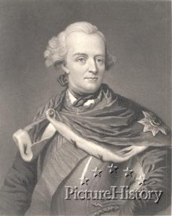
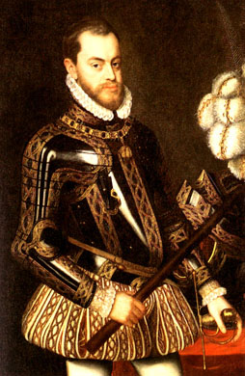
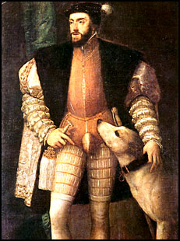
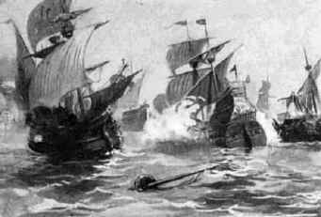
Age of Absolutism

Slide 2
Age of Absolutism: cartoon analysis
Define “Absolutism” & the “Divine Right Theory.”
What characteristics might have enabled T-Rex to become leader of all the dinosaurs?
What does the cartoon suggest about how a ruler gets his power & uses his power?
Do you believe the qualities suggested by the cartoon necessarily make for an effective leader?
What historical events/developments we have discussed do you believe contributed to why or how absolute monarchs came to power?

Slide 3
WHH - Source Analysis
What traditional limits on the power of the monarch were overcome by the 1600’s?
By the 1600’s, what political, military, religious and economic changes were helping to expand royal authority?
How did monarchs expand their power & control?
What two French political figures were largely responsible for both the expansion of royal power in France as well as France dominating the continent?
What are some potential drawbacks or flaws of absolute monarchy as a system of government?
What obstacle will prevent monarchs in England from becoming absolute rulers?

Slide 4
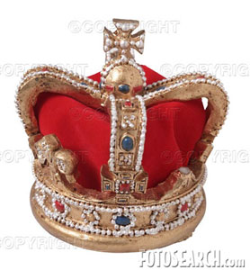
Age of Absolutism (1500’s – 1700’s)
Absolutism: Government where a monarch has “total” or “absolute” power. The ruler is actually “above the law.”
Ruled by a strong dynasty
Controls nobility (maintain their loyalty)
Efficient government
Generates revenue ($); efficient taxes, mercantilism
Large standing army
Keeps order

Slide 5
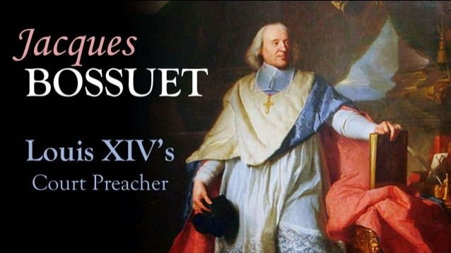
Divine Right Theory

Slide 6
Divine Right Theory

Slide 7
Age of Absolutism (1500’s – 1700’s)
Divine Right Theory: Theory which justified unlimited royal power of absolutism.
Stated that a hereditary monarch was an
“agent of God” (God’s representative) and thus ruled by “divine right” or the grace of God.
The monarch is responsible only to God.
All subjects must obey them.

Slide 9
Absolute Monarchy – Summary/Evaluation
Determine whether each statement is either a positive / benefit or a negative /weakness to a nation under an absolute monarch.
Provided a strong central government
The welfare of the nation depends upon the ability of only one person
Many good rulers are succeeded by poor ones which creates a weak/unstable government
Many absolute rulers put personal interests & selfish motives above what is in the best interests of the people & nation
United people together under them to form a nation
Many absolute monarchs involved their nations in frequent wars
Absolute rulers tend to disregard the “rights” of the people

Slide 10
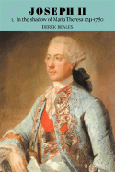
Enlightened Despots
Some monarchs acknowledge
criticisms of “abuse of power”
“Enlightened Despots” felt they had a responsibility to their people & used their power to improve the people’s lives.
(examples: reforms, religious toleration, living conditions)
Frederick the Great
Joseph II, Hapsburg ruler of Austria (1780-90)

Slide 11
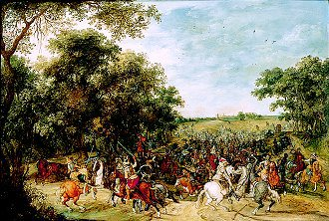
Age of Absolutism
Balance of Power: Maintaining an even distribution of international power & politics to preserve national security.
(No one gets too strong & threatens the others!)
DIPLOMACY & ALLIANCES

Slide 12
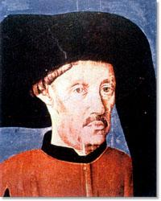
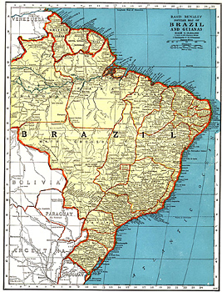
Portugal
1st in overseas exploration
Prince Henry the Navigator & school @ Sagres
Establish 1st all water route to the East
Dias, da Gama & Cabral
Decline by the end of the 1500’s:
- conquered by Spain in 1580
- small population
- colonial empire too big to manage
(put a drain on population & resources)

Slide 13
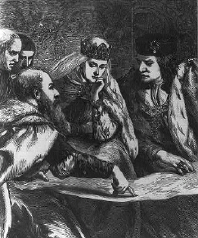
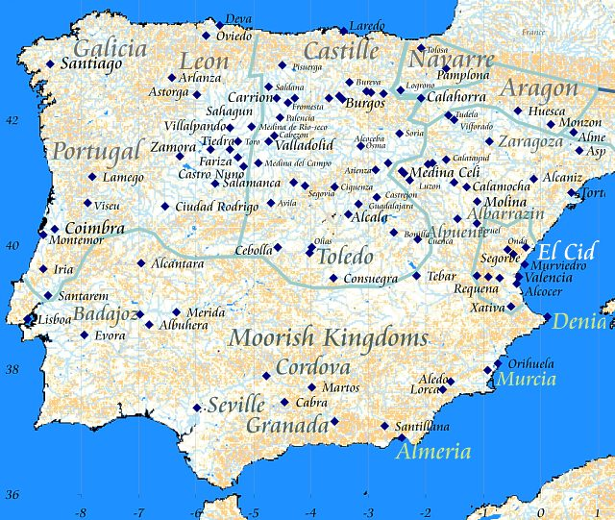
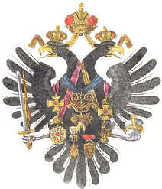
Spain & the Hapsburgs
(1469) marriage of Ferdinand & Isabella lead to the unification of Spain by 1492
Their daughter Joan, marries
into the Hapsburg family from
Austria (which also holds the
title of Holy Roman Empire)
Isabella & Ferdinand
consult with advisors.
The Austrian Hapsburg
royal emblem.

Slide 14
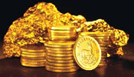
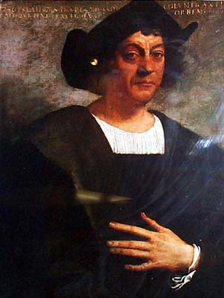
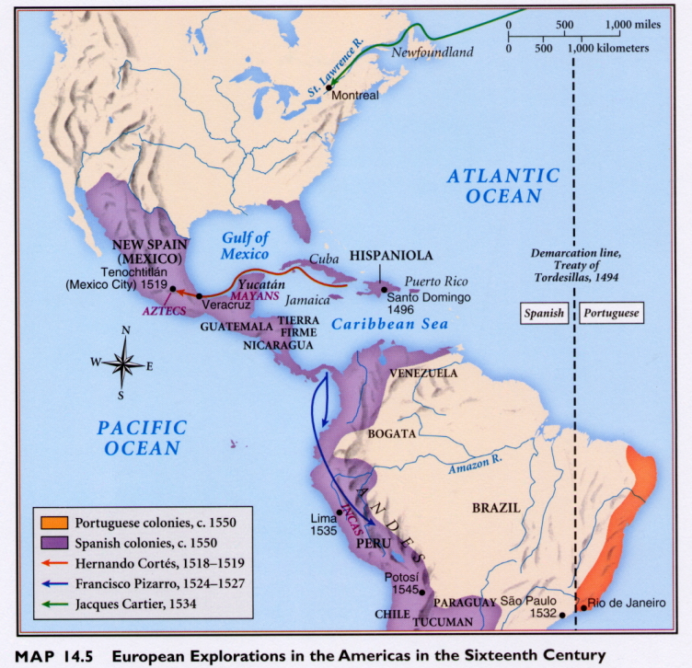
SPAIN
Funded Columbus’s voyages
which led to Spain’s colonial empire
in the Americas
WEALTH
BUT, the Inquisition persecuted non-Christians, leading to the expulsion of all Jews & Moors (Muslims) from Spain by 1500 (hurt the economy).

Slide 15
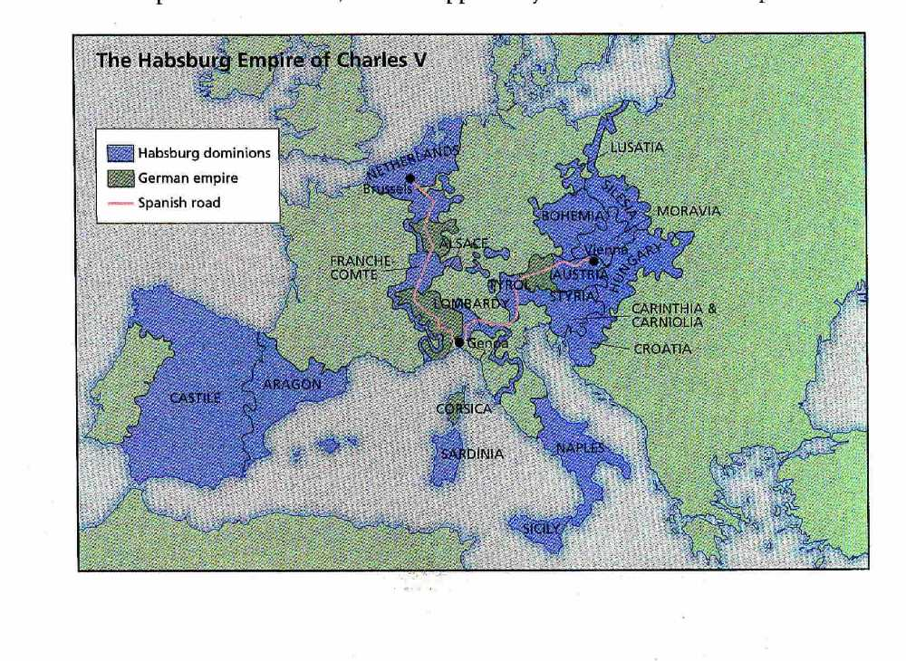
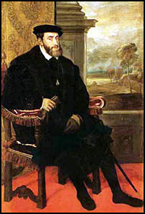
Spain & the Hapsburgs
Charles V (1516-1556)
Ruled a “super state”
(enormous power & wealth threatens the “balance of power”)

Slide 16
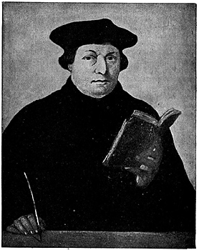
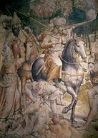
Charles V
Problems
Religion = Protestant Reformation & Luther in the Holy Roman Empire
Lands too vast
Religious & ethnic diversity
Economic = high costs of war
Image of Charles leading troops against the Ottoman Turks.

Slide 17
Hapsburg Empire in Europe

Slide 18
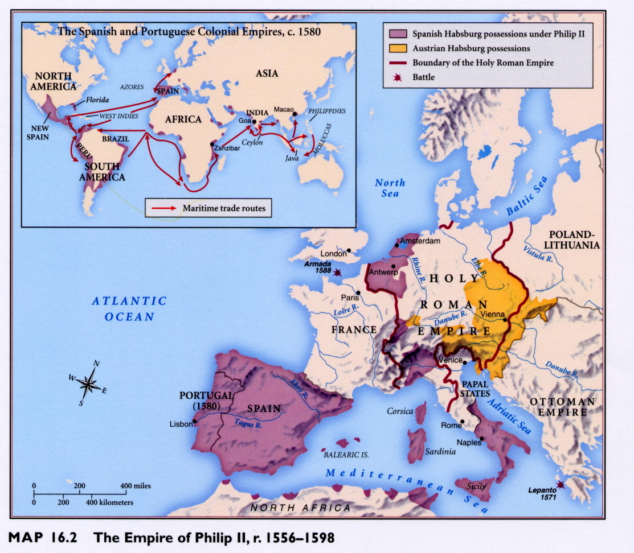
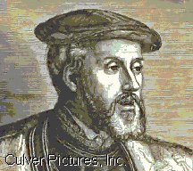
Hapsburg Division
1556 he abdicates & divides his lands:
Brother Ferdinand (Austria & the East = HRE)
Son Philip (Spain, S. Italy, Netherlands and the
New World)
Emperor Charles V
Division of the
Hapsburg Empire (1556)

Slide 19
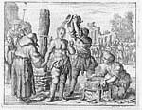
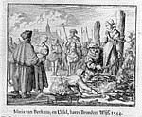
Philip II – King of Spain
Philip II (1556-1598)
defender of the Catholic Church; no tolerance for non-Catholic heretics in his lands = persecution. Increased power of the court of Holy Inquisition
Execution of “heretics.”
“I would rather rule a desert
Wasteland than a land full of
Heretics.” – Philip II

Slide 20
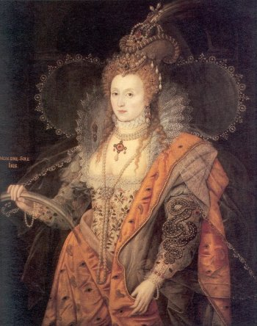
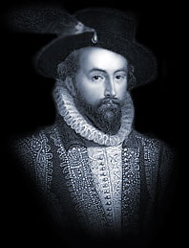
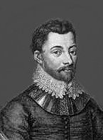
Philip II
Dutch revolt (1560s-1580s)
Spanish taxation & persecution
Protestant England & the “sea dogs”
(1588 defeat of the Invincible Spanish Armada)
Sea Dogs
Raleigh &
Drake
Defeat of the “Invincible”
Armada - 1588
Tudor Queen Elizabeth I

Slide 21
Philip II Hapsburg Empire

Slide 22
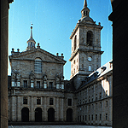
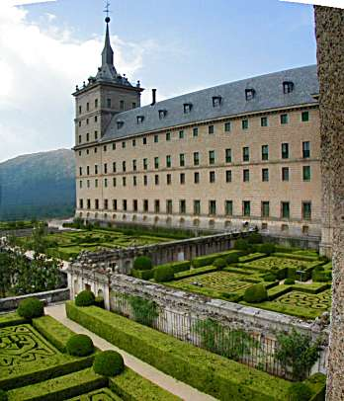
The Escorial Palace

Slide 23
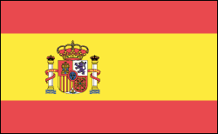
Spain’s decline by the 1600’s
DUE TO:
Expense of costly wars
High inflation & unfavorable balance of trade
Decrease of gold & silver from colonies
Weak rulers

Slide 24
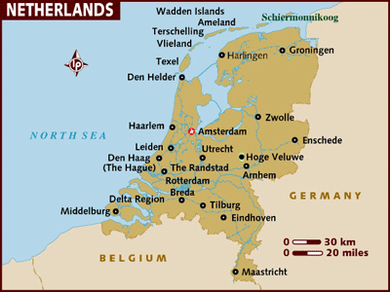
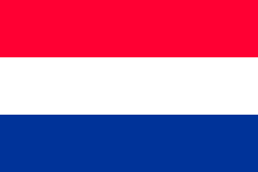
The Dutch
live in the Netherlands
(no absolutism, Calvinist but practice
religious toleration)
Merchants & leading bankers by 1600
Ruled by the Hapsburgs

Slide 25
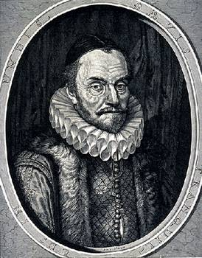
The Dutch
Harsh treatment by Philip II (Inquisition!) & excessive taxation results in revolt…
(1560’s-80’s) – led by William the Silent which was eventually successful
William “the Silent,”
leader of the Dutch revolt

Slide 27
Dutch Trade

Slide 28
Groups of 4
Identify/Explain how each of the following contributed to the power of the French monarchy (kings) as well as to the strength of the French nation.
Henry IV
Cardinal Richelieu
Jean Baptiste Colbert
Louis XIV
USE CHP. 21– SECTION 2 (pages 596-602)

Slide 29
Bourbon Dynasty in France
USE CHP. 21– SECTION 2 (pages 596-602) to answer the following questions:
How did Henry of Navarre end crisis & restore order in France?
How did Cardinal Richelieu strengthen the French monarchy?
How did he strengthen France? (also see pg. 604)
Why was Louis XIV called the “Sun King” & known as the “symbol of absolutism?”
How did Colbert turn France into an economic power?
What was Versailles & what role did it play in Louis XIV’s France?
Was Louis’ foreign policy a success or falure? Explain

Slide 30
How did HENRY OF NAVARRE end crisis & restore order in FRANCE?
How did CARDINAL RICHELIEU strengthen the monarch and FRANCE?
How did LOUIS XIV help / benefit FRANCE?
BOURBON DYNASTY IN FRANCE
How did LOUIS XIV abuse his power and fail FRANCE?

Slide 31
Questions
Why was Peter “Great?” . . . Why not??
Louis XIV is called the “symbol of absolutism.” What did he do that made him a “positive” symbol? A “negative” symbol?

Slide 32
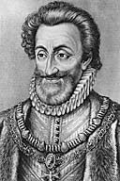
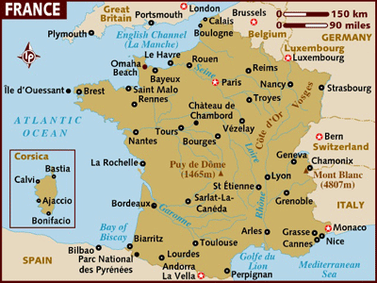
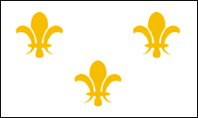
France = Bourbon Dynasty
Religious civil wars between
Catholics & Huguenots end in 1589
Henry IV (1589-1610)
Starts Bourbon dynasty
Flag of the
Bourbon
monarchy

Slide 33
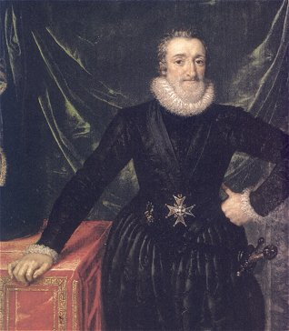
Henry IV (1589-1610)
Huguenot who converts to Catholicism
(“Paris is worth a Mass”)
Issues the Edict of Nantes (1598)
(religious toleration for Huguenots)
Duke of Sully & improvement
of the country’s industry, trade
& finances
Despite being truly interested
in the welfare of the French
People Henry is assassinated
(1610)

Slide 34
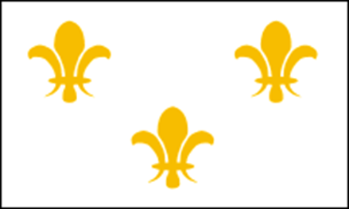
Henry IV (1589-1610)
Religious civil wars between Catholics & Huguenots in FRANCE end by 1589
Henry IV : Starts Bourbon dynasty
Huguenot who converts to Catholicism
(“Paris is worth a Mass”)
Issues the Edict of Nantes (1598)
(religious toleration for Huguenots)
Flag of the
Bourbon
monarchy

Slide 35
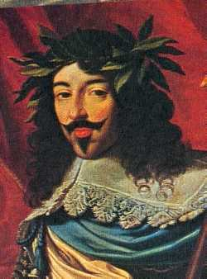
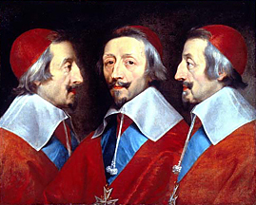
France = Bourbon Dynasty
Louis XIII (1610-1643)
Only 8 years old when
he inherits the throne
Chief minister Cardinal Richelieu
(1624-1642)
(shrewd politician who
really rules France but,
unpopular w/the people;
whom he called, “mules”)
3 Musketeers villain!

Slide 36
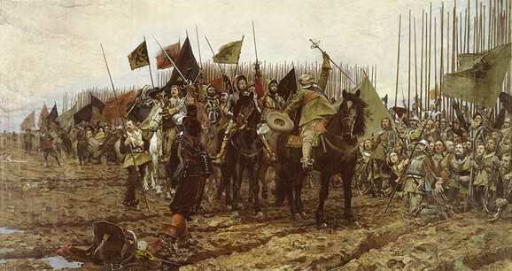
Cardinal Richelieu
2 goals:
Strengthen power of the king in
France vs. Huguenots & nobles;
(intendants)
Make France supreme in Europe
vs. Hapsburgs = 30 Years War
Peace of Westphalia
(1648)
30 Years War started as a religious
Struggle but became a political war
involving most European countries

Slide 37
Peace of Westphalia (1648)

Slide 38
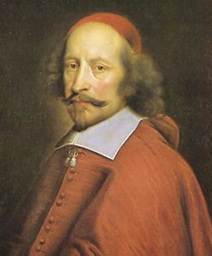
Louis XIV (1643-1715)
Son Louis, 4 years old when Louis XIII dies
Cardinal Mazarin & the “Fronde”
Symbol of absolutism; “Sun King”
“I am the state”
Cardianal Jules
Mazarin
The “Sun King,”
Louis XIV

Slide 39
Louis XIV (1643-1715)
made France a colonial empire under his finance minister – Jean Baptiste Colbert
Louis ended religious toleration
when he revoked the Edict of Nantes
Colbert who used ideas of
mercantilism
to expand France’s
wealth & power.

Slide 40
Wars of Louis XIV
Foreign policy = expand to France’s
“natural boundaries” and …spent 30 of his 54 year reign at war ($)
(high taxes & abuse of power = discontent)

Slide 41
Wars of Louis XIV

Slide 42
Versailles Palace
32 years to construct; cost over $100 million
Outside of Paris
Center of art & culture; envy of other monarchs
Symbol of extravagance & power
Aerial view of
Versailles
Palace,
the home to
Bourbon Kings starting
with Louis XIV

Slide 43
Versailles Palace

Slide 44
Versailles Palace

Slide 45
Bourbon Monarchy
The power, economy, culture & prestige of France reached its heights under Louis XIV, but the constant warfare, extravagance and disregard for the common good that continued after him would lead to revolution & the end of the Bourbon monarchy.

Slide 46
Russia
What were czars? Who was the 1st one?
Who were boyars? What was their relationship w/the 1st czar?
What family dynasty controlled Russia for 300 years?
How was Peter the Great going to accomplish his goal of making Russia stronger to compete with Europe?
What types of reforms/changes did Peter make?
How did he improve Russia’s military?
What were “windows on Europe?” How would they help Peter accomplish his goal?
Who did he defeat to gain his “window?”
What did he build there?
What class of people didn’t benefit much from Peter?

Slide 47
Russia
Russia under Mongol control (1200’s-1400’s)
(1533) Ivan the Terrible becomes 1st official “czar”
“emperor”

Slide 48
Russia & the Romanovs
Michael Romanov becomes czar & begins the 300 year reign of the
Romanov Dynasty: (1613-1917)
Peter the Great
czar of Russia (1682-1725)
towering figure (@6’-7’’)
Romanov family crest

Slide 49
Peter the Great (1682-1725)
Wants to modernize / westernize Russia
must acquire warm water ports =
“windows to the West”
(to increase trade & cultural diffusion)
(1690’s): Peter travelled in disguise throughout the West to see & learn (gov’t, trade, economy, shipbuilding, military, culture & customs)

Slide 50
Reforms of Peter the Great
When he returned. Implemented new ideas & hired Western advisors/experts
Introduced potatoes to increase food supply
Started 1st newspaper in Russia
Increased status of women
Advanced arts & education by creating new schools
Opened a school of navigation
All nobles must serve the state (military, gov’t), but must earn rank & position through merit

Slide 51
Czar Peter the Great
Introduced Western style customs & dress & demanded their acceptance or tax:
No beards, no robes, etc

Slide 52
Peter the Great (1682-1725)
BUT. . .
He increased taxes
Forced conscription in military
Maintained serfdom for labor
State control of the Orthodox Church
Spent over 30 of his 36 year reign at war

Slide 53
Peter’s Foreign Policy
To obtain warm water ports, he resorted to war:
The Great Northern War (1699-1721)
vs. Sweden (Charles XII)
Gained control of the Baltic coast
Russia became dominant power in N. Europe
Builds Russia’s 1st navy

Slide 54
Peter’s Expansion
Russian Empire reached greatest size to that time under Peter

Slide 55
St. Petersburg
built new modern capital of St. Petersburg along the Baltic Sea . . . his “window”
Image of Peter supervising
Construction of
St. Petersburg
A palace of the Peterhof estate,
constructed
by Peter the Great

Slide 56
Catherine the Great
German princess who was
czarina of Russia (1762-1796)
(married Peter III)
Captured the Crimea
from the Turks and now Russia
had a port on the Black Sea (2nd “window”)
Took part in the partition of Poland
She won support of the nobles by exempting them from taxes and abandoned the peasant serfs

Slide 57
Austria & Maria Theresa
After the 30 Years War, Hapsburg power was concentrated in the East
(lost Spain to Bourbon by 1713)
Hapsburg ruler of Austria (1740-1780)
Pragmatic Sanction & war with
Frederick the Great of Prussia
(War of Austrian Succession)
Hapsburg ruler of Austria
Empress Maria Theresa

Slide 59
Prussia
Prussia = a German state that was part of HRE
The Hohenzollern Family ruled scattered lands that were recognized as the kingdom of Prussia by 1713

Slide 60
Prussia
Known for its efficient & powerful army
Military strength
was necessary
to protect such
scattered lands.

Slide 61
Frederick the Great
Hohenzollern ruler of Prussia
(1740-1786)
Very intelligent, well educated &
a brilliant military commander
but too many wars.
Warred with
Maria Theresa
& Austria over
Silesia
Held off 4 armies
during the 7 Years War
(1756-63)

Slide 63
Frederick the Great
Positive domestic & social policies:
(religious toleration, improved education
and legal system, developed the economy, actually left the treasury filled by his death!)
Interested in culture & learning
(A musician & philosopher himself!)
Frederick met with the philosopher/scholar
Voltaire
He felt an obligation to use
his power to improve his
people’s lives

Slide 64
Frederick’s Palace of Sans Souci
Frederick called himself:
“The First Servant
of the State.”

Slide 65
Poland
large & powerful nation during the 14-1500’s
By 1600’s nobles challenge king’s power which resulted in a weak central government
By 1700’s, a weakened Poland was surrounded by powerful neighbors & no natural boundaries
Russia, Prussia & Austria
partitioned it 3 times during
the 1700’s until it was gone
by 1795

Slide 66
Poland Disappears
General Kosciuszko who aided colonials of American Revolution, staged an
unsuccessful revolt vs.
foreign occupiers in (1794)

Slide 69
Bourbon Hapsburg Hohenzollern Tudor
Romanov warm water ports northwest passage
Charles V Philip II Henry IV Richelieu
Louis XIV Peter the Great Huguenots Versailles
Frederick the Great Escorial divine right Dutch
Ivan the Terrible Elizabeth I mandate of heaven

Slide 70
EXTRA CREDIT!
1. What was the name of the brother of Charles V, who became HRE after Charles abdicated?
2. The book, The Three Musketeers, portrayed Cardinal Richelieu as a villain. Who was the author?
What was the name of the Austrian Queen whom Frederick the Great refused to recognize leading to the War of Austrian Succession?
Who was the Swedish king defeated during the Great Northern War?
Where is the Kosciuszko Bridge? (Specific city!)
Who lived in Whitehall?

