Slide 1
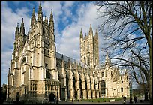
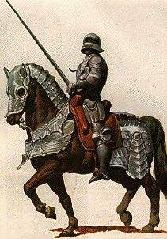
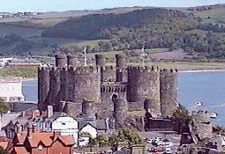
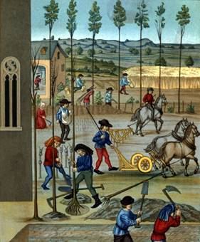
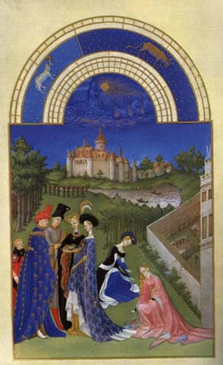
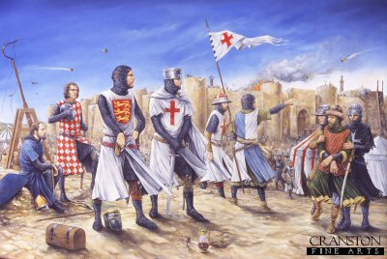
The Middle Ages

Slide 2
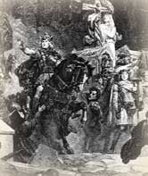
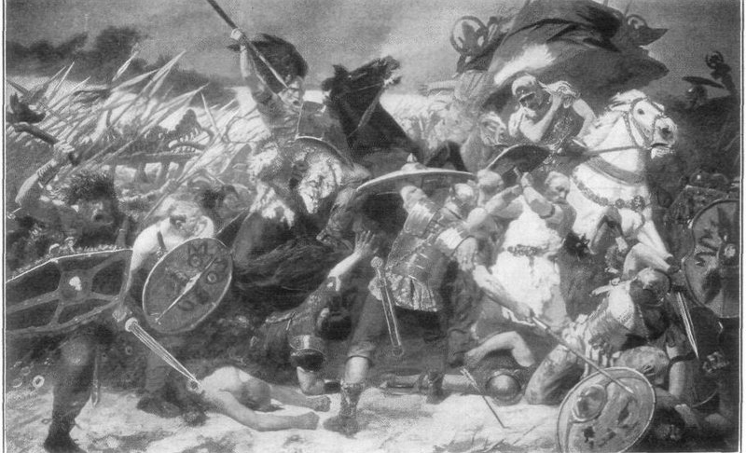
MEDIEVAL TIME in Europe (aka: the Middle Ages=@500-1500AD)
“Dark Ages” = anarchy of the earliest years; Characterized by decay of
Roman civilization & barbarian invasions:
(Goths, Vandals, Saxons, Franks)

Slide 3
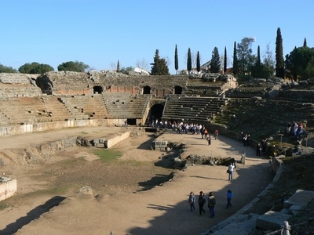
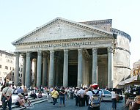
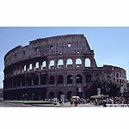
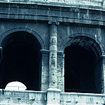
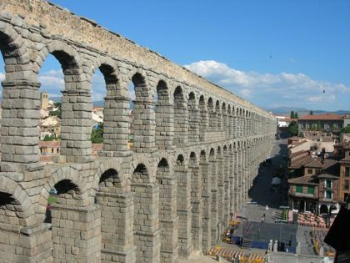
1. Ancient Rome’s Legacy to Western Civilization: Did Rome really ever “fall?”
Latin , alphabet & “Romance” languages
Gov’t & Law: “republic”, concepts of “innocent until proven guilty” & universal application of laws to all citizens
Engineering: arch, dome, concrete, roads

Slide 4
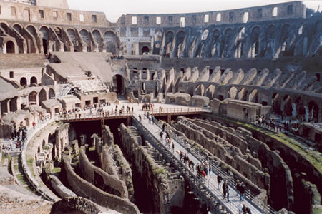
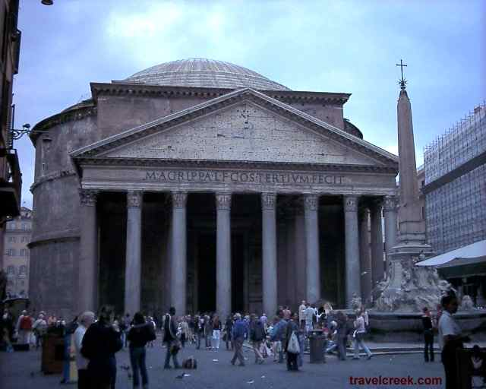
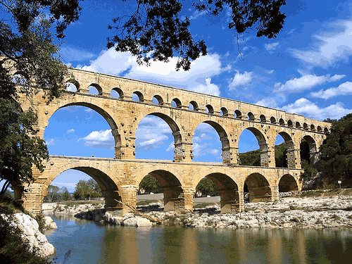
Engineering

Slide 5
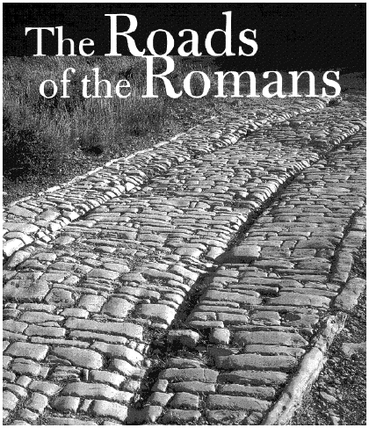
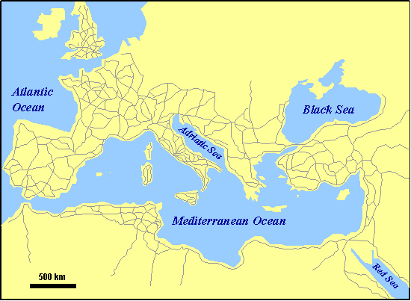
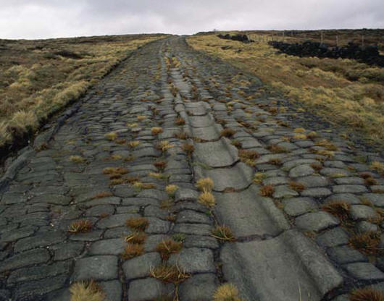
Roads & Road building
The ROMANS built an extensive network of roads which helped expand communication, transportation, trade, government effectiveness and military control.
“All roads lead to Rome.”

Slide 6
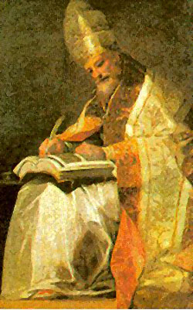
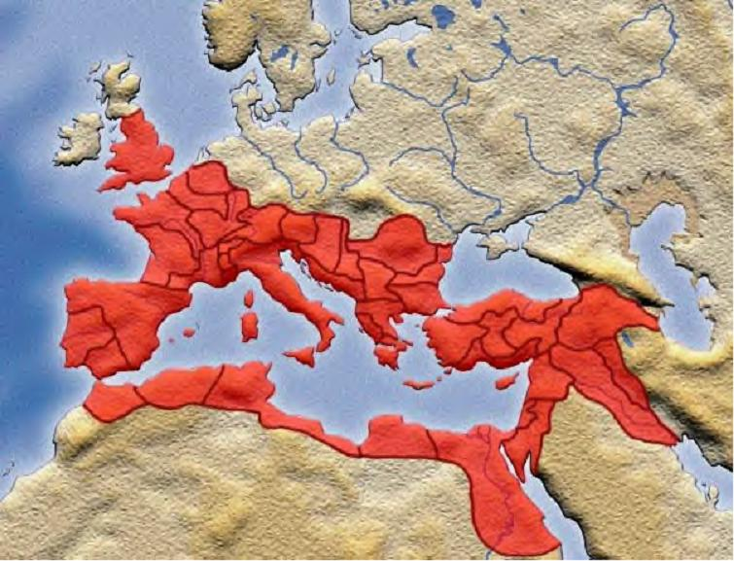
Ancient Rome’s Legacy to Western Civilization
4. Christianity & organization of the Catholic Church
Concept of “a universal empire”
to govern all

Slide 7
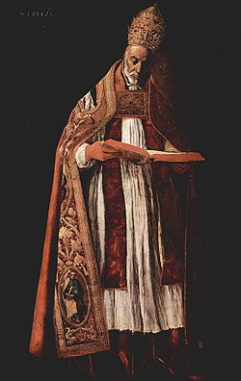
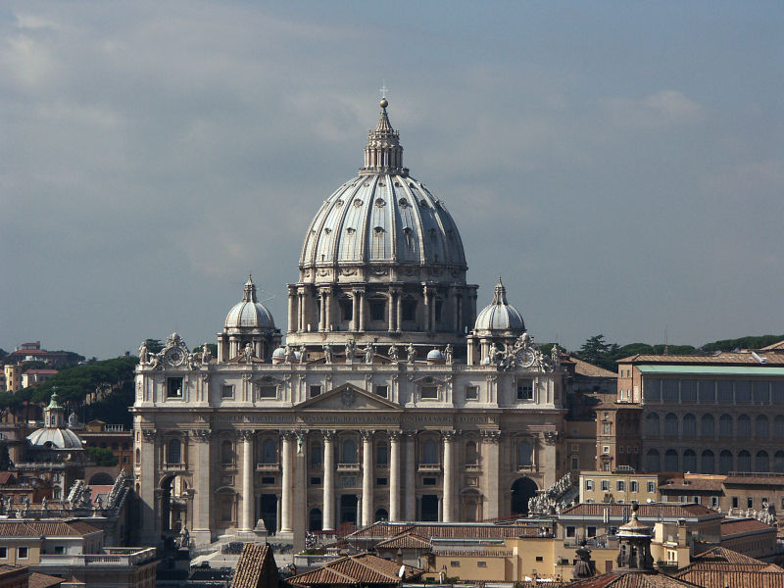
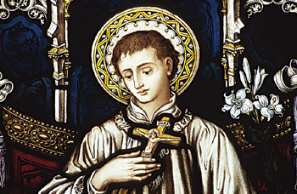
2. Catholic Church in the Middle Ages
Most powerful & influential institution
during the Middle Ages
Offered leadership & guidance during the anarchy of post-Rome Europe
Bishop of Rome = the Pope extended power to include
both spiritual and secular (worldly) authority.
St. Peter’s Basilica

Slide 8
The Roman Empire at its Height

Slide 9
The Spread of Christianity

Slide 10
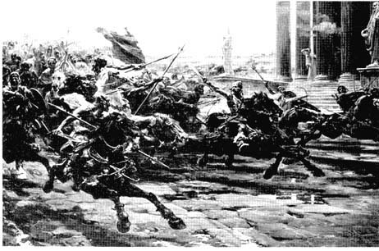
MEDIEVAL TIME in Europe
3. Germanic Influence
Germanic invaders overrun & destroy declining western Roman Empire
Constant fighting & anarchy = decentralized gov’t, decline in trade, cities disappear, decline in education & learning, fragmentation of language.

Slide 11
Barbarian Invasions

Slide 12
Germanic Kingdoms

Slide 13
German Culture & Influence
Germanic warriors pledge loyalty to their chief, not some
unseen king = period of local power & authority
Many of these chiefs & their warriors convert to
Christianity (mutual benefit: Church gets protection & expansion…chief/king gets recognition from the Pope)
The FRANKS establish the dominant kingdom
of Europe in what was called Gaul (France)
Clovis – 1st king of the Franks (France)
(481-511AD); Becomes a Christian by 500’s AD

Slide 14
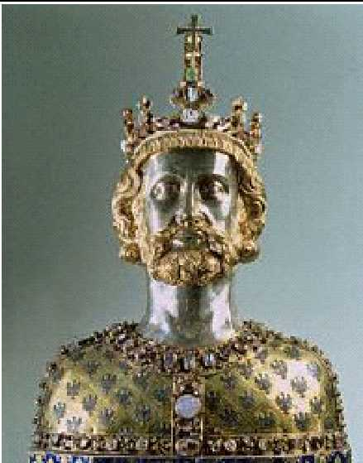
Charlemagne: 742 to 814

Slide 15
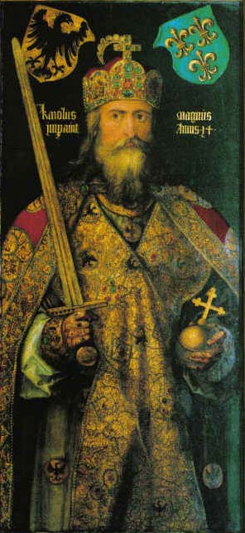
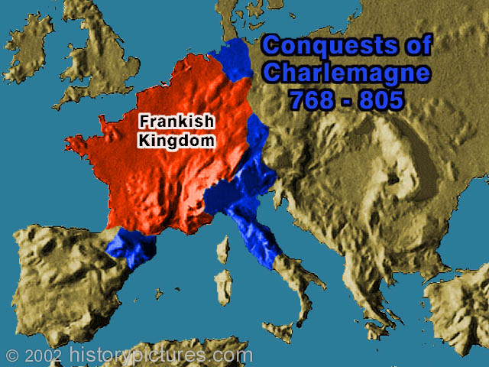
MEDIEVAL TIME in Europe
Charlemagne (Christian Empire of the Franks)
Many military victories
Crowned “emperor” by Pope (800AD)
Restored order & unity with his empire
Spread Christianity
Sponsored learning

Slide 16
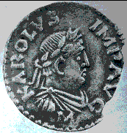
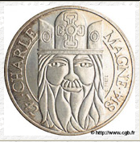
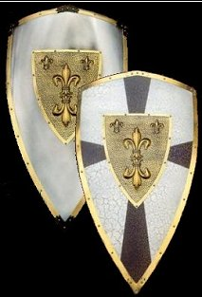
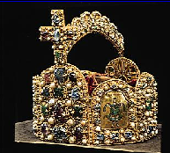
The Carolingian Renaissance

Slide 17
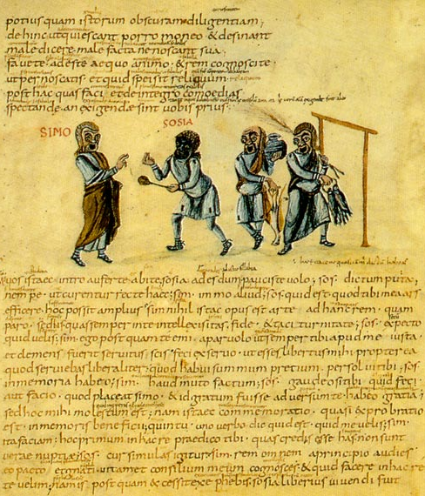
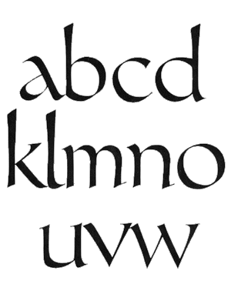
Carolingian Miniscule

Slide 18
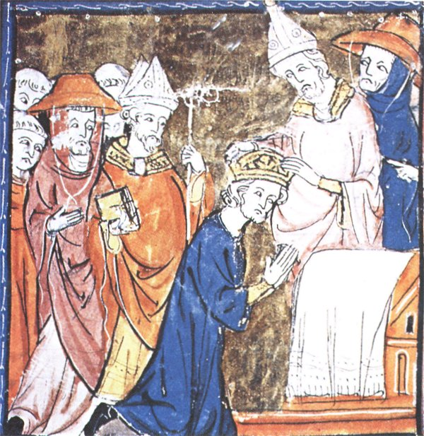
Pope Crowned Charlemagne Holy Roman Emperor: Dec. 25, 800

Slide 19
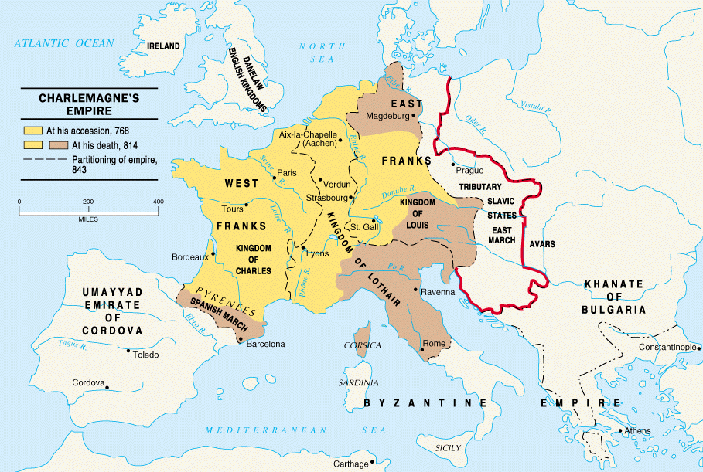
Charlemagne’s Empire

Slide 20
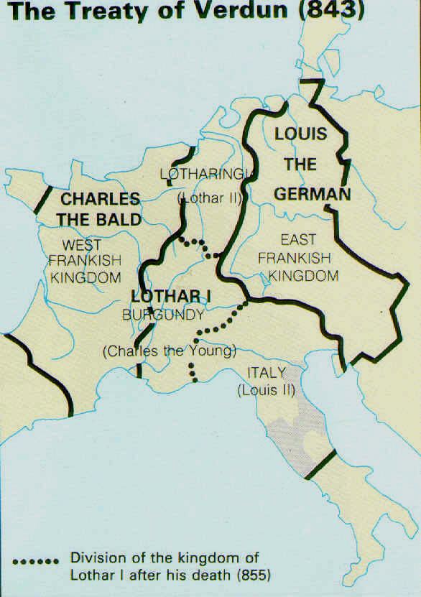
Charlemagne’s Empire Collapses: Treaty of Verdun, 843

Slide 21
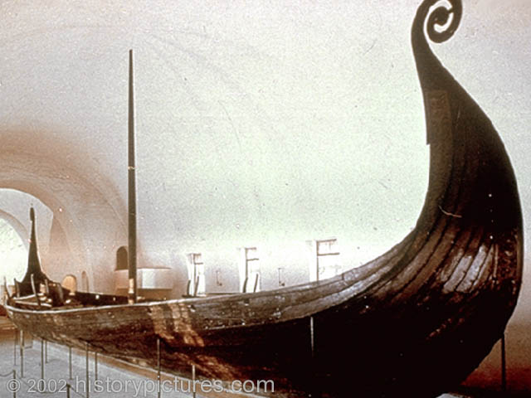
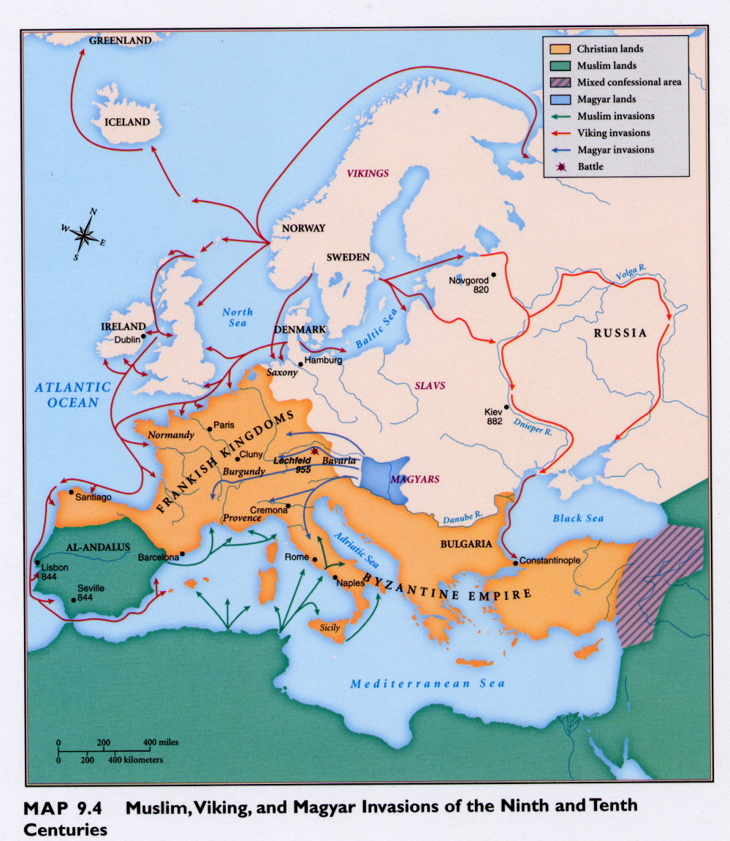
Failed Attempt at Empire
New invasions (Vikings, Muslims)
Empire collapses & return to anarchy
With no strong
central government,
how will Europe
attempt
to restore order &
get protection??

Slide 22
Read source – “Read to Learn”
Answer the following questions in your notebook:
1) What was feudalism?
Political basis of the Middle Ages
2) Why did it develop in medieval Europe?
Weak central govt’s & traditional Germanic customs
3) What were the 3 groups in feudal society of the Middle Ages?
clergy, nobles, peasants
4) What was power in the Middle Ages based upon?
land
5) Who was Charles Martel & what impact did he have?
gave land/fiefs to his most loyal warriors
6) What important roles did nobles play ?
(military service to the weak kings; law, order & protection for peasants)

Slide 23
Read source – “Read to Learn”
What was a lord?... A vassal?
Both nobles who give & receive land
What was homage? What was a fief?
Pledge of loyalty ; land grant
In the feudal relationship, what duties / obligations did a lord have? A vassal?
Check primary source!

Slide 24
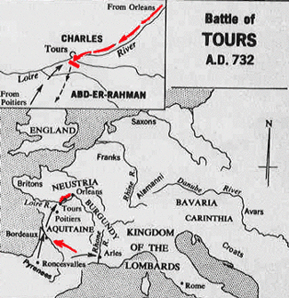
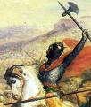
MEDIEVAL TIME in Europe
Charles Martel
Frank warlord who halted the Muslim advance into Europe at the Battle of Tours (732).
Charles “the Hammer”
leads the Franks to
victory at Tours.

Slide 25
Organizing in a Decentralized Society
Local nobles take over administration from weak central government
Nominal allegiances, especially to Carolingian kings
But increasing independence

Slide 26
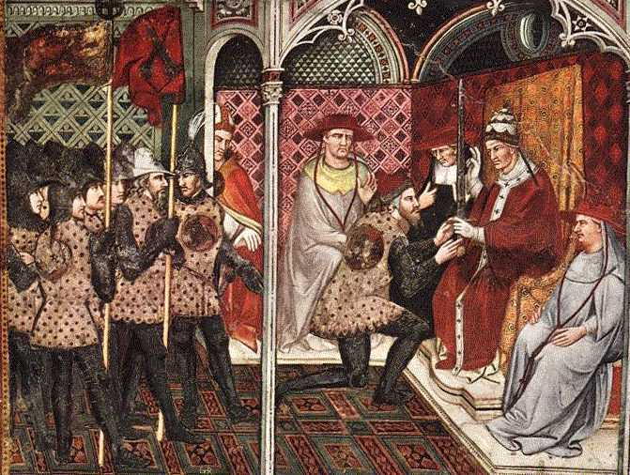
Middle Ages & Feudalism
3. feudalism = results from custom &
weak kings (Political basis of Middle Ages)
TERMS:
Lord
Vassal
Fief
Fealty & homage
Subinfeudation
A French vassal receiving a feudal grant from the king

Slide 27
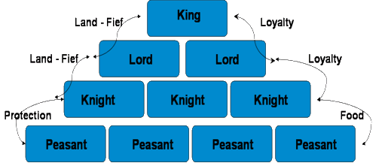
Feudalism
A political, economic, and social system based on loyalty and military service.

Slide 28
Lords and Retainers
Noble lords form small private armies
Incentives: land grants = wealth & power
Formation of hereditary class of military retainers
Development of other functions
Protection, justice, social welfare for commoners (peasants)

Slide 29
Pillars of Medieval Life Activity
Your group will use sources to create THREE visuals / graphic organizers to represent the pivotal role played by each of the following on life in the Middle Ages.
The feudal system
The manor (economics, class structure & everyday life)
The Roman Catholic Church
Each visual/organizer should contain words, symbols and or images that represent the role and impact each of these three institutions played on life & society in Western Europe during this period.
Be prepared to present & explain your visuals.

Slide 30
DUKE BEAVER (lord)
Count Conrad
(Vassal)
Earl Geoffrey
(Vassal)
Sir Tancred
(Vassal)
Entertain lord & his entourage for a week in July
Provide $ to help ransom my son
Attend wedding of princess Victoria w/ a gift
Provide knights
Provide $ for a bridge project
Attend wedding of princess Victoria w/ a gift
Provide infantry
Serve on lord’s court
Attend wedding of princess Victoria w/ a gift

Slide 31
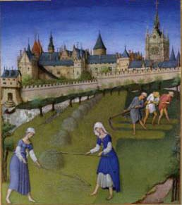
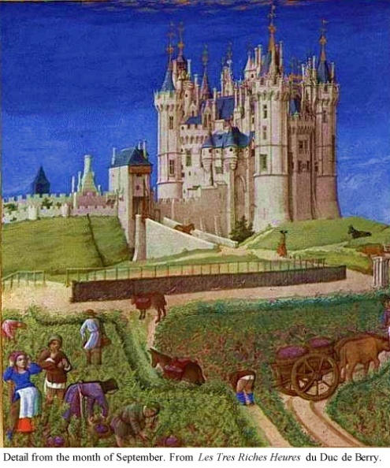
DO NOW - Medieval Life
Read source and create two lists.
One list of words and/or statements that describe peasants & peasant life
One list that describes nobles & noble life.

Slide 32
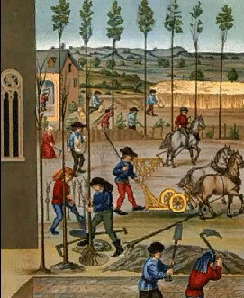
Medieval Life
Life in the Middle Ages revolved around
the manor = a self-sufficient estate.
(Lord’s Domain & commons)
Manorial System = Economic basis of the Middle Ages
Peasant Life = harsh & short (under 40)
Serfs or freemen
Worked long hard hours
Poor diet & shelter
Little to no education

Slide 33
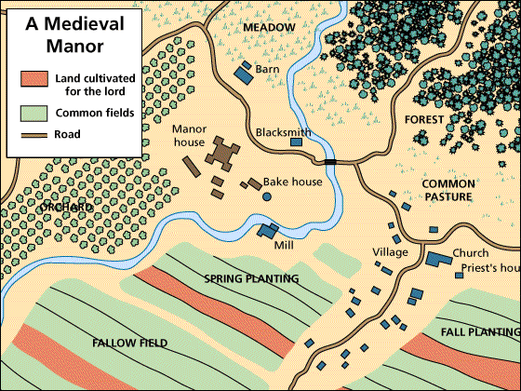
The Medieval Manor

Slide 34
Peasants’ Rights and Obligations on the Manor
Obligation to provide labor, payments in kind to lord
Serfs unable to move from land
Worked in return for:
place to live
Access to resources
Defense/protection
Justice

Slide 35
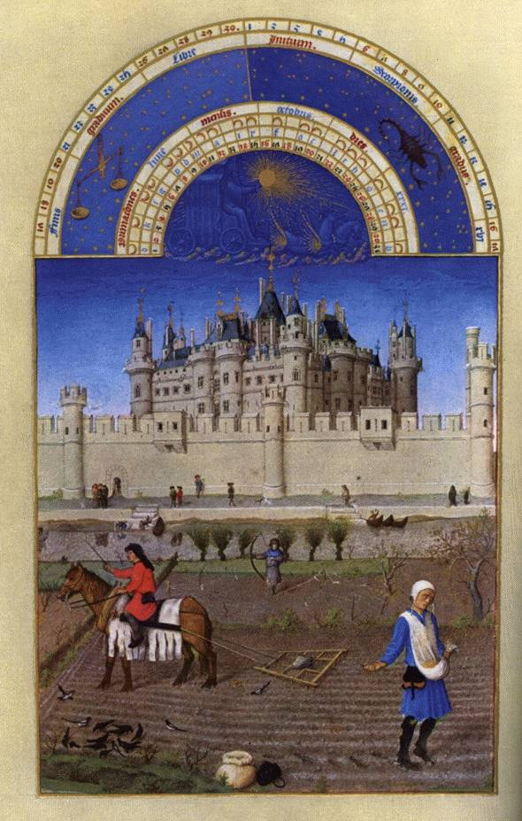
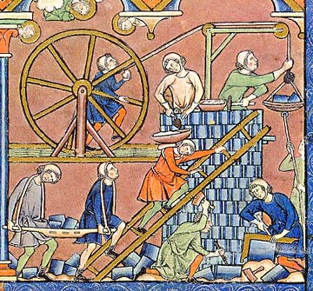
Life on the Medieval Manor
Serfs at work

Slide 36
The Nobility
Privileged, land owning class.
Governed (feudal justice), fought & partied!
Monarch
Nobles
Lesser Nobles & Knights
Peasants
The hierarchy of Medieval
society.
NOBLES
“COMMONERS”
- Freemen
- Serfs

Slide 37
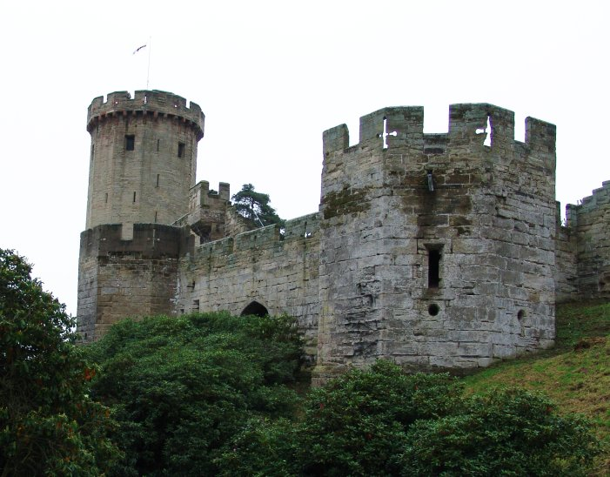
Castles
Lived in manor houses = castles from which they managed their lands & administered justice. (power)
Built for defense not comfort.
Stone w/ few windows = damp, dark & smokey.
The keep = strongest part

Slide 38
Medieval Castle

Slide 40
Knights & Chivalry
Knights = warriors on horseback
Chivalry – from the French “chevalier” meaning “horseman”; was a code of conduct that developed by the 1100’s which combined Christian values with the virtue of being a noble warrior.

Slide 41
Knights & Chivalry
Training as a page & squire (“sword bearer”)
Armor, “coat of arms” & tournaments

Slide 42
Self Assessment
Assessment: Identify the important role played by each of the following during the feudal period of the Middle Ages:
peasant serfs
noble lords
knights
women

