Slide 1
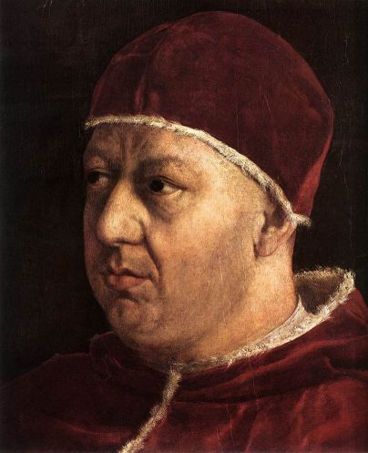
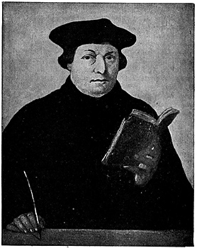
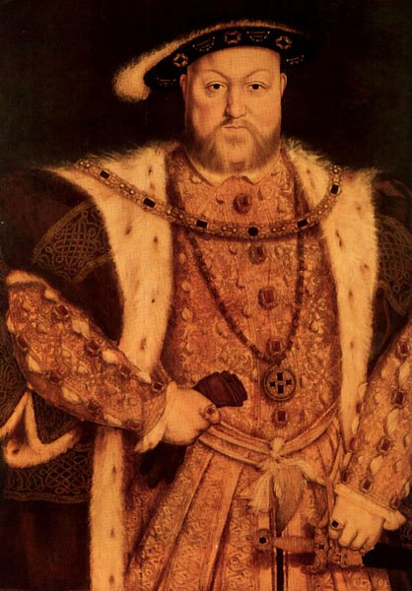
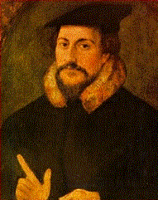
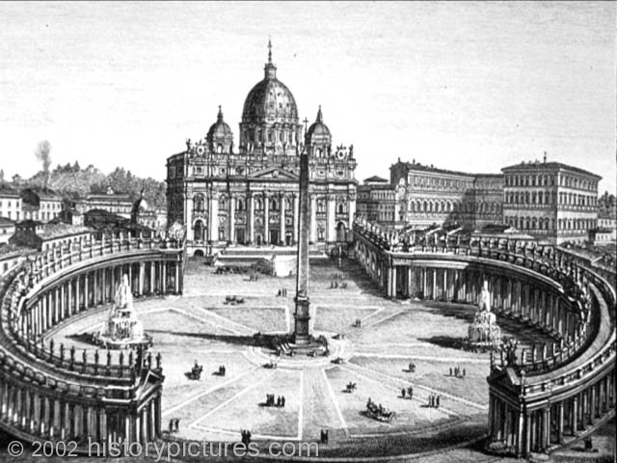
The Protestant Reformation

Slide 2
The Protestant Reformation
By the 14th-15th centuries, the Catholic Church was experiencing a decline of power & prestige.
Identify/explain the problems, criticisms & critics of the Medieval Catholic Church
(A : 398-99; 488-89)

Slide 3
Protestant Reformation
Problems
Church & papal power challenged by powerful kings & nobles
Criticism by merchants (usury, price & taxes)
New learning & ideas (humanism)
(differed/disagreed w/Church positions)
4. Embarrassment/humiliation
Babylonian Captivity (1305-1378)
(papacy held “captive” in Avignon, France)
Great Schism (1378-1418)
(more than one pope…who is legit??)

Slide 4
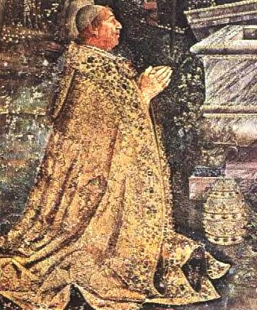
Protestant Reformation
Criticisms
Worldly Lives ($, luxury & power)
Too much Papal political power
Simony: buying & selling Church positions
(all = corruption)
Church has lost sight of its
spiritual mission as proclaimed
by Christ
Doctrines & ceremonies
too complicated
Pope Alexander VI
of the Borgia family

Slide 5
Protestant Reformation
Problems & Criticisms of the Church
Pope’s power challenged by powerful kings
Criticism by merchants (usury, prices & tax)
New Ideas questioning Church
Too much greed, wealth & power (corrupt)
Ceremonies & doctrines too complicated
Church Embarrassments
Church has lost sight of its spiritual mission as proclaimed by Christ.

Slide 6
The Great Schism (1378-1417)

Slide 7
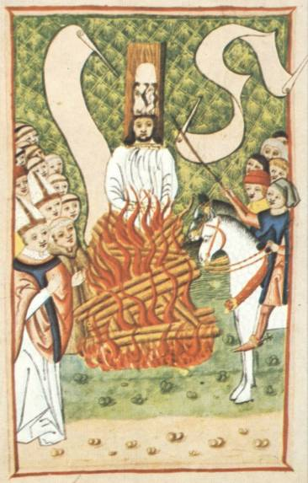
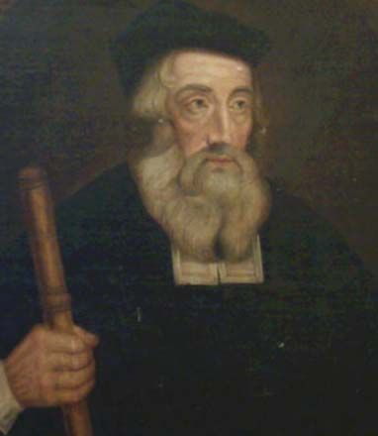
Protestant Reformation
Critics:
John Wycliffe (England) &
John Huss (Bohemia)
Both were critical of the clergy, power & authority of the pope & emphasized reading the Bible
John Wycliffe
leader of the
Lollards
(late 1300’s)
John Huss was
condemned as
a heretic &
burned at the
stake in 1415.

Slide 8
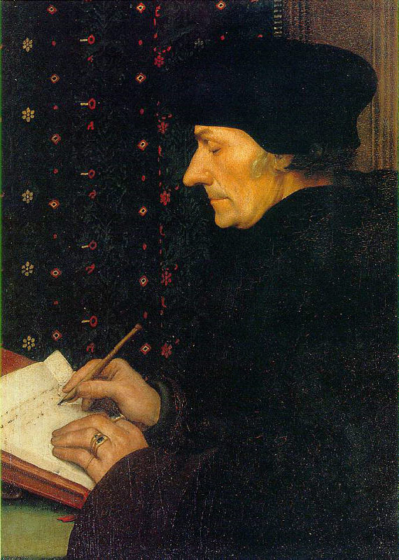
Protestant Reformation
Critics
Northern Humanists study the early Church
“Christian Humanists”
Believe Church lost sight of its spiritual mission
Too complicated & ceremonial
Too much wealth, power & corruption
Call for REFORM!
Desiderus Erasmus:
“Greatest Northern Humanist”
Wrote In Praise of Folly (1511)
A satire on abuses of the Church

Slide 9
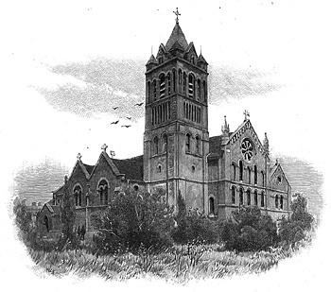
Protestant Reformation
When the Church refused the call for reform, these “reformers” broke away in “protest” & formed their own churches.

Slide 10
Analyze this quote:
“Erasmus laid the egg that Luther hatched”

Slide 11
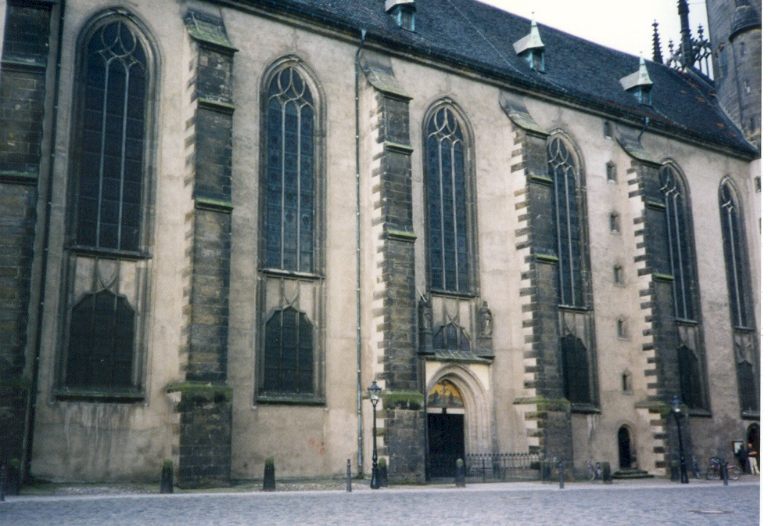
Martin Luther (1483-1546)
(1) Priest & professor at
Wittenberg University
Martin Luther
Wittenberg Church

Slide 12
Mansfield, Saxony
in Germany

Slide 13
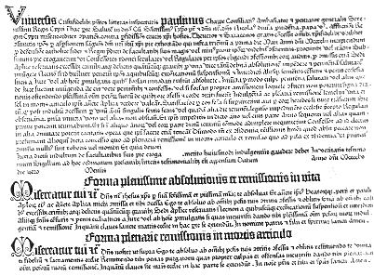
Martin Luther (1483-1546)
(2) indulgences: were pardons which reduced punishment for sins in exchange for a donation.
A copy of a 15th century
indulgence

Slide 14
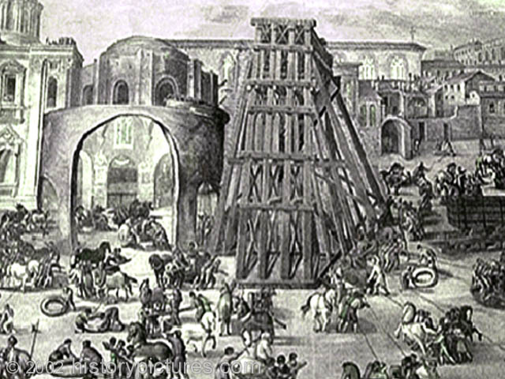
Martin Luther (1483-1546)
Leo X was the pope who wanted to raise $ for construction on St. Peter’s Cathedral in Rome.
Pope Leo X
St. Peter’s
during and
after construction.

Slide 15
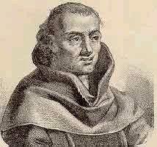
Martin Luther (1483-1546)
Johann Tetzel was the Dominican monk sent to sell indulgences in Germany.
The enthusiastic and ambitious Tetzel made outrageous promises claiming that buying indulgences was like buying a “ticket” to heaven.
Johann Tetzel and one of the indulgences
he sold in Germany.

Slide 16
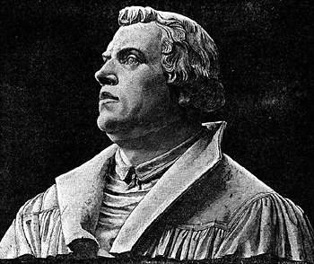
Martin Luther (1483-1546)
Luther believed selling indulgences was a crime of deception, proving Church corruption
(3) Luther believed faith alone gets you to heaven.

Slide 17
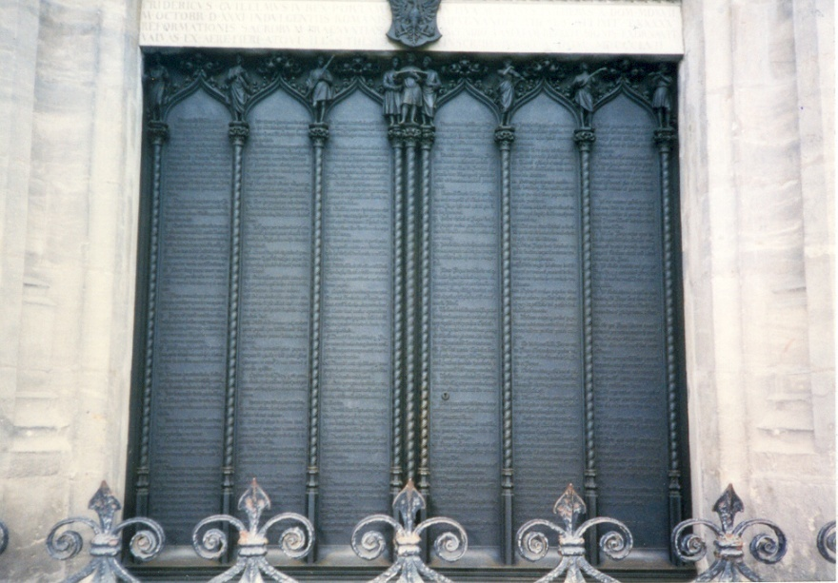
Martin Luther (1483-1546)
(4) He allegedly posted the 95 theses on the door of the Wittenberg Church (1517)
it was customary for people to post in writing issues they wished to submit for discussion within their community.
A Reproduction of Luther’s 95 Theses covering the doors of the church in Wittenberg.

Slide 18
Martin Luther (1483-1546)
Luther did not see himself as a revolutionary. He wanted a debate on this controversy to seek reform.

Slide 19
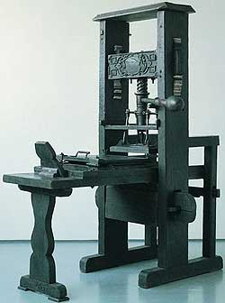
Martin Luther (1483-1546)
(5) Luther’s ideas & criticisms were spread with the aid of the printing press

Slide 20
Martin Luther (1483-1546)
(6) Pope Leo orders Luther to recant. He refuses.
(1520) Pope Leo issues a papal bull condemning Luther a heretic & excommunicating him.
Luther burns it!

Slide 21
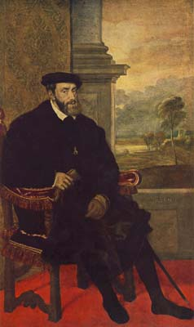
Martin Luther
Emperor Charles V tries Luther at the
Diet of Worms & declares him an outlaw.
Holy Roman Emperor
Charles V of the Hapsburg
Family – ruler of Germany.
Luther’s response
to Charles V
inquiry at Worms.
I cannot and I will not retract anything, since it is neither safe nor right to go against conscience. I cannot do otherwise, here I stand, may God help me. Amen.”

Slide 22
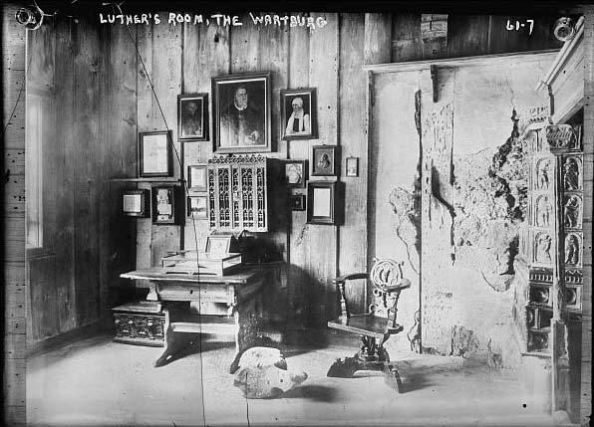
Martin Luther
(7) Luther (an outlaw) was protected by some German princes and kept at Wartburg Castle.
Some supported him for sincere reasons of faith.
Some saw him as a way to challenge the pope’s power in Germany.
Some hoped to take
Church lands/wealth in
Germany.
Some saw him as a way
to challenge the power
of Charles (the HRE).
Luther’s room at Wartburg castle.

Slide 23
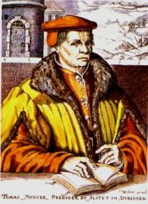
Martin Luther
Thomas Muntzer
Revolt Leader
(8) Peasant Revolt (1524):
Some peasants applied Luther’s revolutionary ideas to society, inspiring a revolt when demands to end serfdom were rejected.
Revolt crushed by noble princes with Luther’s support!

Slide 24
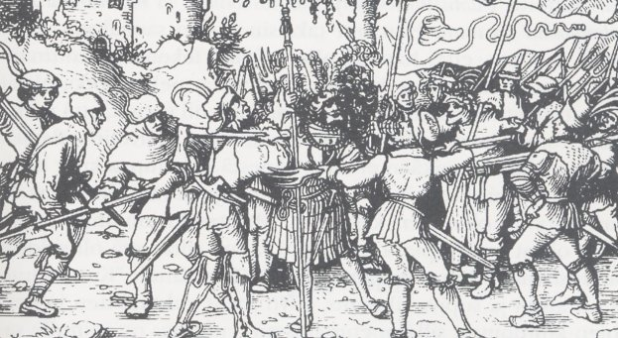
Martin Luther
(8) Civil War in Germany (1530’s – 1550’s) Protestant supporters of Luther vs. Catholic supporters of Charles & the pope
(9) Ended by the Peace of Augsburg (1555) which was a “compromise”
Ruler of each state decides the religion of that state (“Curus regio, reus religio.”)
No religious
toleration!!
But Lutheranism
is secure.

Slide 25
Lutheranism
(10) Beliefs & actions:
salvation attained by faith alone
(all people of faith are equal)
Bible is the only source of religious authority
Translates Bible into German (vernacular)
Don’t need clergymen to get to heaven (individual)
Accepted only the 2 sacraments mentioned in the Bible
(Baptism & Communion)

Slide 26
Luther / Calvin Comparison
Create a chart that compares Luther to John Calvin in the following categories:
Where did reform movement 1st take place?
The sources they each wrote containing their religious views
How does a person attain salvation in heaven?
What did they think about people?
What did they think about the Church and religious authority in people’s lives?
Where did their ideas spread?

Slide 27
DO NOW
Did the Reformation improve the status of women in society?
Noblewomen & wives of reformers sometimes played prominent roles early in the Reformation.
Later, when male leaders established church rules, women were limited.
…except Anabaptists who treated women equally!

Slide 28
The Act of Supremacy (1534)
“…be it enacted by authority of this present Parliament, that the king…shall be accepted as the only supreme head of the Church of England…and shall have full power…to reform…and amend all (matters), whatsoever they be…any foreign authority to the contrary not withstanding.”
Why does Henry VIII want a break from Rome?
Why do you think members of Parliament would support such a law?

Slide 29
The Anglican Church: “Church of England”
War of the Roses (1455-85) and
the Tudor dynasty
Henry VIII (1509 – 1547)
– “Defender of the Faith”

Slide 30
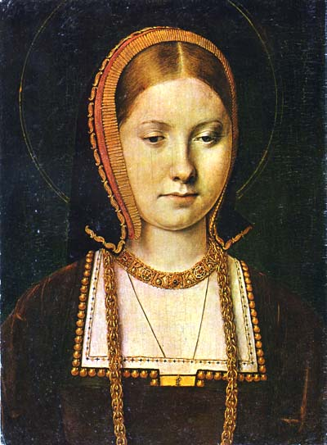
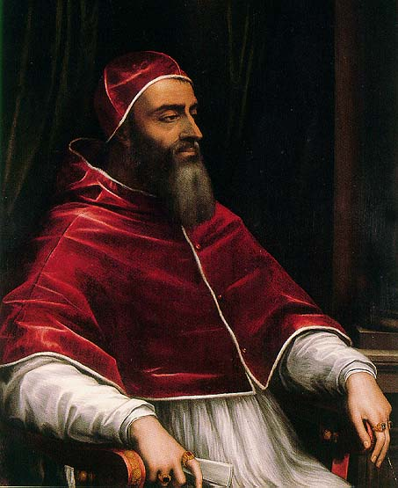
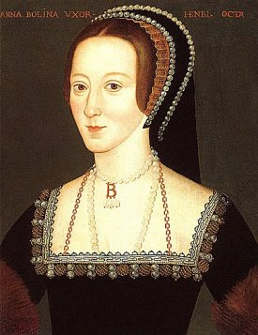
The Anglican Church
Catherine of Aragon, Anne Boleyn & the desire for a male heir to the throne.
Pope’s refusal to grant an annulment
(1534) Act of Supremacy (Parliament makes Henry head of the Church in England)
Hapsburg,
Catherine of Aragon
Anne Boleyn
Pope Clement VII

Slide 31
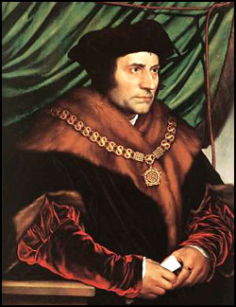
Henry Breaks with Rome
Parliament required all subjects to recognize the king’s authority as head of the Church of England.
Those who refuse = executed
(Thomas More)
Church remained very similar to Catholicism
Noble support (confiscated land)
Growing strength of monarchy.
Thomas More, humanist and
friend of Henry VIII, who was
executed for opposing
Henry’s plans.

Slide 32
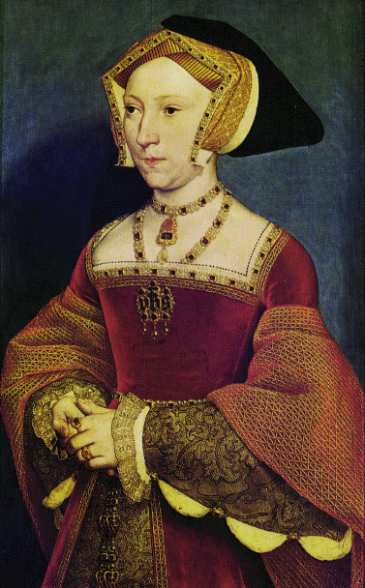
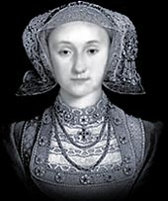
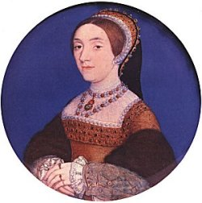
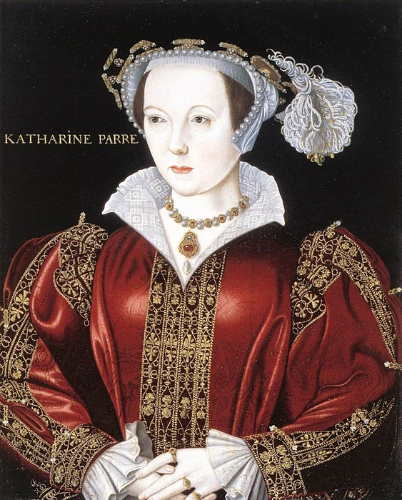
Henry’s 6 wives!!! Catherine of Aragon divorced Anne Boleyn executed for treason!
Anne of Cleves:
Political marriage;
Divorced & sent
to a convent.
Henry called her
a“Flemish mare”
Catherine Howard:
Executed for
Infidelity!
Catherine Parr:
Survived Henry’s
death in 1547.
Jayne Seymour:
Died after delivering
Henry’s son Edward.

Slide 33
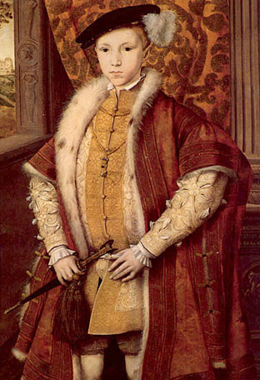
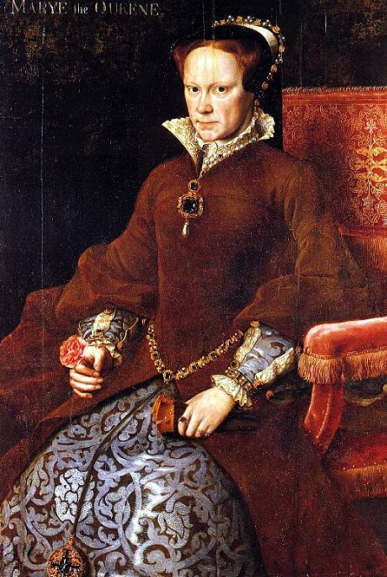
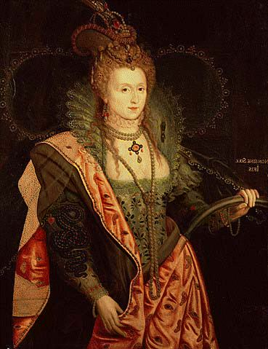
Henry VIII’s Children
Edward VI
Ruled 1547-53
Died at age 15
“Bloody” Mary I
Ruled 1553-58;
Tried to restore
Catholicism
Elizabeth I
“Greatest Tudor Monarch”
Ruled 1558-1603

Slide 34
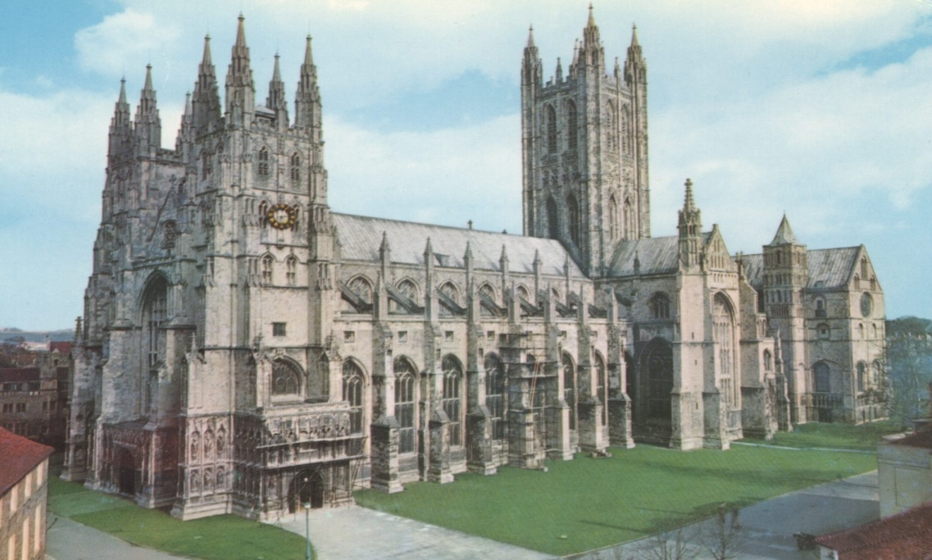
Elizabeth I (1558-1603)
Restores Protestantism in England
Made head of the Anglican Church by Parliament
Very moderate reforms
“We are all English first . . .
loyal to monarch & country.”

Slide 35
DO NOW - QUESTION
Why did Henry VIII go from being a “defender of the faith” to breaking away from the Catholic Church?

Slide 36
Primary Source – Council of Trent
If anyone said, that faith alone is enough for salvation; let him be condemned
If anyone said, that man is predestined for salvation; let him be condemned
If anyone said, that nothing besides faith is commanded in the Gospel & that no other things commanded nor prohibited; let him be condemned
If anyone said, that sacraments are not necessary for salvation; let him be condemned

Slide 37
Construct a Thesis Statement
Defend how Martin Luther could be viewed both as a revolutionary and as a conservative.

Slide 38
Chp.17 – sec. 4 Identify the following:
Pope Paul III
The Council of Trent
The Roman Inquisition
Index of Forbidden Books
Ignatius Loyola
The Jesuits

Slide 39
Counter / Catholic Reformation
Church’s attempt to respond to and deal with Protestant movement
Goals: (How can we win people back??)
Create a more spiritual outlook on the Church
Clarify all the basic beliefs & practices
Goals of the Counter Reformation
Restore the authority of the pope
Campaign against the Protestants

Slide 40
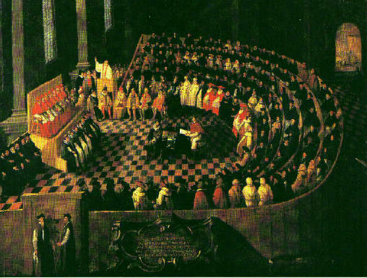
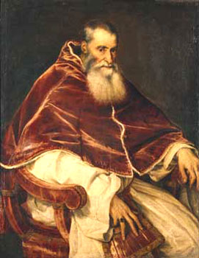
Counter/Catholic Reformation
Pope Paul III (1534-49) calls for the
Council of Trent (1545-1563)
Pope Paul III & a session
Of the Council of Trent.

Slide 41
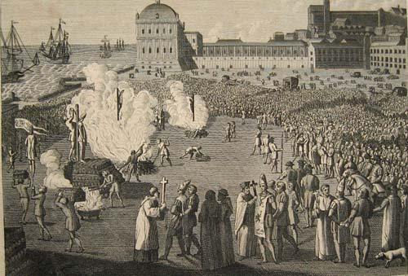
Church actions during the Counter Reformation
1. Expanded court of Inquisition (heresy)
2. The Index of forbidden books
3. Accepted only Latin version of Bible
4. Ended indulgences & simony
5. Created seminaries for training of priests
6. All Protestant doctrines / teachings rejected.
Heretics burned at the stake
after being condemned by
the Court of Inquisition

Slide 42
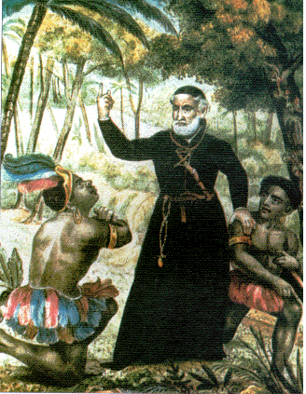
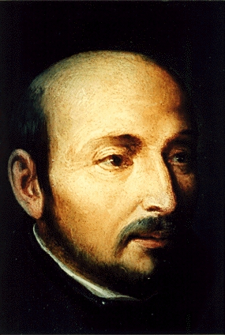
The Jesuits
Jesuits : “the Society of Jesus”
Ignatius Loyola & the Spiritual Exercises
Education & missionary work
Swore obedience to the Pope
“shock troops” to combat
Protestantism & spread faith
St. Ignatius Loyola
A noble & former
Spanish soldier
A Jesuit missionary
In familiar black robes.

Slide 43
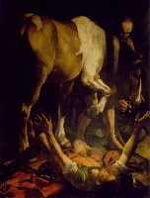
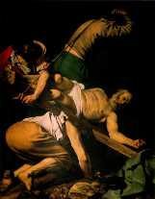
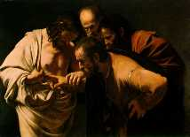
Baroque Art
An extravagant style of art (ornate, colorful & emotional suggesting movement) used by the Catholic Church to attract people during the Counter Reformation
Michelangelo Caravaggio
1572-1610
Conversion of St. Paul
Crucifixion of St. Peter
Incredulity of St. Thomas

Slide 44
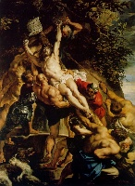
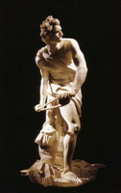
Baroque Art
Reubens’
Elevation of
the Cross
Bernini’s David

Slide 45
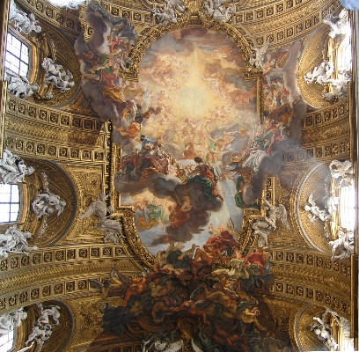
Baroque Ceilings - Baciccio

Slide 46
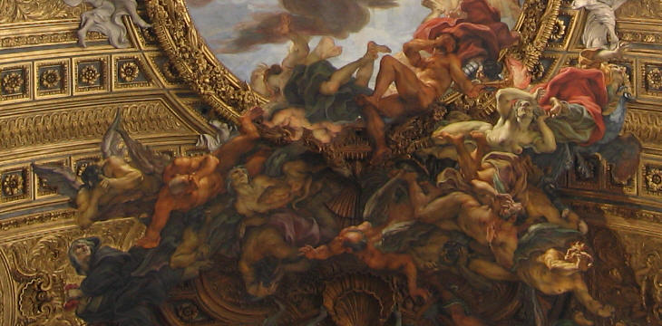
Baroque Ceilings

Slide 47
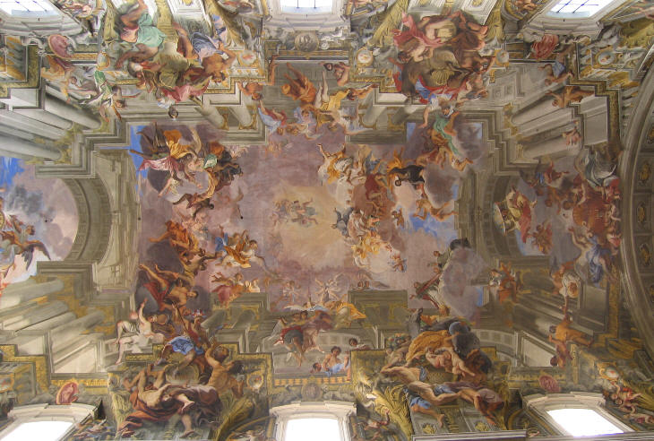
Baroque Ceilings – Andrea Pozzi

Slide 48
Results of the Reformation Era
Quarrels, warfare & persecution:
Huguenots & civil war in France: 1560’s –90’s
30 Years War in Germany: 1618 – 1648
No longer one Christian Church in Western Europe
North = Protestant, South = Catholic
Increased interest in reading & education
Decrease in power & authority of the pope & Catholic Church
“Protestant work ethic”

Slide 51
LUTHER OR CALVIN???
Germany
France, Scotland & England
Scandinavia
Geneva, Switzerland
95 Theses
Institutes of Christian Religion
Rejected all Church ceremonies & rituals
Salvation is attained by faith alone
Predestination & the elect
Rejected the pope & created a theocracy.
Prayer services & Bible in the vernacular of the people
The Bible is the only source of religious authority
Hard work = good while excessive pleasure = bad
You do not need the pope, Catholic Church or any clergy

