Slide 1
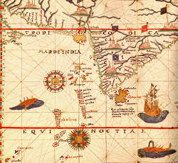
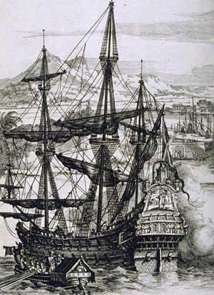
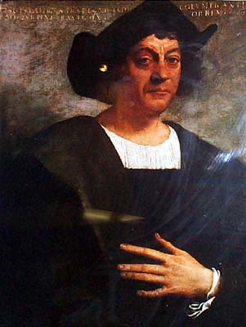
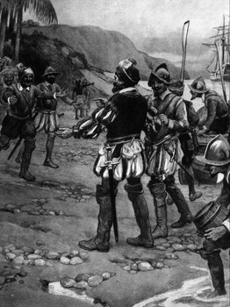
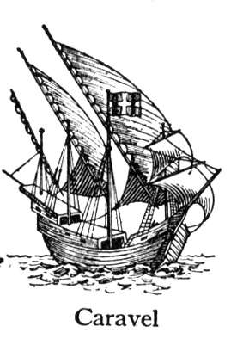
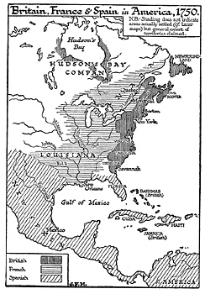
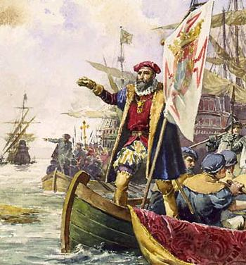
Age of Exploration

Slide 2
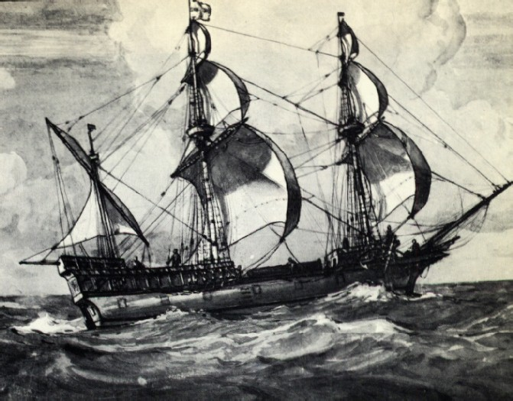
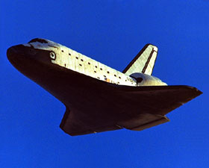
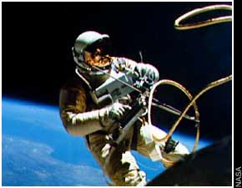
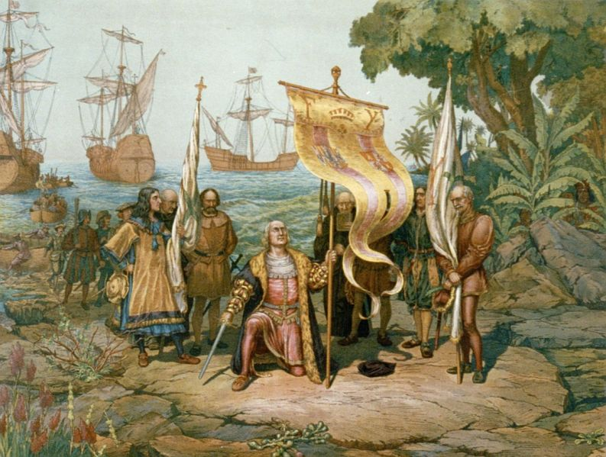
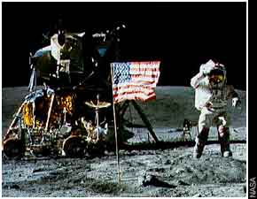
Age of Exploration
How are explorers of the 15th-16th centuries similar to astronauts of the 20th-21st centuries?

Slide 3
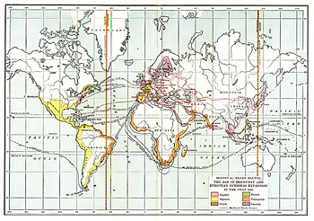
Age of Exploration & Discovery (1400’s – 1700’s)
Ends the separate & unconnected histories of different parts of the world + ushers in an era of European dominance which lasts until 1945

Slide 4
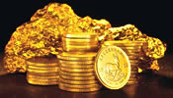
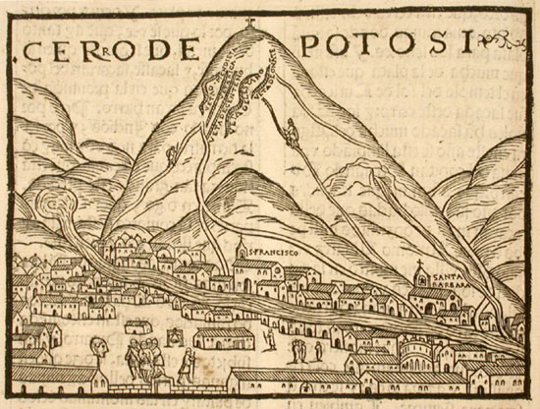
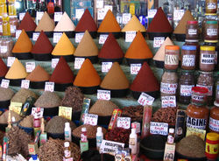
Motivated by the “Three G’s”:
GOLD – New trade routes to the East (Asia) to avoid “middle men” (Ottoman Turks & Venetian merchants); gain access to new products, (spices) precious metals (gold / silver) & raw materials.

Slide 5
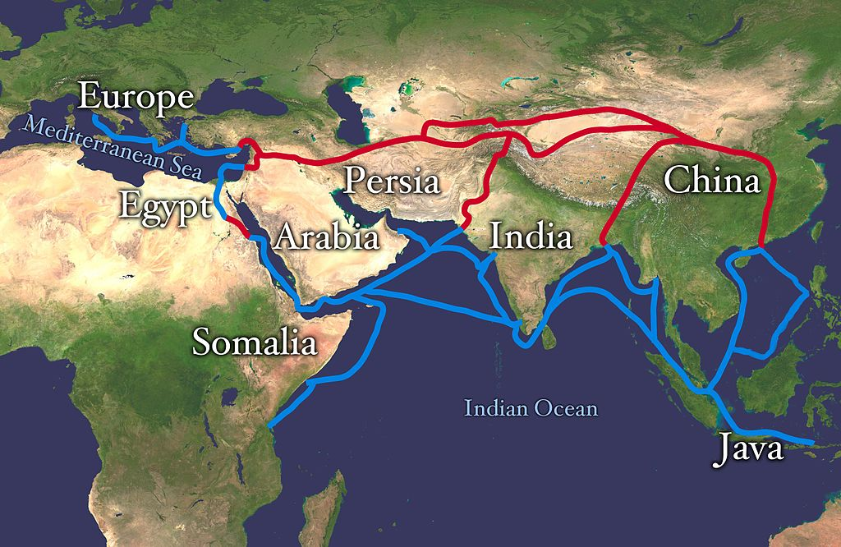
Eastern Trade Routes

Slide 6
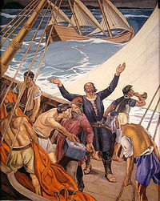
“The Three G’s”
GLORY – Adventure, Renaissance spirit of curiosity, fame & national pride
(colonies & empire)
“We came here to serve God & king, but also to get rich!”

Slide 7
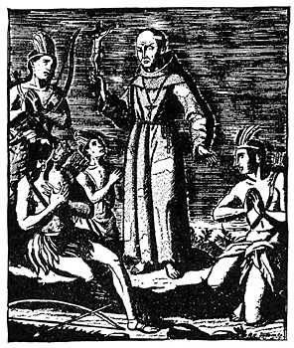
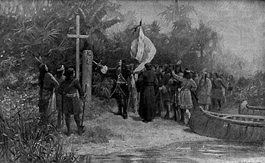
“The Three G’s”
GOD – Missionary activity; especially among Catholic countries like Spain= Jesuits

Slide 8
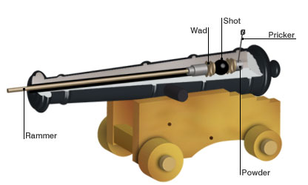
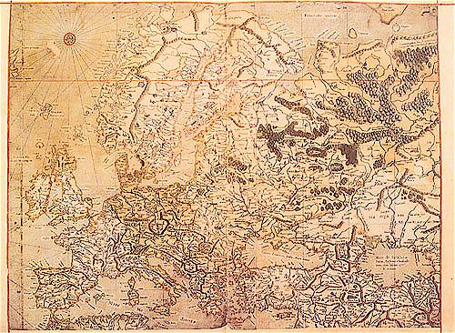
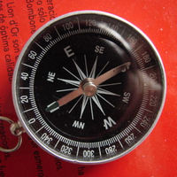
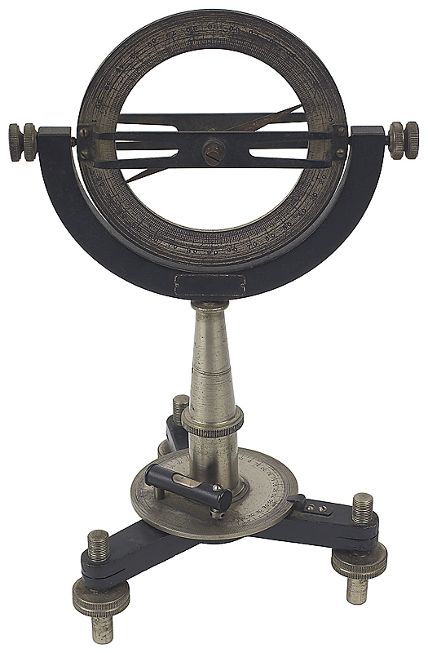
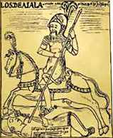
Voyages also made possible by new scientific progress & technological developments:

Slide 9
Science & Technology
Improved maps
Navigational instruments
(compass, astrolabe)
New ship design (caravel)
Weapons – gunpowder, canon & the horse

Slide 10
Explorer Chart
Zheng He, Vasco da Gama, Christopher Columbus & Ferdinand Magellan
Chart categories include:
nationality/home state
What country & monarch/company sent them
# voyages/expeditions
Whose expeditions(s) had the most ambitious purpose / objective?
Which explorer is the “worst?” (Have reasons!!)
Rank the 4 in the following and be able to defend your rankings/analyses with evidence!!
1. Who had the greatest achievement / accomplishment?
2. Who was the greatest sailor/ship captain?
3. Who was the most “successful?”
4. Overall rank of these four explorers.

Slide 11
DO NOW
Answer the questions based upon the timeline
Shade the areas on the map colonized/settled by the following colonial powers:
Spain, Portugal, England, France & Netherlands

Slide 15
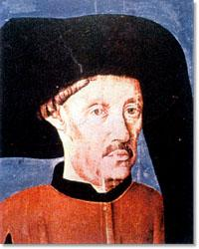
Timeline of Exploration
Portugal leads the way
- Prince Henry the Navigator (1394-1460) &
school of navigation @ Sagres
- he pushed for expeditions down the coast of Africa to find a water route to India

Slide 16
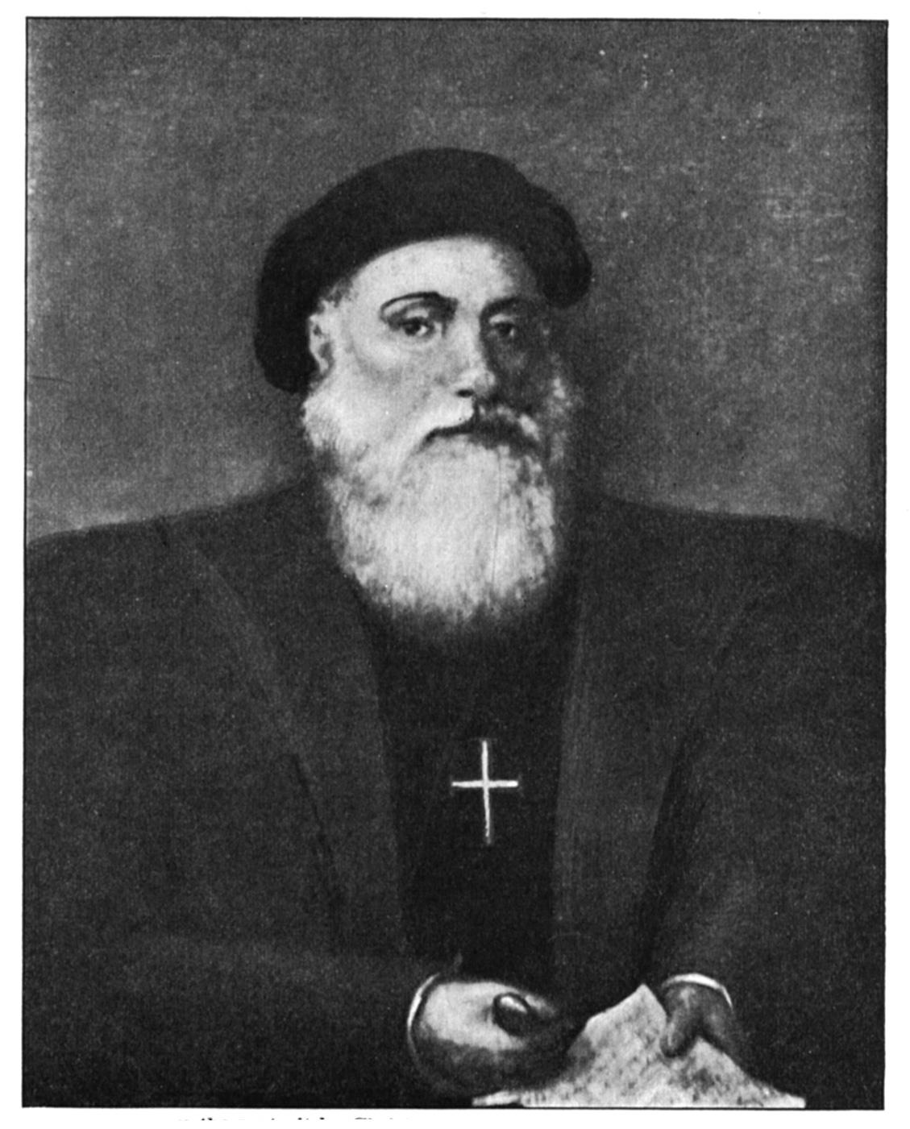
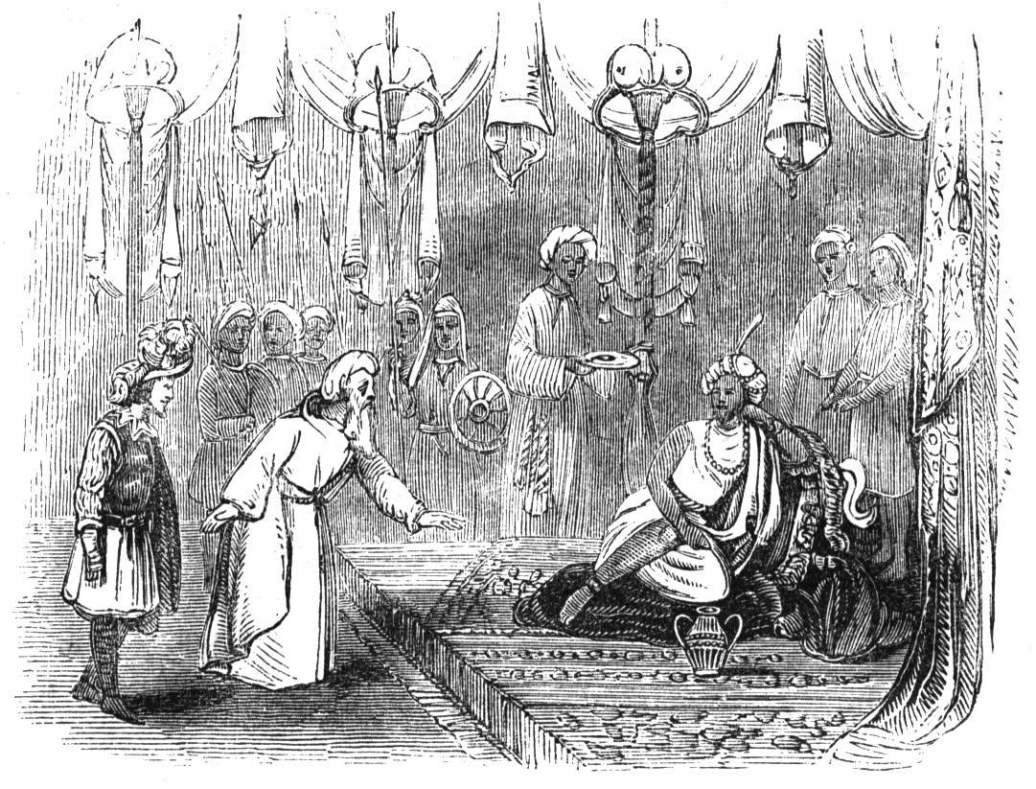
Portugal
1488, Bartolome Dias reaches the Cape of Good Hope in South Africa
1498: Vasco DaGama
reaches India & establishes trading posts
1500: Pedro Cabral is
Blown off course.
Lands in South
America & claims Brazil
for Portugal

Slide 17
Competition from Spain
Spain becomes dominant empire (gold/silver!)
Italian explorer Christopher Columbus will undertake 4 voyages (1492-1501)for Spain
Searching for western all-water
route to the East
Monarchs Ferdinand & Isabella
Will support expeditions to compete
with Portugal’s success

Slide 18
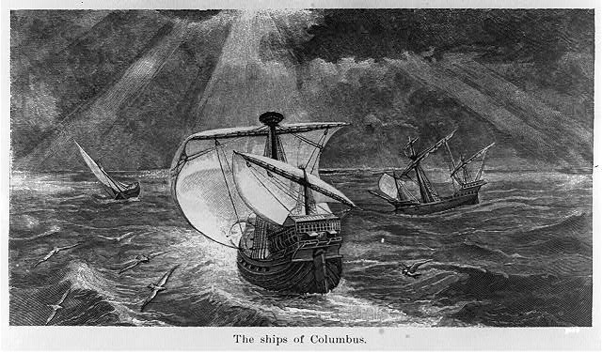
Spain
Columbus miscalculated size of the
Earth & didn’t expect continents of the
Western Hemisphere.
San Salvador & “Indians”
The ships of Columbus’
initial voyage:
Nina, Pinta & Santa Maria

Slide 19
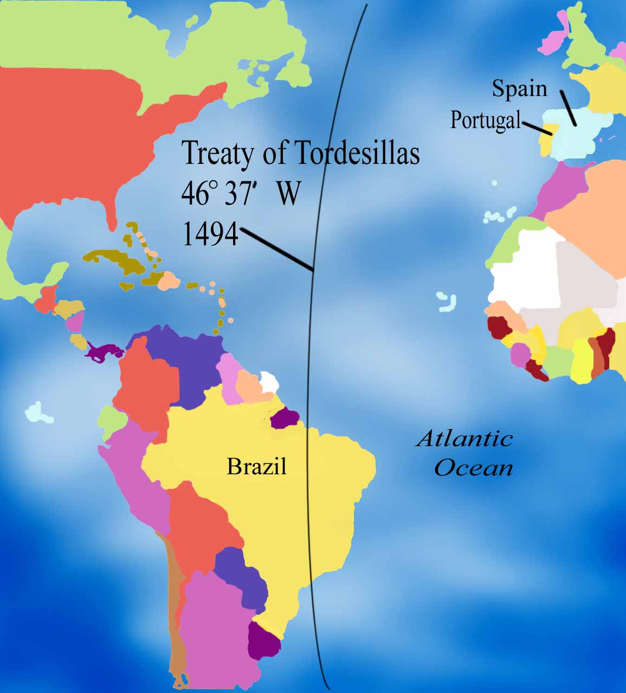
3. Competition & Potential Conflict
Spanish & Portuguese disputes over rights to control territory around the world = rivalry
Eventually settled by the Treaty of Tordesillas
(1494)
Created a “fixed line” to divide world between Spanish & Portuguese explorers/colonizers.
Didn’t factor in any other nations, nor did it consider the interests of the native peoples.

Slide 21
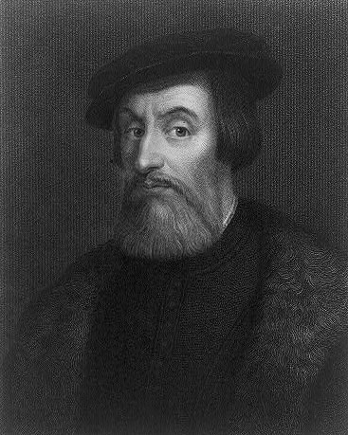
4. Spanish “Conquistadors”
Spain sent “conquistadors” (explorer/conquerors) to the Americas for the creation of an empire;
Destroyed native American civilizations
(a) Hernando Cortes (1519-21)
Landed in Mexico with
600 men, 16 horses and
a few artillery pieces
Destroyed Aztec civilization
(Emperor Montezuma)
Aided by other natives

Slide 22
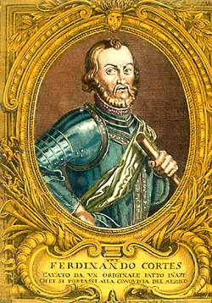
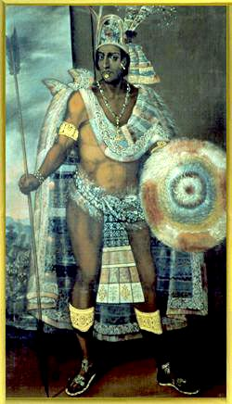
The First Spanish Conquests: The Aztecs
vs.
Fernando Cortez
Montezuma II

Slide 23
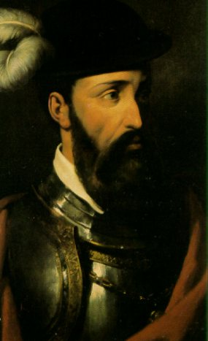
Spanish “Conquistadors”
Francisco Pizarro (1532)
Led an army @ 180 men to South America & conquered the Inca Empire.
Emperor Altahualpa
Wealth of Potosi silver mines
Portrait of conquistador Pizarro who had his horses
fitted with silver shoes when there was no iron
available

Slide 24
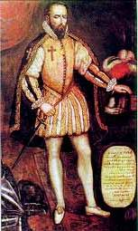
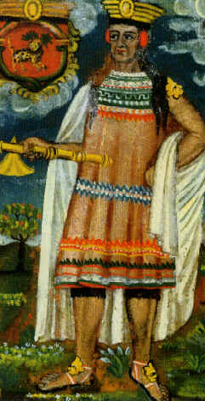
The First Spanish Conquests: The Incas
vs.
Francisco Pizarro
Atahualpa

Slide 25
5. Spanish Colonies
Spain, unlike Portugal, established a colonial empire in the “New World” (Americas)
“Viceroys” (governors) kept order & sent resources back to Spain
(25% of Spain’s income)
Native populations now “subjects” of Spain, were exploited for labor in mines & plantations
encomienda

Slide 26
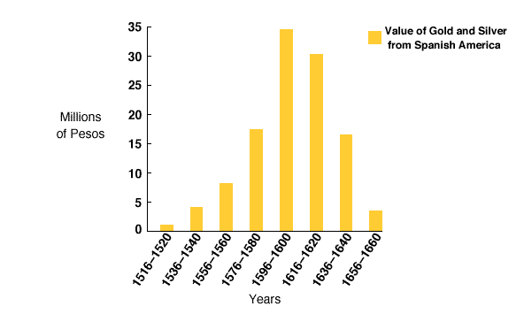
Treasures from the Americas!

Slide 27
Spain’s
American
Empire

Slide 28
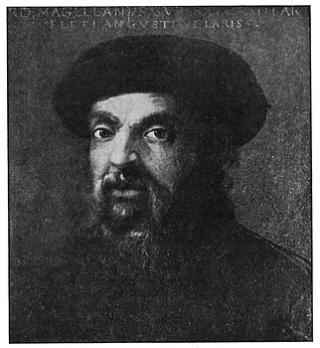
6. Ferdinand Magellan
Portuguese explorer for Spain
Seeking a southwest water route to Asia, Circumnavigates the globe (1519-22)
Departs w/5 ships & 243 men
Names “Pacific” ocean
Dies in the Philippines
Only the Victoria returns
w/ a crew of 18 men.

Slide 29
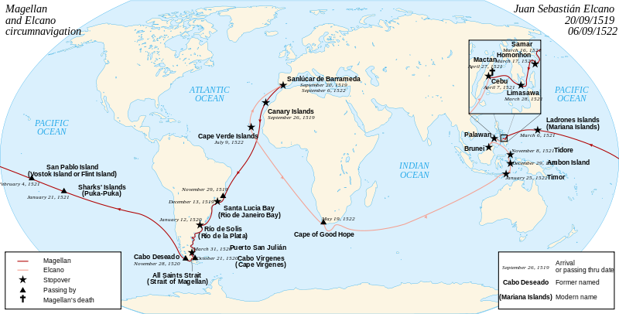
Magellan’s Route

Slide 30
Magellan
Magellan’s route
Magellan lands in the
Philippines

Slide 31
7. Northern Europeans
(1600’s): northern European countries begin:
“Northwest Passage” = (doesn’t exist)
Netherlands = the Dutch move into old Portuguese colonies
(1580 Spain annexed Portugal)
huge profits from trade, religious toleration
& became the leading bankers in Europe

Slide 32
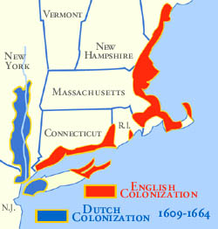
The Dutch
Colonies: New Amsterdam in N. America (New York), South Africa, Indonesia and
trade w/ Japan
Henry Hudson’s
exploration helped
establish the Dutch
colony of
New Amsterdam

Slide 33
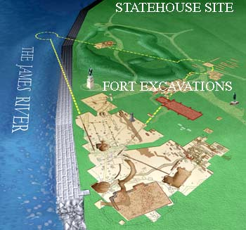
7. Northern Europeans
(b) England = Unsuccessfully seek
“northwest passage” (John Cabot)
Established colonies on the northeast coast of N. America & Canada (early 1600’s)
Sketch of the
Jamestown Colony (1607) in Virginia; England’s 1st permanent settlement in N. America
Originally seeking gold, later made profits from tobacco.

Slide 34
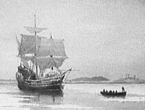
England
Pilgrims arrive at Plymouth (Massachusetts) in 1620 seeking religious freedom.
Later followed by the Puritans.

Slide 35
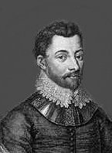
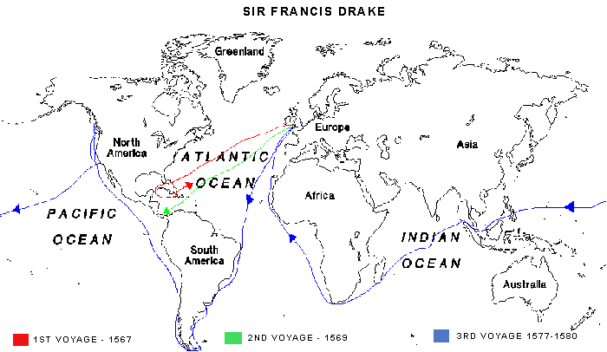
Sir Francis Drake
1st Englishman to circumnavigate
the world (1577-1580)
“sea dogs” (pirates)
Drake’s route
of
circumnavigation
Drake’s ship, the
Golden Hind

Slide 36
7. Northern Europeans
(c) French establish colonies in parts of Canada
Jacques Cartier (1522) and Samuel Champlain in Quebec (1608)
Louisiana territory
Robert LaSalle claims land on the Mississippi
for France

Slide 37
Zheng He
What seemed to be the primary purposes for these Chinese expeditions?
Why do you think the Ming Emperor Yong Le selected Zheng He, a Muslim, for these expeditions?
Why did these magnificent expeditions cease?

Slide 38
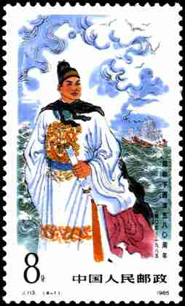
Admiral Zheng He (Cheng Ho)
China’s “Columbus?” 
Notes:
The Han Synthesis term refers to the emphasis on Legalism, but with a touch of Confucianism. The Han dynasty recorded Confucius’s teachings (The Analects) and put a big emphasis on the family.
Founded the Imperial University
Required examinations to become bureaucrat (civil service system)
Soldiers dropped to lowest status.
Confucianists at work; Daoists at home.
The Han tried to replace literature, including Confucius’s writings, lost during the Qin Dynasty. Created new works of literature and music. Scroll painting began during this time. Iron was now used for plows and weapons. Acupuncture was invented. Invented a crude seismic sensing tool, so they could send troops and food to the scene of an earthquake!
Inventions include: paper (105 CE), sternpost rudder on ships, water mill, wheelbarrow, furrowed cultivation
Show map for Silk Road trade. It brought Chinese together into one civilization, creating a common culture. Economically, it brought much wealth to the Han, as they exported much more than they imported.
Wudi’s public schools taught Confucianism. Grand School in capital. In 100 years, 30,000 studied there.

Slide 39
The Tribute System
Notes:
The Han Synthesis term refers to the emphasis on Legalism, but with a touch of Confucianism. The Han dynasty recorded Confucius’s teachings (The Analects) and put a big emphasis on the family.
Founded the Imperial University
Required examinations to become bureaucrat (civil service system)
Soldiers dropped to lowest status.
Confucianists at work; Daoists at home.
The Han tried to replace literature, including Confucius’s writings, lost during the Qin Dynasty. Created new works of literature and music. Scroll painting began during this time. Iron was now used for plows and weapons. Acupuncture was invented. Invented a crude seismic sensing tool, so they could send troops and food to the scene of an earthquake!
Inventions include: paper (105 CE), sternpost rudder on ships, water mill, wheelbarrow, furrowed cultivation
Show map for Silk Road trade. It brought Chinese together into one civilization, creating a common culture. Economically, it brought much wealth to the Han, as they exported much more than they imported.
Wudi’s public schools taught Confucianism. Grand School in capital. In 100 years, 30,000 studied there.

Slide 40
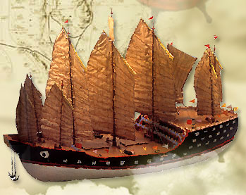
Admiral Zheng He (Cheng Ho)
Ming “Treasure Fleet”
Each ship 400’ long & 160’ wide
1371-1435
Notes:
The Han Synthesis term refers to the emphasis on Legalism, but with a touch of Confucianism. The Han dynasty recorded Confucius’s teachings (The Analects) and put a big emphasis on the family.
Founded the Imperial University
Required examinations to become bureaucrat (civil service system)
Soldiers dropped to lowest status.
Confucianists at work; Daoists at home.
The Han tried to replace literature, including Confucius’s writings, lost during the Qin Dynasty. Created new works of literature and music. Scroll painting began during this time. Iron was now used for plows and weapons. Acupuncture was invented. Invented a crude seismic sensing tool, so they could send troops and food to the scene of an earthquake!
Inventions include: paper (105 CE), sternpost rudder on ships, water mill, wheelbarrow, furrowed cultivation
Show map for Silk Road trade. It brought Chinese together into one civilization, creating a common culture. Economically, it brought much wealth to the Han, as they exported much more than they imported.
Wudi’s public schools taught Confucianism. Grand School in capital. In 100 years, 30,000 studied there.

Slide 41
Admiral Zheng He’s Voyages
First Voyage: 1405-1407 [62 ships; 27,800 men].
Second Voyage: 1407-1409 [Ho didn’t go on this trip].
Third Voyage: 1409-1411 [48 ships; 30,000 men].
Fourth Voyage: 1413-1415 [63 ships; 28,500 men].
Fifth Voyage: 1417-1419
Sixth Voyage: 1421-1422
Emperor Zhu Gaozhi cancelled future trips and ordered ship builders and sailors to stop work.
Seventh Voyage: 1431-1433
Emperor Zhu Zhanji resumed the voyages in 1430 to restore peaceful relations with Malacca & Siam
100 ships and 27,500 men; Cheng Ho died on the return trip.
Notes:
The Han Synthesis term refers to the emphasis on Legalism, but with a touch of Confucianism. The Han dynasty recorded Confucius’s teachings (The Analects) and put a big emphasis on the family.
Founded the Imperial University
Required examinations to become bureaucrat (civil service system)
Soldiers dropped to lowest status.
Confucianists at work; Daoists at home.
The Han tried to replace literature, including Confucius’s writings, lost during the Qin Dynasty. Created new works of literature and music. Scroll painting began during this time. Iron was now used for plows and weapons. Acupuncture was invented. Invented a crude seismic sensing tool, so they could send troops and food to the scene of an earthquake!
Inventions include: paper (105 CE), sternpost rudder on ships, water mill, wheelbarrow, furrowed cultivation
Show map for Silk Road trade. It brought Chinese together into one civilization, creating a common culture. Economically, it brought much wealth to the Han, as they exported much more than they imported.
Wudi’s public schools taught Confucianism. Grand School in capital. In 100 years, 30,000 studied there.

Slide 42
1498 --> Da Gama reached Calcutta, China’s favorite port.
Notes:
The Han Synthesis term refers to the emphasis on Legalism, but with a touch of Confucianism. The Han dynasty recorded Confucius’s teachings (The Analects) and put a big emphasis on the family.
Founded the Imperial University
Required examinations to become bureaucrat (civil service system)
Soldiers dropped to lowest status.
Confucianists at work; Daoists at home.
The Han tried to replace literature, including Confucius’s writings, lost during the Qin Dynasty. Created new works of literature and music. Scroll painting began during this time. Iron was now used for plows and weapons. Acupuncture was invented. Invented a crude seismic sensing tool, so they could send troops and food to the scene of an earthquake!
Inventions include: paper (105 CE), sternpost rudder on ships, water mill, wheelbarrow, furrowed cultivation
Show map for Silk Road trade. It brought Chinese together into one civilization, creating a common culture. Economically, it brought much wealth to the Han, as they exported much more than they imported.
Wudi’s public schools taught Confucianism. Grand School in capital. In 100 years, 30,000 studied there.

Slide 43
Why did expeditions stop?
Confucian low view of merchants.
Expeditions were costly & unnecessary.
Emperor Yongle = great sponsor of expeditions dies
Need to divert funds towards defense of the northern border. (Great Wall)

Slide 44
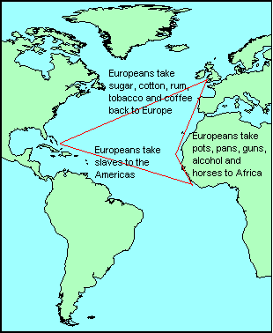
Vocabulary Sheets
“Middle Passage” – establishment of colonies in the “New World” led to the development of a series of triangular trade routes
(3 points or stops:
Europe, Africa & New World)
The leg or portion that
carried slaves to the
Americas was called this.
Horrific conditions!

Slide 45
Cycle of Conquest & Colonization
Explorers
Conquistadores
Official European Colony!
Missionaries
Permanent Settlers

Slide 46
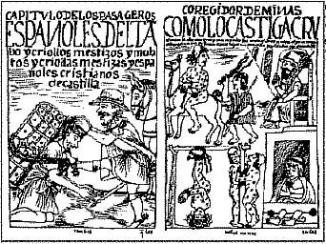
Administration of the Spanish Empire in the New World
Encomienda or forced labor.
Council of the Indies.
Viceroy.
New Spain and Peru.
Papal agreement.

Slide 47
The Colonial Class System
Peninsulares
Creoles
Mestizos
Mulattos
Native Indians
Black Slaves

Slide 48
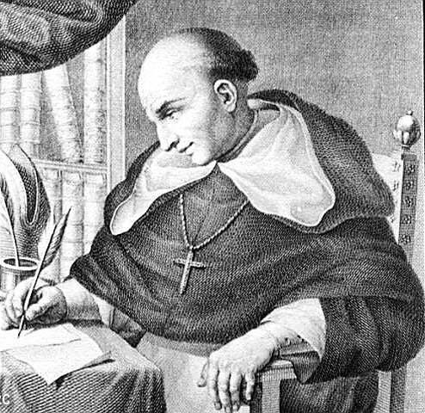
Father Bartolome de Las Casas
New Laws → 1542

Slide 49
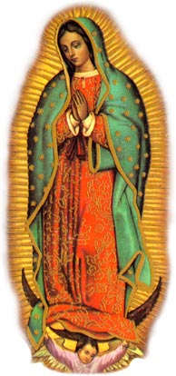
The Influence of the Colonial Catholic Church
Our Lady of Guadalupe
Guadalajara Cathedral
Spanish Mission

Slide 50
The Atlantic Slave Trade
How did each of the following contribute to the development of the slave trade?
European colonization
smallpox
African rulers & merchants
What were the consequences of the slave trade for each of the following?
African societies
American colonies
Enslaved Africans
American culture/society

Slide 51
Early Portuguese Slave Trade
As Portuguese travelled along west African coast,
established trade outposts
Involved in the slave trade around 1443
Pope Nicholas V sanctioned the slave trade
Local African slave trade already existed
Eventually used by Spanish for plantations in the New World
as the native Indian population declined due to disease & overwork
1600’s-1800,
England
dominates the
slave trade

Slide 52
The Atlantic Slave Trade
Causes:
European colonial need for cheap labor
Encomienda unsatisfactory due to smallpox devastating Native American population (Africans largely immune)
Africans experienced farmers & less likely to escape (unfamiliar w/terrain & language)
Pre-existing African slave-trade; captives used to secure goods & profits (guns!)

Slide 53
The Atlantic Slave Trade
Consequences:
Population drain in Africa
Conflicts among African tribes over slave acquisition; introduction of guns
Economic profits for European colonies in the Americas (plantations)
Enslaved Africans suffer; families separated, severity of slave trade, inferior status
New cultural heritage for Africans (religion, language, etc.)
American cultural & ethnic diversity

Slide 54
Trans-Atlantic Slave Trade
Between 16^{c} & 19^{c}, about 10 million Africans
shipped to the Americas.

Slide 55
Slave Ship
“Middle Passage”

Slide 56
Exploitation around the World
Spain in Latin America
Viceroyalties
Encomienda & “mita” system (mandatory labor)
Portuguese in Brazil
Sugar plantations (“engenho”)
Relied upon African slave labor = BRUTAL!
Larger percentage of African slaves sent to Brazil compared to southern plantations of N. America

Slide 57
Slaves Working in a Brazilian Sugar Mill

Slide 58
Exploitation around the World
Dutch in Indonesia (Spice Islands)
Cloves, cinnamon, nutmeg,
Killed or enslaved large numbers & destroyed local economy
The Dutch East India Company
(VOC) administered control over
Indonesia until
it became a
colony run directly by the Dutch
gov’t in 1800

Slide 59
Characteristics of American Slavery
Immense size of slave “traffic”
Centrality to economy of colonial America
Largely based on plantation agriculture
Lacking any rights in society
Treated as “dehumanized” property – “chattel”
Slave status was inherited across generations with little hope of eventual freedom
Racial dimension: (Muslims & the “Zanj”) slavery becomes identified wholly with Africa and “blackness”

Slide 60
Joint-stock company :
To raise $ for expense of voyages & colonial development, several people invest to start a company.
Granted a charter from the monarchy.
Settlers seek opportunity & are “encouraged” to build and work the colony = jobs.
Profits & losses shared in proportion to your investment.

Slide 61
Vocabulary Sheets
Mercantilism: Economic theory which states that power is based upon wealth. There is a fixed amount of wealth in the world, so a nation must secure a larger share than its competitors.
Encouraged nations of the 1600 – 1700’s to :
Attain more colonies to get gold, silver & raw materials and control the market there.
Export more than you import =
“favorable balance of trade” (tariffs)
Create & maintain a “self-sufficient economy”

Slide 62
Results / Effects of Exploration
Colonial Empires = rivalry & wars:
Portugal & Spain(Treaty of Tordesillas – 1494)
Spain & England (Spanish Armada – 1588)
c) England & France (India & N. America)
British troops land near Quebec
To fight the French
Battle between fleets
of Spain & England

Slide 63
Results / Effects of Exploration
Economic: mercantilism & colonies
(N. Europe becomes new economic center)
Social: new opportunities, religious & political freedom, exploitation of natives & African slavery

Slide 64
The Columbian Exchange
4. Cultural: new goods & products;
“cultural diffusion” & the Columbian Exchange
the diffusion of food crops, plants, animals, people, and disease between the Americas and the Old World
Sketch depicting smallpox victims
The smallpox disease brought to the
New World by Europeans devastated
the native American population.
Mexico’s population dropped from
25 to 1 million
Peru: 7million to 500 thousand

Slide 65
The “Columbian Exchange”
Squash | Avocado | Peppers | Sweet Potatoes
Turkey | Pumpkin | Tobacco | Quinine
Cocoa | Pineapple | Cassava | POTATO
Peanut | TOMATO | Vanilla | MAIZE
 | Syphilis
Trinkets
Liquor
GUNS
Olive | COFFEE BEAN | Banana | Rice
Onion | Turnip | Honeybee | Barley
Grape | Peach | SUGAR CANE | Oats
Citrus Fruits | Pear | Wheat | HORSE
Cattle | Sheep | Pigs | Smallpox
Flu | Typhus | Measles | Malaria
Diptheria | Whooping Cough

Slide 66
Columbian Exchange
OLD WORLD TO NEW
NEW WORLD TO OLD
Horses
Cattle, Pigs, sheep, chicken
Wheat, barley, rice & oats
Bananas, citrus & melons, grapes, peaches, pears
Onions, cabbage, lettuce, peas & cauliflower, olives
Coffee, black pepper, sugar
Wheel & iron
Gunpowder & firearms
Smallpox, measles & influenza
Turkey
Rattlesnake, catfish
Tobacco
Potatoes, beans, tomatoes, chili peppers, corn
Peanuts & cashews
Pumpkin & many kinds of squash
pineapple, avocado, papaya
Chocolate, vanilla beans
syphilis

Slide 67
Answer the following on a separate piece of paper:
What is your favorite food/meal?
If you lived in the Americas prior to the Columbian Exchange…could you make it/enjoy it???
If you lived in Europe…???

Slide 68
Meal Activity – Create a Menu
Your group is going to create a menu for a fictitious 15th century restaurant (pre-Columbus) in either the Old or the New World.
Referring to the lists of what came from either location, create a menu that includes 3 courses:
Appetizers b) main course including vegetable
c) dessert d) beverages
*Be sure to have at least TWO choices for each
**Take care to realize the INGREDIENTS that may go into making each of your dishes!
Don’t forget to come up with a name for your restaurant!!

