Slide 1
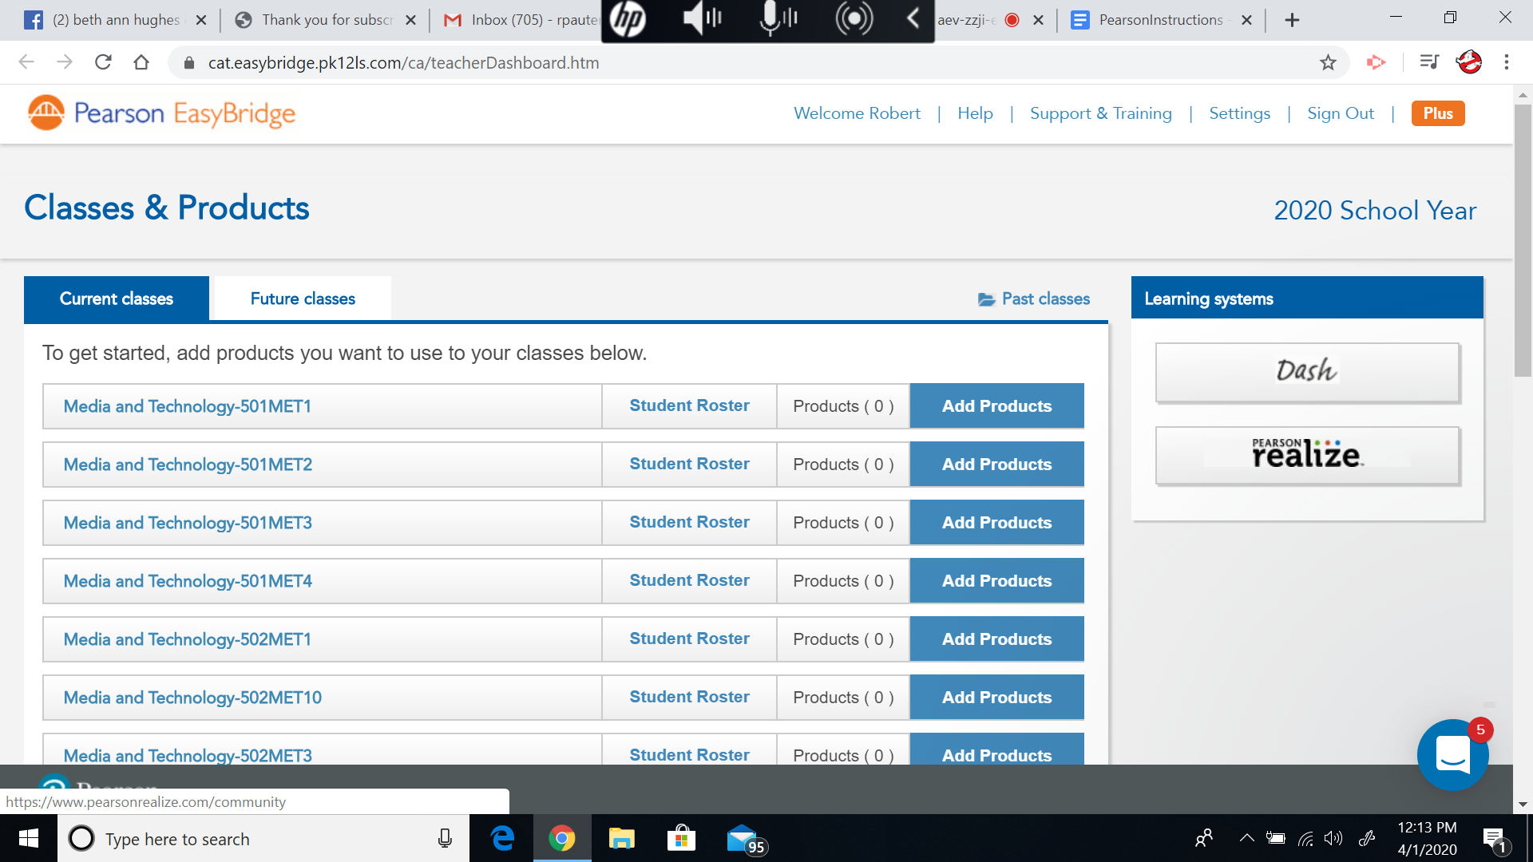
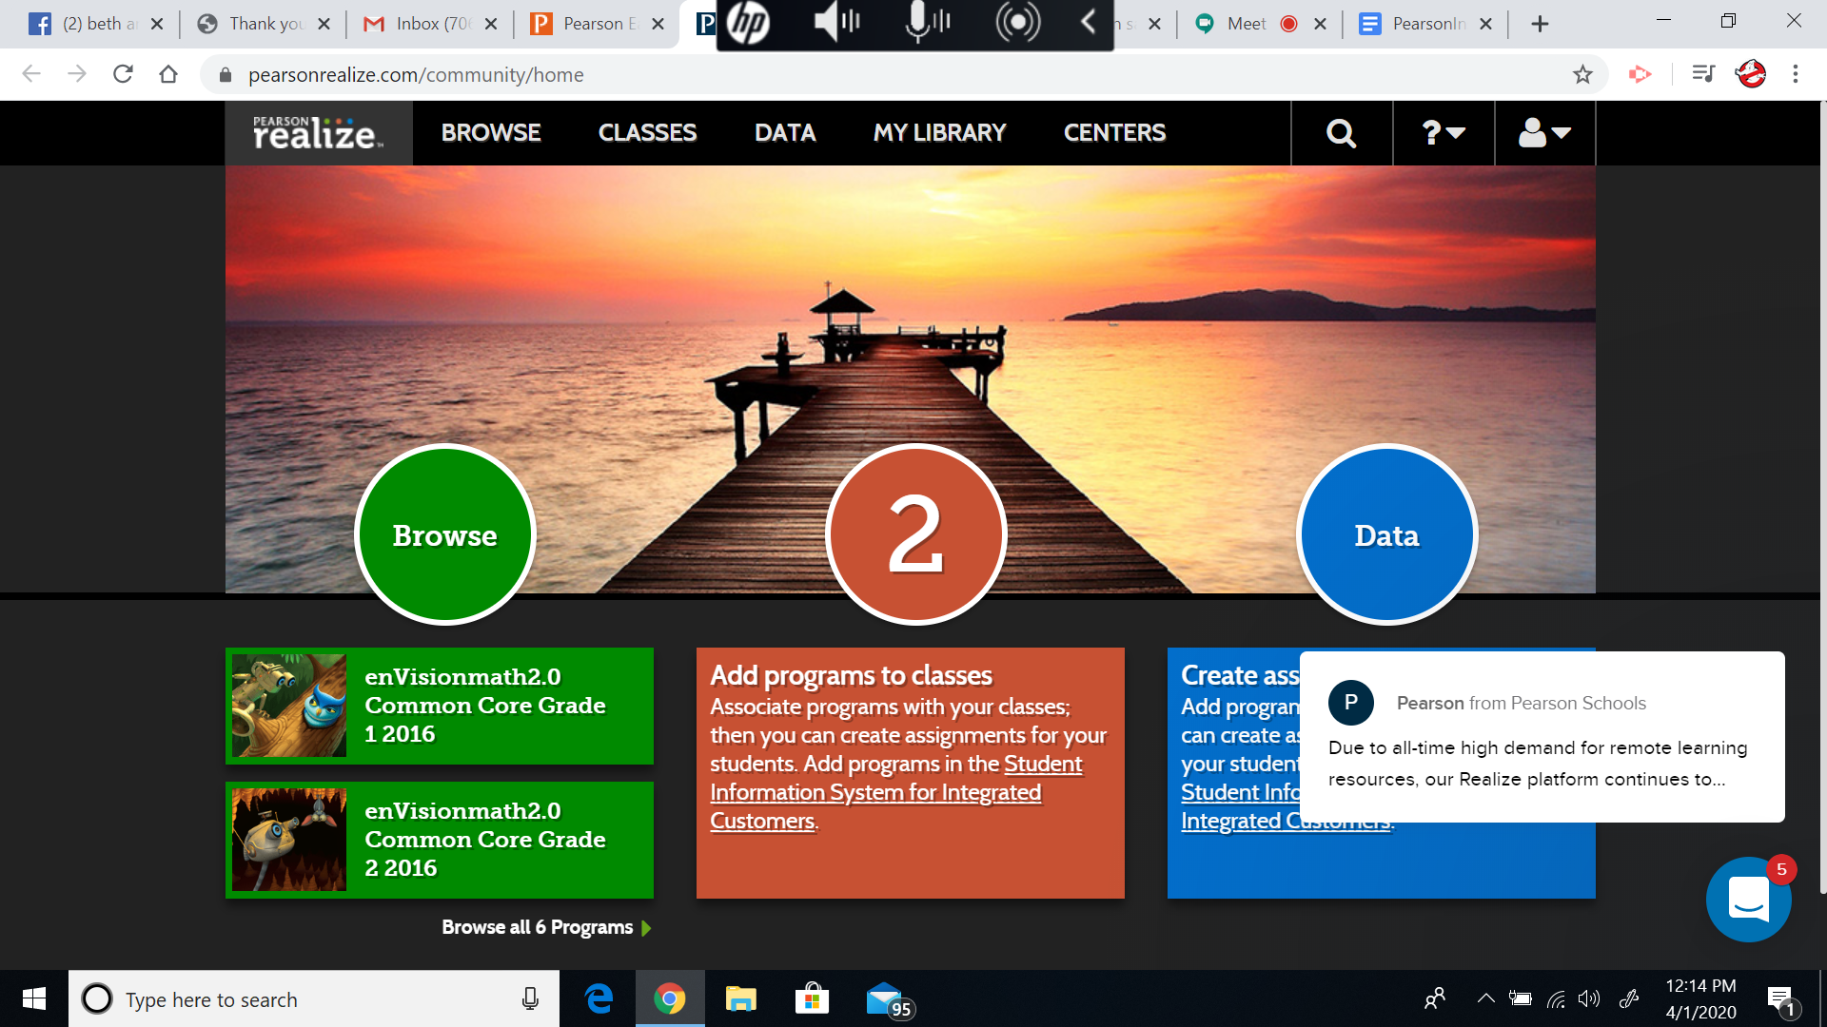
Step 1
Log In
Step 2
Go To Google Apps
Step 3
Grab Right Side Scroll Bar, Move Down All The Way Until You See “Easy Bridge” - Click Easy Bridge!
Step 4
Now You’re In!
Click “Pearson Realize” on the Right!
Step 5
You Are Now in Your Pearson Book & Class!

