Slide 1
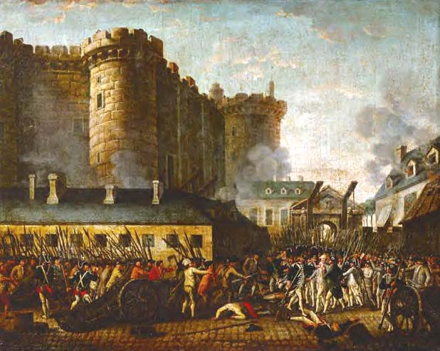
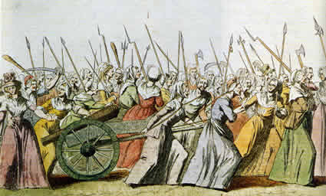
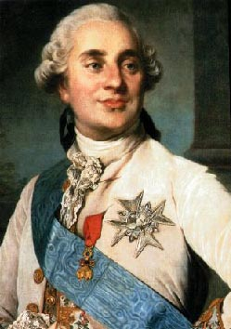
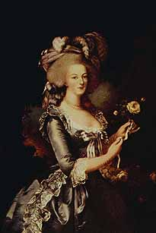
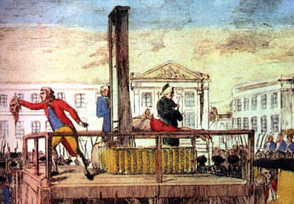
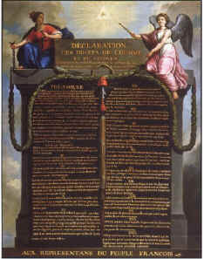
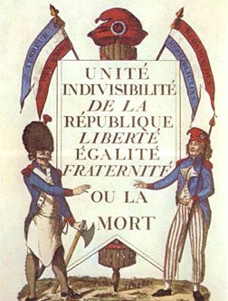
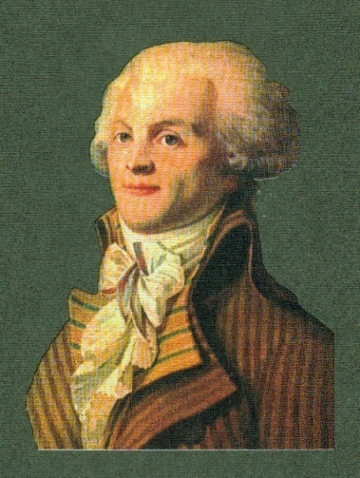
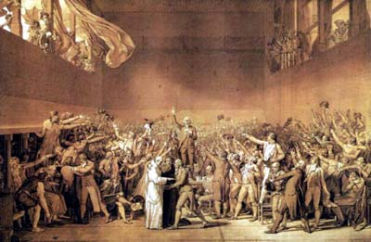
The French Revolution

Slide 2
DO NOW:
1. What was meant by the “Old Regime?”
2. Explain how the following quote reflects the state/condition of French society on the eve of Revolution (1789):
“It was the best of times, it was the worst of times.”
Does anyone know what book this quote is taken from???

Slide 3
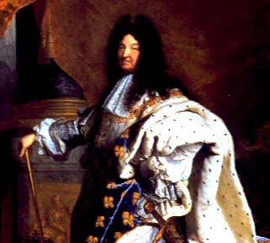
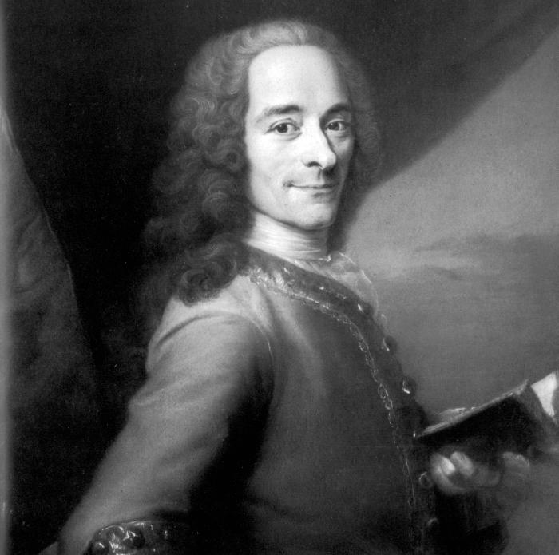
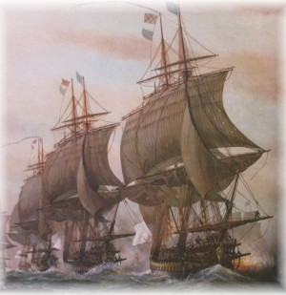
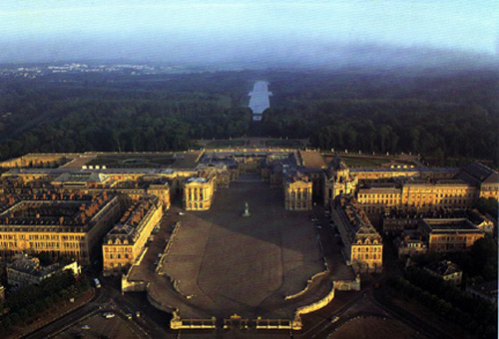
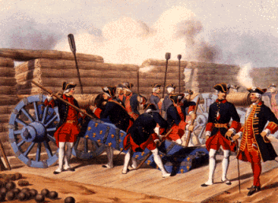
France
By the death of Louis XIV, France was the strongest nation in Europe
Strongest army
Navy 2nd only to Britain
Versailles the envy of monarchs
Paris the center of culture & learning

Slide 4
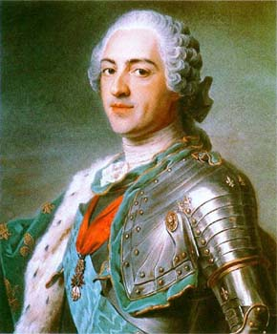
The French Revolution (1789-99)
I – Causes
Abuses of the “Old Regime”
Traditional political & social structure in France which included:
Absolute rule of the king
These Bourbon monarchs centralized
power, frequently involved France in
costly wars, spent heavily on
construction projects & spent huge sums
on their lavish lifestyles.
Louis XIV (1643-1715)
Louis XV (1715-1774)

Slide 5
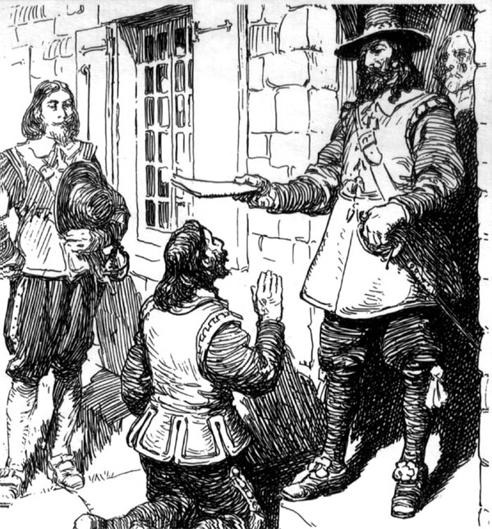
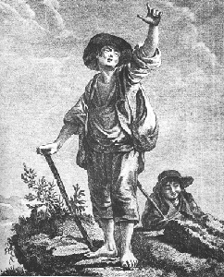
Abuses of the “Old Regime”
Feudal ownership of land
Nobility owned large portions of land
Peasants who lived on the land forced to work & pay taxes to nobles

Slide 6
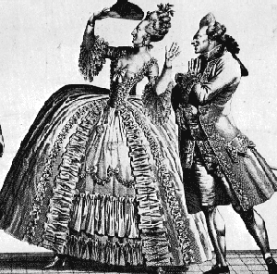
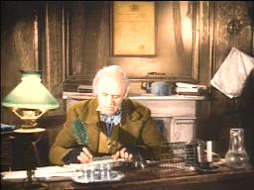
Abuses of the “Old Regime”
c) Society represented:
“INEQUALITY”
3 classes or “Estates”
1st estate = clergy
2nd estate = nobility
3rd estate = everyone else

Slide 7
1st Estate
Catholic clergy
1% of the population
2nd Estate = nobles
2% of the population
3rd Estate = “commoners”
97% of the population
80% of which are peasant farmers
Also city artisans & workers
And…the bourgeoisie

Slide 8
Abuses of the “Old Regime”
Disproportionate amount of the land, wealth, rights & privileges are with the 1st two estates BUT the taxes are paid by the 3rd estate. . .
80% of whom are peasants
Taille – land tax
Gabelle – salt tax
Tithe – Church tax
Corvee – road tax or
service
Champart – farm
resources

Slide 9
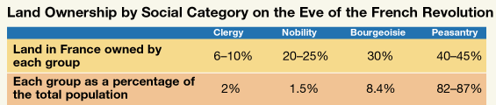
Socio-Economic Data, 1789

Slide 10
The French Urban Poor

Slide 11
Abuses of the “Old Regime”
Complaints:
Nobles & higher clergy dislike lack of power; Nobles want a “limited” monarchy. Many (especially higher clergy) opposed Enlightenment!
Bourgeoisie want rights, privileges & political influence similar to the nobility
Peasants & workers are tired of paying all the taxes as well as high prices & cost of living while wages were low (poor economy)
(Have the least $ yet pay the most in tax)

Slide 12
What message does this image convey about French society?
Who do each of
the figures
represent?
In addition to tax
burden, poor
weather in the
1780’s caused crop
failures & food
shortages.

Slide 13
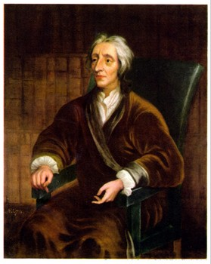
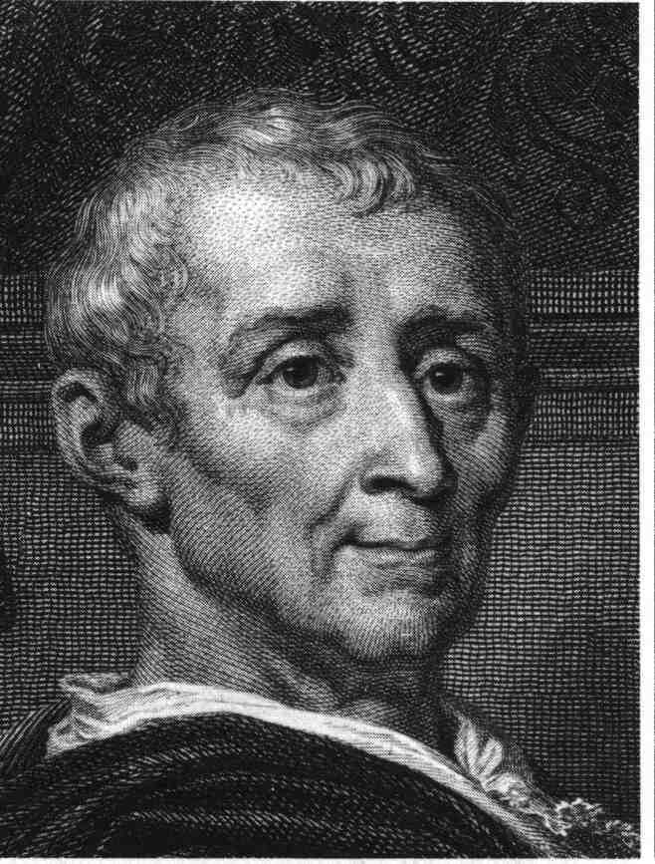
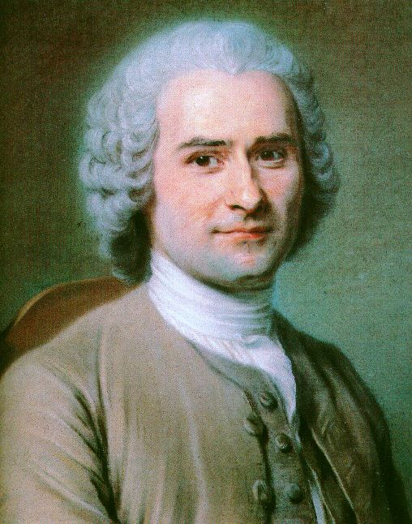
Causes of the French Revolution
Enlightenment Thinkers – Inspire well educated bourgeoisie to demand change.
Natural rights / freedoms
Separation of powers
Popular sovereignty
Criticisms of inequality & injustice
“social contract” & people’s right to change government

Slide 14
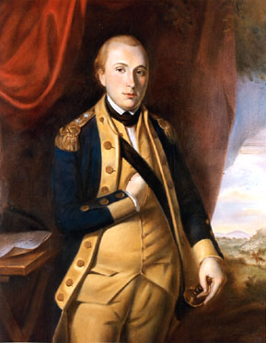
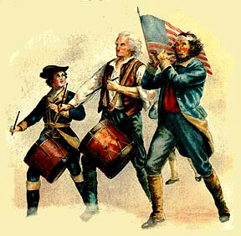
Causes of the French Revolution
Success of English & American Revolutions
the ideals influenced French thinking
Success in America inspired call for change
Aiding Americans vs. British = costly
Marquis de Lafayette
Aided cause of American
Independence

Slide 15
Causes of the French Revolution
4. DEBT – Financial Crisis by 1750’s… WHY?
Wars, extravagance of royal court, aid to Americans and outstanding loans.
1780’s French government near bankruptcy
Poor were already overburdened with taxes
Louis XV:
“Apres moi,
le deluge!”

Slide 16
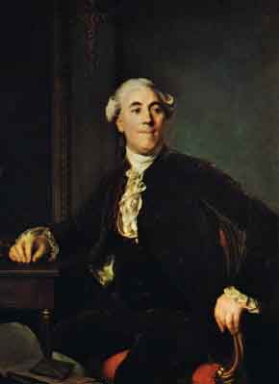
Causes of the French Revolution
This financial crisis fell onto the lap of king Louis XVI grandson (1774-1792)
Finance minister Jacques Necker
realized a new source of revenue
needed to be found.
Necker recommended a tax on land
which meant the clergy & nobles
would have to pay.

Slide 17
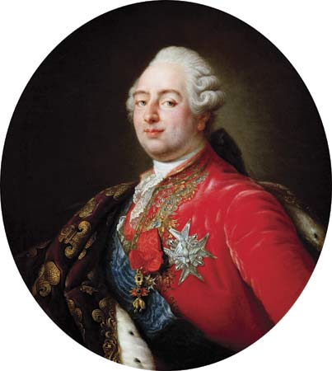
Louis XVI
Not a bad ruler, but weak & indecisive
“wishy, washy Louis”
Fears noble reaction to this “attack” on their birthright of tax exemption
With pressure from nobility,
decides to convene a meeting
of the Estates-General;
The representative body of
France

Slide 18
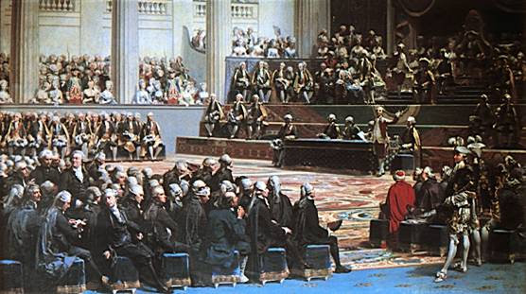
Moderate start to Revolution
II – The Estates-General
Louis XVI summons the Estates-General to help deal with the financial crisis. (May, 1789)
It had not met since 1614
Representatives of the
3 estates were chosen
from throughout the country
and met in Paris
“cahiers”
List of complaints

Slide 19
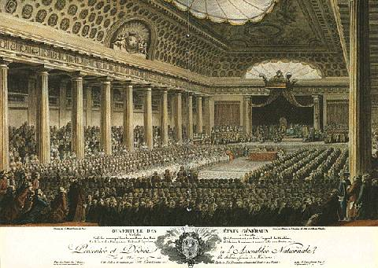
The Estates-General
Voting is UNFAIR!
Each estate gets ONE vote…
(3%) 1st estate (300 delegates)=1vote
2nd estate (300 delegates)=1vote
(97%) 3rd estate (over 600 delegates)=1vote
***1st two estates always
vote together

Slide 20
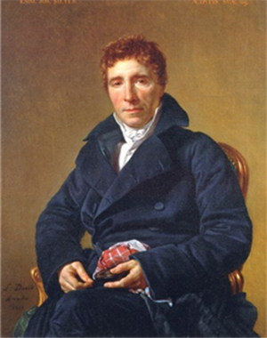
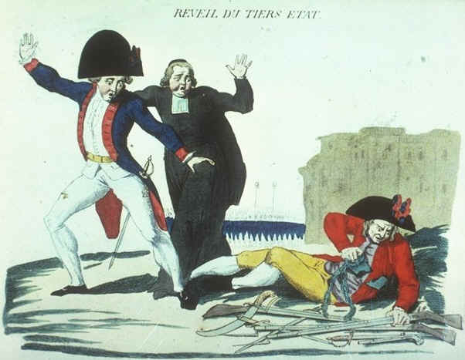
The French Revolution
Call for voting reform rejected
by King Louis XVI
3rd estate forms the National Assembly
Encouraged by Abbe’ Sieyes’ pamphlet:
“What is the Third Estate?”
Abbe Sieyes
“The 3rd Estate Awakens”;
the formation
of the National Assembly
(June17, 1789)
is the first act of the
French Revolution.

Slide 21
“Tennis Court Oath”
Louis XVI refused to recognize
this assembly & “locked them out”
of the meeting hall.
Delegates of the National Assembly met at
nearby tennis court
pledged not to
disband until
France had a
written constitution

Slide 22
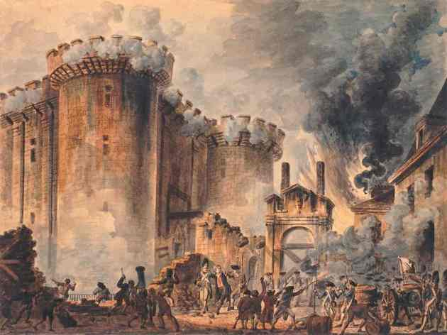
Storming the Bastille
Louis orders members of all 3 estates to join National Assembly (1man/1vote)
By July, Louis masses troops & plots to stop the Assembly . . . (mistake)
riots in Paris (fear Louis’ troops)
July 14, 1789
the storming of the
Bastille prison
(symbol of tyranny)

Slide 23
“Bastille Day” – July 14 French Independence Day
July 14, 1789, Parisian
mobs storm the Bastille,
prison. This emotional
action against tyranny was
also an effort to secure
weapons.
The 7 prisoners were
freed and most of the
garrison defenders were
killed.
Lafayette & the National Guard
restores order in Paris
The “tricolor”

Slide 24
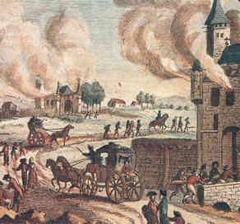
The Great Fear & Violence
(July-August) peasant violence spread throughout the countryside against nobles & the “Old Regime”
(allegedly fearing noble/monarch retaliation)
Many nobles, fearful
of spreading violence
flee the country
“emigres”

Slide 25
Moderate Phase of the Revolution
Work of the National Assembly
What actions were taken by the National Assembly to end oppression, injustice & inequality?
What was the Declaration of the Rights of Man?
(What influenced it? What did it say?
What was its purpose?)
How did the Nat. Assembly deal with France’s debt?
How did the Nat. Assembly deal with the Catholic clergy?
What kind of gov’t did the Constitution of 1791 create?
What was Louis XVI’s reaction to the changes & the coming constitution?
Why would other rulers fear the revolution in France?

Slide 26
Group Timeline Activity
a) 1789 Aug: Nobles & clergy join the Nation Assembly and all speak out against the Old Regime.
QUESTION – What was the result of the National Assembly’s actions of Aug.4?

Slide 27
Work of the National Assembly (1789-1791)
(Aug 4) Immediate reforms made to deal w/ the violence:
All feudal dues & services cancelled
Abolished the tithe
All class privileges & tax exemptions ended

Slide 28
Timeline of the Revolution
b) 1789 Aug: National Assembly adopts the Declaration of the Rights of Man.
QUESTION – What are some of the rights this guarantees French citizens?

Slide 29
Work of the National Assembly (1789-1791)
2. (Aug 27) Declaration of the Rights of Man
Established guiding principles of Revolution
Influenced by
English Bill of Rights,
Enlightenment
& American
Declaration of Independence

Slide 30
Declaration of the Rights of Man
From this declaration we get
the Slogan of the French Revolution:
liberty, equality, fraternity

Slide 31
Timeline of the Revolution
c) 1790: National Assembly reforms the status of the Catholic Church in France.
QUESTION – What was the purpose of confiscating Church lands in France?

Slide 32
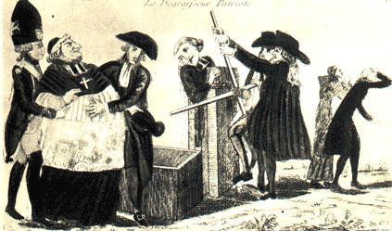
Work of the National Assembly (1789-1791)
Lands of the Catholic Church confiscated by the government and sold it (to peasants).
(help pay off debt & help peasants)

Slide 33
Work of the National Assembly (1789-1791)
4. (July 1790) Civil Constitution of the Clergy
Clergyman elected
Paid civil servants of the government
Must swear oath of allegiance to new gov’t
“break from Rome to weaken Pope in France”

Slide 34
Timeline of Revolution
d) 1791 June: Louis XVI and his family attempt to flee the country.
QUESTION – Why did the king try to flee and how do you think this affected how the French people looked at him?

Slide 35
The Friend of the People – Jean Paul Marat
Who is the Austrian woman?
Why do you suppose Marat refers to her in this way rather than by her title?
What “action” does Marat recommend?
What is the “national contribution?”
According to Marat, what should be done with it?
In reality, how was it being used?
In the summer of 1789, the French people were hungry and many were desperate. How might Marat’s words have affected them?

Slide 36
Louis’s Reaction
(Oct 1789) bread shortages drove an angry Parisian mob to Versailles & force royal family back to the city. (Louis fears future)

Slide 37
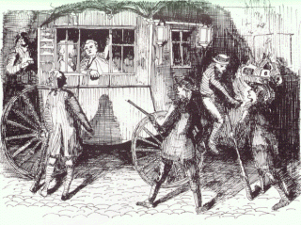
Louis’s Reaction
(June 1791) fearing limitations of new constitution, Louis & family try to flee France in disguise . . . Stopped at Varennes
Cannot have a constitutional monarchy w/out a monarch . . . Growing mistrust of Louis

Slide 38
Timeline of Revolution
E) 1791 September: Constitution completed and power turned over to Legislative Assembly.
QUESTION – What groups divided this Assembly and what role do you think this played in its effectiveness?

Slide 39
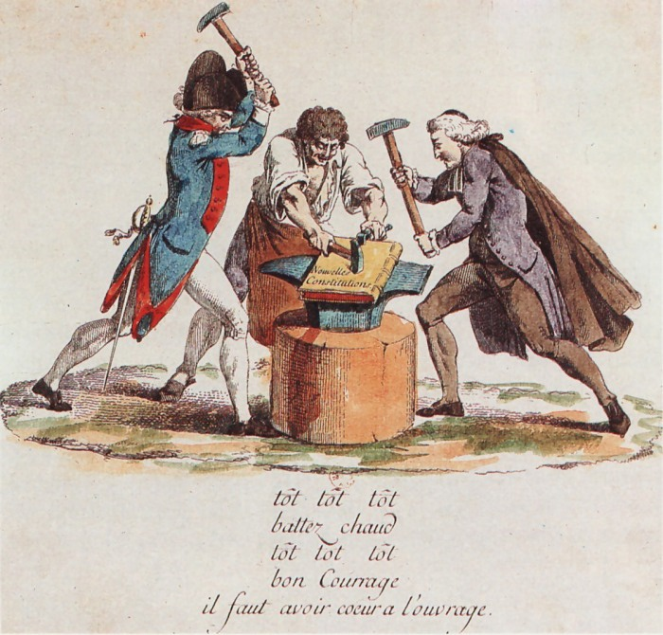
DO NOW
Did the Constitution of 1791 follow the guiding principles of “liberty, equality & fraternity?”
Explain why or why not.

Slide 40
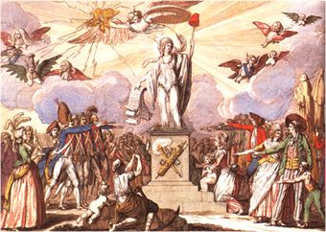
Constitution of 1791
France’s 1st written constitution; (but not last!!!)
(Sept. 1791) Created a constitutional monarchy
Separation of powers, a limited monarch &
a Legislative Assembly

Slide 41
Constitution of 1791
BUT . . .
A tax of 3 days wages to vote & property requirements to serve = “EQUALITY??”
Government created by & favored the bourgeoisie
Discontent

Slide 42
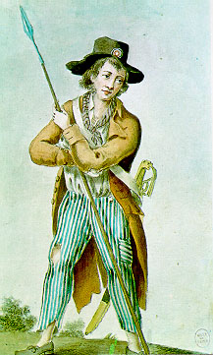
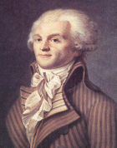
What went wrong???
1. Constitution of 1791 favored the bourgeoisie
Discontent; including radicals who want to abolish the monarchy :
“Sans-culottes”
Jacobins
New government
Divided by opposing
views which weakened
its effectiveness.
Radicals – “left”
Moderates – “center”
Conservatives – “right”

Slide 43
Timeline of Revolution
f) 1792 April: Legislative Assembly declares war on Austria.
QUESTION – What did other European monarchs fear from France & its revolution?

Slide 44
Louis’s Reaction
(June 1791) fearing limitations of new constitution, Louis & family try to flee France in disguise . . . Stopped at Varennes
Cannot have a constitutional monarchy w/out a monarch . . . Growing mistrust of Louis

Slide 45
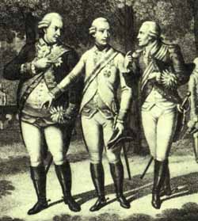
What went wrong???
Louis attempts to flee!! - (June 1791)
(mistrust of the king)
3. Foreign threat (especially Austria) & war.
Declaration of Pillnitz (Aug. 1791)
foreign demand to restore monarch
in France & pledge to protect
the royal family.
* They fear spread of revolution!
Prussian King Frederick William &
Austrian Emperor
Leopold (queen’s brother) meet with
the brother of
Louis XVI

Slide 46
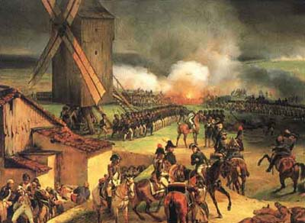
What went wrong???
France declares war 1st (April 1792)
only way to protect the revolution!!
War does not go well
initially & enemies
promise revenge
if monarch is harmed.
Sans-culottes murder
political prisoners in
September

Slide 47
Timeline of Revolution
g) 1792 Aug: Louis XVI & the Royal family imprisoned.
QUESTION – Why do you think radicals in the government deposed the king, and &
abolished monarchy?

Slide 48
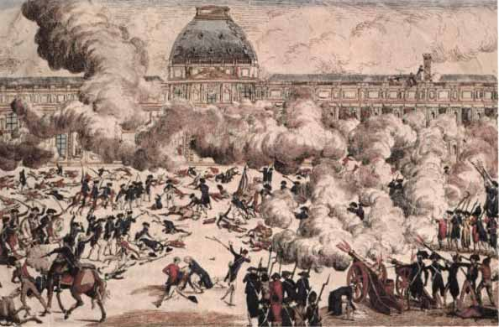
What went wrong???
4. (Aug 1792) Louis XVI & Marie Antoinette arrested for treason (country was at war)
Constitution suspended; a National Convention elected to create a republic
Controlled by radicals (Jacobins)
An angry mob storms the
Tuileries Palace, arresting
the royal family for
conspiring w/enemies.

Slide 49
What was the guillotine???
Why was it called, “the National Razor???”

Slide 50
What went wrong???
Pressure from groups discontented w/ constitution . . .
Nobles (emigres & at home)
Sans –culottes: demanding & rioting more reforms to correct inequality
Division w/in Legislative Assembly
Louis attempt to flee & strengthening of the radicals
War w/ foreign powers who now threatened the revolution

Slide 51
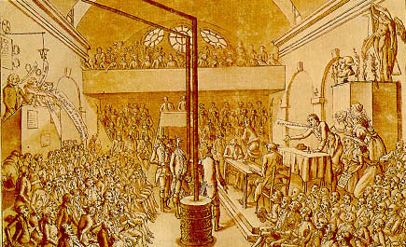
National Convention (1792-95)
(Sept 1792) A National Convention is elected by “universal manhood suffrage” and the monarchy is abolished, creating
the 1st French Republic
(see sheet for accomplishments)
The National Convention
working on yet another
constitution for
France

Slide 52
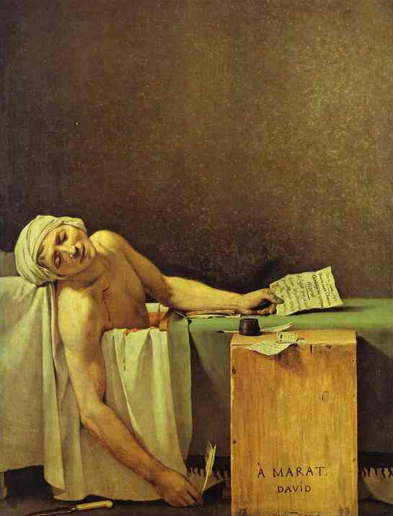
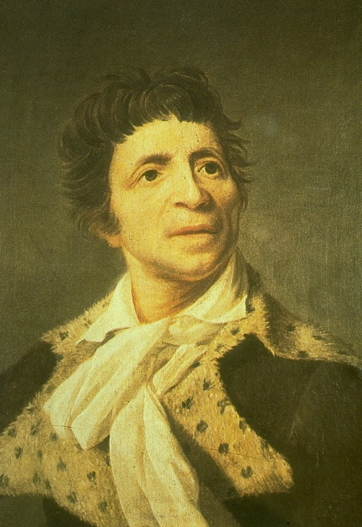
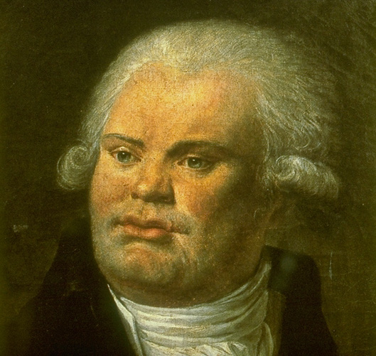
National Convention (1792-95)
It is controlled by the radical Jacobin Party who accomplish bringing about the execution of Louis XVI.
Georges Danton organized
the overthrow of the
monarchy
Jean-Paul Marat ran a Jacobin newspaper.
He was murdered by a rival political party

Slide 53
Timeline of Revolution
h) 1792 Sept: The National Convention
(the 1st French republic) was born.
QUESTION – What happened to the king on Jan 21, 1793?

Slide 54
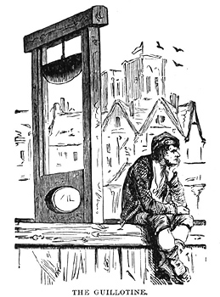
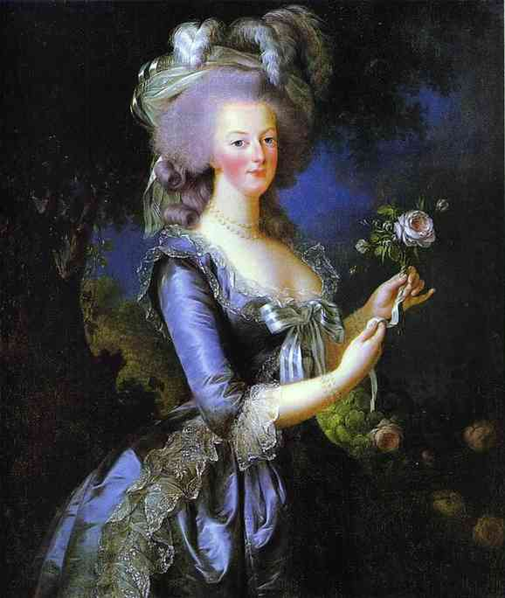
Execution of the King – Jan 21, 1793
Radical Jacobins were able to convince
the National Convention to execute
Louis XVI for his treason
Queen Marie Antoinette followed later that year
The guillotine
Aka: “National Razor.”
Execution of Louis XVI

Slide 55
IS THE KING GUILTY OF TREASON?
Suspended the National Assembly
Threatened military action vs. Nat. Assembly
Attempted to flee
Didn’t oppose Declaration of Pillnitz
Received a letter from his brother pledging to rally support in behalf of restoring his power
Delayed in reporting info from his ambassador of Prussian invasion
Delayed in carrying out various decrees of Legislative Assembly (churchmen, Swiss Guard, dismissal of officials charged w/treason)

Slide 56
Should Louis XVI have been executed?
BUT . . .
Will only exacerbate foreign hostility
Might result in plunging country into civil war
Self-preservation & fear

Slide 57
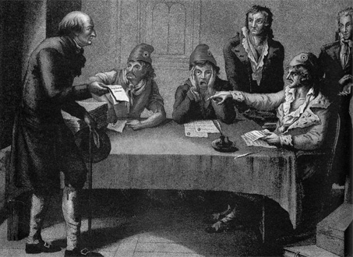
Committee of Public Safety
This 12 man committee was created to deal with the war effort abroad & internal revolt.
Victories vs. the 1st Coalition
(levee en masse & “La Marseillaise”)
It eventually amassed
dictatorial powers
to protect & promote the
Ideals of the revolution.
“Purge” France of
“counterrevolutionaries.”
Unfair Trials!

Slide 59
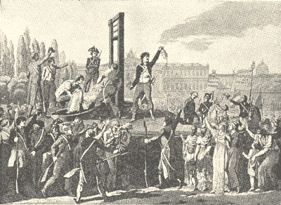
Reign of Terror (1793-1794)
Jacobin Maximilian Robespierre becomes leader of the committee & uses its power to eliminate all who oppose him = dictator
Some 30-40,000 “counterrevolutionaries” executed around country
Robespierre
The guillotine = symbol of the Reign of Terror; thousands killed in Paris alone!

Slide 60
Was “the Terror” justified?
Robespierre: “terror without virtue is murder…virtue without terror is powerless”
Virtue: goodness, morality, purity
Terror: fear or horror often brought
on due to violence

Slide 61
Thermidorean Reaction (July 27, 1794)
Robespierre arrested & executed (fear)
Ends the Terror
(no need . . . 1st Coalition enemies pushed back)
Another constitution creates The Directory (1795-1799) a moderate, but weak & corrupt republic controlled by the bourgeoisie.
The overthrow of
Robespierre

Slide 62
Matching Self-Assessment
Guillotine radicals Jacobins Reign of Terror
Emigres Legislative Assembly sans-culottes
Robespierre Danton liberty,equality,fraternity
Declaration of the Rights of Man
Declaration of Pillnitz National Convention
Committee of Public Safety

Slide 63
National Assembly or National Convention???
Formed by the 3rd estate
Responsible for executing Louis XVI
Created the 1st French Republic
Temporarily controlled by the Jacobins
Abolished all feudal privileges
Created the Committee of Public Safety
Confiscated Church land to help pay off national debt
The Reign of Terror took place during it
Limited the right to vote to those who could pay tax
All citizens could vote
Created the Civil Constitution of the Clergy
Made the Tennis Court Oath
Wrote the Declaration of the Rights of Man
Government controlled by bourgeoisie/middle class
Adopted the metric system & abolished slavery
Created a constitutional monarchy

Slide 64
National Assembly or National Convention???
Formed by the 3rd estate
NATIONAL ASSEMBLY
Responsible for executing Louis XVI
NATIONAL CONVENTION
Created the 1st French Republic
NATIONAL CONVENTION
Temporarily controlled by the Jacobins
NATIONAL CONVENTION
Abolished all feudal privileges
NATIONAL ASSEMBLY

Slide 65
National Assembly or National Convention???
Created the Committee of Public Safety
NATIONAL CONVENTION
Confiscated Church land to help pay off national debt
NATIONAL ASSEMBLY
The Reign of Terror took place during it
NATIONAL CONVENTION
Limited the right to vote to those who could pay tax
NATIONAL ASSEMBLY

Slide 66
National Assembly or National Convention???
All citizens could vote
NATIONAL CONVENTION
Created the Civil Constitution of the Clergy
NATIONAL ASSEMBLY
Made the Tennis Court Oath
NATIONAL ASSEMBLY
Wrote the Declaration of the Rights of Man
NATIONAL ASSEMBLY

Slide 67
National Assembly or National Convention???
Government controlled by bourgeoisie/middle class
NATIONAL ASSEMBLY
Adopted the metric system & abolished slavery
NATIONAL CONVENTION
Created a constitutional monarchy
NATIONAL ASSEMBLY

