Slide 1
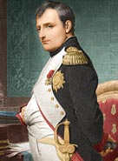
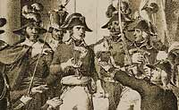
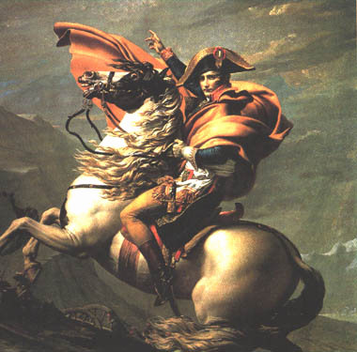
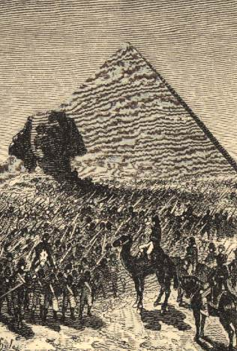
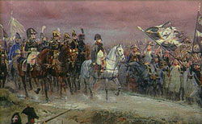
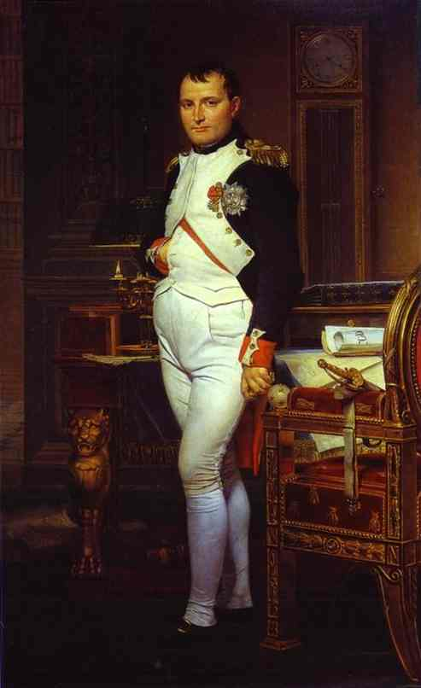
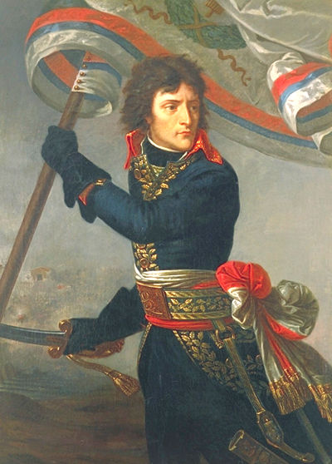
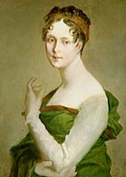
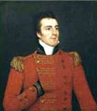
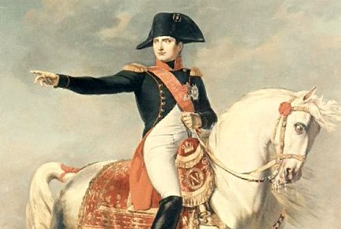
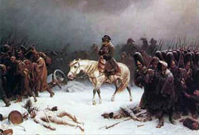
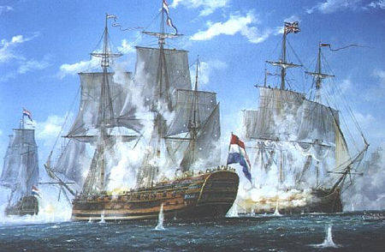
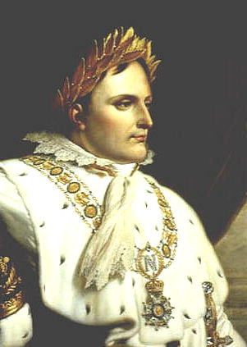
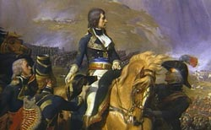
THE AGE OF NAPOLEON

Slide 2
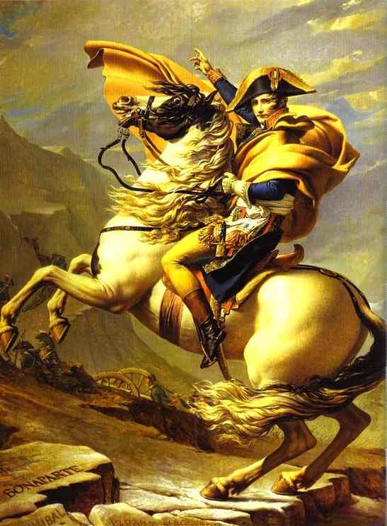
Jacques Louis David: Napoleon Crossing the Alps (1800)
What details does David use to make
Napoleon appear heroic?
Why do you suppose David wrote the names
of Hannibal & Charlemagne on the rocks?
What emotions does the painting make the
observer feel?
How might this painting have affected
Napoleon’s image in France?

Slide 3
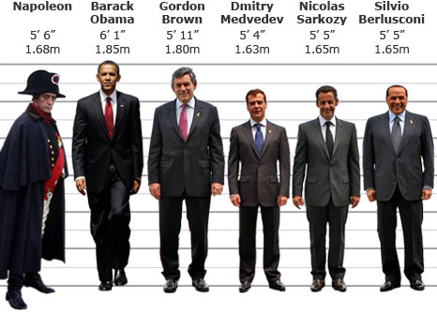
How tall was Napoleon???

Slide 4
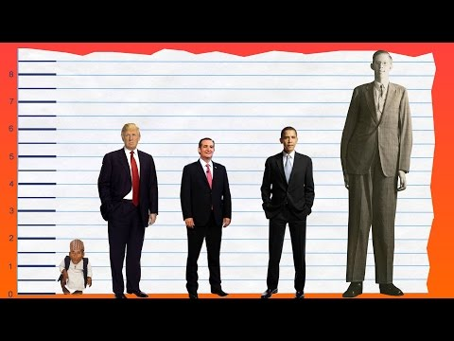
Donald Trump 6’3”

Slide 5
Propaganda – information meant to influence opinion

Slide 6
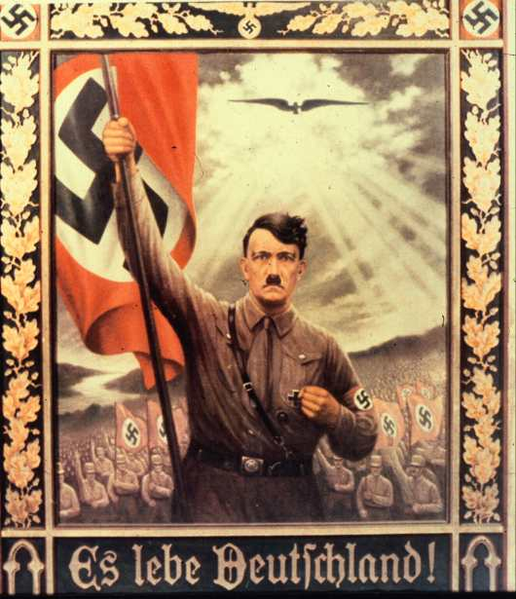
Propaganda – information meant to influence opinion

Slide 7
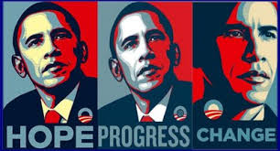
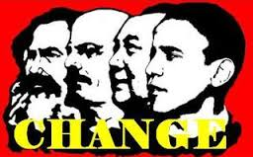
Propaganda – information meant to influence opinion

Slide 8
Marketing = Propaganda?

Slide 9
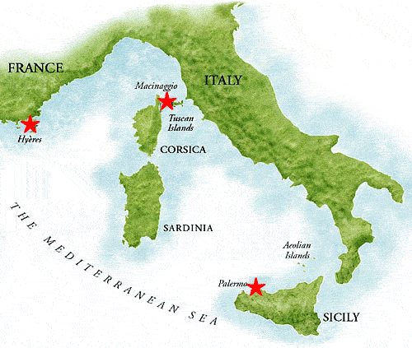
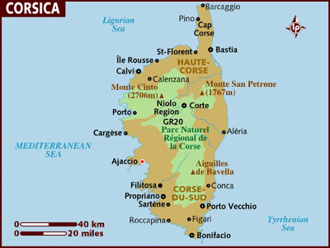
Napoleon Bonaparte (1769-1821)
Born on island of Corsica to a minor noble family
Joined the military, supported the revolution & defended the government

Slide 11
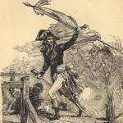
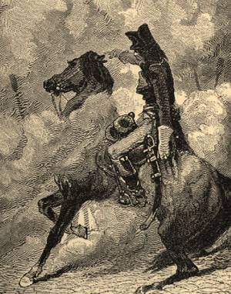
Napoleon Bonaparte(1769-1821)
Rose rapidly through the ranks; General at 24
(brilliant military mind; artillery expert)
Great success vs. Austria in Italy = hero
Napoleon defended
the government by
firing on the mob;
“a whiff of grapeshot”
Displayed genius & bravery against Austria
In Italy

Slide 12
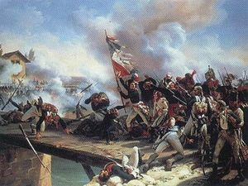
“The Little Corporal”
Napoleon leads his men into the Battle of Arcola against the Austrians (1796)

Slide 13
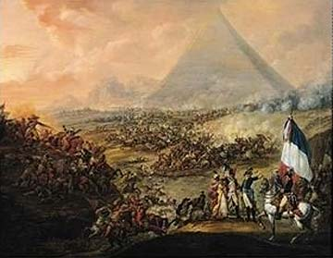
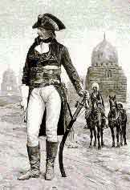
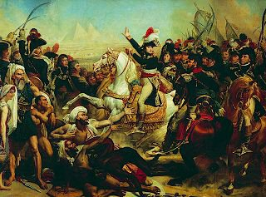
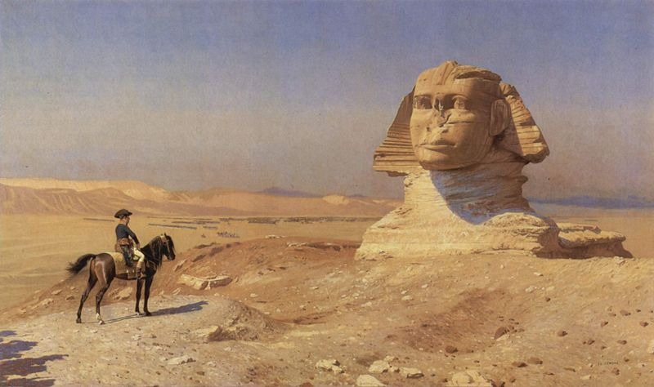
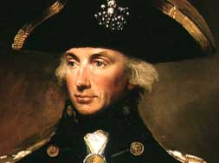
Napoleon Bonaparte (1769-1821)
Failure vs. Britain at Egypt (1799)
Victorious on land at the Battle of the Pyramids, but defeated at sea by British
Admiral Nelson,
foiling his plan in Egypt.

Slide 14
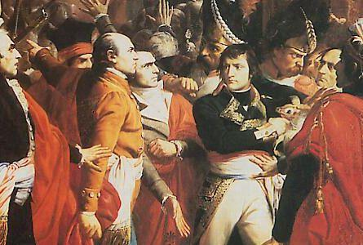
Napoleon Takes Power
Nov. 9, 1799 coup d’etat
overthrows the Directory & becomes
1st Consul (dictator)
“Revolution is over!” = stability

Slide 15
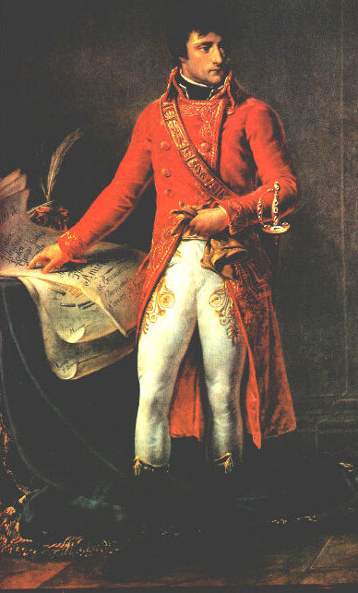
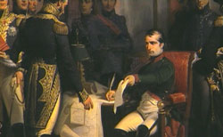
Napoleonic France
Napoleonic Code of Law (1804)
Organizes uniform tax collection
& establishes Bank of France (1800);
paid debt, stabilized the economy
& balanced the budget

Slide 16
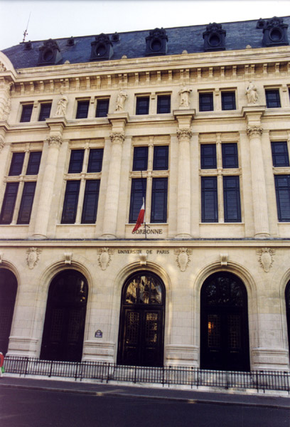
Napoleonic France
System of public education
Supervised by the University
of France

Slide 17
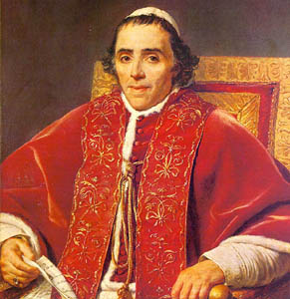
Napoleonic France
Made peace w/ the Catholic Church through the Concordat of 1801
Pope Pius VII

Slide 18
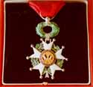
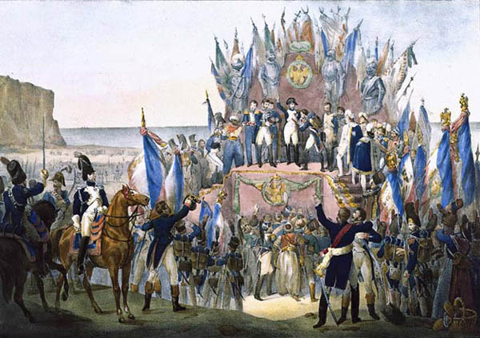
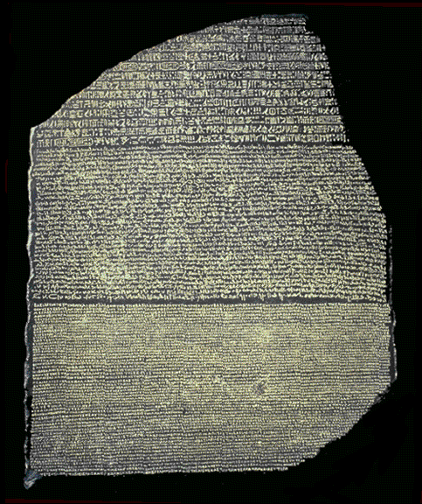
Napoleonic France
Legion of Honor recognized achievement of all
Supported arts, architecture
& science
Image of the Legion of Honor Medal
The Rosetta Stone discovered
by French troops in Egypt.
provided the “key” to
understanding hieroglyphics
thanks to Jean Champollion

Slide 19
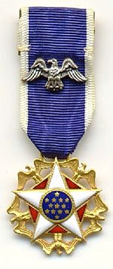
Presidential Medal of Freedom
an award bestowed by the President of the United States and is the highest civilian award of the United States. It recognizes those individuals who have made "an especially meritorious contribution
to the security or national interests of the
United States, world peace, cultural or
other significant public or private
endeavors".
http://en.wikipedia.org/wiki/List_of_Presidential_Medal_of_Freedom_recipients

Slide 20
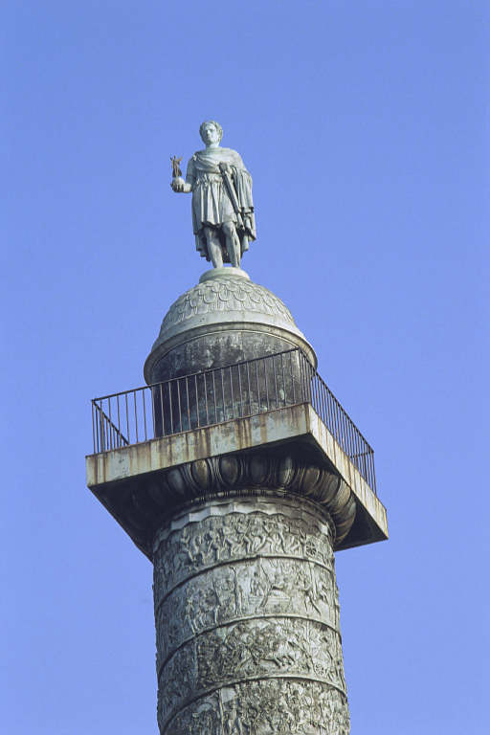
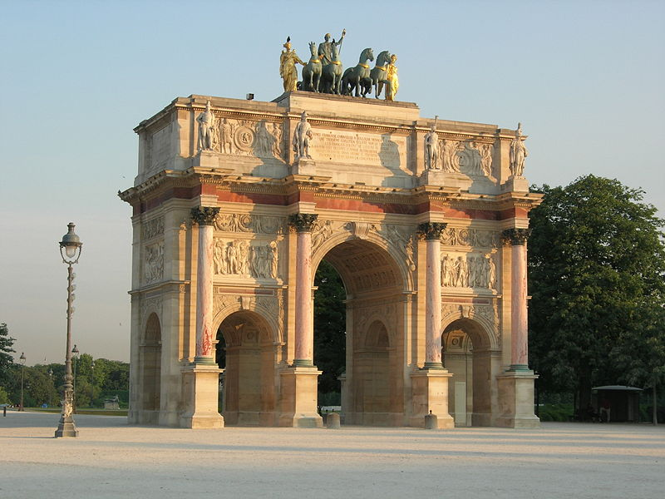
Napoleon Supports Art, Architecture & Science

Slide 21
BUT. . .
No public election of local officials (appointed)
No free speech / nor criticism of gov’t allowed
Secret police force
Propaganda
No equality for women
before the law
With support of people
(yes/no vote called a plebiscite):
made Consul for life (1802)

Slide 22
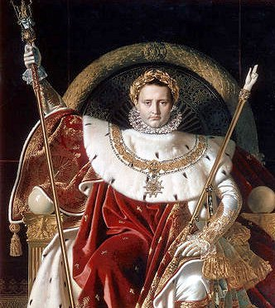
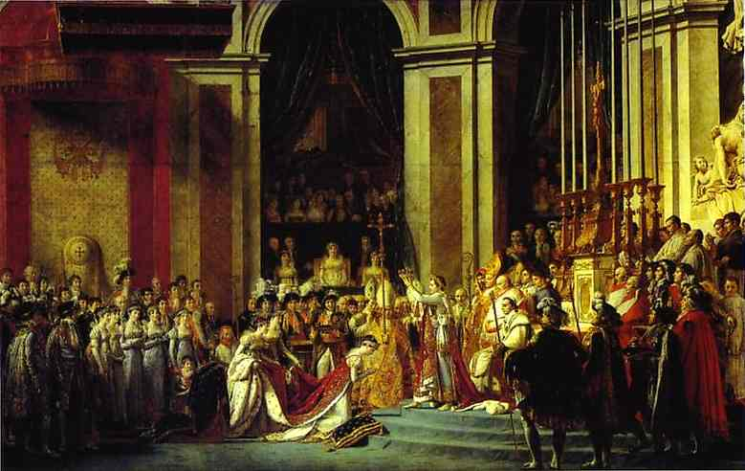
Emperor Napoleon Bonaparte
Declared emperor & crowned himself (1805)

Slide 23
Consider & Discuss:
“In exchange for equality, stability & unity, Napoleon deprived the French of their liberty”
What evidence would you use to support this statement?

Slide 24
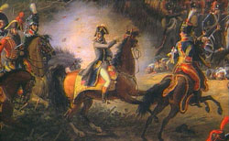
Napoleonic Europe
Defeated second coalition of Europeans
(1799-1801)
Britain & 3rd coalition by 1805
Victorious on land: (vs. Austria, Prussia) & signs a treaty with Russia
(1805) Defeats Austrian & Russian forces
at the Battle of Austerlitz
(1806) Defeats Prussia at
the Battle of Jenna

Slide 25
Napoleon’s Empire
Creates an Empire and dominates Europe
(redraws the map & places new rulers)
Desires to spread ideas of the revolution; but is ambitious & power-hungry
(viewed 1st as liberator; later occupier)

Slide 26
Resistance & Decline
What led to problems & discontent in Europe against Napoleon???
Taxes to pay for armies of occupation
Cost of the Continental System
Growing nationalism vs. French control

Slide 27
Napoleon’s Empire

Slide 28
NAPOLEON’S EMPIRE
1) Goal? 2) Success or Failure?? 3) Why???
Americas
Trafalgar
Continental System
Peninsula Campaign
Russia
100 Days

Slide 29
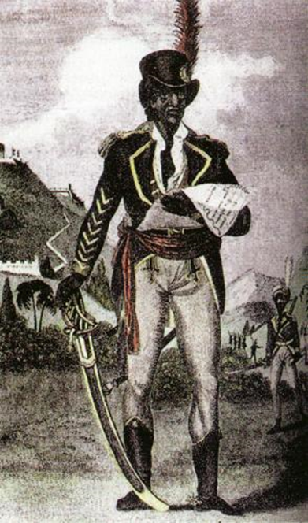
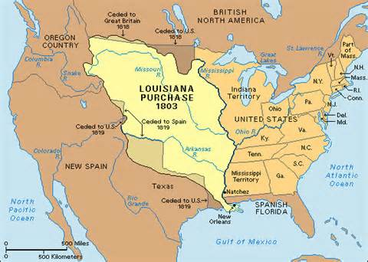
ST. DOMINIGUE
Toussaint L’Overture in Haiti
(led slave rebellion – 1790’s)
French troops wiped out by 1804
(1803) With loss of Haiti apparent, Napoleon abandons dream of an American empire & sells Louisiana Territory to the United States

Slide 30
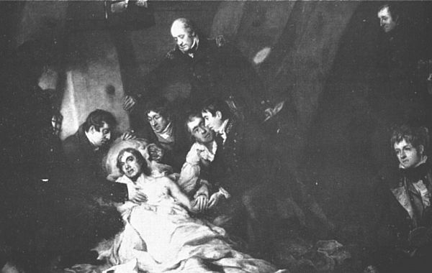
GREAT BRITAIN
Defeated by British at sea – Trafalgar (1805)
Admiral Horatio Nelson crushes Napoleon’s
Fleet off the coast of Spain ending his hopes
for invading Britain
Nelson ‘s victory came at the cost
of his life.

Slide 31
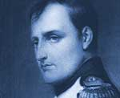
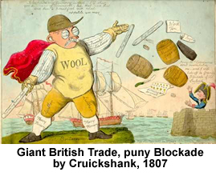
Collapse – 1. Great Britain
Called Great Britain:
“a nation of shopkeepers”
Attempts to cut off their trade
Continental System against
British trade a failure
British Navy & smuggling

Slide 32
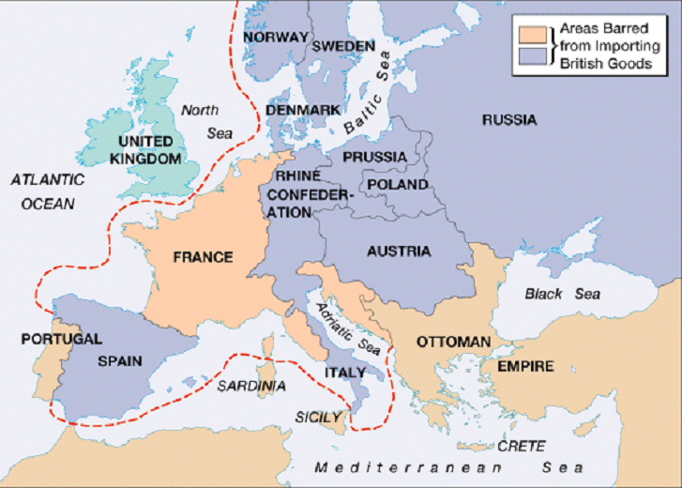
Attempt to Blockade Europe from British Trade (1806-1810)

Slide 33
2. Peninsula Campaign
Portugal’s defiance & Spanish revolt
(Peninsula Campaign & Britain’s Duke of
1808-1814 Wellington)
The Iberian Peninsula
Portugal & Spain
Joseph Bonaparte who was made
king of Spain & rejected by many.

Slide 34
2. Peninsula Campaign
Wellington’s troops aided Spain & Portugal
tormenting Napoleon’s army until he was forced
out by 1814.
Francisco Goya’s “3rd of May”
represented the horrors of war
and painted Napoleon’s army
as brutal barbarians

Slide 35
3. Russia
Russian defiance and (1812) invasion of the Grand Army (@500k men)
“scorched earth” policy & “General Winter”
Russia’s Czar Alexander I
who defied 1807
Treaty of Tilsit
The French arrive at Moscow,
only to find it in flames.

Slide 37
“General Winter” & Defeat in Russia
Napoleon retreats from Russia with a
beleaguered army
of fewer than 100,000

Slide 38
Defeat at Leipzig (1813) “Battle of the Nations”
Exiled to Elba island

Slide 39
“The 100 Days”
March 1, 1815: Napoleon returns!
March 20 –June 18 = “100 Days” in power
“If there be one among you who wishes to kill his emperor, he can.”
Napoleon’s return saw the army abandon
restored Louis XVIII
and flock to the support of
their commander & emperor.
Louis XVIII

Slide 40
WATERLOO – June 18, 1815
Coalition of nations sends army under Wellington…Napoleon defeated at Waterloo in Belgium.
Napoleon scans the battlefield at Waterloo
Prussian commander
Field Marshall Blucher
The Duke of Wellington

Slide 41
Napoleon’s Final Exile
Napoleon forced to
abdicate for good
Final exile to St. Helena
where he dies (1821)
Napoleon on his death bed (1821)
Atlantic
Ocean
Africa
S.America

Slide 42
Do Now
Did the Congress of Vienna have a positive or negative effect on 19th century Europe ? EXPLAIN!

Slide 43
Congress of Vienna (1814/1815)
International meeting to settle political & territorial questions and restore stability after 25 years of revolution & warfare.
Delegates represented many countries, but main ones from Austria, Britain, Russia,
Prussia & France
Chairman: Prince Metternich
(Austria)

Slide 44
REACTIONARIES
Purpose – “turn back the clock”
Reactionaries: want to remove changes made & revert back to the way things were

Slide 45
Congress of Vienna - Purposes
Restore legitimate rulers to power
Establish a “balance of power”
Redraw map of Europe
Pre-French Revolution (1790)
“spoils” of war
“surround” France
Louis XVIII
Bourbon king
Of France

Slide 46
Balance of Power:
Maintaining an even distribution of international power & politics to preserve national security.
(No one gets too strong & threatens the others!)

Slide 48
Congress of Vienna - Purposes
Prevent future revolutions
Created a system of alliances
“Concert of Europe”
Principle of intervention
“Metternich System”
(stopped revolutions in
Germany, Spain & Portugal)

Slide 49
New Ideas
New Ideas fuelled revolution in Europe:
Liberalism: grew from
Enlightenment ideas
Equality before the law
Individual rights & freedoms
(speech, press, assembly)
Representative government
A bill of rights &
written constitution

Slide 50
Some opponents:
Conservatives = Old / traditional ways
(monarchy & privileged nobility)
Liberal: Many middle class bourgeoisie support several ideas of liberalism, but not in favor of real democracy for all
Radicals favored democratic ideal for all people

Slide 51
New Ideas
Nationalism: feelings of loyalty to one’s country; the belief that people who share a common language, culture, history and/or tradition have a right to unify & rule themselves
Some groups were ruled by others (Austria)
Some groups were scattered with no country
(Italy & Germany)

Slide 52
Spread of Revolution
The reactionaries at the Congress of Vienna wanted to reverse changes & stop these ideas from spreading …
How can you kill an idea ?
“Metternich System” had
early success with stopping
Revolution & change.
Revolutionaries fighting
for a united German nation
and a representative
government.

Slide 53
Congress of Vienna (1814/15)
Members and
Representatives
Goals
Prevent future
French aggression & revolutions
Restore balance of power
Restore legitimate rulers
Maintain lasting peace
5 Great powers (Austria, Russia, Britain, France & Prussia)
Prince Metternich
Actions
Taken
Redraw map of Europe
Restored old monarchies
Alliances
Nationalism & revolutions
Principle of Intervention = “Metternich System”
Legacy or
Effects

Slide 54
Revolutions in Latin America (1790’s-1830)
Influenced by Enlightenment ideas as well as the success of the American & French Revolutions, colonists in Latin America seize opportunities to gain freedom
“Creoles”
“Napoleon effect”
Toussaint L’Overture in Haiti
(led slave rebellion – 1790’s)

Slide 55
Revolutions in Latin Americas (1790’s-1830)
Military “juntas”
Simon Bolivar & Jose de San Martin in South America
Fathers Hidalgo & Morelos in Mexico
Dom Pedro in Brazil
Bolivar – “The Liberator”

Slide 56
Latin American Revolutions

Slide 57
Latin America
Effects: independence, but instability due to:
great economic class divisions
little economic improvement for commoners
regional differences
frequent military “caudillos”
Porfirio Diaz
Of Mexico

Slide 59
Revolutions
(1821-1830)- Greece
revolts and win independence from the weakening Ottoman Turks
The naval battle of Navarino (1827)

Slide 60
Revolutions
(1830) – some revolutionary success in France & Belgium
Delacroix’s “Lady Liberty”
leading revolutionaries
in Paris.

Slide 61
Continued Revolution in France
Louis XVIII – a constitutional monarch
(1824) Charles X – tries to restore
absolutism
Led to revolution of 1830

Slide 63
Continued Revolution in France
Louis Philippe = “citizen king”
& constitutional monarchy
(1848) Ineffective government
& worker discontent led to revolt.
King Louis abdicates
Following a failed worker uprising
in Paris, the new constitution creates the
2nd French Republic and the people
elect Louis Napoleon Bonaparte
president!!!

Slide 64
Louis Napoleon Bonaparte
YUP, just like his uncle! (almost)
Domestic reforms win the people
Dictator (1851)
Emperor (1852)
Aggressive foreign policy
BUT, not the same
military commander
(1870) Defeated by Prussians & captured
3rd French Republic declared (sigh, another constitution)

Slide 65
1848 – “Year of Revolutions”
start in France
“When France sneezes, Europe catches a cold” - Metternich
Louis Napoleon

Slide 67
Do Now
How did nationalism lead to the weakening of the Austrian, Russian & Ottoman Empires?

Slide 68
Austrian Empire
Austrian Empire
was made up
of many
different
ethnic groups
under
Austrian control
(Hapsburg Family)

Slide 69
Austria-Hungary
(1848) Louis Kossuth led the the Magyars (largest ethnic group) in nationalist revolt. (largely unsuccessful)
Louis Kossuth

Slide 70
Austria-Hungary
Emperor Franz Joseph (1848-1916) & the
Compromise of 1867
Creates the “Dual Monarchy”
(Austria-Hungary)
2 separate parliaments
One ruler
Other ethnic groups unsatisfied (Serbs)

Slide 71
The Ottoman Empire
The Ottoman Turks reached their heights of power during late 15-early 1600’s

Slide 72
“Sick Man of Europe”
Russia & Austria look to capitalize on this decline in Eastern Europe
Crimean War (1854-56)
Russia sought to take advantage
of the Turks …but fail, thanks to British & French
Involvement (this ends the “Concert of Europe”)
After the war, Austria looked to make
gains in the Balkans.

Slide 73
The Balkans

Slide 75
Austria & Eastern Europe
Austria’s control over Slavic people of the East (Balkans) was slipping due to nationalism.
(Pan Slavism)
Russia & Ottoman Empire also have influence here:
Competition
The Balkans = a “powder keg”

Slide 76
Assassination of Alexander II March - 1881
Czar Alexander II
Alexander III

Slide 77
RUSSIAN EMPIRE
Czars of the Romanov dynasty
Diverse ethnic make-up
Romanov’s determined to maintain “iron control” over this diversity
“Russification” – forced all ethnic groups within the empire to accept and practice Russian language, culture & customs.
Resulted in hatred & greater nationalist feelings, weakening the empire & leading to defeats against enemies.

