Slide 1
FIGURES OF THE RENAISSANCE
DIRECTIONS: Create a Google Doc that answers the questions and provides the images according to the directions for each of the following Renaissance personalities.
All answers must be in complete sentences to receive full credit. All images must have a name/title to identify what they are.
You may work together and share your research, to complete the assignment to be submitted.

Slide 2
Directions continued:
Be sure to label the people, questions & letters for each of the answers on your document.
EXAMPLE:
Leonardo da Vinci
1.
2.
(image)
3.
4.
5.
a)
b)

Slide 3
Leonardo da Vinci
1) Where was he from & when did he live?
2) Why can he be described as a pioneer in human
anatomy & biology?
Provide a picture/image that verifies this and explain
what it is.
3) Why can he be called a “man ahead of his time?”
Provide an image that verifies this & explain what it is?
4) Explain why he can be accurately called a “Renaissance Man”
5) Identify each of the images on the next slide including, what it is/called, what it shows, when it was created & where it is today:

Slide 4
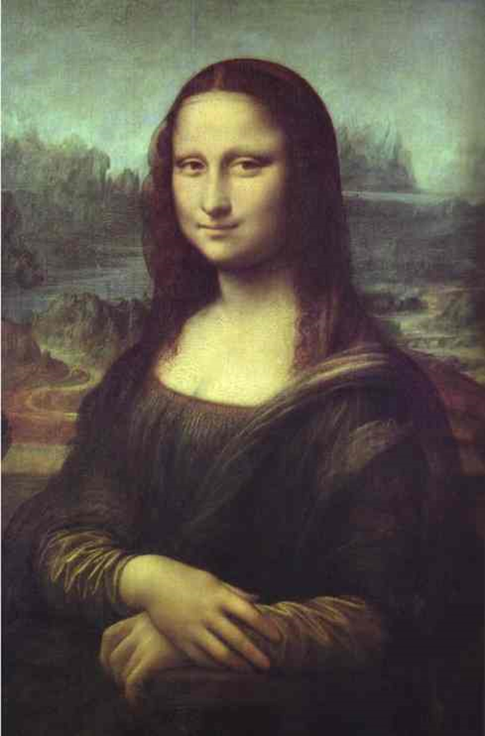
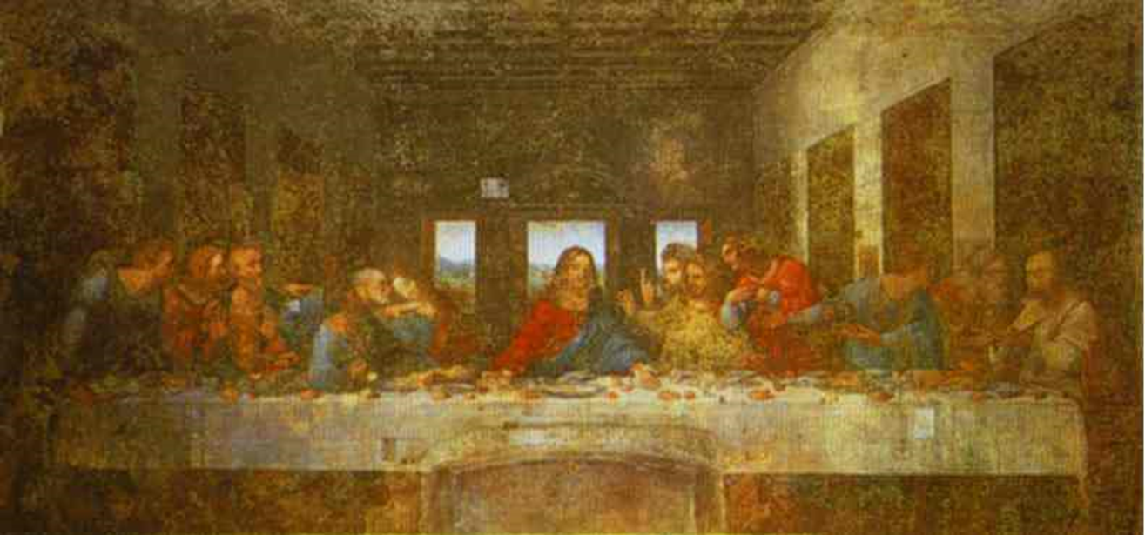
Leonardo da Vinci
(A) (B)

Slide 5
Michelangelo Buonarroti
1) Where was he from & when did he live?
2) Who were some of his most famous patrons?
3) Michelangelo believed his greatest talent was sculpting, provide the image of his most famous sculpture…what is it? Where is it found today?
4) Why he can be accurately called a Renaissance Man?
5) Find one quote credited to Michelangelo about art.
6) Identify each of the images on the next slide including,
what it is/called, what it shows, when it was created & where it is today:

Slide 6
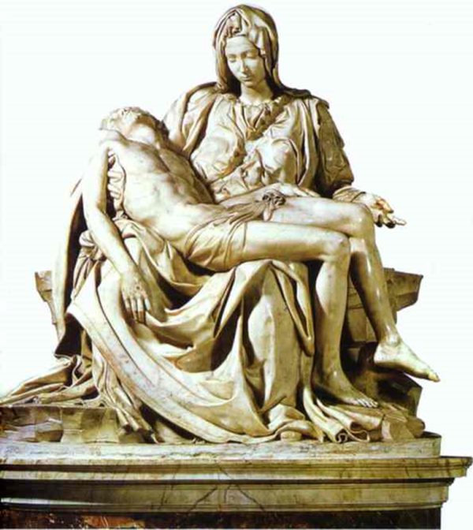
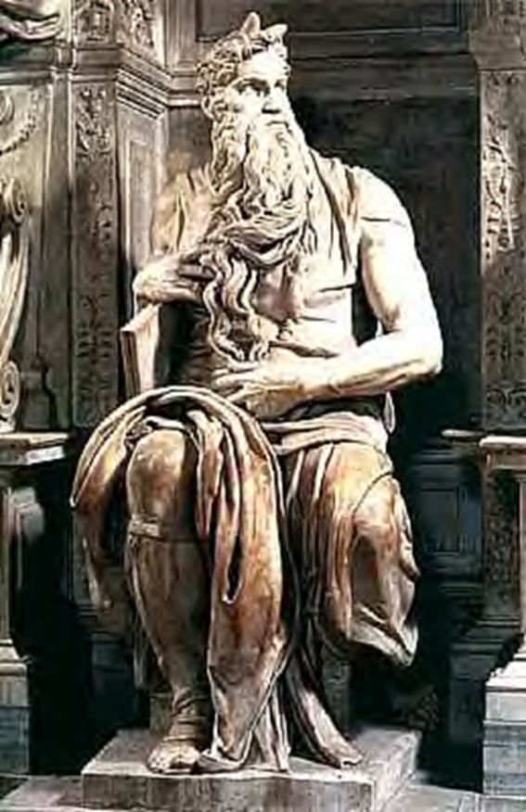
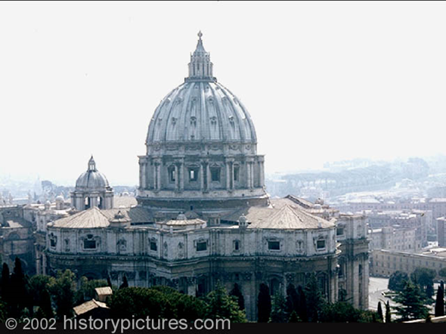
Michelangelo
(A) (B)
(C)

Slide 7
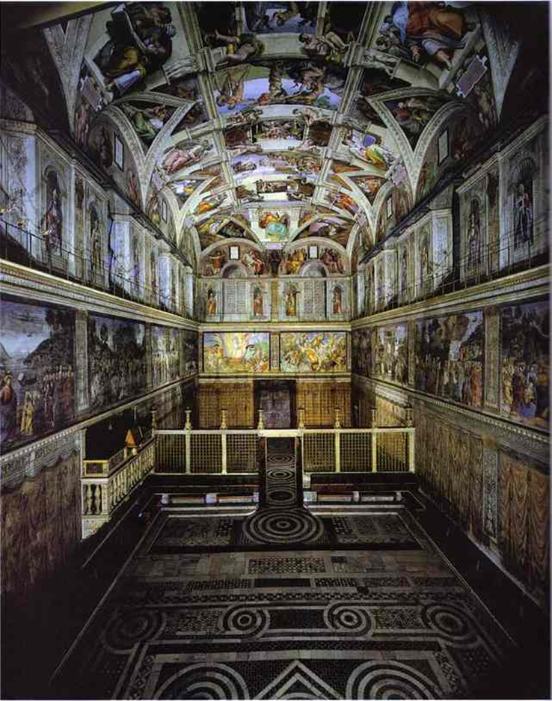
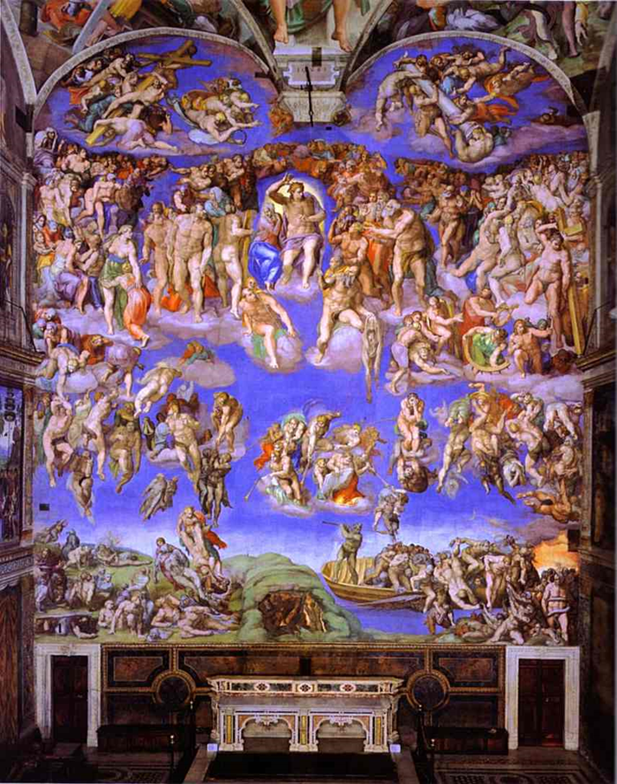
Michelangelo
(D) (E)

Slide 8
Raphael Santi
1) Where was he from & when did he live?
2) What is his most famous painting?
Provide an image of it.
3) When did he paint it?
4) Where is it currently located?
5) Name at least TWO famous people who are shown in the scene.

Slide 9
Filippo Brunelleschi
1) Where was he from & when did he live?
2) Brunelleschi was the first major architect of the Renaissance. Provide an image of his famous dome of the Santa Marie del Fiore Cathedral in Florence.
3) Why is it so famous?
4) He lost a commission to create the bronze doors of the Florence Baptistery to whom? Provide an image of the doors.

Slide 10
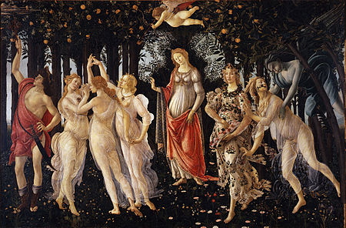
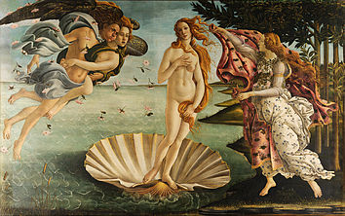
Sandro Botticelli
(1) Where was he from & when did he live?
(2) Identify his two following works below, indicating what they are called, what they show or represent & when they were painted.
(A) (B)

Slide 11
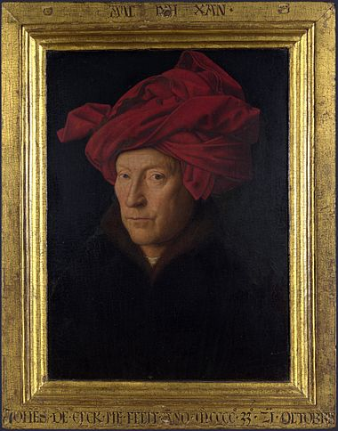
Jan van Eyck
(1) Where was he from & when did he live?
(2) Who is the person in The Portrait of a Man in a Turban shown below thought to be?

Slide 12
Jan van Eyck
(3) Van Eyck’s most famous work is called The Arnolfini Portrait. Provide an image of this painting.
(4) What does it show?
(5) What is the curious oddity seen within this painting?
(6) It is recognized as one of the first paintings to use what kind of paint?
(7) Where is the painting today?

Slide 13
William Shakespeare
(1) Who was he? Where was he born? When did he live?
(2) What skill first made him famous?
(3) Why was the time during which he lived called the “Elizabethan Age?”
(4) How do Shakespeare’s works show Renaissance influence?
(5) Of what type are his most famous poems? Describe.

Slide 14
William Shakespeare
(6) Provide images of/from THREE of his most famous plays. Identify the names of the plays that go with each picture/image.
(7) In what famous theatre in England were many of Shakespeare’s plays performed? Provide an image.
(8) What is the epitaph inscribed on Shakespeare’s grave stone at Holy Trinity Church?

Slide 15
Niccolo Machiavelli
(1) Who was he? Where was he from? When did he live?
(2) What is his single most famous work?
(3)What is it about? What was his purpose for writing it?
(4) Identify TWO main ideas or themes that are portrayed in this book.

