Slide 1
ENGLAND & THE UNITED STATES
How many similarities can you identify between the English government that formed by the end of the 1600’s and our government today, which first formed in the 1780’s?

Slide 2
Similarities to the U.S.
Limited power of the chief executive
a representative body of the people
Representatives of the people make laws & levy taxes
A Bill of Rights protecting the people
Use of “common law”
Jury systems
Right to be informed of charge
Right to a “speedy” trial
No cruel/unusual punishment

Slide 3
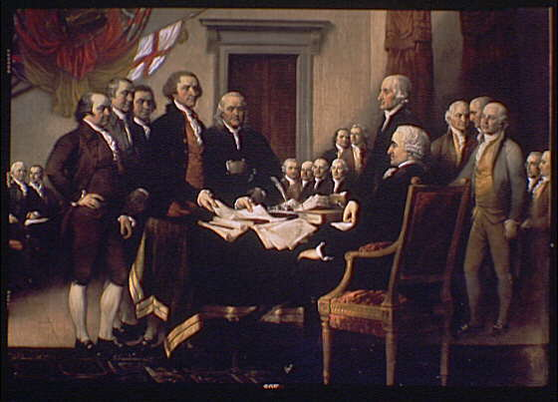
Similarities to the U.S. Is this a coincidence???
NO, our “Founding Fathers” who wrote the U.S. Constitution were originally British subjects raised in the British political & legal tradition during the 1700’s . . .
The generation after Parliament’s actions.

Slide 4
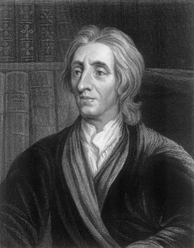
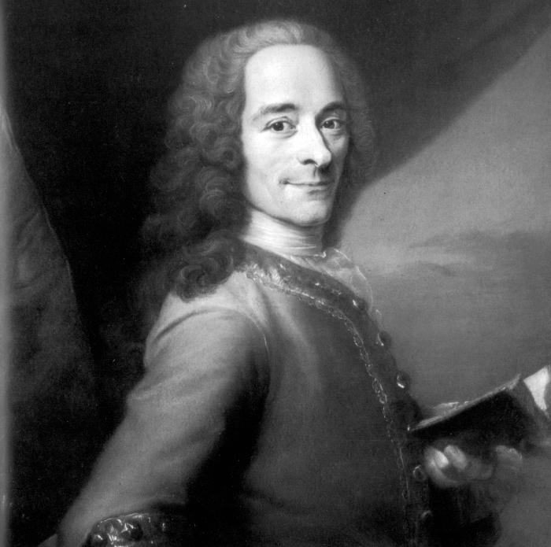
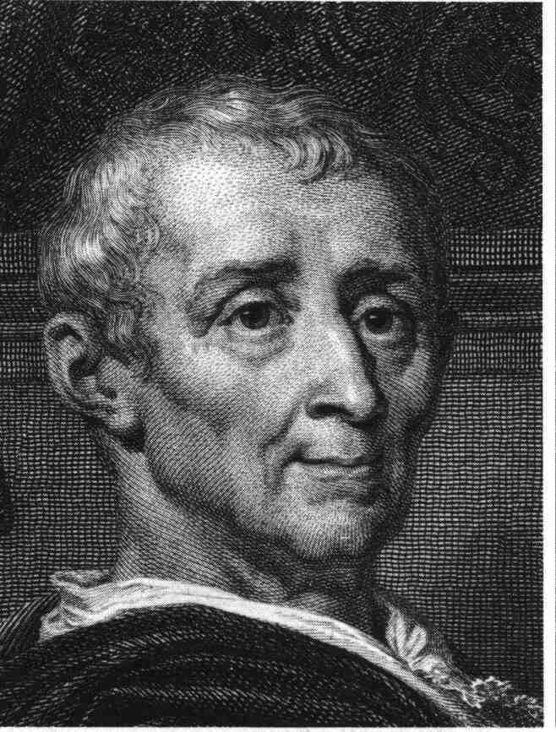
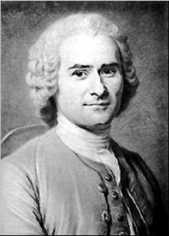
Impact of Enlightenment
How did British political & legal system by the late 17th century, as well as John Locke & thinkers of the Enlightenment influence our “Founding Fathers” who created the Constitution of the United States?

Slide 5
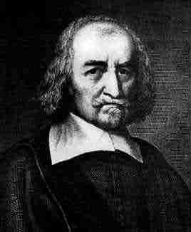
New Ideas on Government
Thomas Hobbes (1588-1679)
English philosopher
Wrote Leviathan (1651)
Selfishness & greed of humans
The “social contract”
Supported absolute monarchy to maintain order & a stable society if need be
People keep right to protect their lives

Slide 6
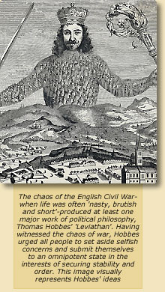
Thomas Hobbes’
“Leviathan”

Slide 7
New Ideas on Government
John Locke (1632-1704)
English scholar & philosopher
Wrote Two Treatises of Government
(1690)
Through the “social contract”,
people grant gov’t power to keep order & protect their rights
People have “natural rights”
(life, liberty & property)
People can change the government if it fails to protect those rights…even by rebellion

Slide 8
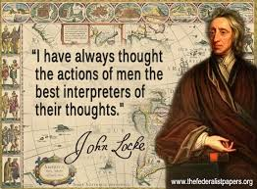
On Human Understanding . . .
“tabula rasa” – all knowledge is learned through experience, not innate. Importance of education.
By calling the mind a blank sheet of paper, Locke means to claim that the mind at birth contains no ideas. Experience must then "write" on the mind by furnishing it with ideas.

Slide 9
Hobbes or Locke?
The “social contract” grants the ruler absolute power
Without absolute rule there is anarchy
Wrote Two Treatisies of Government
Wrote Leviathan
People should give up only some of their rights for order
People sacrifice their rights for order & protection
The “social contract” is where people grant the gov’t power to establish order & protection
People are entitled to “natural rights” (life,liberty,property)
People only keep the right to protect their lives.
People have the right to replace an ineffective ruler

Slide 10
Who’s Ideas? What document?
When in the course of human events it becomes necessary for one people to dissolve the political bonds
……equal station to which laws of nature & of nature’s God entitle them
…we hold these truths to be self evident, that all men are created equal, that they are endowed by their Creator with certain unalienable rights…Life, Liberty & pursuit of Happiness
…to secure these rights, Governments are instituted…deriving just power from the consent of governed…when gov’t becomes destructive to these ends, it is the right of the people to alter or abolish it

Slide 11
The Enlightenment
“Age of Reason” (1687-1789): logic & reason of science can help us understand and improve society.
Locke inspired “Founding Fathers” of the American Revolution as well as several French thinkers.
Paris became the center of the
Enlightenment.
Salons: social gatherings where thinkers
discussed new ideas
(woman often hosted!)

Slide 12
The Enlightenment
Characteristics of Enlightenment Thought:
Using reason to understand & improve society
Freedom of thought
Get rid of “superstition” & promote tolerance for religions
Progress for the future
Importance of education
Economics: vs. mercantilism; Individualism
Adam Smith – competition & “laissez-faire”
7. Humanitarianism
(ease human suffering . . . vs. slavery, war, religious persecution, poor treatment of physically or mentally ill, cruel or unusual punishment)

Slide 13
Enlightenment Ideas
Rousseau: Government is created by a contract among the people and receives its powers from them.
Locke: All men have certain natural rights (life, liberty, property). The purpose of government is to protect these; if it fails to do so, people may set up a new gov’t.
Montesquieu: There is no liberty if judicial power is not separated from the legislative & executive branches.
Voltaire: We respect those who lead by the force of truth not who enslave men by violence. Popular government is therefore, less unjust and less hated that despotic.

Slide 14
Rousseau - Government of the people, by the people and for the people
Voltaire – I may not agree with what you say, but I will defend to the death your right to say it.

Slide 15
The Enlightenment
Denis Diderot’s- Encyclopedia (20+ years)
28 volumes to organize all knowledge
Many famous / noted contributors
Encompasses all human knowledge
To educate & inform
Criticizes injustices & inequalities
of society & its institutions
Promotes idea of progress
Denis Diderot (1713-1784)

Slide 16
Baron de Montesquieu (1689-1755)
Wrote Spirit of the Laws (1748)
Liberty best achieved through a
“separation of powers” so one man/group can’t abuse power
“checks & balances”
Legislative = makes laws
Executive = enforce laws
Judicial = interprets laws

Slide 17
Francois Arouet – “Voltaire” (1694-1778)
Most famous Enlightenment thinker/writer
Criticized society’s institutions; used satire
(Church, absolute rule)
Supported a government where educated people used reason
Freedoms (speech, religion, etc)
“I may not agree with what
you say, but I will defend to the
death your right to say it.”

Slide 18
Jean Jacques Rousseau (1712-1778)
Wrote The Social Contract (1762)
“man is born good, but is corrupted by immoral laws and society”
Man must be free to live under a government of his choice… “popular sovereignty”
“Only the general will (of the people)
can direct the state in a manner that is appropriate for the common good.”

Slide 19
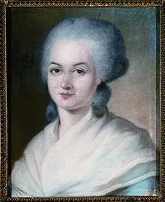
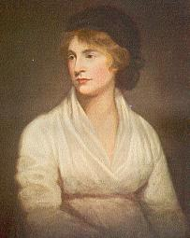
Olympe De Gouges & Mary Wollstonecraft
Declaration of the Rights of Women (1791)
exposes the failure of French Revolution
to attain gender equality
executed during the French Revolution
A Vindication of the Rights of Women
(1792): Arbitrary power of men over
women is wrong.
Women have reason & entitled to same
rights as men
De Gouges
Wollstonecraft

