Slide 1
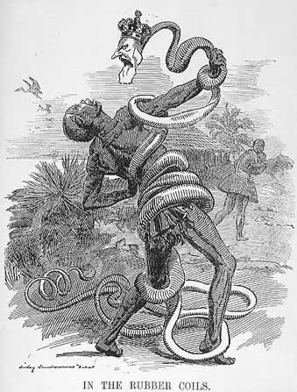
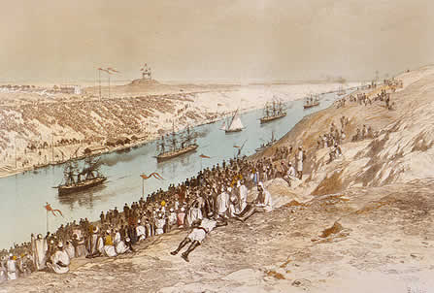
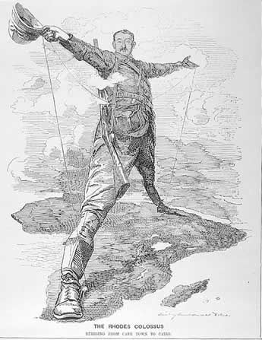
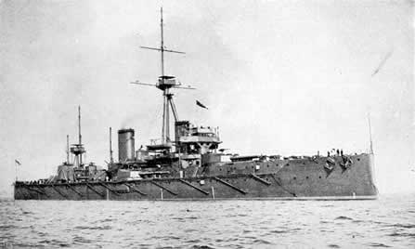
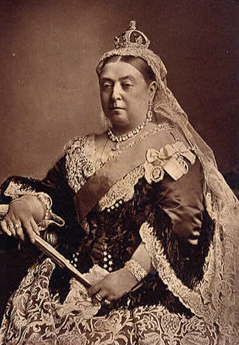
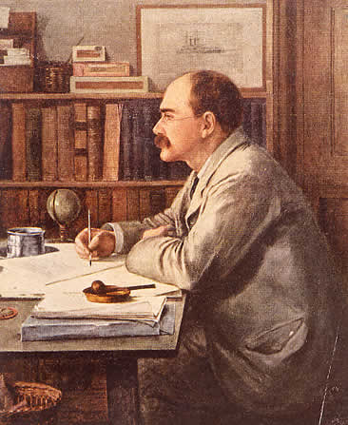
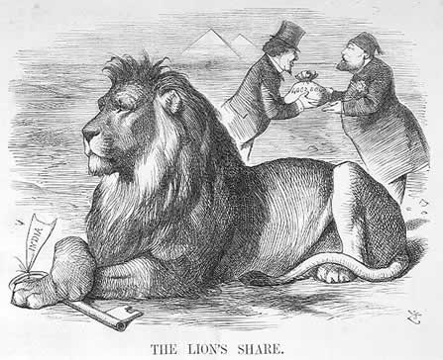
The Age of Imperialism

Slide 2
Source Questions
What forces stimulated late 19th-early 20th century imperialism?
How was this wave of European expansion different from that of the 15th & 16th centuries?
How was imperialism dangerous? Cite specific examples.
Where were imperial attitudes a danger on the continent of Europe itself?
What were the effects of imperialism in both Europe & abroad?

Slide 3
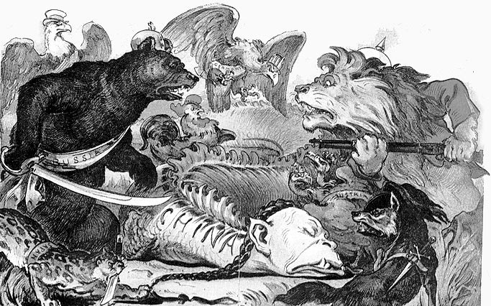
DO NOW
What motives or factors drove nations to take colonies & build empires during the “new” imperialism of the late 19th & early 20th century?

Slide 4
Imperialism
Transparency 12 (stampeding elephants)
Based upon what you see, what is going to happen?
If this cartoon were to represent the “New Imperialism of the late 19th century,” who do the elephants represent?
The frogs?
3. What does this cartoon say about this New Imperialism (Interpret what the cartoon suggests.)
Transparency 27 (England as an octopus)
(the arms are touching Egypt, India, Canada, Cape Colony, Gibraltar, Australia, Cyprus, Ireland, Jamaica)
Based upon what you see, explain the quote,
“The sun never set on the British Empire.”
2. What benefits did England get from this empire? Difficulties?
3. Why do you think a small country like England was able to control this empire?

Slide 5
The “New” Imperialism
Imperialism = “empire building”; control by one nation over another weaker nation or area.
1. “Old” Imperialism (1400’s-1700’s)
Motivated by trade; “mercantilism”
By 17oo’s many colonies were liabilities
“New” Imperialism (1800’s-1914)
a) Economic Reasons
Industrialization = need for raw materials,
new markets and investment in colonial development (self-sufficiency & favorable balance of trade)

Slide 6
Belgian Congo
A colony initially controlled by King Leopold II of Belgium, who exploited the natives & the resources (rubber & ivory)
Belgian government eventually was forced to administer here.

Slide 7
“New” Imperialism
Political
Nationalistic Pride
Competition & balance of power
Defense: Strategic locations & naval race
(ex: waterways, naval bases & refueling stations)

Slide 8
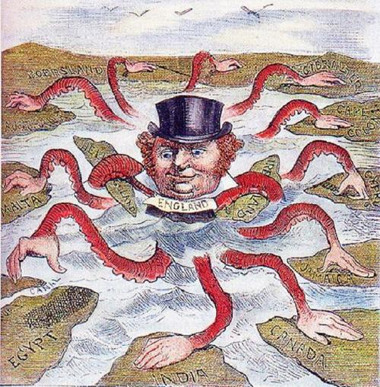

Slide 9
The sun never set on the British Empire

Slide 10
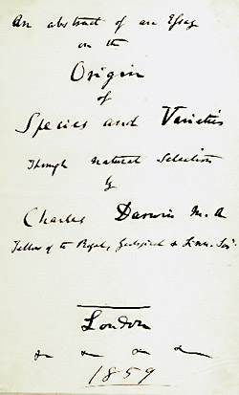
“New” Imperialism
Social
Overpopulation in Europe…new opportunities
Social Darwinism - “survival of the fittest”
Missionary activity & the “White Man’s Burden”
- Cover to Darwin’s
Origin of Species
Author/Poet
Rudyard Kipling -

Slide 11
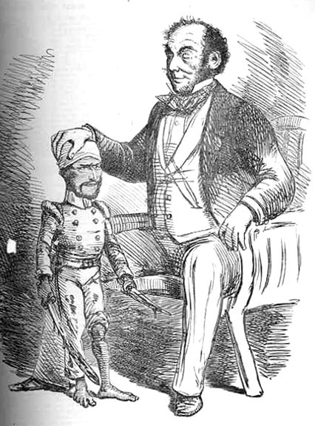
“White Man’s Burden”
Paternalism: Non-western/European natives who live in areas controlled by imperialist powers should be “watched over” and taken care of like children.
Providing for their needs, but
not giving them “rights.”

Slide 12
The White Man’s Burden
Take up the White Man’s Burden – Send forth the best ye breed
Go bind your sons to exile To serve your captive’s need
To wait in heavy harness On fluttered folk & wild
Your new caught sullen peoples, Half devil & half child . . .
Take up the White Man’s burden – The savage wars of peace
Fill full the mouth of Famine And bid the sickness cease
And when your goal is nearest The end for others sought
Watch sloth & heathen folly Bring all your hope to nought
Take up the White Man’s burden Ye dare not stoop to less
Nor call too loud on Freedom To cloak your weariness

Slide 13
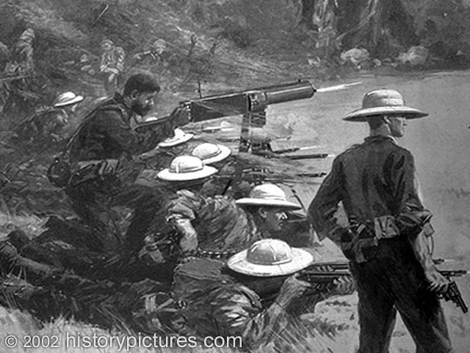
“New” Imperialism
Technological & Military Innovations
Improved transportation & communication
(steam power)
More advanced weaponry
Dreadnought Maxim Gun

Slide 14
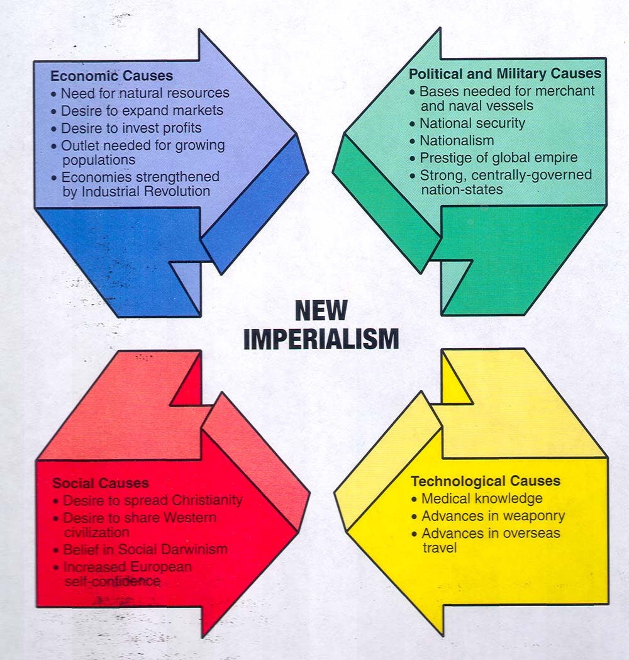

Slide 15
Imperialist Forms
Colony: a settlement established by one country in the region of another. The foreign nation gains control.
Protectorate : Native ruler retains title of office, but “protecting” power controls foreign policy.
3. Sphere of influence: A nation gains partial/total economic (trading) power, which leads to political involvement to protect interests.

Slide 16
Concession: A foreign nation gets certain, special privileges. (land to build a RR, control over ports, rights to access or control resources)
“Direct” - FRANCE &
“Indirect” Rule - BRITAIN
(paternalism & assimilation)
The “scramble” to acquire colonies by modernized/industrialized nations of Europe, US & Japan touched all corners of the globe & led to competitive rivalry fueled by nationalism.

Slide 17
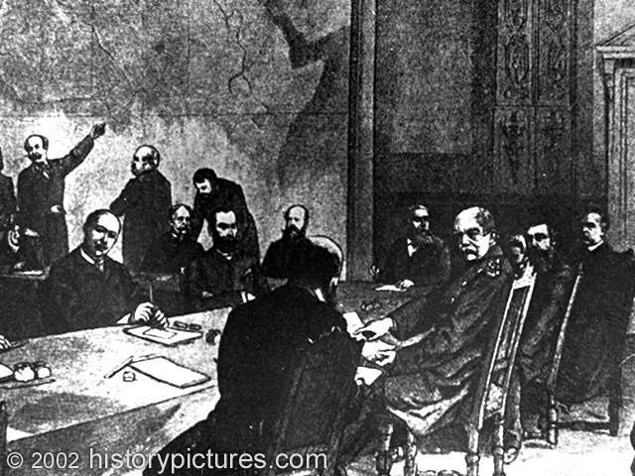
Imperialism in Africa
North Africa
As Ottoman Empire declined, its influence over N. Africa & the Middle East diminished.
(1884) Berlin Conferences addressed the “Scramble” for Africa & established rules competing nations would follow.
No African representatives
were invited to attend.
No attention was paid to ethnic
or tribal borders.
RULES
1-must notify other nations
of territorial claims
2-territory could not be
claimed unless occupied.
3-Arbitration to settle disputes.

Slide 20
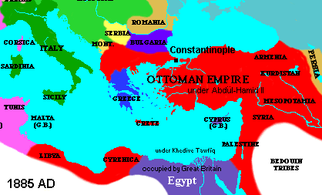
Imperialism & the “Sick Man”
The decline of the Ottoman Empire, led to competition & rivalry over its territory
1820’s-50’s - British & Russians compete for control of various Middle East areas slipping from Ottoman grasp.
Competition
Over
Persia
(oil
&
tobacco)

Slide 21
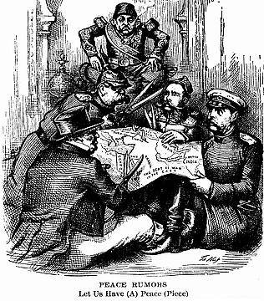
Imperialism & the “Sick Man”

Slide 22
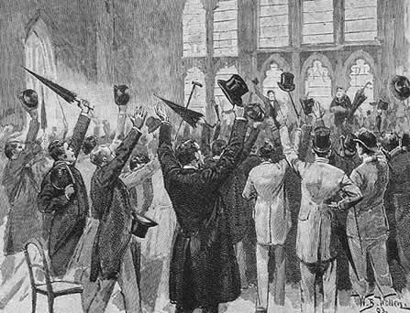
Imperialism in Africa
1830’s – French take Algeria
1870’s – French take Tunisia
Early 1900’s – dispute between France & Germany (Kaiser William II) over Morocco…close to war;
French claims were recognized
Tripoli: 1911 invasion & capture by Italy ; “worthless” colony (Libya)…prestige.
“jingoism” &
“saber rattling”

Slide 23
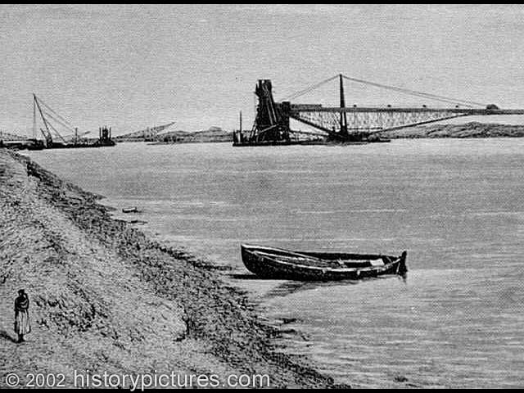
Imperialism in Africa
Egypt
Khedive of Egypt & self-rule (Muhammad
(1869) – Suez Canal Ali - 1805)
Egyptian debt & British purchase
“Lifeline” to India the
“Jewel of the Empire”
Egypt becomes a
British protectorate

Slide 24
“The Key to India” D’Israeli and the khedive

Slide 25
Imperialism in Africa
Sudan
South of Egypt & vital to controlling the Nile River
competition between Britain & France
(1898) Fashoda Incident between Britain & France (from west)
Conflict avoided; British control & France secures a “friend” (vs. Germany?)
(1880’s) Muslim revolt vs. British (crushed)

Slide 27
West, Central & East Africa
West dominated by France
Central: Belgian Congo, a colony initially controlled
by King Leopold II, who
exploited the natives & the
resources (rubber & ivory)
Belgian government eventually
was forced to administer here.
Liberia = independent (US support)
East: Italy & Ethiopia (Emperor Menelik II)
Failed Italian invasion & Battle of Adowa (1896)

Slide 28
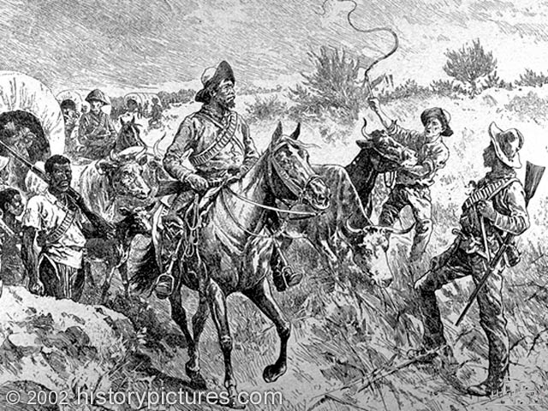
South Africa
Dutch establish colony here in 1652 (Cape Colony)
Descendants of settlers = Afrikaaners or Boers
British take control after Congress of Vienna (1815)
(1836) Boers & the “Great Trek” move to the interior & establish Transvaal & Orange Free State.
Shaka & the Zulu Uprisings
1870’s-80’s: Gold & Diamonds
bring the British north

Slide 30
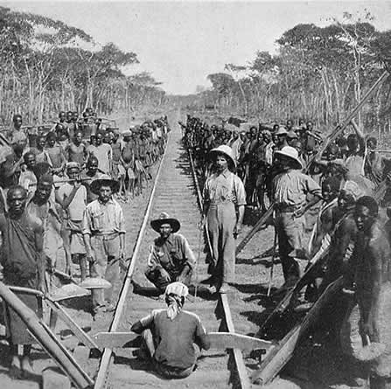
South Africa
Cecil Rhodes – wealthy governor of British Cape Colony who dreamed of a “Cape to Cairo” railroad linking Britain’s African Empire
- construction of
the railroad
The “Rhodes
Colossus” -

Slide 31
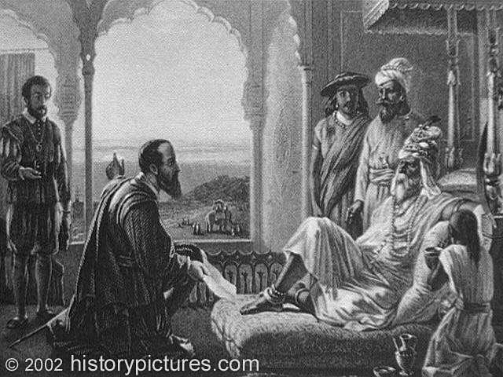
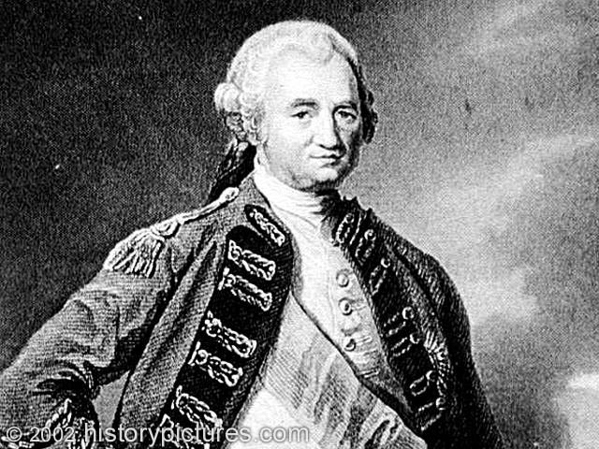
British in India
(1600’s) - Britain & France
compete in India
Weakening Mogul Empire
& British victory the
Seven Years War (1756-1763)
Robert Clive & the British East
India Company
tea, coffee, cotton

Slide 33
Sepoy soldiers
1-F

Slide 34
The Sepoy Mutiny: 1857
Resentment
Nationalism
Religion
2-A

Slide 35
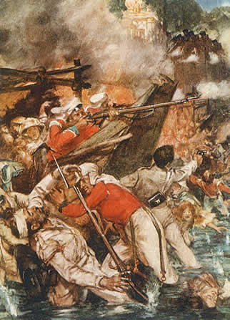
British in India
Native resentment due to discrimination & exploitation & the Sepoy Mutiny (1857)
Sepoys: Indian soldiers who served under British commanders
Rebellion crushed by regular British troops
East India Co. dissolved & India placed under direct British control

Slide 36
India – “Jewel of the British Empire”
“Crown Colony”: India, Pakistan & Bangladesh
Queen Victoria: Empress of India
positives:
Modern transportation,
Communication health care and
Education
negatives
Exploitation of resources (cotton),
Reduced food production, destroyed
Domestic industry & discarded
Traditional Indian culture & ways.
“The sun never set on the
British Empire”

Slide 38
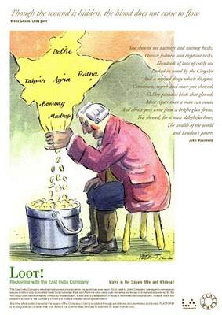

Slide 39
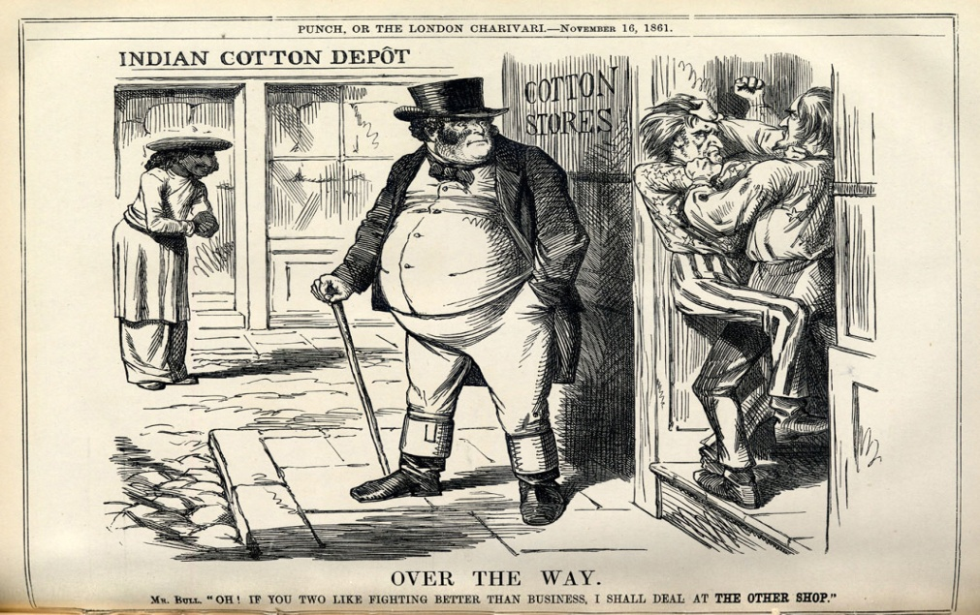

Slide 41
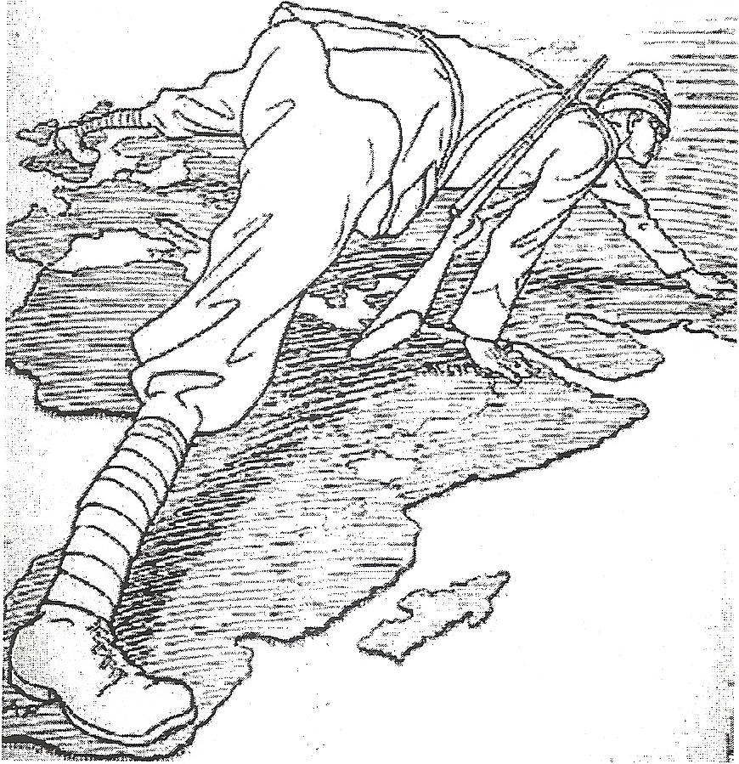
HOW DOES
THIS CARTOON
REPRESENT THE
BRITISH EMPIRE?

Slide 42
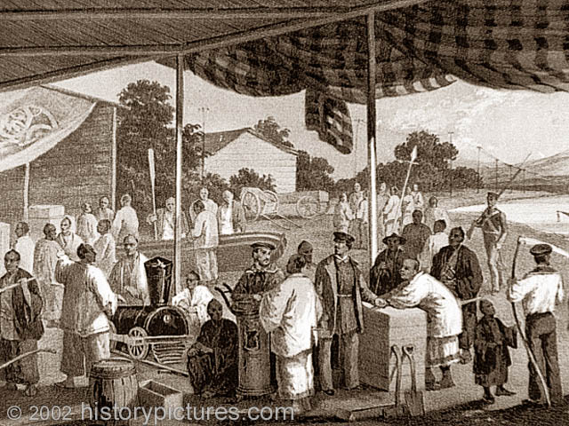
JAPAN
1600’s: Tokugawa Shogunate “closes” Japan (isolation)
Economic growth & peace, but no industrialization
(1853) US Commodore Perry & Treaty of Kanagawa “opens” Japan to foreign trade
& by the 1860’s, other imperialist
powers demand same.

Slide 43
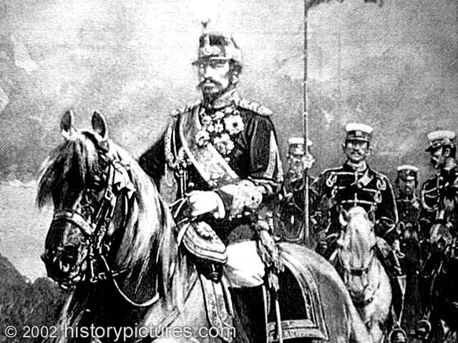
JAPAN
Japanese concern & plan to modernize/westernize
Civil War & Meiji Restoration (1868-1912)
Reform-minded leaders & Emperor Mutsushito
Abolish feudalism & class system
Created a Western style
constitutional government
Invite Western advisors
to help w/military, industry,
government and banking
systems

Slide 44
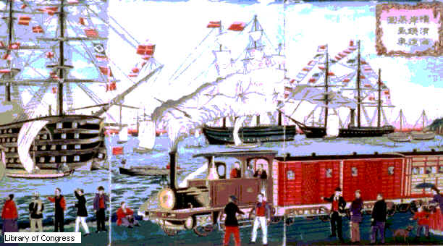
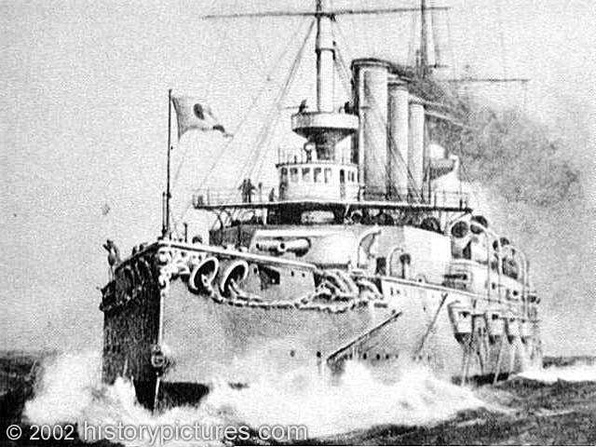
JAPAN
Supported & protected new industries
(zaibatsu = government supported family owned businesses; example – Mitsubishi)
Japan = 1st Asian country to industrialize

Slide 45
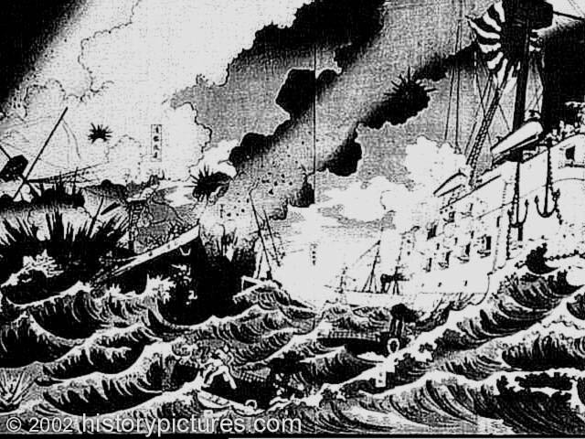
JAPAN
Japan becomes an imperialist power
(need for resources, markets, respect & prestige)
Expands into China (1890’s) & defeats Russia (1904) to start its own empire (Taiwan, Korea & Manchuria)
A Japanese print depicting
Japan's naval victory in the
Russo-Japanese War

Slide 46
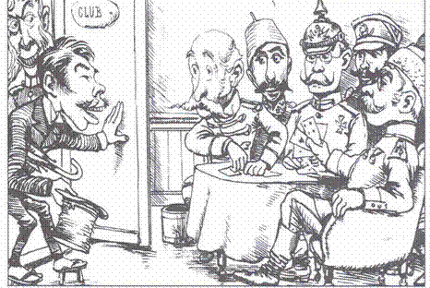
Japan joins the “Club.”

Slide 47
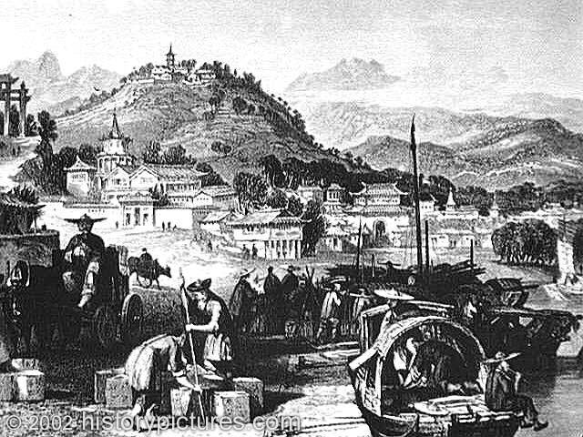
CHINA
Once the most technologically advanced civilization, China experienced decline under the foreign
Manchu (Qing) Dynasty
Population decline
Poor agriculture
Gov’t corruption
Military weakness

Slide 48
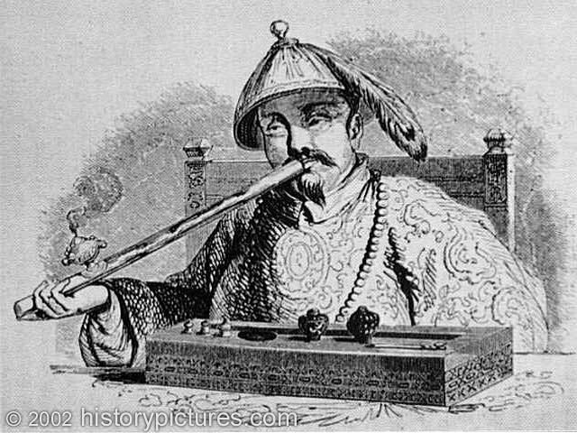
CHINA
European imperialists demand trading rights to gain access to China’s markets & goods (tea & silk)
Canton System: Chinese control & tariffs
By 1770’s, British demand for things like tea exceeds Chinese desire for British goods, so British begin selling opium (from India)
This led to widespread
addiction problems,
objections from the Chinese
government & eventually
war.

Slide 49
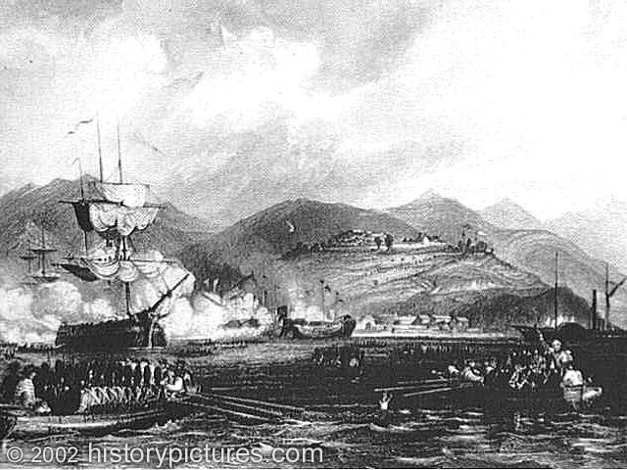
CHINA
Opium Wars (1839-42) vs. Great Britain:
Britain’s powerful navy & modernized army won easily
Unequal Treaties granted Britain special concessions, including control, of trade in certain cities & extraterritoriality for its citizens. Also gets Hong Kong
- The British navy
attacks a Chinese port

Slide 50
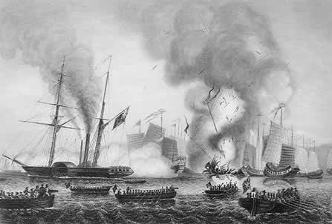
CHINA
The British navy demolishes Chinese “junks.”

Slide 51
CHINA
Other nations soon “request” similar arrangements creating “spheres of influence”: an area dominated by an imperialist power who has economic & political privileges as well as the right to protect their interests.
China became a valuable market for many imperialist powers. To get to China & the East, many of them will establish coaling stations & naval bases on various Pacific islands.

Slide 52
CHINA

Slide 53
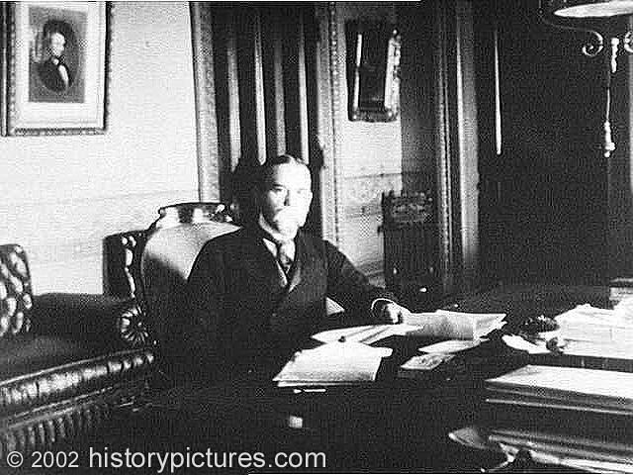
CHINA
United States and the Open Door Policy (1899)
Formulated by Secretary of State John Hay
all nations should have equal trading rights in China
(US had no “sphere”)
to protect China’s
territorial integrity
(no partitioning)

Slide 54
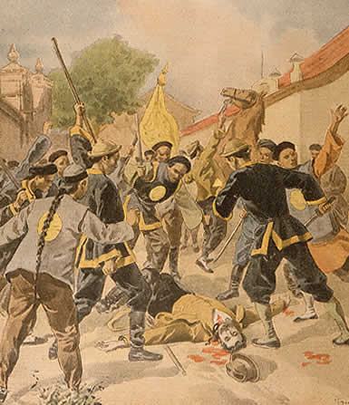
CHINA
Many Chinese people deeply resent exploitation at the hands of foreigners, including Manchu dynasty for not handling it. Rebellions materialize.
Boxer Rebellion (1900)
Society of the Righteous & Harmonious Fist
attacked missionaries, government
officials, Chinese Christians and
foreigners
Boxers attack & murder a German ambassador --

Slide 55
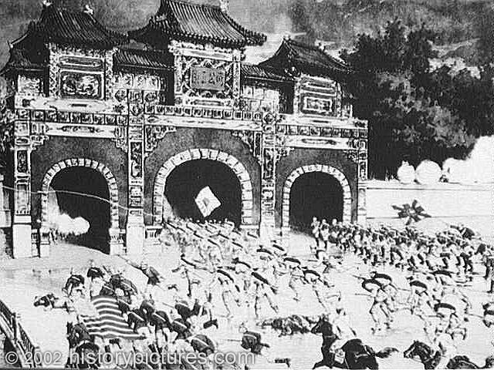
CHINA
Rebellion eventually put down by an international army of imperialist forces protecting their interests.
American, Japanese &
European troops storm a
Boxer stronghold in
Beijing

Slide 56
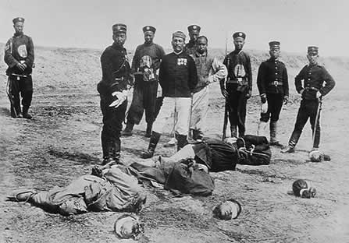
CHINA
China was forced to pay for any damages incurred by the Europeans during the rebellion and allow foreign troops to remain in Beijing (China’s capital).
The execution of
some Boxers.

Slide 57
How does this cartoon depict imperialism in China?

Slide 58
France
Italy

Slide 59
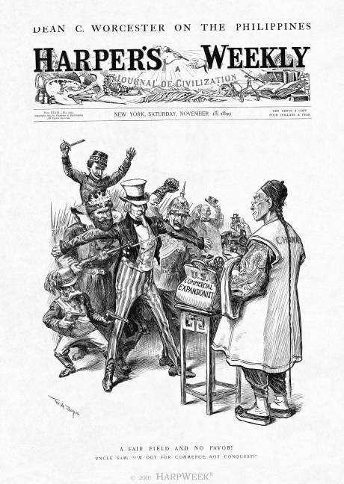

Slide 60
Effects/Impact of Imperialism
POLITICAL
Introduced new ideas of democracy & nationalism to non-West
Ended civil war & brought order & stability to some
Colonial competition & rivalry = war
Colonial powers had trouble controlling & protecting
vast lands
ECONOMIC
Non-West resources exploited
Native agriculture & industries disrupted
Improved transportation & communication
By 1914 – 85% 0f the world controlled by imperialists
SOCIAL
Imperialists built schools & hospitals
Introduction of more technology
Improved health care & services
Native people exploited, mistreated, segregated
CULTURAL
Traditional culture & ways ignored / replaced
“White Man’s Burden”
(paternalism, assimilation)

Slide 61
EFFECTS/IMPACT OF IMPERIALISM
Positive
Improved transportation communication, technology & health care
Built schools & hospitals
Ideas of democracy & nationalism
Political order & stability
Negative
Rivalry & competition = warfare
Native people lost independence
Resources exploited
Natives exploited, & treated w/brutality
Traditional culture ignored at expense of Western culture & ways through education
Native agriculture & industry disrupted

Slide 62
Colonial Powers had problems with controlling, protecting & governing vast empires…example:
British Empire
By 1914, 85% of the world was colonized/controlled by imperialist powers.

