Slide 1
The Renaissance (use chp. 17 pgs. 471-480)
Explain why the Renaissance began in Italy?
How did Renaissance thinking differ from that of the Middle Ages?
What was “humanism?” How did it change the way people thought? Acted/lived?
What is meant by a “Renaissance Man?”
How did the Renaissance change art?
How did it change writing & literature?
How was the Northern Renaissance different from the Italian Renaissance?

Slide 2
The Renaissance - B
What does the word “renaissance” mean?
Where did this Renaissance begin?
In what type of society did it take place?
What type of viewpoint did people of this Renaissance society share?
How was the Renaissance different from the Middle ages before it?
What were Renaissance thinkers interested in?
Why do you think the Renaissance began where it did?
How did the Renaissance change the way human beings were viewed?

Slide 3
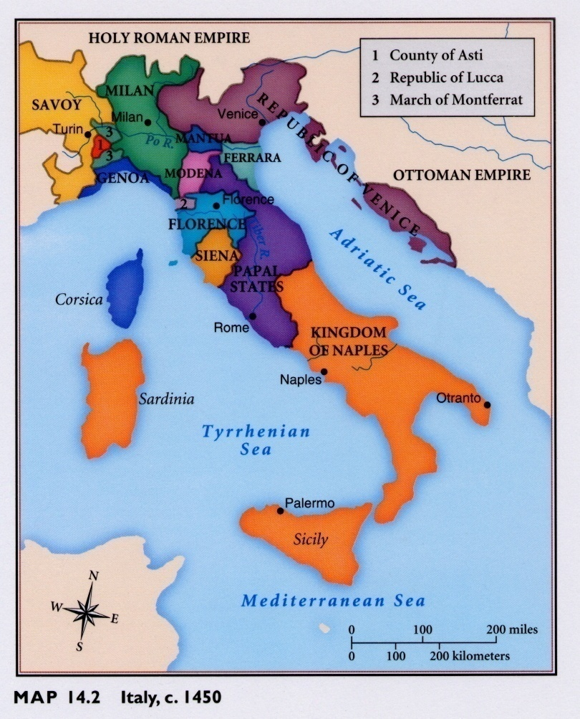
The Renaissance
Why did the Renaissance begin in Italy?

Slide 4
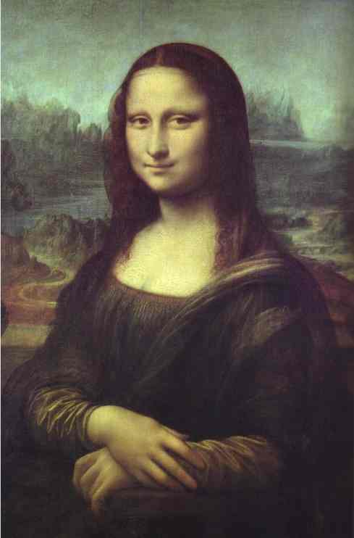
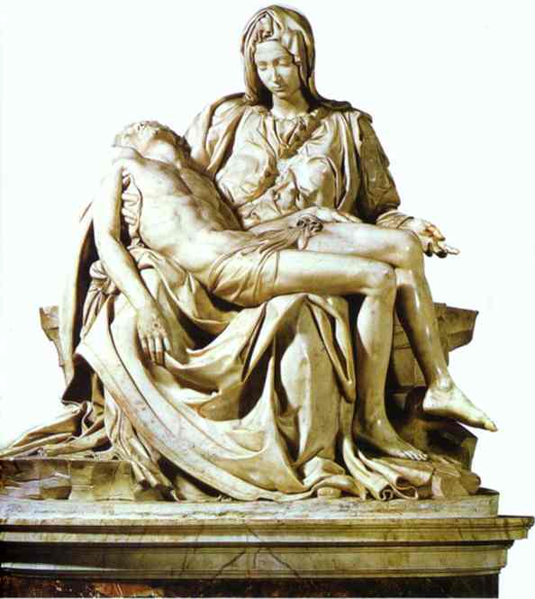
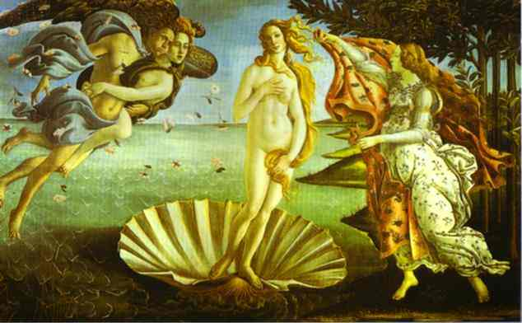
The Renaissance
Do Now: On the map of Italy, shade
the following regions/areas: Venice,
Milan, Florence, Genoa &
The Papal States.
Then write an explanation for why the Renaissance began in Italy.
(pgs.471-2)

Slide 5
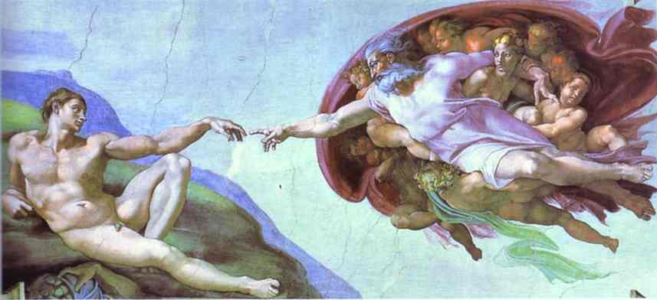
THE RENAISSANCE (1300’S – 1600’S)
“Rebirth” of cultural & scholarly activity in
Western Europe
(not just religious but “classical” & “secular”)
“Bridges the gap” between Medieval &
Modern history (a transition)

Slide 6
Renaissance Italy - @1450
Initial centers
of the Renaissance movement were in Northern Italy.

Slide 7
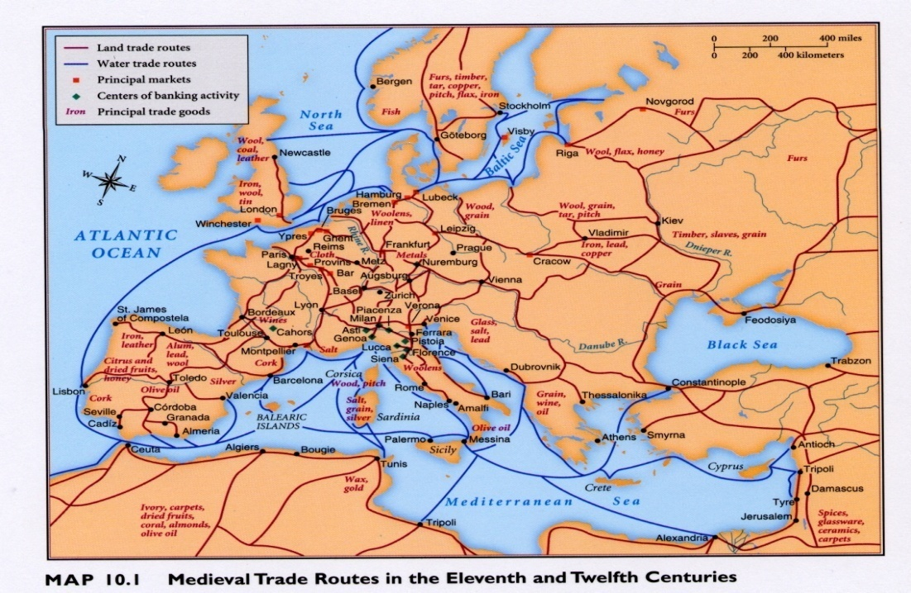
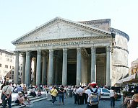
THE RENAISSANCE
The Renaissance began in Italy.
WHY?
1)Geography (trade & cult. diffusion/exchange ideas)
2)Trade = $, powerful merchant class & cities
3) History (Ancient Roman civilization)

Slide 8
Renaissance patrons
patrons -supporters of arts & learning = ($$$)
Pope & Church in Rome
Medici family in Florence
Sforza family in Milan
Merchants of Venice
(Doge)
“benefactor”
“philanthropist”

Slide 9
Humanism
HUMANISM = Literary movement which was the basis of the Renaissance.
Emphasizes education:
Study of the classics
(ancient Greek & Roman civilizations)
Learn @ human possibilities = “humanities” to become a more full person & display “virtu” = quality of being a human

Slide 10
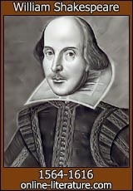
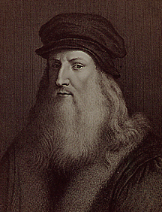
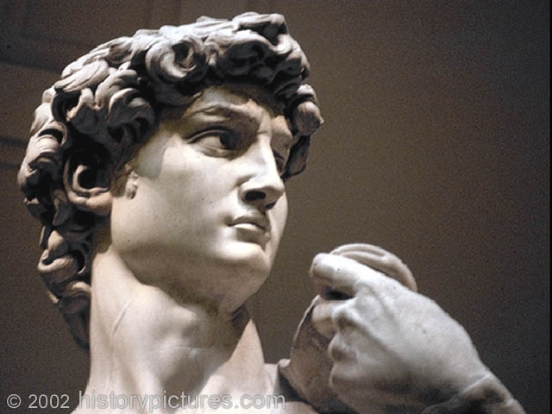
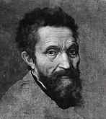
The Renaissance
DO NOW: How was the Renaissance & the people who lived during it different from the Middle Ages?

Slide 11
MEDIEVAL OR RENAISSANCE??
During which period did people have more confidence in their ability to think for themselves?
During which period did people have a more pessimistic outlook on life?
During which period did people believe they could make life / society better?
During which period did people have a feeling that life was beyond their control?
During which period did people accept the concepts of prior authorities including the Church on how the world worked?
During which period did people question to develop a greater understanding of the world they lived in?

Slide 12
MEDIEVAL OR RENAISSANCE??
During which period do you believe people lived “fuller” lives, best utilizing their talents/abilities?
During which period did people believe life was largely a preparation for the afterlife?
During which period do you believe students received a more “well rounded” education?
During which period did higher education focus mostly on role of religion as well as technical studies?
During which period do you think art more greatly reflected everyday life & society?
During which period did art largely reflect religious themes and subjects?

Slide 13
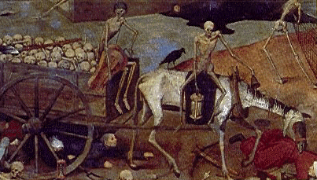
Middle Ages
Created a pessimistic view of life
Minimized the significance of individuals
Gave people a sense of no control
Increased power & influence of the Church
people fear end of world – focus on the afterlife
(Plague, constant warfare,
peasant suffering,
place in society, feudalism and
lack of education)

Slide 14
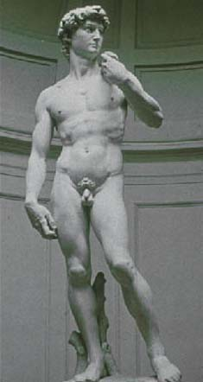
Medieval to Modern - Renaissance View
NEW IDEAS
1) Renewed interest in classical Greek &
Roman culture
2) Importance of the individual;
“Glorify humanity”
Humans should strive to achieve – “Renaissance Man”
(has many talents & achieves
in many different fields)

Slide 15
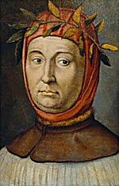
Francesco Petrarch (1304-1374)
Italian poet / scholar
“Father of Humanism”
Rediscovery of Cicero’s letters
Writings helped to shape modern
Italian language
Coined “Dark Ages”

Slide 16
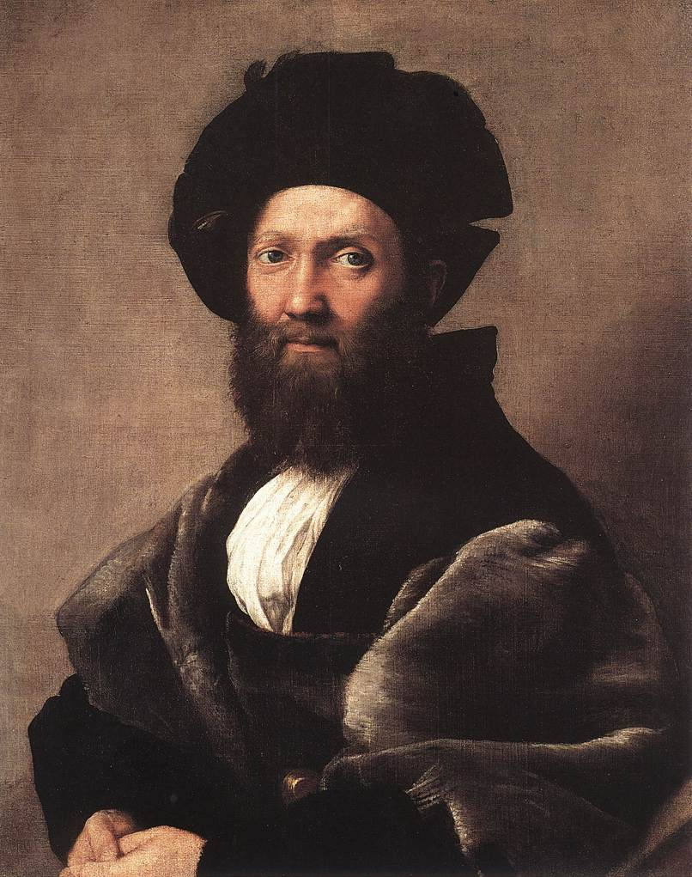
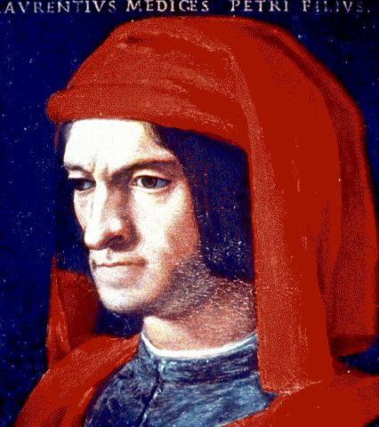
THE RENAISSANCE
virtu – “quality of being a human”
a “great” man shaped his own destiny, seized his opportunities; excelled & made change (politics, business, war, art, etc.)
Baldassare Catsiglione;
Author of The Courtier,
Describing the “ideal”
Renaissance man.
Lorenzo de Medici;
“the Magnificent”
displayed “virtu.”

Slide 17
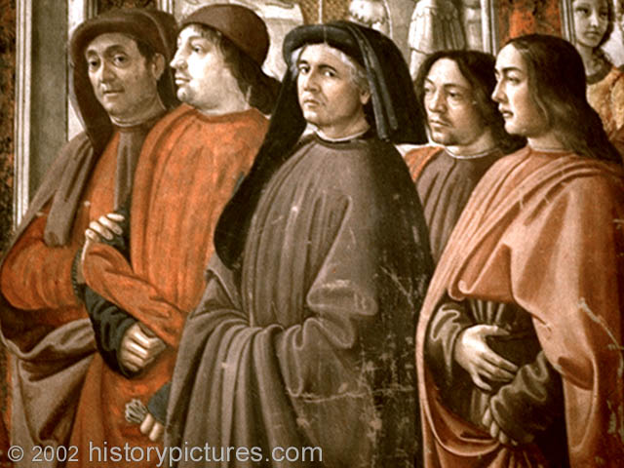
THE RENAISSANCE
3) Human achievement in this world has value; Humans have dignity & worth
Carpe Deim- “seize the day”

Slide 18
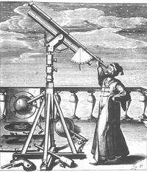
THE RENAISSANCE
4) Question & reason to seek natural explanations about the world.
***All emphasize human possibilities instead of shortcomings = enthusiasm for life!
Don’t just accept ancient “authorities,” religion or superstition to explain the natural
world.

Slide 19
MEDIEVAL OR RENAISSANCE??
Pessimistic
Secular
Focus on the group
Focus on the importance of the individual
World is beyond your comprehension
Question to better understand the world
We can learn from Greeks & Romans
Only Listen to the Church
Life is just a preparation for the afterlife
accept things as they are
Strive to achieve a fulfilled life
Stress human possibilities over human shortcomings

Slide 20
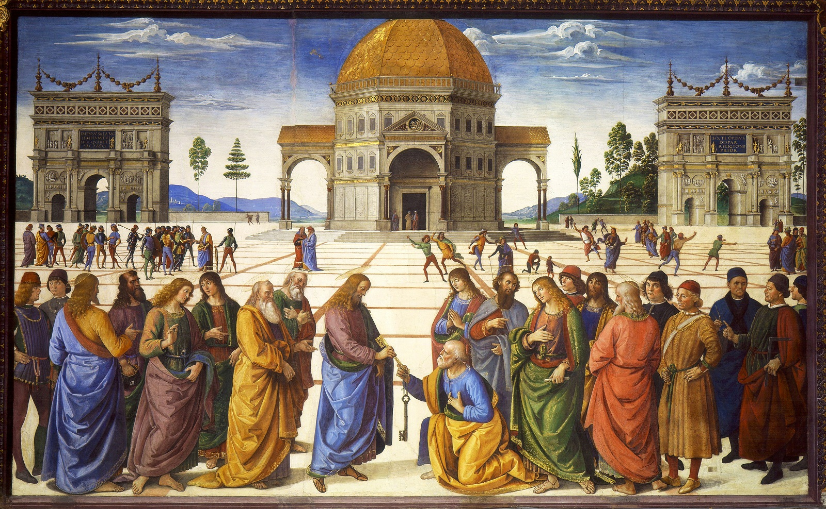

Slide 21
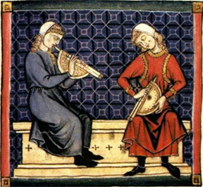

Slide 22
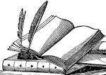
Do now:
Students in each row are to copy the 1st hundred pages from the book sitting on the front desk of the row.
Use paper provided & divide task among yourselves.
Due by the end of the period.

Slide 23
Source Questions
How did ideas of humanism spread from Italy to the North?
How was the view & interest of
Northern Humanists (Holland, Germany, France & England) different from Italian Humanists?
3. How were books printed before the invention of the printing press?
Describe some problems this method caused.
Who invented the movable type printing press?
What were some of the effects of this invention?

Slide 24
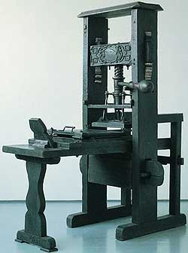
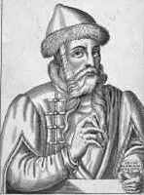
HUMANISM SPREADS
The ideas of humanism began to grow popular outside of Italy.
How did they spread…?
Movable type printing press (1440’s)
Developed in Europe
by Johann Gutenberg
Soldiers, Students, merchants . . .
15th century model
of the Gutenberg
printing press.

Slide 25
Effects of the printing press
Made books more available & affordable
Increased desire for education as more people want to learn how to read
Helped the spread of more ideas
(humanism & religious criticisms)
Increased use of vernacular languages
(language of the common people);
(Latin = educated)
1st book printed – Gutenberg Bible

Slide 26
Spread of printing

Slide 27
Question for discussion . . .
How was the view & interest of
Northern Humanists (Holland, Germany, France & England) different from Italian Humanists?
Scan page 482 (A) if your not sure!!!

Slide 28
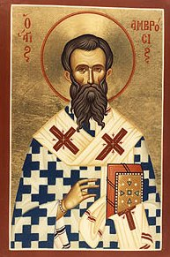
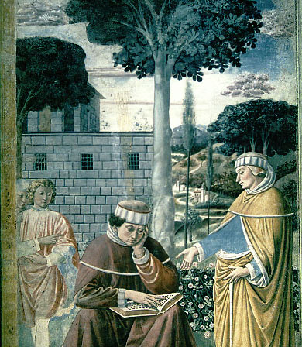
Northern Humanism
“Northern Humanists” were interested in “classical” Greek & Roman culture as well as importance of the individual
But many of them focused in on the early Christian period / Church which developed during the time of ancient Rome
“Christian Humanists”
St. Augustine & Ambrose
who lived during the 3-400’s

Slide 29
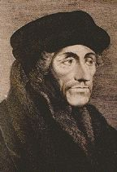
Northern Humanism
Studied the early Church & its texts.
Stressed importance of the Bible
Criticized the Church of their day calling for reform of both the Church & of society.
Desiderus Erasmus: “Greatest Northern
Humanist”
Thomas More: Utopia (1516)
“no place”
Tried to show the ideal /perfect society

Slide 30
Written analysis
How is the impact of Internet technology today, similar to the impact that the printing press had on Europe during the 15th-16th centuries?

Slide 31
Analysis Question
Why are Leonardo da Vinci & Michelangelo Buonarroti known as “Renaissance Men?”

Slide 32
Written Analysis
Humanists like Petrarch admired and were inspired by the classical civilizations of ancient Greece & Rome…
Who or what do you find admirable or inspirational from the Renaissance era? Why?
Who or what from our era (last 30 years or so) do you believe will bring admiration or inspiration to students hundreds of years from today?

Slide 33
Renaissance Video Questions
Identify the artists mentioned in this video as well as at least one example of their creations.
What three things gave Renaissance art its “special flavor?”
How did math play a role in achievements of Renaissance art?
Why did Renaissance artists have such a keen interest in understanding how the human body works?
Give evidence to show that not all of da Vinci’s innovations in art were successful
Renaissance painters & sculptors focused upon both secular and ______ subjects.

Slide 34
Renaissance Art
Characteristics of new style:
Influenced by classical Greek & Roman art
“Realism” with attention to detail
(scientific approach, emotion, nature)
3. Religious & secular subjects
4. Emphasize individual & achievements
(“glorify” humans & their abilities; portrait)
5. New techniques
(perspective, proportion, light & shadow)

Slide 35
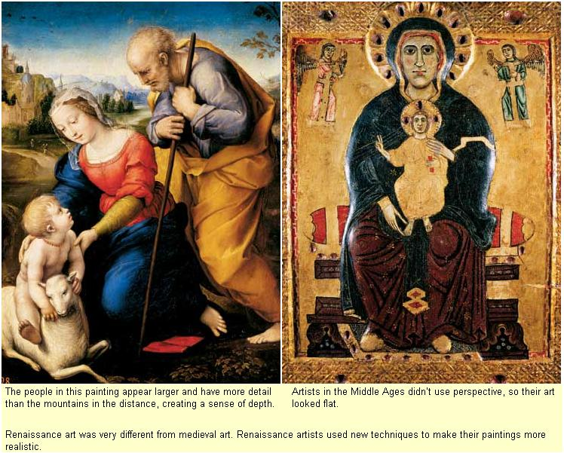
Medieval vs. Renaissance Art

Slide 36
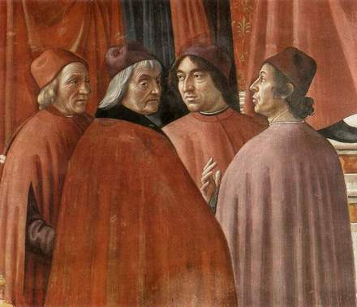
Renaissance Art

Slide 37
Renaissance Art
Raphael Santi’s “School of Athens” which is in the Vatican employs perspective
And symmetry to create depth a more realistic image

Slide 38
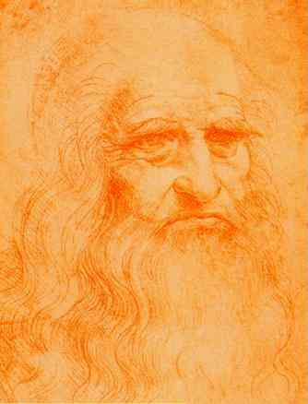
Leonardo da Vinci (1452-1519)
Born in Vinci, village near Florence
Painter, inventor, sculptor, architect,
engineer, musician, poet
Many unfinished works; few survive
Last Supper, Mona Lisa
Notebooks with sketches studying
human anatomy & ideas for inventions
“man ahead of his time”
(flying machines, weapons of war)
Worked for many patrons
(Medici, Sforza, King of France)

Slide 39
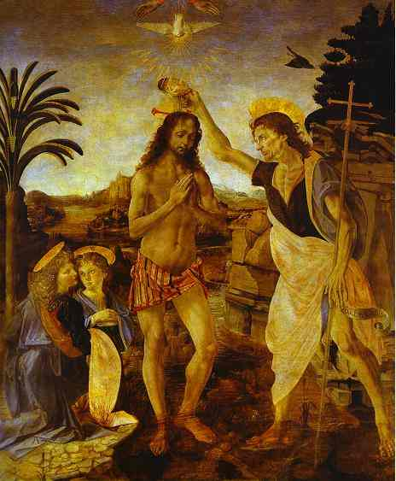
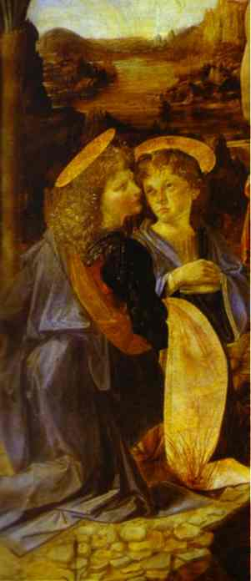
Leonardo da Vinci (1452-1519)
It was da Vinci’s
contribution to
this Verrocchio
work that first
attracted attention
to his “genius”
He painted the
angels in the
corner prompting
his master to say
they were more
alive than anything
he ever painted.

Slide 40
Leonardo da Vinci (1452-1519)
“Lady With An Ermine”
(1480’s)
Painted by Leonardo in his early 30’s depicts Cecilia Gallerani who was the mistress of Milan’s ruler Lodovico Sforza the artist’s patron.
An example of the popularity of the “portrait.”

Slide 41
Leonardo da Vinci (1452-1519)
“The Mona Lisa” – (1502)
Brilliant use of light & shadow,
Subtle layering of paint “sfumato”
(outlines are blurred, colors are mellow & forms blurred – corners of the mouth & eyes) and the depiction of landscape.

Slide 42
Leonardo da Vinci (1452-1519)
The Last Supper – (1490’s)
Depicts Christ & his apostles at the announcement of his future betrayal.
“Psychological portraits”
A mural in the Convent of Santa Maria delle Grazie in Milan, Italy.
Took 3 years to complete.
Brilliant use of perspective, but new technique has resulted in decay.

Slide 43
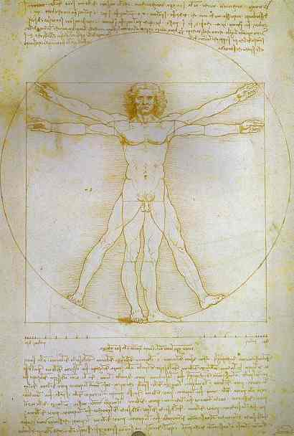
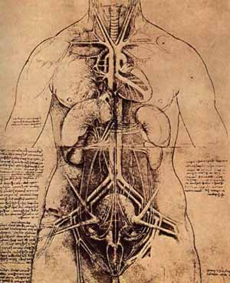
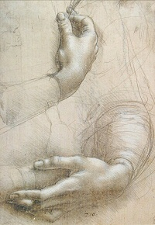
da Vinci: Anatomy Sketches
Used observation & dissection (illegal autopsies) to better
understand how the human body worked; made sketches in his
notebooks to “study” the human form.

Slide 44
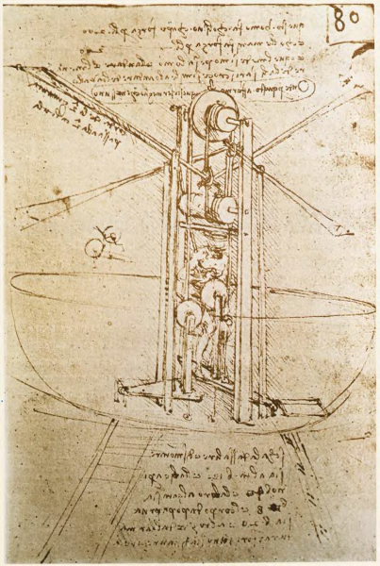
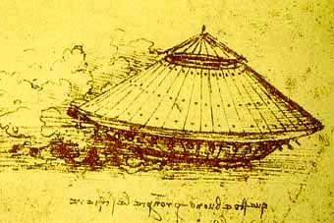
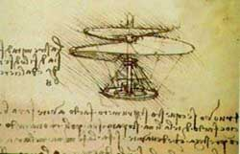
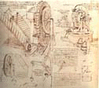
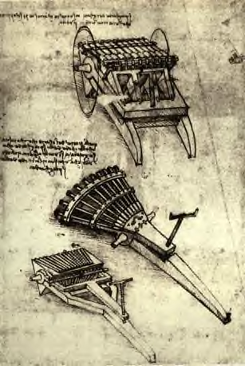
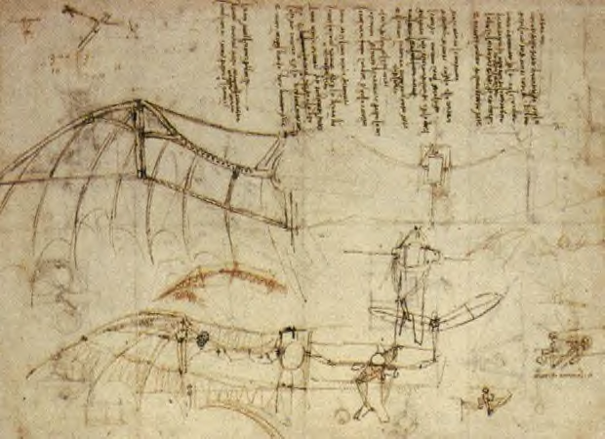
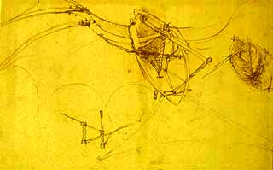
da Vinci: “A man ahead of his time” Sketches of ideas for inventions

Slide 45
Michelangelo Buonarroti (1475-1564)
Born in Caprese near Florence
Medicis = patron
Sculptor, painter, architect & poet
David & Pieta
Commissioned by Pope Julius II to paint ceiling of the Sistine Chapel: (40x133 feet with 145 pictures & took 4 years)
Architect who designed the dome of
St. Peter’s Basilica

Slide 46
Michelangelo Buonarroti (1475-1564)
The Pieta – (1490’s)
Image of Mary holding
Christ’s body after crucifixion.
Depicts a mother’s suffering.
Michelangelo believed he removed the sculpture / “soul” from within the marble.

Slide 47
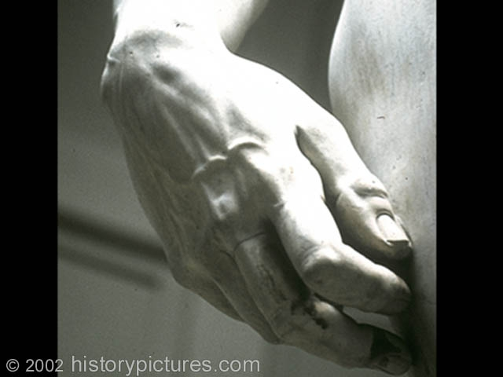
Michelangelo Buonarroti (1475-1564)
The David: (1501-1504)
16 ft tall classic nude (Greek style – free standing)
Shows biblical David prior to battle with Goliath.
(tension, intensity, power & confidence)
“Symbol” of Florence
Considered the “perfect” representation of
the human form.

Slide 48
Michelangelo Buonarroti (1475-1564)
Moses – (1515)
Commissioned by Pope Julius for his tomb.
Some believe it was Michelangelo’s
Representation of the pope.
Michelangelo is considered the greatest
Sculptor of the Renaissance.

Slide 49
Michelangelo Buonarroti (1475-1564)
Ceiling of the Sistine Chapel: (1508-12)
Commissioned by Pope Julius
40 x 133 foot ceiling
145 pictures w/ over 300 human figures
68 foot scaffolding
Depicts numerous scenes from
the Bible’s book of Genesis
Did most of the work alone

Slide 50
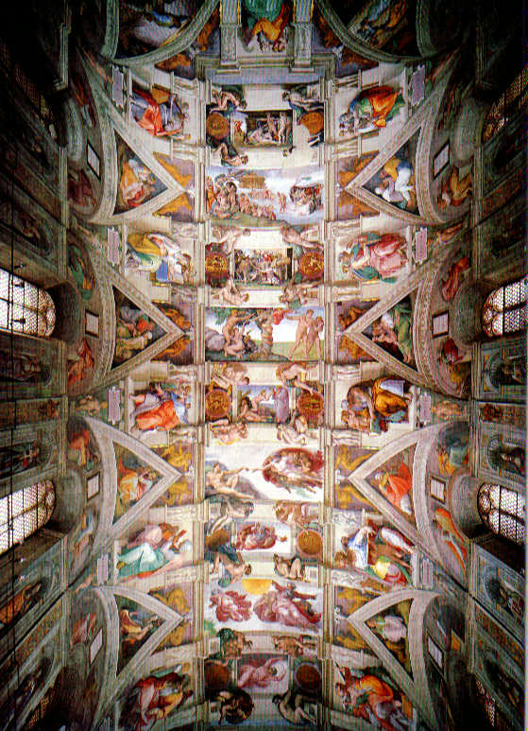
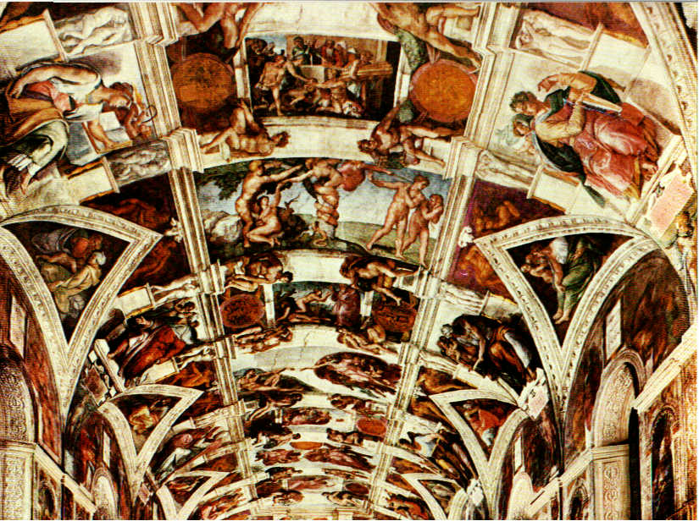
Michelangelo Buonarroti (1475-1564)

Slide 51
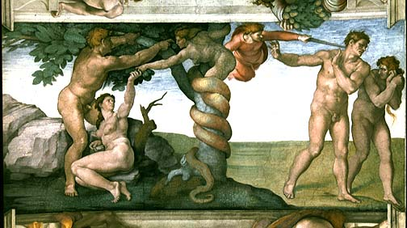
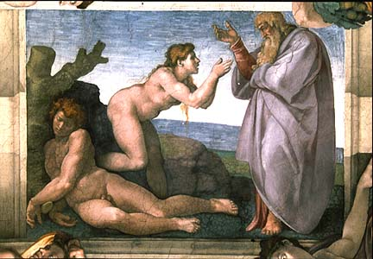
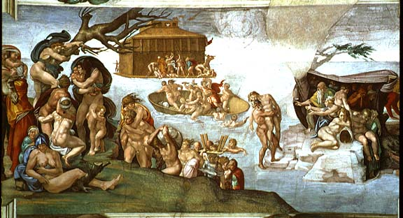
Michelangelo Buonarroti (1475-1564)

Slide 52
Michelangelo Buonarroti (1475-1564)
The Last Judgement: (1536-41)
Located above the altar wall in the
Sistine Chapel
Was the largest single fresco of its time

Slide 53
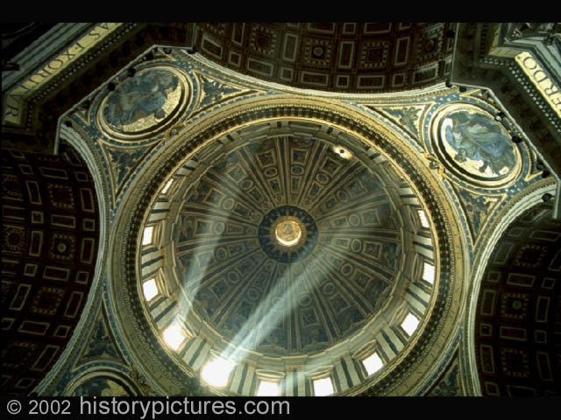
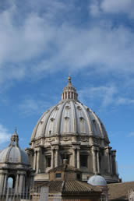
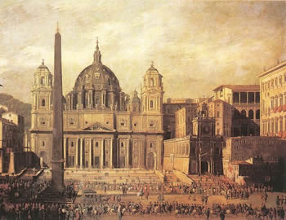
Michelangelo Buonarroti (1475-1564)
Michelangelo
was made chief
architect of
St. Peter’s
Basilica in 1546;
He designed the
dome which was
completed
after his death.

Slide 54
PARTNER ACTIVITY - Sort the following facts to create a chart that compares Leonardo da Vinci to Michelangelo Buonarroti :
(1) many unfinished works, (2) greatest sculptor of the
Renaissance, (3) Last Supper, (4) David,
(5) Mona Lisa, (6) sketches on human anatomy,
(7) ideas for inventions, (8) Sistine Chapel ceiling,
(9) “a man ahead of his time,” (10) Pieta,
(11) Pope Julius, (12) King of France,
(13) moody architect, (14) Moses,
(15) born in Caprese, (16) The Last Judgement,
(17) Sculpted portrayals of the human body,
(18) Lady with an Ermine, (19) sfumato,
(20) encrypted writing,
(21) dome of St. Peter’s Basilica,
(22) only 17 surviving paintings

Slide 55
WHAT DO YOU THINK???
“a ruler must be like both a fox & a lion, cunning enough to know the traps & avoid them; bold & brave enough to terrify the wolves”
Would you support a candidate for political
office who said publically that
government officials should not
hesitate to be dishonest or not
completely truthful if such deceptions
were in the best interests of the
people/nation?

Slide 56
William Shakespeare (1564-1616)
“The Bard”
Considered by many to be the
“greatest” poet /play writer
sonnets & English language
Plays use superb dramatic technique
probed human character
Dealt w/ universal human emotions
Addressed questions of virtue & morality
Historical & legendary events
Appealed to the masses
(common people)
“rebuilt” Globe Theatre

Slide 57
William Shakespeare (1564-1616)
Sketches of theatre design
during Shakespeare’s time.
Queen Elizabeth I

Slide 58
Niccolo Machiavelli (1469 – 1527)
Diplomat from Florence
Wrote, The Prince
His book has been called the single
most influential work of the Renaissance,
impacting politics & government to this day
Government is separate from morality
(a secular view of government)
“end justifies the means”
“safer for a ruler to be feared
than loved”
Cesare Borgia

Slide 59
MEDIEVAL OR RENAISSANCE??
Pessimistic
Secular
Focus on the group
Focus on the importance of the individual
World is beyond your comprehension
Question to better understand the world
We can learn from Greeks & Romans
Only Listen to the Church
Life is just a preparation for the afterlife
accept things as they are
Strive to achieve a fulfilled life
Stress human possibilities over human shortcomings

Slide 61
Machiavelli or Shakespeare???
The Bard
The Prince
Secular view of gov’t decision-making as separate from morality
Drew from “classical works” & displayed a deep understanding of human character
Sonnets
end justifies the means
Appealed to the “groundlings”
Safer to be feared than to be loved

Slide 62
Medieval vs. Renaissance ideas
During which period did people have more confidence in their ability to think for themselves?
During which period did people have a more pessimistic outlook on life?
During which period did believe they could make life / society better?
During which period did people have a greater understanding of human anatomy & biology?
During which period do you believe people lived “fuller lives, best utilizing their talents/abilities?
During which period do you believe students received a more “well rounded” education?
During which period do you think art more greatly reflected everyday life & society?

