Slide 1
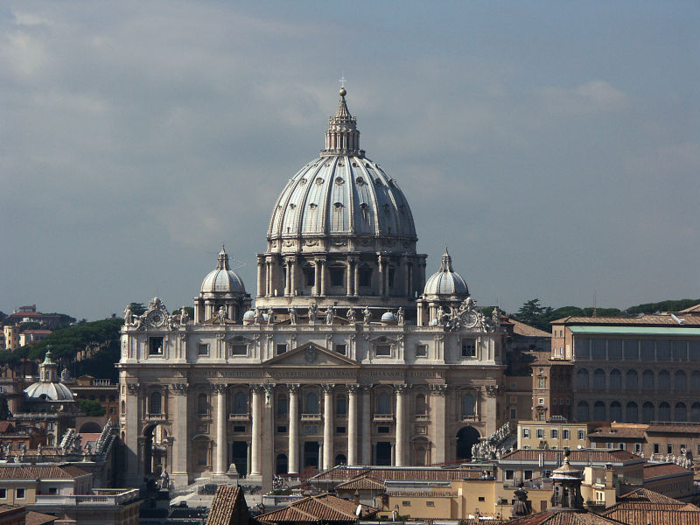
Catholic Church in the Middle Ages
Use (370-71, 379-80 & 384) & handout
DEFINE: clergy, sacraments, canon law, excommunication, heresy, the Inquisition
How was the Catholic Church a unifying force in medieval society?
How did the popes of the medieval period wield political power?
Why was the Church so important in the lives of the people (what did it provide or do for them)?

Slide 2
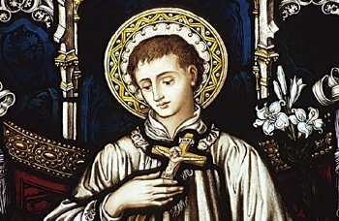
Catholic Church in the Middle Ages
Most powerful & influential institution
during the Middle Ages
Offered leadership & guidance during
the anarchy of post-Rome Europe
Bishop of Rome = the Pope
(452) Leo I & Attila
(800) Leo II & Charlemagne
(1198) Innocent III, “monarchs are
servants of the Church”
(1200’s) Boniface VIII:
“Unam Sanctum”
Hierarchy (ranking);
cardinals elect new popes (1059)
St. Peter’s Basilica

Slide 3
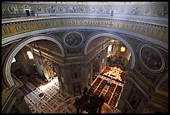
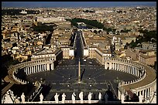
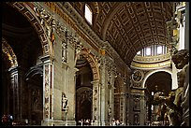
Catholic Church in the Middle Ages
As Christianity spread (thanks to missionaries & rulers like Charlemagne) the power of the pope spread
(900AD) controlled 1/3 of land in W. Europe
Political, economic & social/cultural influence
Piazza de
San Pietro
Interior of
St. Peter’s Basilica

Slide 4
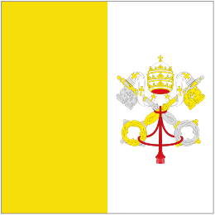
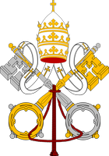
Hierarchy of the Catholic Church
Pope
& Curia
Cardinals
(1059 -elect new popes)
Archbishops
Bishops
Parish Priests
(usually peasants; at bottom, but most important as they administered sacraments , services & supervised moral/religious guidance to community)

Slide 5
Church Influence on Medieval Life
POLITICAL
ECONOMIC
($)
Role & influence of the Catholic Church
SOCIAL or CULTURAL

Slide 6
Construct a Thesis
Defend the following statement:
The Catholic Church had enormous political, economic & social/cultural influence during the Middle Ages.

Slide 7
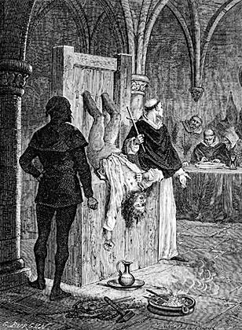
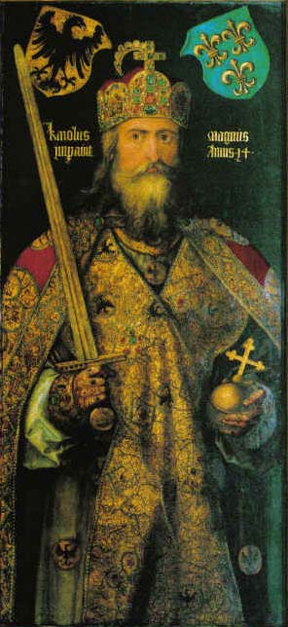
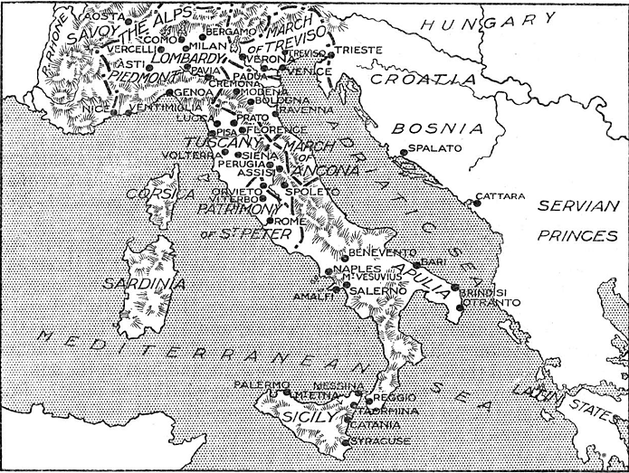
Church Influence on Medieval Life
POLITICAL
Crown & remove monarchs
Serve as advisors to monarchs
& feudal lords
Become lords & vassals
Excommunication & interdict
Canon law (heresy & the Inquisition)
Pope ruled the Papal States
Peace & Truce of God

Slide 8
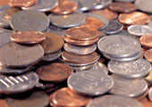
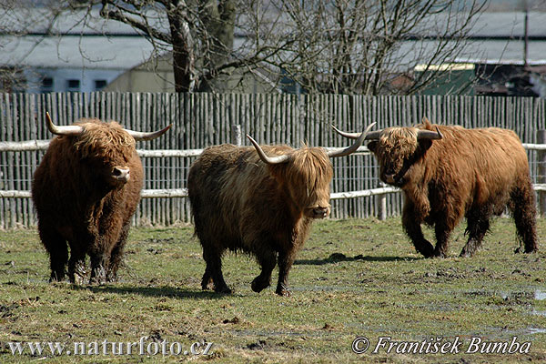
ECONOMIC
Tithe (1/10 income tax)
Usury (interest)
Require charging a “fair price”
Income from vast lands
Monks & advanced
breeding / farming
techniques

Slide 9
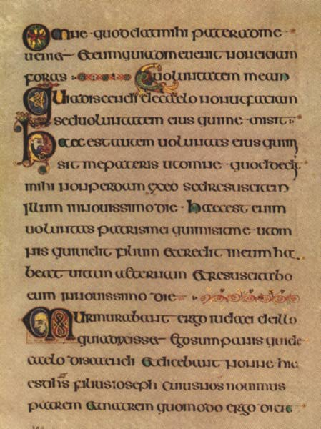
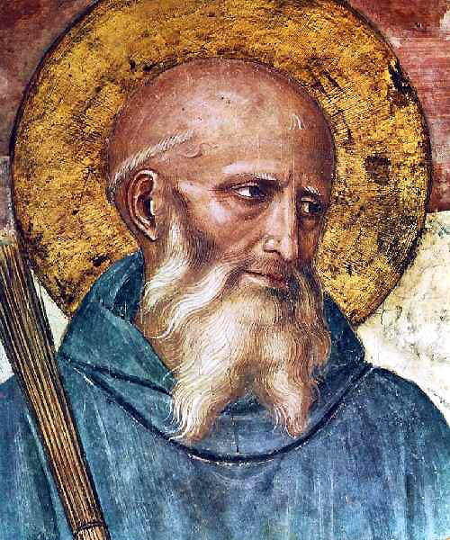
SOCIAL / CULTURAL
Schools & orphanages
Hospitals
Shelters & poor houses
Parish priest gave “advice”
Monks copy books
Holy Days or “holidays”
Sacraments : ceremonies / rituals that gave grace against sin & helped a person attain heaven
Prior to the invention of the printing press, “manuscripts” were usually produced by monks who would also illustrate or “illuminate” the document.

Slide 10
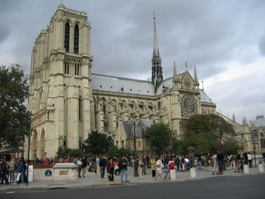
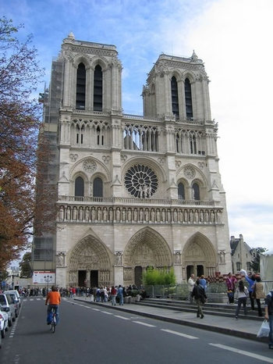
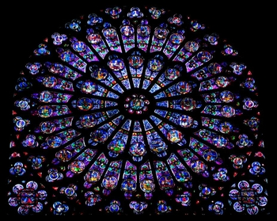
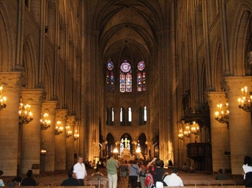
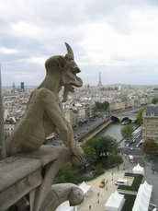
Social / Cultural Influence (pg.380-81)
Medieval architects designed & constructed magnificent cathedrals; glorify God
Notre Dame Cathedral in Paris
(1345)

Slide 11
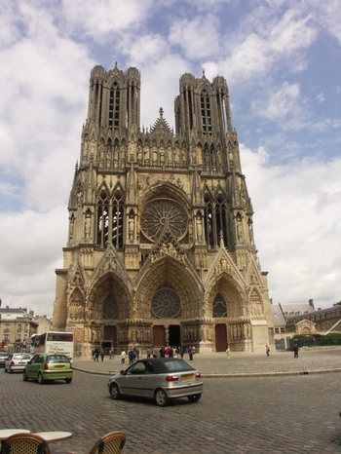
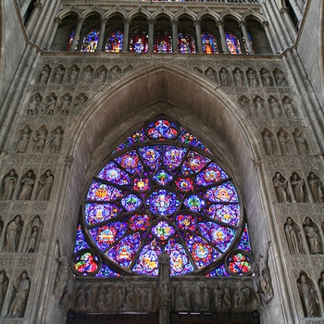
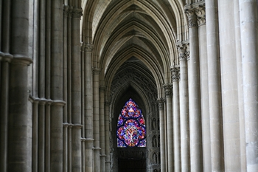
Reims Cathedral, France (late 1200’s)
“Rose Window”
and interior
sculptures

Slide 12
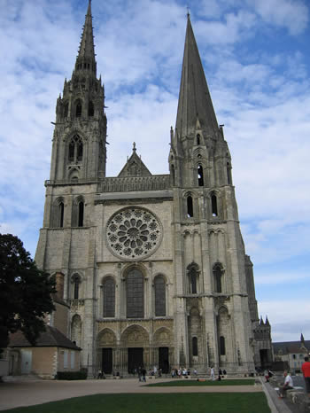
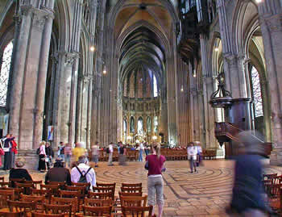
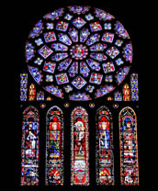
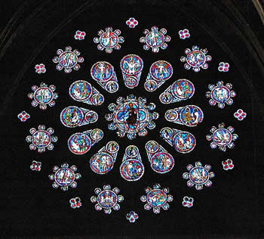
Chartres Cathedral, France (1260)
GOTHIC
ROMANESQUE

Slide 13
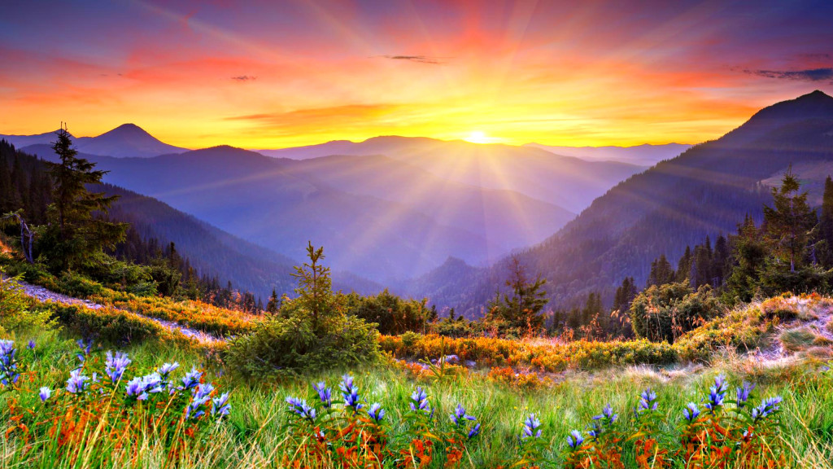
Spiritual Salvation
Everything in this world was part of “God’s plan.”
Church helped people attain salvation (heaven) in the after-life; need faith, perform good works and . . .
Sacraments : ceremonies / rituals that gave grace against sin & helped a person attain heaven.
Can ONLY be received from priests (the Church)

Slide 14
Self Assessment
Determine the role fulfilled by each of the following people from Medieval society:
Peasant serf
Noble lord/vassal
Knight
Peasant or noble woman
Parish priest
Medieval pope

Slide 15
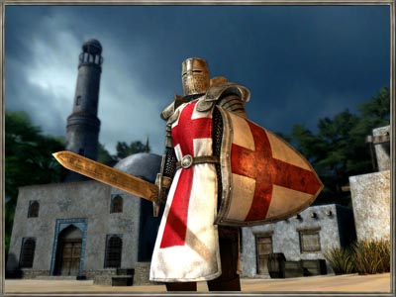
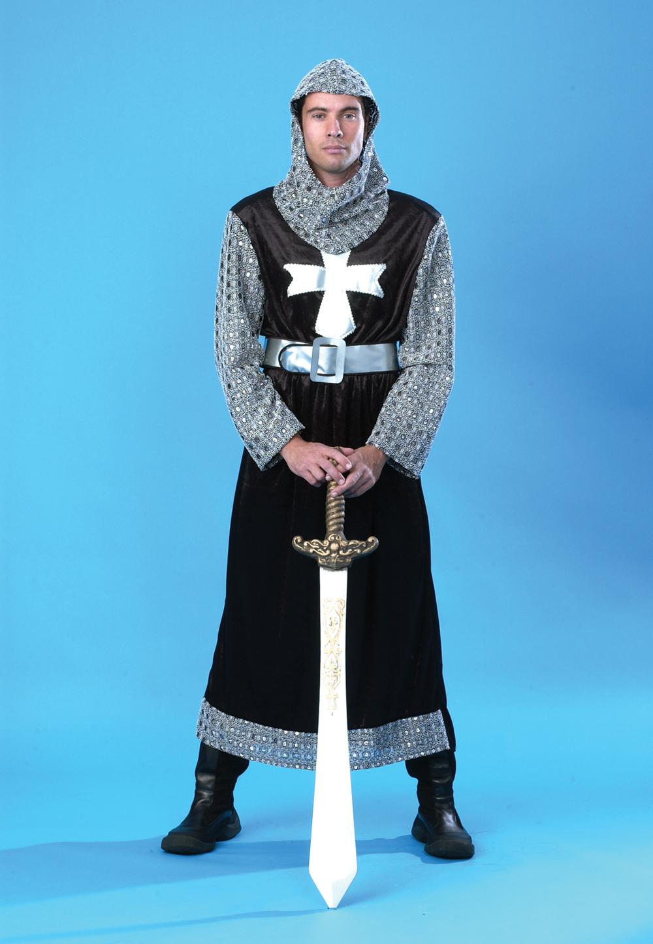
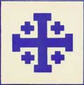
Complete the statement :
I am going on Crusade because . . .
REFER TO HOMEWORK

Slide 16
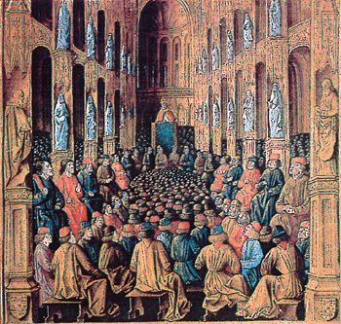
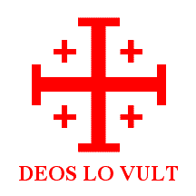
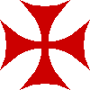
The Crusades : (1095-1291)
The Turks & the Holy Land = (Palestine)
The Byzantine Emperor Alexus’ plea
Pope Urban II & the Council of Clermont
(1095)
* “God Wills it!”
Crusader = “marked with
the Cross”

Slide 17
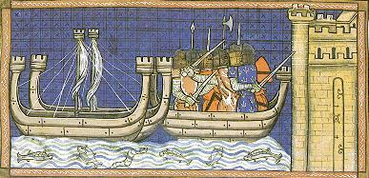
The Crusades : (1095-1291)
4. Why called?
5. Why go?
Eight (8) official Crusades – all military failures except for the 1st (4 Crusader States created)

Slide 18
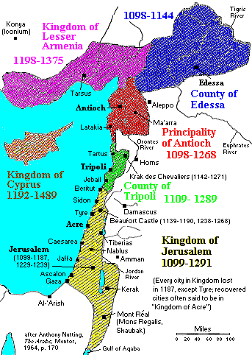
The four Crusader
States established
after the 1st Crusade:
County of Edessa
Principality of
Antioch
County of Tripoli
Kingdom of
Jerusalem
“Outremer” = kingdom beyond the sea”

Slide 23
Crusade Events & Highlights
Using pgs. 382-385 as well as note sheets, identify the event that occurred during each year below, along with what was significant.
1095
1096-1099
1144
1187
1202-04
1212
1291

Slide 24
“RECONQUISTA” – THE RECONQUEST 1150-1492
Christians in Spain worked to drive Muslim control out of Spain
The conflict continued long after Crusades in the Holy Land ended in 1295
Complete success came the same year Spain became a united country. (1492)

Slide 25
The Crusades = “Successful Failures”
What did the Europeans learn from their military encounters during the Crusades?
How did the Crusades result in an increase in the power of kings?
How did the Crusades help increase European trade?
How did the increase in trade reduce the importance of the manor?
What new “class” of people appeared in European society as a result of increased trade?
How did the Crusades improve culture & learning in Europe?

Slide 26
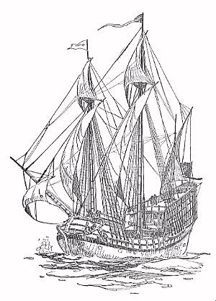
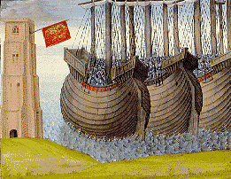
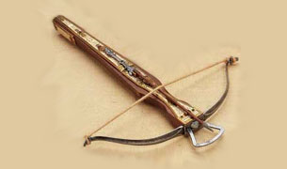
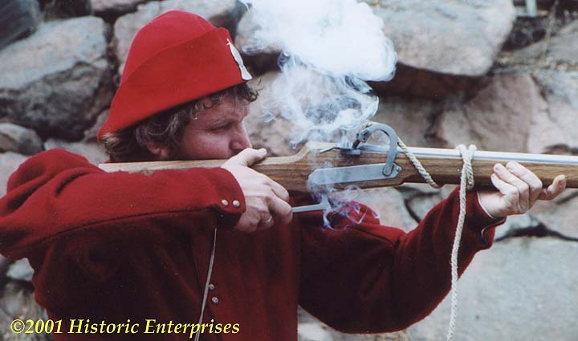
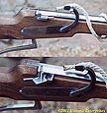
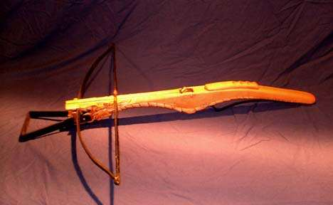
Effects of the Crusades “successful failures”
All military failures for the Christians EXCEPT for first
New weapons & tactics (crossbow, gunpowder, improved ship design & siege tactics, chivalry)

Slide 27
The four Crusader
States established
after the 1st Crusade:
County of Edessa
Principality of
Antioch
County of Tripoli
Kingdom of
Jerusalem
“Outremer” = kingdom beyond the sea”

Slide 28
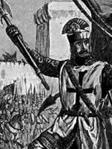
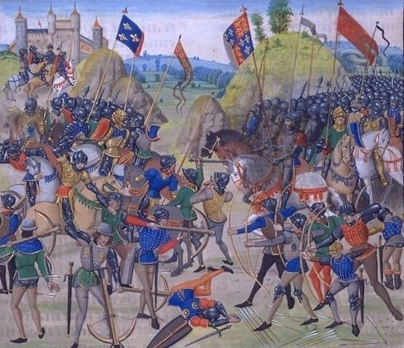
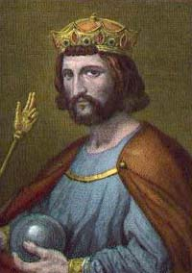
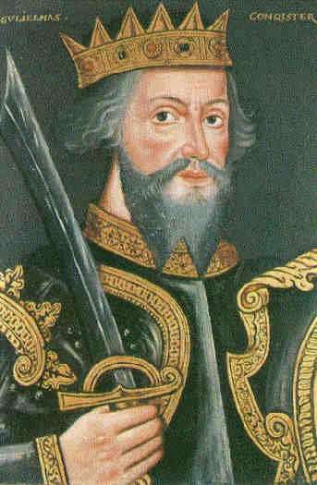
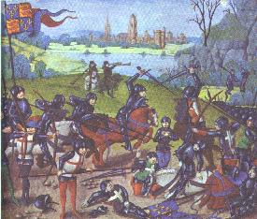
Feudalism Weakens
Power of nobles diminishes + kings grow stronger =
Decline in feudalism & rise of nation states

Slide 29
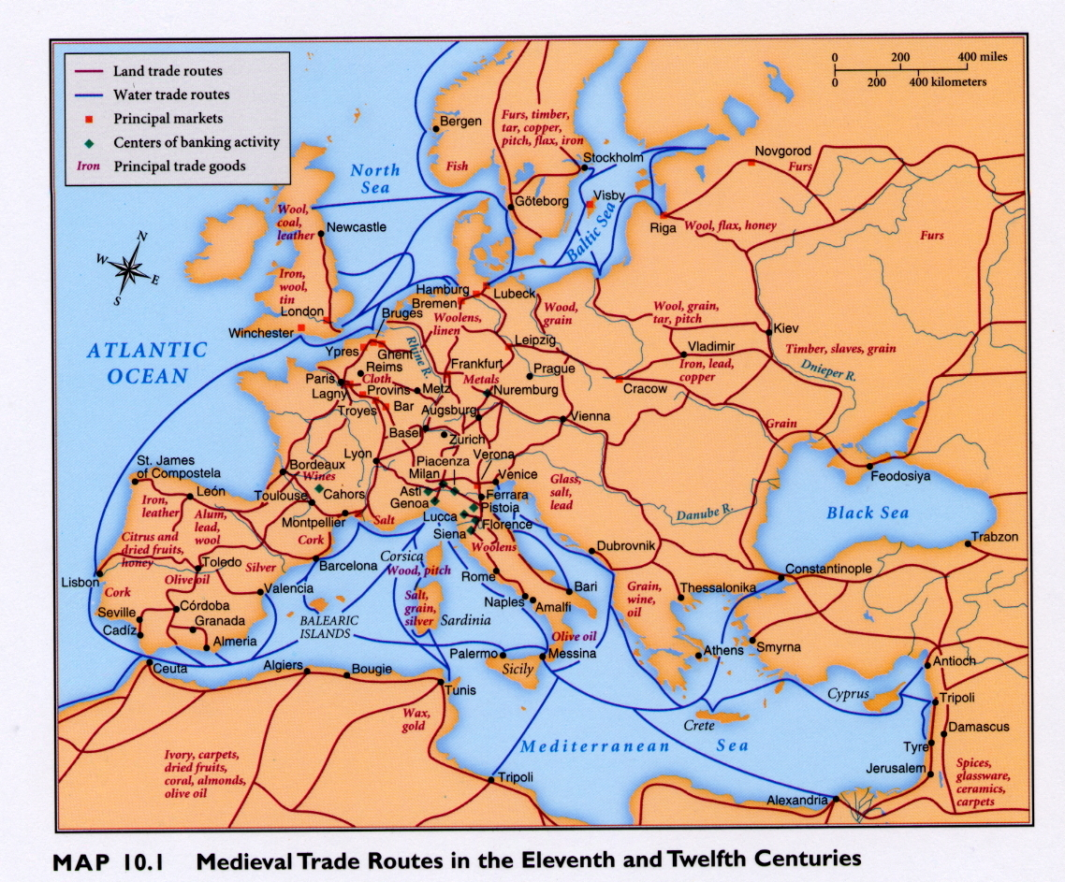
Revival of Trade
New goods & products = increase in trade;
Cultural diffusion
In Italy First . . .
WHY?
Geography &
LOCATION!!!

Slide 30
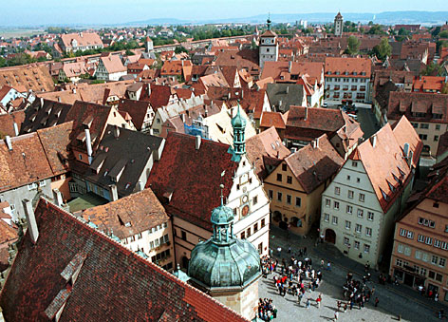
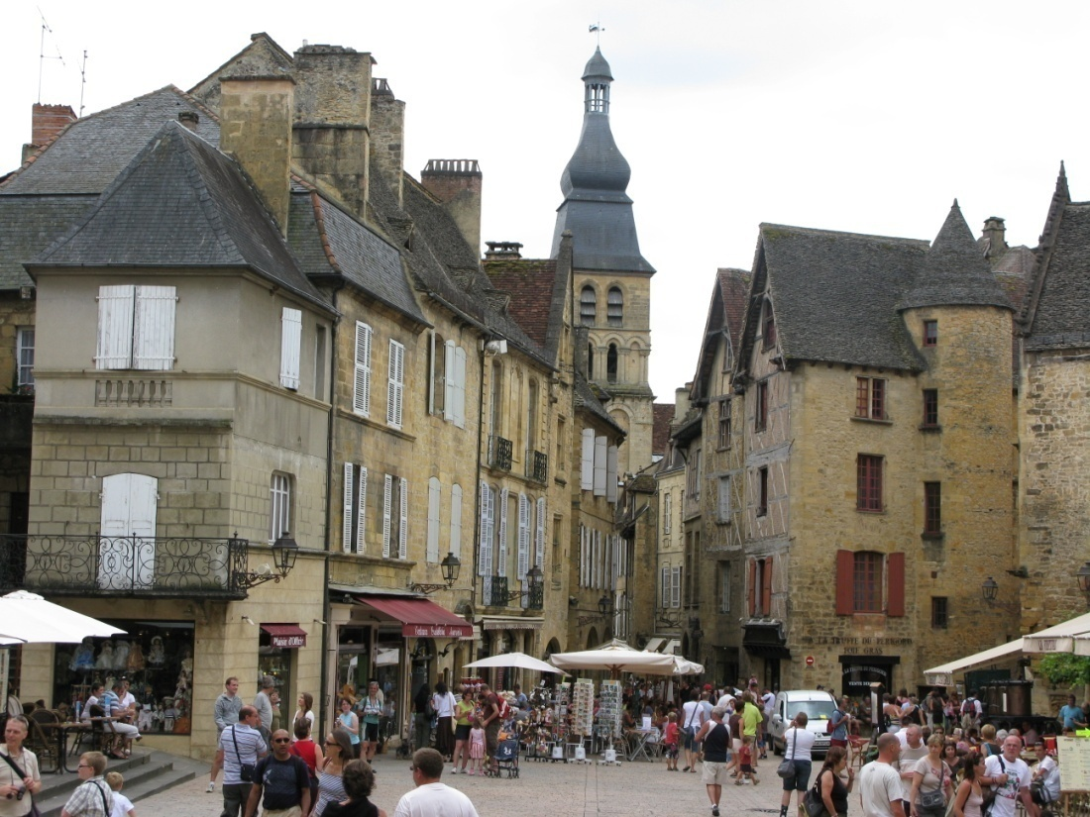
Changes in Society – “Commercial Revolution”
Increase in trade results in:
a. The growth of cities & towns in Western Europe
hurts the manor. (And nobles!)
(Jobs & opportunities in cities & towns – attracts peasants)
More $ & modern banking services

Slide 31
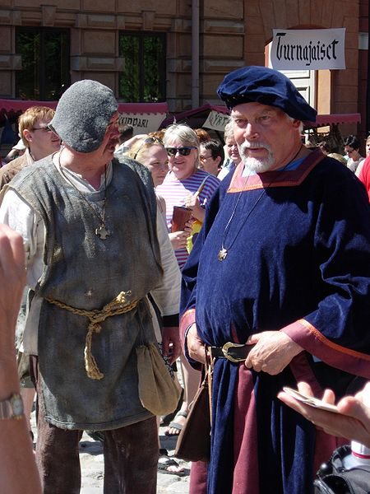
Changes in Society
b. More merchants = new middle class called the bourgeoisie:
“people of the town” ($=power/not land)
They organize guilds & control trade
and the towns.

Slide 32
Guilds & Bourgeoisie
As trade increases, merchants and craftsmen unite into business associations to :
improve conditions of its members
Regulate business practices & establish standards
Protect interests (profits - $)
Establish training for new members of the craft
(apprentice system)
Benefit the community

Slide 33
Changes in Society
Kings & townspeople work together vs. nobles
(King brings stability, grants town charters & taxes)
d. Rapid growth of population in cities & towns
(crowding & unhealthy conditions – problems & plague)

Slide 34
Effects of the Crusades “successful failures”
Split between Christians in the east (Orthodox)
and west (Roman Catholic)
Byzantine Empire weakened – collapse by 1453
(many scholars flee to Italy)
New learning from advanced Byzantine
and Muslim cultures
Medicine;
Rhazes
Constantinople falls
to Turks in 1453
Arabic numbers
& Algebra
Advanced mapmaking
1, 2, 3, 4, 5
3x + 4 = 13

Slide 35
Medieval Universities
Early education run by the Church / monasteries
Cultural diffusion w/ Muslims brought contact with ancient Greek & Roman as well as advanced Muslim learning.
Groups of interested students &
teachers formed early universities.
(established standards of progress
and teacher qualifications.)
Include Oxford, Paris, Bologna & Salerno

Slide 36
How did the Crusades effect each of the following?
Peasants
Nobles
Monarchs
Bourgeoisie
Italian port cities

Slide 37
QUESTION:
How is overpopulation harmful???

Slide 38
“A Medieval Town”
“Jam-packed wooden houses, each a potential
tinderbox, sought extra room through upper
stories jutting out over the street. The streets
themselves were mere alleys, 6 to 10 feet
across. Sewers were open & sanitation scant.
The pedestrian had to dodge human waste
dumped from above and swilling pigs below,
while scab covered beggars jostled him in the
streets . . . Signs of filth & disease assailed him everywhere.”
Which characteristics of medieval towns might have contributed to the spread of the plague?

Slide 39
THE BLACK DEATH
Directions: Using the video & chp. 14 (pgs 399-401) on the Bubonic Plague, answer the following questions.
What caused the disease?
How did it spread? What types of activity and/or people contributed to the spread of plague?
Why did it spread so rapidly? Why was the plague so hard to combat/stop?
What happened to the victims?

Slide 40
THE BLACK DEATH (1347-1351)
Aka: Bubonic Plague, The Great Mortality
Over 1/3 of Europe’s population died
(20-25 million)
Origins: from Asia; brought by merchants returning from the Black Sea to Italy
(1347) Mongols at Caffa
by 1348 . . .
spreading rapidly

Slide 41
THE BLACK DEATH
What caused the disease?
Bacteria (yersinia pestis) carried by fleas living on rats.
Fleas spread disease by biting victims. (parasites)

Slide 42
How Plague was Transmitted

Slide 43
THE BLACK DEATH
How did it spread?
Overcrowded cities & poor sanitation.
Garbage, sewage & no running water…
Rats in close proximity to unclean people.

Slide 44
Spread city to city along merchant trade routes.

Slide 45
THE BLACK DEATH
Why did it spread so rapidly?
People did not know
what caused it and were
powerless to stop it!
Remedies included:
Bleeding
Leeches
Urine baths
Onions
Flowers & burning incense
Fire
Isolation & quarantine
“Flagellants”
A costume worn by doctors to protect
themselves from contracting plague.

Slide 46
THE BLACK DEATH
What happened to the victims?
Bubonic : most common (over ½ victims die)
Swelling glands – “buboes”
Internal bleeding – “black” patches
Tongue turns black
High fever
Pneumonic: attacks lungs; usually fatal
Extremely contagious; airborne
Chest pains, vomit & spit foul smelling blood

Slide 47
THE Bubonic plague
What types of activity and/or people contributed to the spread of plague?
Why was the plague so hard to combat/stop?
Why might the plague have divided rather than united people?
Which characteristics of medieval towns might have contributed to the spread of the plague?

Slide 48
Consequences of the Plague
How did the Plague actually benefit the peasants who survived?
Why might the plague have divided rather than united people?
How could the Plague increase the power & influence of the Church, yet at the same time weaken its influence in the eyes of some people?
How did the Plague effect relationships and behaviors people normally associate with society?

Slide 49
EFFECTS
Over 1/3 of Europe’s population died
Mass graves & bodies in the streets
Villages / towns disappear; “ghost towns”
Trade & farm production diminishes
Labor shortages help survivors &
weaken serfdom & manor system
Homes & ships quarantined
Fear, despair & pessimism
(families abandon one another)
“Ring Around the Rosie”
Pied Piper

Slide 50
What would you do?
If you could travel back in time and offer advice to the leaders of a specific Medieval city/town on how to best devise a plan to combat Bubonic Plague from spreading in their town, what would your advice include?
Develop a plan of (4-5) steps or measures they could take to reduce the chances of Bubonic Plague from spreading amongst them.
(gov’t actions/policies, personal behaviors/steps)

